Slide 2
Recommendation Report
Session ID: 5e79e489-90fc-475b-8d03-c3607c7aad68
Generated: 2025-04-28

Slide 3
Fragment: Green With Software

Slide 4
Green With Software: Top 3 Insights
The organization’s IT structure limits its ability to fully realize a product-centric and sustainable operating model due to significant siloing. Establishing dedicated cross-functional teams and integrating sustainability considerations directly into the initial design phase of all IT solutions are critical to breaking down these barriers.
The current IT architecture, while leveraging Agile development practices, is constrained by a largely traditional N-Tier design. Modernizing to a microservices and API-driven architecture is essential for achieving the scalability and agility needed to support future growth and innovation; a phased approach focusing on key applications should be prioritized.
Despite a commitment to data-driven decision-making, the cloud strategy remains heavily reliant on traditional infrastructure. Shifting towards greater utilization of public cloud services, coupled with standardization of core technologies and improved virtualization management, will unlock cost efficiencies and enhance the organization’s overall IT resilience.

Slide 5
Green With Software: Roadmap Overview
Summary: This roadmap addresses the need to modernize IT operations by adopting agile practices, leveraging data-driven insights, and integrating sustainability considerations. It focuses on transitioning from project-based work to a product-centric model, enhancing collaboration, and embedding innovation into the business strategy. Successful implementation will require cross-functional collaboration and a commitment to continuous improvement.
Total Est: 72 hrs (~9.0 days)
Key Roles: IT Operations, Developers, Business Analysts, Security Professionals, Innovation Managers, Data Scientists, Executive Sponsors

Slide 6
Green With Software: Implementation Plan Details
Overall Goal: Green With Software Implementation Plan
Description:
This roadmap outlines a phased approach to transform IT operations into a sustainable, agile, and data-driven function. The Early Steps focus on establishing foundational elements, including cross-functional collaboration, scalable architectures, and initial agile adoption. Intermediate Steps build upon this foundation by enhancing collaboration, formalizing agile frameworks, and shifting towards persona-based operations. Finally, the Advanced Steps leverage data analytics to drive strategic alignment, strengthen critical event support, and embed innovation into the core business strategy.
Methodology / Steps:
--- Early Steps ---
1. Establish cross-functional collaboration for solution development. 2. Integrate sustainability considerations into solution design. 3. Evaluate and adopt scalable solution architectures. 4. Implement a mix of enterprise databases and NoSQL solutions for flexibility. 5. Begin the transition towards Agile and continuous integration. 6. Introduce virtualization to enhance resource utilization. 7. Develop a basic set of agreed-upon technologies. 8. Monitor applications running in virtual machines within a private data center. 9. Establish baseline technology standards.
--- Intermediate Steps ---
1. Implement iterative development processes. 2. Enhance collaboration within development teams. 3. Introduce formalized agile frameworks. 4. Shift focus from ticket-based to persona-based operations. 5. Encourage solution adoption and persona-based training. 6. Set key performance indicators (KPIs) for each department and manager involved in innovation.
--- Advanced Steps ---
1. Make data and analytics central to the overall business strategy. 2. Assess the value of data and its influence on investments. 3. Ensure strategy and execution are continually aligned and improved. 4. Strengthen critical event support. 5. Increase executive sponsorship for innovation. 6. Embed innovation into the overall business strategy.
Roles Involved (Overall): IT Operations, Developers, Business Analysts, Security Professionals, Innovation Managers, Data Scientists, Executive Sponsors
Tools/Platforms (Overall): Jira, Git, VersionOne, Bitbucket, MongoDB, Jenkins, VirtualBox, VMware, Scrum, Docker, Kubernetes, Red Hat OpenShift, Amazon ECS, Prometheus, Cherwell, Brightidea, Apache Spark, IBM Cognos, Taiga, ServiceNow, Miro
Subtask Estimates (Aggregated):
--- Early Steps ---
Collaboration Setup - 4h; Sustainability Integration - 4h; Scalable Architecture - 6h; DB Implementation - 4h; Agile Transition - 6h; Virtualization - 4h; Tech Standards - 4h
--- Intermediate Steps ---
Iterative Development - 4h; Collaboration Enhancement - 4h; Agile Frameworks - 6h; Persona-Based Operations - 4h; Innovation KPIs - 4h
--- Advanced Steps ---
Data Strategy - 6h; Data Value Assessment - 4h; Strategy Alignment - 4h; Critical Event Support - 4h; Innovation Sponsorship - 4h

Slide 7
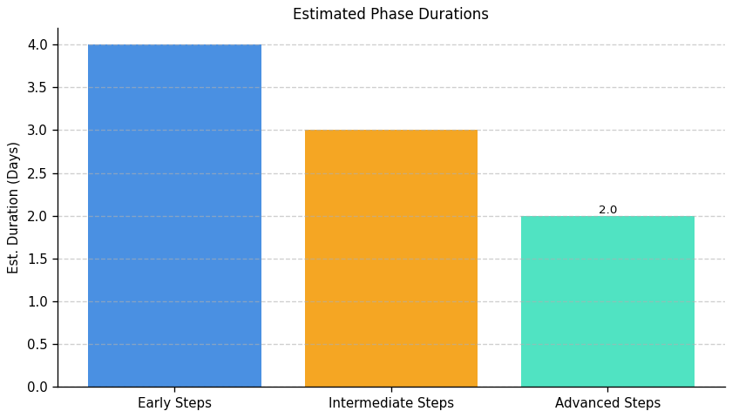
Green With Software: Roadmap Phase Durations

Slide 8
Fragment: Green With Software

Slide 9
Green With Software: Top 3 Insights
The organization demonstrates a critical lack of proactive planning for server infrastructure, specifically in scalability, capacity, and performance. This reactive stance will likely lead to increasing performance issues and service disruptions as demand grows, requiring costly and disruptive fixes instead of preventative measures.
Security practices are fundamentally underdeveloped, leaving the organization vulnerable to breaches and non-compliant with industry standards. The absence of intrusion detection, centralized logging/auditing, and basic network security protocols represents a significant and immediate risk.
Despite some basic operational hygiene – including patching, load balancing, and documentation – these efforts are insufficient to compensate for the broader immaturity of infrastructure and security management. These isolated positive practices do not indicate a robust or sustainable operational model.

Slide 10
Green With Software: Roadmap Overview
Summary: This roadmap addresses critical gaps in server infrastructure, encompassing scalability, monitoring, security, and compliance. It outlines a phased approach to build a resilient IT environment through assessment, implementation, and ongoing optimization, ensuring proactive threat detection and efficient resource utilization.
Total Est: 495 hrs (~61.9 days)
Key Roles: IT Architects, Infrastructure Managers, Scalability Planning Team, IT Leadership, IT Administrators, Infrastructure Team, Business Analysts, IT Specialists, Monitoring Team, Monitoring Administrators, Testing Teams, Security Analysts, Compliance Specialists, Caching Strategists, Development Teams, Optimization Experts, Logging System Analysts, Logging System Integrators, QA Engineers, Performance Analysts, Network Administrators

Slide 11
Green With Software: Implementation Plan Details
Overall Goal: Fragment B Implementation Plan
Description:
This roadmap guides the implementation of a scalable and secure server infrastructure. The initial phase focuses on assessing the current state, identifying gaps, and developing a detailed plan. The intermediate phase involves implementing the planned upgrades, integrating monitoring and security tools, and establishing caching strategies. Finally, the advanced phase refines the implemented solutions through performance testing, ongoing monitoring, and network optimization, ensuring a resilient and optimized IT environment.
Methodology / Steps:
--- Early Steps ---
1. Assess the current server infrastructure for scalability gaps, collaborating with IT architects and conducting workload analysis. 2. Develop a plan for enhancing server infrastructure scalability, identifying solutions and creating a roadmap. 3. Predict server growth requirements by analyzing historical data and collaborating with business and IT teams. 4. Evaluate and select effective alerting systems, researching tools and considering real-time monitoring capabilities. 5. Evaluate and select a centralized logging system, researching solutions and considering scalability and compatibility. 6. Conduct a security threat assessment to identify potential risks and vulnerabilities, collaborating with security experts and performing risk analysis.
--- Intermediate Steps ---
7. Implement planned upgrades to enhance scalability, upgrading hardware and implementing scaling solutions. 8. Develop a roadmap for scaling server infrastructure based on growth assessments, defining milestones and collaborating with IT and business teams. 9. Configure alerts based on abnormal server behavior or performance issues, defining alert thresholds and collaborating with monitoring teams. 10. Integrate the selected logging system into the server infrastructure, configuring log sources and collaborating with IT teams. 11. Evaluate and select an IDS solution suitable for the infrastructure, researching tools and aligning with the threat assessment. 12. Develop a caching strategy based on server workload and application requirements, collaborating with development teams and analyzing application behavior.
--- Advanced Steps ---
13. Configure and integrate the selected monitoring tool with the server infrastructure, following tool documentation and testing configurations. 14. Implement resource monitoring in the production environment and provide training, rolling out the solution and training relevant teams. 15. Implement the selected firewall solution and conduct testing, configuring firewall rules and performing security testing. 16. Implement selected caching mechanisms and conduct testing, configuring caching and performing load testing. 17. Develop a plan for performance testing of critical server applications, identifying testing scenarios and defining success criteria. 18. Conduct a network assessment to identify areas for optimization, using network monitoring tools and analyzing traffic patterns.
Roles Involved (Overall): IT Architects, Infrastructure Managers, Scalability Planning Team, IT Leadership, IT Administrators, Infrastructure Team, Business Analysts, IT Specialists, Monitoring Team, Monitoring Administrators, Testing Teams, Security Analysts, Compliance Specialists, Caching Strategists, Development Teams, Optimization Experts, Logging System Analysts, Logging System Integrators, QA Engineers, Performance Analysts, Network Administrators
Tools/Platforms (Overall): docker, kubernetes, Amazon ECS, Google Kubernetes Engine (GKE), OpenStack, VMware vSphere, Snort, Wazuh, Prometheus Alertmanager, ELK Stack (Elasticsearch, Logstash, Kibana), Redis, Varnish, Grafana, Prometheus, Datadog, New Relic, iptables, Cisco ASA, Palo Alto Networks, Akamai, Cloudflare, Apache JMeter, LoadRunner, iperf, SolarWinds Network Performance Monitor
Subtask Estimates (Aggregated):
--- Early Steps ---
Scalability Analysis: 25h; Collaboration with IT Architects: 20h; Solution Identification: 30h; Roadmap Creation: 25h; Assessment: 25h; Collaboration with Business and IT Teams: 20h; Evaluation: 20h; Research: 15h; Threat Assessment: 20h; Risk Analysis: 15h
--- Intermediate Steps ---
Hardware Upgrade: 40h; Scaling Solution Implementation: 35h; Roadmap Development: 30h; Collaboration with IT and Business Teams: 25h; Configuration: 30h; Collaboration with Monitoring Teams: 25h; Integration: 30h; Collaboration with IT Teams: 25h; Research: 25h; Alignment with Threat Assessment: 20h; Strategy Development: 25h; Collaboration with Development Teams: 20h
--- Advanced Steps ---
Configuration Setup: 30h; Testing: 25h; Rollout: 35h; Training: 30h; Security Testing: 25h; Load Testing: 25h; Plan Development: 25h; Scenario Identification: 20h; Success Criteria Definition: 15h; Assessment: 20h; Traffic Pattern Analysis: 15h

Slide 12
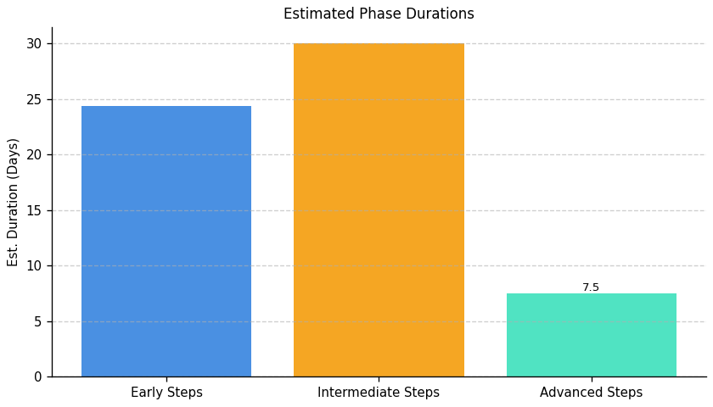
Green With Software: Roadmap Phase Durations

Slide 13
Fragment: Green With Software

Slide 14
Green With Software: Top 3 Insights
Critical data is at significant risk due to a lack of consistent data protection practices. Specifically, scheduled backups of critical server data are not reliably implemented, and disaster recovery procedures are rarely, if ever, tested, leaving the organization vulnerable to substantial data loss and extended outages. Remediation will require a significant investment of resources – exceeding 90 hours – to establish a baseline level of protection.
Disaster recovery and business continuity planning is underdeveloped and lacks formalized, tested procedures. Despite available guidance and estimated resource needs (over 135 hours), the organization currently operates without documented protocols, representing a major operational and compliance risk.
Data movement practices during infrastructure decommissioning are inconsistent and poorly standardized. While a protocol exists in some areas, its implementation is not universal, particularly regarding alignment with architectural boundaries, creating potential data integrity issues and hindering effective infrastructure modernization.

Slide 15
Green With Software: Roadmap Overview
Summary: This fragment highlights critical deficiencies in disaster recovery, backup, and data movement procedures, despite existing documentation. Implementing and rigorously testing these procedures is essential to ensure business continuity, data integrity, and compliance with industry best practices. A comprehensive strategy encompassing documentation, solution evaluation, and process alignment is required.
Total Est: 444 hrs (~55.5 days)
Key Roles: DR Specialists, BC Specialists, System Administrators, Data Stakeholders, IT Specialists, Backup Administrators, IT Administrators, Testing Teams, Data Owners, IT Operations, IT Security Specialist, Backup Strategist, Documentation Specialist, Communication Coordinator, Data Engineers, Solution Architects, Infrastructure Specialist, Networking Specialist, Analysis Team, Data Architect

Slide 16
Green With Software: Implementation Plan Details
Overall Goal: Fragment C Implementation Plan: Disaster Recovery and Data Protection
Description:
This roadmap addresses critical gaps in disaster recovery, backup, and data movement protocols. The initial phase focuses on documenting existing procedures and establishing a foundational backup policy. The intermediate phase involves identifying areas for improvement, evaluating backup solutions, and designing a comprehensive strategy aligned with data criticality and security requirements. Finally, the advanced phase centers on implementing the chosen solutions, conducting thorough testing, updating protocols, and ensuring aligned processes for efficient data handling and business continuity.
Methodology / Steps:
--- Early Steps ---
1. Document current Disaster Recovery (DR) and Business Continuity (BC) protocols through collaboration with specialists and review of existing documentation. 2. Develop a backup policy outlining frequency, types, and locations of backups, collaborating with stakeholders and assessing data criticality.
--- Intermediate Steps ---
3. Identify areas of improvement in existing DR and BC protocols through thorough analysis and consideration of industry best practices. 4. Evaluate and select a backup solution aligned with policy requirements, researching tools and aligning with data criticality. 5. Design a comprehensive strategy for backups and archives based on criticality, collaborating with IT security and operations teams. 6. Analyze existing data movement processes to identify gaps and inefficiencies, collaborating with data engineers and architects.
--- Advanced Steps ---
7. Update DR and BC protocols based on identified improvements, collaborating with specialists and aligning with industry standards. 8. Implement the selected backup solution and conduct testing, configuring backup schedules and performing data recovery tests. 9. Document the aligned processes and communicate changes to relevant teams, using documentation tools and conducting communication sessions. 10. Implement standardized protocols for efficient data movement across infrastructure elements, collaborating with infrastructure and testing teams. 11. Align data movement processes within defined architecture boundaries, collaborating with architecture teams and updating processes accordingly.
Roles Involved (Overall): DR Specialists, BC Specialists, System Administrators, Data Stakeholders, IT Specialists, Backup Administrators, IT Administrators, Testing Teams, Data Owners, IT Operations, IT Security Specialist, Backup Strategist, Documentation Specialist, Communication Coordinator, Data Engineers, Solution Architects, Infrastructure Specialist, Networking Specialist, Analysis Team, Data Architect
Tools/Platforms (Overall): Bacula, Duplicity, Commvault, Veeam Backup & Replication, Amanda
Subtask Estimates (Aggregated):
--- Early Steps ---
Documentation Review: 20h; Collaboration with Specialists: 15h; Policy Development: 20h; Collaboration with Stakeholders: 15h
--- Intermediate Steps ---
Thorough Analysis: 30h; Best Practices Review: 25h; Research: 25h; Alignment with Policy Requirements: 20h; Strategy Design: 30h; Alignment with Business Needs: 20h; Analysis Collaboration: 18h; Gap Identification: 28h
--- Advanced Steps ---
Collaboration with Specialists: 20h; Update Implementation: 25h; Configuration: 30h; Data Recovery Testing: 25h; Documentation: 25h; Communication Sessions: 15h; Implementation: 30h; Testing and Performance Monitoring: 35h; Collaboration with Architecture: 22h; Process Updates: 20h

Slide 17
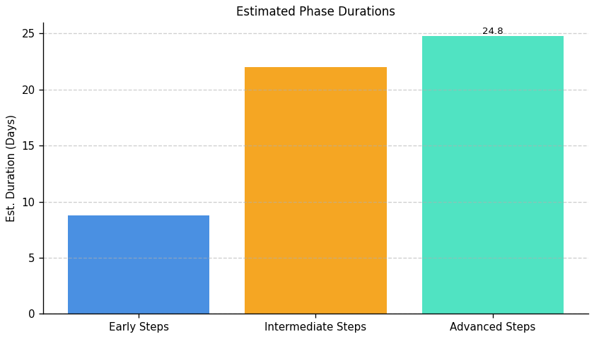
Green With Software: Roadmap Phase Durations

Slide 18
Fragment: Green With Software

Slide 19
Green With Software: Top 3 Insights
The organization invests in employee Green IT skills development but lacks a system to identify skill gaps, plan for future needs, or demonstrate the return on that investment. A clear, documented skills matrix linked to sustainability goals is needed, alongside a process for assessing current capabilities and targeted recruitment/training plans.
A critical barrier to advancing Green IT is the absence of measurable metrics and monitoring systems to track the environmental and financial impact of initiatives. Implementing specific, quantifiable targets for energy consumption, waste reduction, and cost savings – and regularly reporting on progress – is essential for justifying continued investment and demonstrating value.
While environmental management processes exist for software infrastructure, the organization hasn’t translated these into proactive, tool-supported actions to minimize environmental impact. Prioritizing the selection and deployment of tools for environmental monitoring and management, coupled with clear communication of sustainability expectations across all teams, is crucial for moving beyond compliance to impactful change.

Slide 20
Green With Software: Roadmap Overview
Summary: This roadmap addresses the need for a structured approach to integrating sustainability into the organization's IT practices. It focuses on assessing current environmental impact, developing skills in Green IT, and implementing tools and incentives to foster a culture of continuous improvement. The ultimate goal is to reduce the organization's carbon footprint and attract talent with sustainability expertise.
Total Est: 260 hrs (~32.5 days)
Key Roles: Environmental Experts, Infrastructure Managers, IT Specialists, Sustainability Analysts, Tool Administrators, Training Coordinators, Sustainability Experts, HR Specialists, Assessment Designers, Subject Matter Experts, HR Analysts, Communication Specialists, Program Managers, Team Leads, Sustainability Strategists, Workshop Facilitators, Content Developers, HR Representatives

Slide 21
Green With Software: Implementation Plan Details
Overall Goal: Fragment D Implementation Plan
Description:
This roadmap guides the organization through a phased approach to Green IT implementation. The Early Steps establish a baseline understanding of environmental impact and define necessary skills. Intermediate Steps focus on tool evaluation, skills assessment development, and communication. Finally, Advanced Steps involve tool implementation, training, incentive programs, and continuous monitoring to foster a sustainable IT environment and attract carbon-literate resources.
Methodology / Steps:
--- Early Steps ---
1. Assess the current environmental impact of infrastructure and processes, collaborating with environmental experts. 2. Define criteria for assessing sustainability-related skills proficiency, collaborating with subject matter experts and HR. 3. Define and document the skills required for sustainability initiatives, collaborating with sustainability experts and team leads.
--- Intermediate Steps ---
4. Evaluate existing and potential tools for managing sustainability, collaborating with IT teams. 5. Create tools for assessing proficiency aligned with defined criteria, pilot testing the tools. 6. Communicate the defined skills across teams effectively, conducting workshops and utilizing communication channels.
--- Advanced Steps ---
7. Implement selected tools and provide training to relevant teams, configuring tools and conducting training sessions. 8. Define a structured incentive plan for carbon-literate resources, collaborating with HR. 9. Implement the assessment process and analyze results, gathering feedback and analyzing performance.
Roles Involved (Overall): Environmental Experts, Infrastructure Managers, IT Specialists, Sustainability Analysts, Tool Administrators, Training Coordinators, Sustainability Experts, HR Specialists, Assessment Designers, Subject Matter Experts, HR Analysts, Communication Specialists, Program Managers, Team Leads, Sustainability Strategists, Workshop Facilitators, Content Developers, HR Representatives
Tools/Platforms (Overall): Impact assessment tools, Sustainability tools, Training platforms, Incentive program tools
Subtask Estimates (Aggregated):
--- Early Steps ---
Environmental Assessment - 30h; Criteria Definition - 25h; Skill Definition - 20h
--- Intermediate Steps ---
Tool Research - 25h; Tool Development - 30h; Workshop Conduct - 25h
--- Advanced Steps ---
Tool Implementation - 40h; Incentive Structure Definition - 25h; Assessment Implementation - 35h

Slide 22
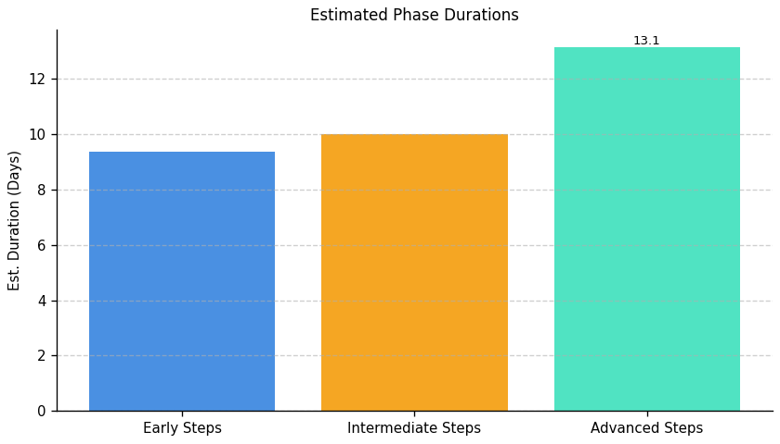
Green With Software: Roadmap Phase Durations

Slide 23
Fragment: Green With Software

Slide 24
Green With Software: Top 3 Insights
The organization’s carbon reduction efforts are currently hampered by a lack of detailed measurement; relying on a single, high-level metric prevents identification of specific IT areas contributing most to emissions and hinders targeted improvements.
A dedicated strategy for reducing the carbon footprint of server operations is missing, despite clear opportunities for implementation with existing tools – this represents a significant, addressable gap in their overall sustainability approach.
Foundational data collection regarding the organization’s total IT carbon footprint is absent, resulting in an inability to track progress or demonstrate impact from sustainability initiatives, and indicating a need to move beyond reactive hardware upgrades to a proactive carbon management system.

Slide 25
Green With Software: Roadmap Overview
Summary: This roadmap addresses the need to quantify and reduce the carbon footprint of IT operations. It begins with establishing a baseline assessment, progresses to developing and implementing a reduction strategy, and concludes with ongoing performance optimization and governance to ensure sustained carbon efficiency.
Total Est: 100 hrs (~12.5 days)
Key Roles: IT Administrators, Environmental Experts

Slide 26
Green With Software: Implementation Plan Details
Overall Goal: Green With Software Implementation Plan
Description:
This roadmap guides the organization through a phased approach to reducing its IT-related carbon footprint. It starts with a foundational assessment to understand current energy consumption and emissions. The next phase focuses on developing and implementing a targeted reduction strategy, leveraging energy-efficient practices and exploring renewable energy options. Finally, the roadmap emphasizes ongoing monitoring, strategy refinement, and governance to maintain long-term carbon efficiency.
Methodology / Steps:
--- Early Steps ---
1. Assess the current carbon footprint associated with server operations. 2. Collaborate with environmental experts to analyze energy consumption and document current IT infrastructure and energy usage patterns.
--- Intermediate Steps ---
3. Develop a strategy to minimize the carbon footprint in server operations. 4. Implement energy-efficient practices and explore the feasibility of utilizing renewable energy sources. 5. Document the developed strategy and implementation plan.
--- Advanced Steps ---
6. Establish ongoing monitoring of carbon intensity metrics. 7. Regularly review and update the carbon footprint reduction strategy. 8. Implement governance processes to ensure continued adherence to carbon efficiency goals.
Roles Involved (Overall): IT Administrators, Environmental Experts
Tools/Platforms (Overall): GreenIT Software, AWS IoT Greengrass, The Green Grid
Subtask Estimates (Aggregated):
--- Early Steps ---
Carbon Footprint Assessment: 30h; Collaboration with Environmental Experts: 20h
--- Intermediate Steps ---
Strategy Development: 35h; Implementation of Practices: 15h
--- Advanced Steps ---
No data available

Slide 27
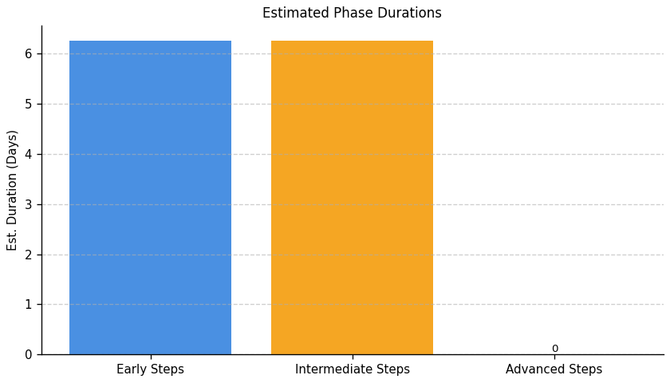
Green With Software: Roadmap Phase Durations

Slide 28
Fragment: Green With Software

Slide 29
Green With Software: Top 3 Insights
IT equipment lifecycle management is currently performed at a moderate level, indicating inconsistent application of best practices across procurement, use, maintenance, and eventual retirement of assets.
The organization lacks a formal, documented policy for the responsible disposal and recycling of electronic waste, creating potential compliance risks and hindering opportunities to recover value from end-of-life equipment.
While some lifecycle considerations exist, the absence of a dedicated e-waste policy demonstrates a systemic gap in fully addressing end-of-life processes, meaning the organization isn’t consistently managing the complete lifecycle of IT assets.

Slide 30
Green With Software: Roadmap Overview
Summary: This roadmap addresses the need for a formalized IT equipment lifecycle management program, including responsible e-waste disposal. The organization currently lacks a policy in this area, posing environmental and potential compliance risks. Implementing this plan will establish foundational practices for sustainable IT asset handling.
Total Est: 60 hrs (~7.5 days)
Key Roles: IT Procurement, IT Operations, Sustainability Officer, Disposal/Recycling Vendor

Slide 31
Green With Software: Implementation Plan Details
Overall Goal: Fragment F Implementation Plan: Green With Software
Description:
This roadmap outlines a phased approach to establishing a sustainable IT equipment lifecycle management program. The Early Steps focus on policy development and initial assessment of current asset flows. Intermediate Steps involve policy implementation, integrating environmental criteria into procurement, and basic lifecycle tracking. Advanced Steps concentrate on optimizing the e-waste disposal process, vendor management, and continuous improvement through KPIs and regular audits to ensure long-term sustainability and compliance.
Methodology / Steps:
--- Early Steps ---
1. Conduct a comprehensive inventory of all IT assets (hardware and software). 2. Research best practices for e-waste disposal and recycling, including relevant regulations. 3. Draft a preliminary e-waste disposal policy outlining responsible practices and compliance requirements. 4. Identify potential recycling vendors, gather quotes, and assess their certifications.
--- Intermediate Steps ---
5. Finalize and formally approve the e-waste disposal policy. 6. Integrate environmental criteria, such as energy efficiency and recyclability, into IT procurement processes. 7. Implement a tracking system (e.g., spreadsheet or asset management software) to record equipment purchase dates, usage, and disposal dates. 8. Communicate the new policy to all relevant employees and provide training.
--- Advanced Steps ---
9. Evaluate the effectiveness of the chosen recycling vendor(s) based on performance metrics and certifications. 10. Explore opportunities to extend equipment lifespan through proactive maintenance, repairs, and upgrades. 11. Develop key performance indicators (KPIs) to measure e-waste reduction, recycling rates, and overall program effectiveness. 12. Conduct regular audits to ensure policy compliance and identify areas for improvement. 13. Investigate options for data sanitization and secure disposal of sensitive information. 14. Explore partnerships with organizations specializing in IT asset refurbishment and reuse. 15. Implement a system for tracking and reporting on the environmental impact of IT asset disposal.
Roles Involved (Overall): IT Procurement, IT Operations, Sustainability Officer, Disposal/Recycling Vendor
Tools/Platforms (Overall): Spreadsheet software, Vendor research platforms, Procurement systems, Vendor performance tracking tools, Audit checklists, Asset management software
Subtask Estimates (Aggregated):
--- Early Steps ---
Inventory: 8h; Research: 4h; Policy Draft: 4h; Vendor Quotes: 2h.
--- Intermediate Steps ---
Policy Approval: 2h; Procurement Integration: 4h; Tracking System: 4h; Communication: 2h.
--- Advanced Steps ---
Vendor Evaluation: 4h; Lifespan Extension: 2h; KPI Development: 2h; Audits: 2h; Data Sanitization Research: 4h; Refurbishment/Reuse Exploration: 4h; Environmental Impact Tracking: 6h; Secure Disposal Procedures: 4h

Slide 32
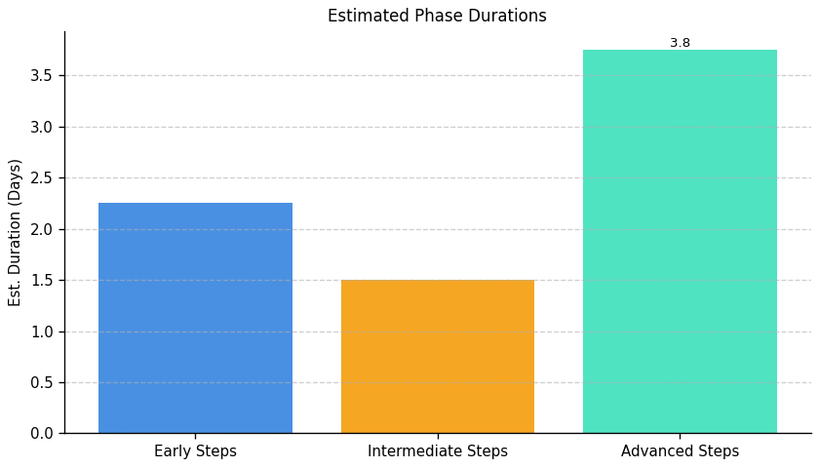
Green With Software: Roadmap Phase Durations

