Slide 1

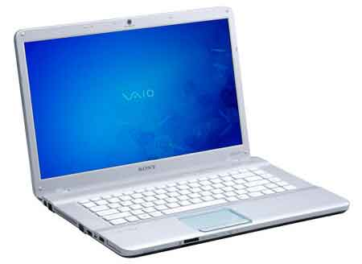



Service
(mybank.com)
Browser in PC
NFC in PC
NFC in Phone
Phone + App
User
This invention is herby placed in the Public Domain
Server Certificate and Private Key
Clicks “Login” Button
1
Initiate Login Process
2
Create Web Session
Create Challenge Data
Create App Login Data
(HTTP GET Request)
Login Cache *
Initiate User Login Process
3
HTML5/JavaScript page including NFC data and WebSocket code
(HTTP Response)
Web Session Cookie (in HTTP header)
4
Write Data
Challenge Data
Login Page State Service
(Web NFC API )
App Login Data
Start Login Page State Service
(WebSocket Creation)
5
Taps Phone on PC
(needed because the login “App” does not talk directly to the invoking login page)
NFC
6
(RF)
Read Data
Web Page Security Context
URL
7
(NFC App API)
Challenge Data
App Login Request
App Login Data
(HTTP POST Request)
Automatic Start of Login App
8
Verify
Web Page Security Context
Login Request
X
Error
mybank.com
Retrieve Web Session Using
Received Challenge Data
PIN
● ● ● ●
OK
9
Authorizes Login Request
Error
User Private Key in TEE or SE
Login Cache *
Request = Sign (User Private Key,
(Web Page Security Context +
Challenge Data +
Time Stamp +
User ID or Client Certificate))
Verify User Credentials
Error
10
Add Login Data to Web Session
Wi-Fi, Bluetooth
or Mobile Network
11
App Login Status
Notification
Login Success Actions
(HTTP Response)
Logged in to: mybank.com
12
Login Page State Change
(WebSocket Message)
Stop Login Page State Service
Get Application Page
13
“Phone Token”
Verify Web Session (Cookie)
(HTTP GET Request)
Error
14
Application Page
(HTTP Response)
Interacts with Web Application
* Entry is removed either by login session timeout or after being used once
15
AR 2017-06-15

