Slide 1


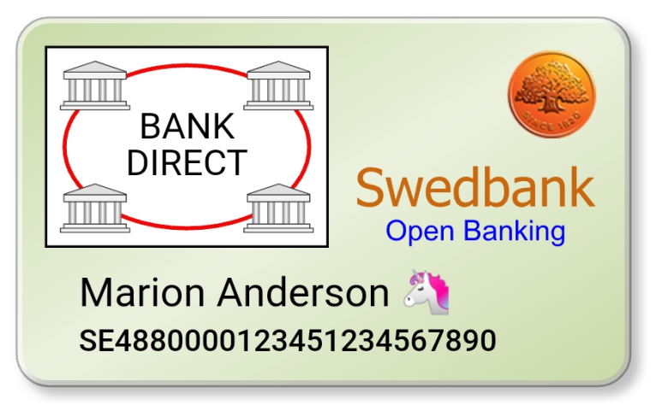




Open Banking/DM: End-to-End Security and Privacy (simplified)
User with
Mobile “Wallet”
Payment Request (PR)
“Virtual” Payment Card
Issued by User Bank
Merchant
①
Buy!
②
€100
③
④
Payment Order
Decrypt D2A
Validate D2A signature
Match PR with D2A
Other steps…
Initiate payment
Account Id: SE48800…
Signature
User Bank
Encryption
Encryption
Signature
Signed and Encrypted User Authorization
Data to Authorize (D2A)
Signed And Encrypted User Authorization
Merchant: Coop
Amount: € 100
AccountId: SE48800…
Merchant: Coop
Amount: € 100
AccountId: SE48800…
V0.1 A.Rundgren 2019-11-09

