Slide 1
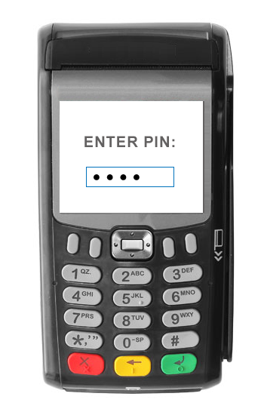
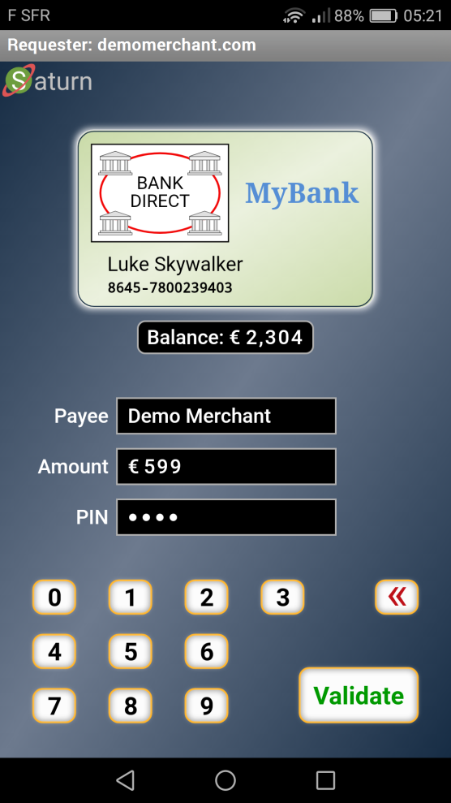

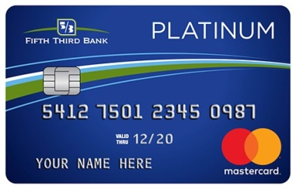
Payment Terminal + Card
Personal Payment Terminal
Medium level Security Protocol
High level End-to-End Secured 360° Web Protocol
POOF!
Adapted to: Your Language & Your Disability
Virtual Card Logo
Optional: Real-Time Account Balance
UI Showing:
Direct Payment
Booking
Gas Station
Etc.
Low level “Trusted” Card Protocol
POOF!
TEE Protected Keys
PIN or Biometric for User Authorization
A.Rundgren 2019-05-05

