Slide 1
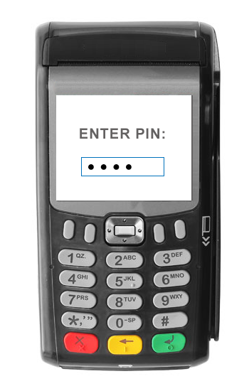
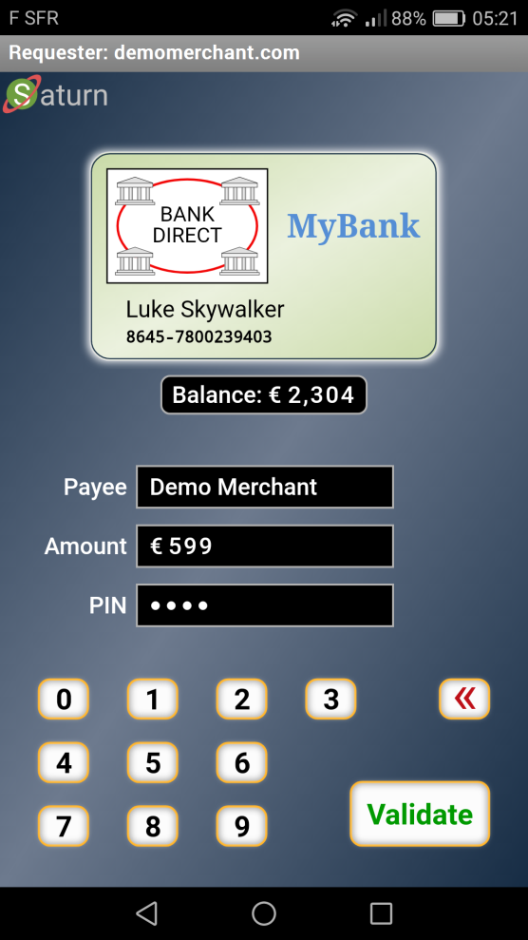

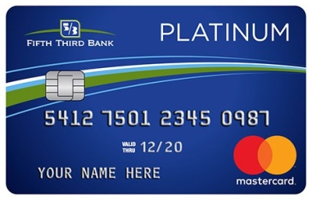
Payment Terminal + Card
Personal Payment Terminal
Medium level Security Protocol
High level End-to-End Secured 360° Web Protocol
POOF!
Adapted to:
Your Language
Your Disability
Virtual Card Logo
Optional: Real-Time Account Balance
UI Showing:
Direct Payment
Booking
Gas Station
Etc.
Low level “Trusted” Card Protocol
POOF!
TEE Protected Keys
PIN or Biometric for User Authorization (as defined by the virtual card issuer, not the payment terminal)
A.Rundgren 2019-05-05

