Slide 1
Saturn™
End-to-End Secured Payment Authorization System
Decentralized operation accomplishes similar goals as 3D Secure and “Tokenization” but without registries or additional services
Facilitates the design of brand/bank independent, “rich UI” wallets, supporting both card- and bank-to-bank payments
Equally applicable on the mobile Web, locally in a shop, at an automated gas station, or as a “PC companion” on the Web
Eliminates the traditional payment terminal and reduces merchant PCI requirements to a minimum
Requires a single “active” method on the issuer side to function*
* Reservations and reoccurring payments will in non-card-based scenarios need a second method as well
Disclaimer: This is a system in development and specifications are subject to change without notice

Slide 2







Merchant
User + Wallet
Virtual Card Properties
Virtual Cards
Signature Key
Bank-to-Bank Payments
State Diagram
Encryption Public Key
“Checkout/Pay”
①
(Scenario dependent)
Account Type URI
URL to User Bank
User Account ID
PIN
Card Logotype
…
Request Signature
②
“PaymentClientRequest”
(Scenario dependent “channel” technology used for Merchant to Wallet communication)
Select Card
Merchant Bank
User Bank Lookup *
Discovery of selected payment method
Creation of payment method specific data
Authorize
Amount:
$ 200
User Bank
PIN
● ● ● ●
“PayerAuthorization”
③
Encryption Private Key
(Signed & Encrypted user authorization + Clear text Account Type and Bank URL)
Merchant Lookup *
Merchant Provider/Bank Lookup * and Verification
User Authorization
Decryption
Verification
Commit Signature
④
“AuthorizationRequest”
(HTTPS POST)
⑤
Existing Payment Rails
(Bank-to-Bank Payments)
“AuthorizationResponse”
⑥
User Bank Verification
(HTTP Response)
“Accept”
All transaction steps are now available in a single object where each layer is signed and embeds inner layers
⑦
“Result”
* See Authority Objects. The rationale for encrypting user authorizations is for enabling such data to pass through Merchants which simplifies the Wallet as described in the Saturn FAQ. Step #5 does not apply when running under the conditions outlined in Hybrid Mode.

Slide 3

Merchant
User + Wallet
User Bank
Card Payments
State Diagram
① ② ③ ④ Identical to Bank-to-Bank Payments
Acquirer
Acquirer Lookup *
Card Data Encryption
“AuthorizationResponse”
⑤
User Bank Verification
(HTTP Response)
“Transaction Request”
“Accept”
Merchant Verification Card Data Decryption
⑥
(HTTPS POST)
Counter Signature
Card Network
⑦
Also see Hybrid Mode
“Transaction Response”
All transaction steps are now available in a single object where each layer is signed and embeds inner layers
“Accept”
⑧
(HTTP Response)
⑨
“Result”
* See Authority Objects. The flow may stop after step #5 resulting in a Secure Authorization Object which only can be activated by a Counter Signature. This scheme supports hotel bookings, upfront reservations for automated gas stations, as well as reoccurring payments. The card data Encryption and Decryption processes enable standard card data to securely pass through Merchants from Issuers to Acquirers.

Slide 4
② Merchant Sends – “PaymentClientRequest” JSON Message
{ "@context": "http://webpki.org/saturn/v3", "@qualifier": "PaymentClientRequest", "paymentNetworks": [{ "acceptedAccountTypes": ["https://supercard.com","https://bankdirect.net","https://unusualcard.org"], "paymentRequest": { "payee": { "commonName": "Demo Merchant", "id": "86344" }, "amount": "599.00", "currency": "EUR", "referenceId": "#1000000", "timeStamp": "2017-09-09T06:01:36Z", "expires": "2017-09-09T06:32:00Z", "software": { "name": "WebPKI.org - Merchant", "version": "1.00" }, "signature": { "algorithm": "ES256", "publicKey": { "kty": "EC", "crv": "P-256", "x": "rZ344aiTaOATmLBOdfYThvnQu_zyB1aJZrbbbks2P9I", "y": "lKOvfJdgN8WqEbXMDYPRSMsPicm0Tk10pmer9LxvxLg" }, "value": "_O4Ta4idtMcAHcRnjyEHkOOkb2 … afRQkUjsnp2LY8wcOn7m4b8OSDA" } } }] }
Account Type URIs to be matched against those in the virtual cards
https://cyberphone.github.io/doc/security/jcs.html
The Merchant (Payee) signs a payment request with its public key. Note that a Merchant may belong to multiple and independent payment networks, where each network typically maintains their own Merchant publicKey and/or id data, which is why there is an array of signed requests put in a PaymentClientRequest message. The request array is sent to the client which through a scenario-dependent mechanism (like Web versus NFC), invokes the Wallet.

Slide 5
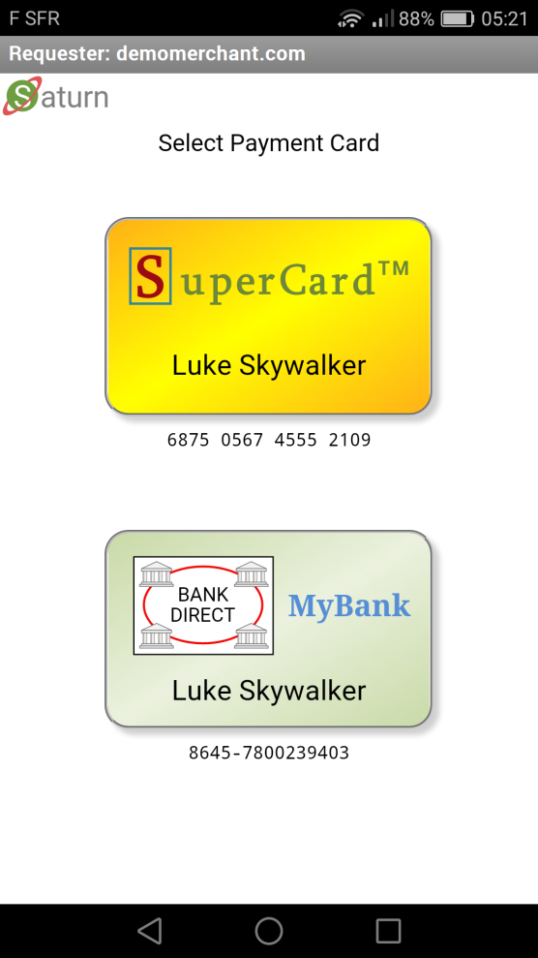
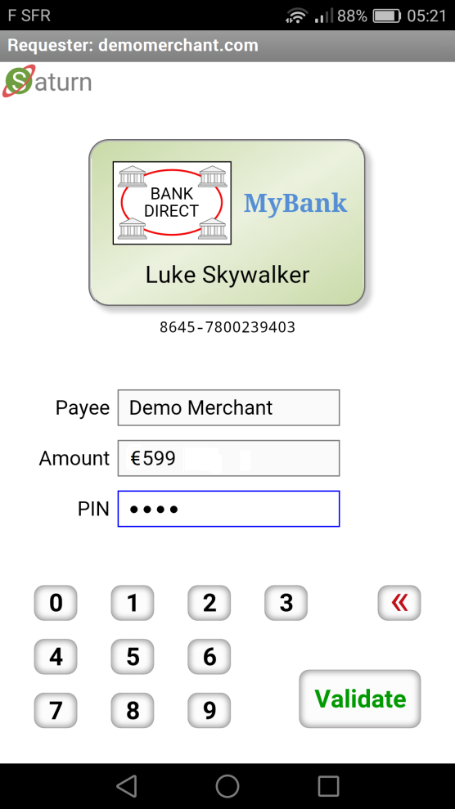
② Wallet Receives the “PaymentClientRequest”
Optional: (more than one matching card)
Authorization UI
When the PaymentClientRequest has been received by the client, the Wallet user interface is launched. The authorization method may consist of a PIN but could also be a biometric option such as touching a fingerprint reader. The authorization is only used to unlock the Signature Key as described in next slide. Note that the Saturn authorization concept not only emulates payment cards, but payment terminals as well.

Slide 6
③ Internal Wallet Processing – Creation of Signed Authorization Data
{ "requestHash": { "algorithm": "S256", "value": "eYqbGYkHfAsOUTJiuqfU98Rou_mfn0etWUkvDVOF_Fw" }, "domainName": "demomerchant.com", "account": { "type": "https://bankdirect.net", "id": "8645-7800239403" }, "encryptionParameters": { "algorithm": "A128CBC-HS256", "key": "Ivq5sSrtNNpOvN9t9_pRCfc6dqT3IuVg6H2h9NlHULs" }, "timeStamp": "2017-09-09T08:02:18+02:00", "software": { "name": "WebPKI.org - Wallet", "version": "1.00" }, "signature": { "algorithm": "ES256", "publicKey": { "kty": "EC", "crv": "P-256", "x": "vlYxD4dtFJOp1_8_QUcieWCW-4KrLMmFL2rpkY1bQDs", "y": "fxEF70yJenP3SPHM9hv-EnvhG6nXr3_S-fDqoj-F6yM" }, "value": "TDKWQb9idTyPXgpOgIxXeogt … lhC5_dG3uU6MPmqjQLc7jju4f0Q" } }
Hash of matching payment request object
Core data of selected virtual card
https://cyberphone.github.io/doc/security/jcs.html
When the user has authorized the transaction the Signature (private) Key associated with the selected card is used to sign a JSON object holding authorization data as follows : requestHash holds the hash of the PaymentRequest object (see PaymentRequest slide) matching the selected Account Type (card), while account holds the actual Account ID (number) and Account Type of the selected card. For more information about encryptionParameters, turn to the slide Risk Based Authentication.

Slide 7
③ Wallet Processing – Creation and Sending of “PayerAuthorization” JSON Message
{ "@context": "http://webpki.org/saturn/v3", "@qualifier": "PayerAuthorization", "providerAuthorityUrl": "https://payproc.mybank.com/authority", "accountType": "https://bankdirect.net", "encryptedAuthorization": { "algorithm": "A128CBC-HS256", "encryptedKey": { "algorithm": "ECDH-ES", "publicKey": { "kty": "EC", "crv": "P-256", "x": "TfCrhFwZRU_ea7lUWwRi3HkuyT2yF9IxN5xKh2khjlk", "y": "nZFwxLP0TvFXD2xPKzRTIGevgLjpiMw2BP86hszj5x4" }, "ephemeralKey": { "kty": "EC", "crv": "P-256", "x": "D7zSvy3mbS4WbB2qgKwchLRwQFir5T_p09HpnAi_RqA", "y": "gkwNJ2o6BtUASkmp1DO4UvllsQL5zAzvVEHB7t0CqX0" } }, "iv": "zyConPq8uA7GFjaTkta-qA", "tag": "S8zUQ3tioyYPzbtNBO6Ftw", "cipherText": "GLkd4uHnjqL_EX9tssDNLzsZj … s7u2ezBOibNoQN5V3cl2ieB-hLHj4XppJI" } }
Base data of selected virtual card
https://cyberphone.github.io/doc/security/jef.html
Encryption Key of selected virtual card
Encrypted user authorization
PayerAuthorization messages provide the URL to the issuing bank’s “Authority” object and the selected payment method which both are featured in virtual cards. This data is used by Merchants (Payees) for routing payment authorization requests to the applicable Bank. The actual authorization data (see previous slides) is encrypted by the Wallet using an Issuer (not User) specific Encryption Key (with a matching private key only known by the issuing Bank), which also is stored in the virtual card. That is, Merchants do not get any information concerning Users (Payers) except their Bank and associated payment method.

Slide 8
Bank/Acquirer “Authority” JSON Object
{ "@context": "http://webpki.org/saturn/v3", "@qualifier": "ProviderAuthority", "httpVersion": "HTTP/1.1", "authorityUrl": "https://payproc.mybank.com/authority",
"homePage": "https://mybank.com", "serviceUrl": "https://payproc.mybank.com/service",
"providerPaymentMethods": ["https://sepa.payments.org","https://ultragiro.se"],
"signatureProfiles": ["http://webpki.org/saturn/v3/signatures#P-256.ES256"], "encryptionParameters": [{ "dataEncryptionAlgorithm": "A128CBC-HS256", "keyEncryptionAlgorithm": "ECDH-ES", "publicKey": { "kty": "EC", "crv": "P-256", "x": "TfCrhFwZRU_ea7lUWwRi3HkuyT2yF9IxN5xKh2khjlk", "y": "nZFwxLP0TvFXD2xPKzRTIGevgLjpiMw2BP86hszj5x4" } }], "timeStamp": "2017-09-09T04:34:29Z", "expires": "2017-09-09T05:34:31Z", "signature": { "algorithm": "ES256", "signerCertificate": { "issuer": "CN=Payment Network Sub CA3,C=EU", "serialNumber": "1461174553809", "subject": "CN=mybank.com,2.5.4.5=#130434353031,C=FR" }, "certificatePath": ["MIIBtTCCAVmgAwIBAgIGAVQ0 … 9Ly9t7A-jMuGl3FwxFeOawwmz1bM6", "MIIDcjCCAVqgAwIBAgIBAzANB … W9x5ZxVhvpP_We_5TddhlTUMNPvw"], "value": "cdRqFlzVEou5Zj-EqWGCCLtxY … JkEBD4fFOqVnU9dstv_P2BoHQ" } }
Authority object URL of a virtual payment card issued by this bank
Accepted signature types
https://cyberphone.github.io/doc/security/jef.html
https://cyberphone.github.io/doc/security/jcs.html
“Authority” objects hold Keys, Payment methods, and URLs which are used by Merchants, Banks, and Acquirers as Secure Distributed Entity Databases creating the foundation for scalability including Delegated Trust. “Authority” objects are published on the Internet and accessed by HTTP GET operations. A Bank/Acquirer “Authority” object is signed by the Bank/Acquirer itself. The providerPaymentMethods array declares the payment methods understood by the Bank. The encryptionParameters are used by Issuers for encrypting card data to Acquirers.

Slide 9
Merchant (Payee) “Authority” JSON Object
{ "@context": "http://webpki.org/saturn/v3", "@qualifier": "PayeeAuthority", "authorityUrl": "https://saturn.bigbank.com/payees/86344", "providerAuthorityUrl": "https://saturn.bigbank.com/authority",
"homePage": "https://demomerchant.com", "commonName": "Demo Merchant", "id": "86344", "signatureParameters": [{ "algorithm": "ES256", "publicKey": { "kty": "EC", "crv": "P-256", "x": "rZ344aiTaOATmLBOdfYThvnQu_zyB1aJZrbbbks2P9I", "y": "lKOvfJdgN8WqEbXMDYPRSMsPicm0Tk10pmer9LxvxLg" } }],
"timeStamp": "2017-09-09T16:26:57Z", "expires": "2017-09-09T17:26:58Z", "signature": { "algorithm": "ES256", "publicKey": { "kty": "EC", "crv": "P-256", "x": "-Vr8Wk3ygt5J2_J3R8TrRaa-AWW7ZiXa6q1P7ELs6gc", "y": "Vuc6z3WiZ3tgXTXvU6F5qdiiYePWeUI1q9Tx83ySDcM" },
"value": "CKAfEg7wzCoxGiCvRAMVIug0RKU … 4AOtKZK_RPNoshOGVnxry7vQZeIuIw" } }
URL to the Merchant’s “Authority” object
URL to the Merchant’s Bank/Acquirer “Authority” object
Merchant core data
https://cyberphone.github.io/doc/security/jcs.html
The same key as in the Bank/Acquirer “Authority” object signature certificate
A Merchant (Payee) “Authority” object is like a short-lived, automatically updated, X.509 certificate not requiring a CA. Such an object is published on the address authorityUrl hosted by the party (Bank or Acquirer) which vouches for the Merchant. If a Merchant is to be “revoked”, the object is simply removed. To automate revocation checks, there is an expires attribute which also is used to clear caching of Merchant “Authority” objects. The signatureParameters list enable key renewals as well as validation of signatures using old keys.

Slide 10
④ Merchant Creates and Sends an “AuthorizationRequest” JSON Message
{ "@context": "http://webpki.org/saturn/v3", "@qualifier": "AuthorizationRequest", "recepientUrl": "https://payproc.mybank.com/service", "authorityUrl": "https://saturn.bigbank.com/payees/86344", "accountType": "https://bankdirect.net", "paymentRequest": {
As selected by the Wallet/User… }, "encryptedAuthorization": {
As created by the Wallet… }, "paymentMethodSpecific": {
Each method defines its own data… }, "referenceId": "#1000005", "clientIpAddress": "224.165.21.50", "timeStamp": "2017-09-09T06:02:20Z", "software": { "name": "WebPKI.org - Payee", "version": "1.00" }, "signature": { "algorithm": "ES256", "publicKey": { "kty": "EC", "crv": "P-256", "x": "rZ344aiTaOATmLBOdfYThvnQu_zyB1aJZrbbbks2P9I", "y": "lKOvfJdgN8WqEbXMDYPRSMsPicm0Tk10pmer9LxvxLg" }, "value": "G4ct46eTx-GgF2qrSnHKRR9f9Ajd … ju85d56gSON2M3I20-u6sfcejw" } }
Where the message is actually sent
URL to Merchant “Authority” object
Account Type URI (must match the encrypted user authorization)
Sample data for a “SEPA-inspired” payment method:
"@context": "https://sepa.payments.org/saturn/v3#areq", "payeeIban": "FR7630004003200001019471656"
https://cyberphone.github.io/doc/security/jcs.html
The counter-signed AuthorizationRequest is sent by a Merchant (Payee) to the serviceUrl of the “Authority” object given by the user’s choice of payment card (method). See providerAuthorityUrl. The inclusion of authorityUrl enables the targeted User Bank to verify that the Merchant belongs to a known Bank-to-Bank or Acquirer payment network.

Slide 11
Private Messaging and Risk Based Authentication
{
"@context": "http://webpki.org/saturn/v3",
"@qualifier": "ProviderUserResponse",
"encryptedMessage": {
"algorithm": "A128CBC-HS256",
"iv": "cht7SYItQF8LO3QBg2bbbA",
"tag": "33orw76LP7YibQqKPmKURA",
"cipherText": "9PyK-rlhb41oBXVSdYa0Ats9 … RBxdxqdGVbLf07Qw8Tr2LblxNYPUEc"
}
}
https://cyberphone.github.io/doc/security/jef.html
When decrypted and rendered by the Wallet (sample)
Message from My Bank
Transaction requests exceeding € 2,500 requires additional user authentication to be performed.
Please enter your mother’s maiden name:
Submit
Occasionally a User Bank needs to inform the user of something related to an AuthorizationRequest like an account overdraft. Another situation requiring an action from the user’s side is when the amount requested is unusually high or when “suspicious” user patterns have been identified. In both cases the request is ignored and the normal response is replaced by a message which only the (Wallet) user can read while still being delivered through the Merchant’s “channel” to the Wallet. Privacy is accomplished by the User Bank encrypting the message contents with the symmetric key supplied in encryptionParameters (see Creation of Signed Authorization Data). This key is a random value generated for each Wallet invocation.
A private message like above (requiring an action), forces the Wallet adding the response to the user authorization data and then performing a full signed and encrypted User Authorization request again. This process may be repeated if necessary.

Slide 12
Refund Option
{ "@context": "http://webpki.org/saturn/v3", "@qualifier": "AuthorizationResponse", "authorizationRequest": { "@context": "http://webpki.org/saturn/v3", "@qualifier": "AuthorizationRequest",
Removed for brevity
} }, "encryptedAccountData": { "algorithm": "A128CBC-HS256", "encryptedKey": { "algorithm": "ECDH-ES", "publicKey": { "kty": "EC", "crv": "P-256", "x": "DOOwVwUyNdgu4dZ9Ej7pg9j4SDLfGlrzoWso2DIz6ts", "y": "WF7ZApRPkbigS4iNoz5-SgPYU-_4891TwHJr-fU4d1w" }, "ephemeralKey": { "kty": "EC", "crv": "P-256", "x": "o2Dj9uXUjq2i8mqc0roFEA0ynRC4xZ_4okp9Sr2s50U", "y": "Ax8TexrghpeFBt2pZZ0RoIdFUkfkFKeuKSaArkfAnO0" } }, "iv": "XHz7Q9AhDk6Y5SaqsR7Lzw", "tag": "MXzvGwciTicYxIgUaMKpSg", "cipherText": "6Q4ngAYxZJjKmHoo0LPtWXl6BI8sXdsK....LMQA29lLvq8z8Ku4_bYUEfMMyUbrLp-Y" },
Removed for brevity
}
https://cyberphone.github.io/doc/security/jef.html
By including the full account ID of the user (but encrypted with the Merchant’s payment provider key), in the AuthorizationResponse object the Merchant can (aided by their payment provider), transfer money in the opposite direction. A RefundRequest message (not shown here) in essence consists of an embedded AuthorizationResponse and an amount, signed by the Merchant.

Slide 13
Gas Station Option (Reserve/Capture)
{ "@context": "http://webpki.org/saturn/v3", "@qualifier": "PaymentClientRequest", "paymentNetworks": [{ "acceptedAccountTypes": ["https://supercard.com","https://bankdirect.net"], "paymentRequest": { "payee": { "commonName": "Gas Unlimited", "id": "86344" }, "amount": "200.00", "currency": "USD",
"nonDirectPayment": "GAS_STATION",
Removed for brevity…
} }] }
For details see PaymentClientRequest
New element
User Interface Implications (Non-normative)
Payee
Gas Unlimited
Amount
$ 200
Reserved, actual payment will match fuel quantity
Gas Station payments presume Card Payments or Hybrid Mode to be carried out.

Slide 14
Merchant
User + Wallet
User Bank
Hybrid Mode
State Diagram
① ② ③ ④ Identical to Bank-to-Bank Payments
“AuthorizationResponse”
⑤
User Bank Verification *
(HTTP Response)
“Accept”
Merchant Bank
“TransactionRequest”
Counter Signature
⑥
(HTTPS POST)
Merchant Verification
⑦
Existing Payment Rails
(Bank-to-Bank Payments)
All transaction steps are now available in a single object where each layer is signed and embeds inner layers
“TransactionResponse”
⑧
(HTTP Response)
“Accept”
⑨
“Result”
* See Authority Objects. In the Hybrid mode traditional card payment methods are “emulated” including support for hotel bookings, upfront reservations for automated gas stations, as well as reoccurring payments. For three-corner payment schemes like PayPal and Alipay as well as for payments where the User and Merchant have the same bank, step #7 is not applicable.

Slide 15
Saturn - FAQ
Q: Doesn't Saturn’s Merchant-to-User Bank AuthorizationRequest introduce security risks?
A: Yes, similar risks as requests from a Wallet or Mobile banking App (since there's no way you can see if an App is "hacked"). Security features include:
Small and strict message format
Signed by the Merchant which in turn is vouched for by the Merchant's Bank/Acquirer through the PayeeAuthority object
Signed by the User by a key which only the User Bank knows about
Time stamped by client
Integral support for RBA (Risk Based Authentication)
Q: Can you trust the Wallet key storage?
A: Apple Pay store keys in a "Secure Enclave". Saturn would need something similar like: https://cyberphone.github.io/doc/security/sks-api-arch.pdf
Q: Doesn't Saturn effectively requires new client-side technology to fly?
A: Yes indeed, exactly like Apple Pay did.
Q: Wouldn't it be better sending requests from the Wallet directly to the User Bank and then handing over responses to the Merchant?
A: No, see https://cyberphone.github.io/doc/defensive-publications/payment-authorization-scheme.pdf for more details on this matter which also is a prerequisite for Wallet payment method independence.
Q: Is Saturn a “Push" or “Pull" payment system?
A: Saturn is not a payment system, it is rather a scheme where a User authorizes Merchant-initiated requests * which are transported back to the User Bank via the Merchant. That is, the actual payment system is not a part of the depicted scheme.
Q: How does Saturn relate to ISO 20022, ISO 8583, and SEPA?
A: Not at all since only the actual payment systems need payment-system-specific security, format, names, conventions, and processing. User authorization on the other hand appears to be quite feasible to standardize.
Q: How are Virtual Cards enrolled?
A: Virtual Cards would typically be enrolled from the User Bank’s Web site using a secure enrollment protocol like: https://cyberphone.github.io/doc/security/keygen2.html
Q: Is Saturn a REST API?
A: No, because in REST an operation is also defined by the HTTP verb (GET, POST, etc.) and URL which is in conflict with the message embedding concept featured in Saturn. In Saturn, messages are uniquely defined by their JSON contents making digitally signing, embedding, debugging, and documenting straightforward. Wallet communication is based on an interactive, scenario-dependent, asynchronous, bi-directional message channel. See: https://cyberphone.github.io/doc/web/yasmin.html
* Enabling Saturn supporting not only direct payments, but bookings, reoccurring payments, and automated gas station payments without modifications to the underlying payment system

