Slide 1
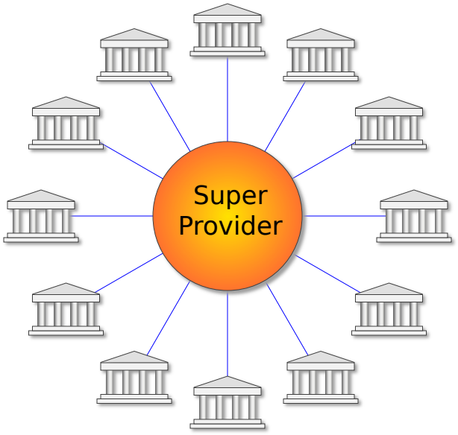
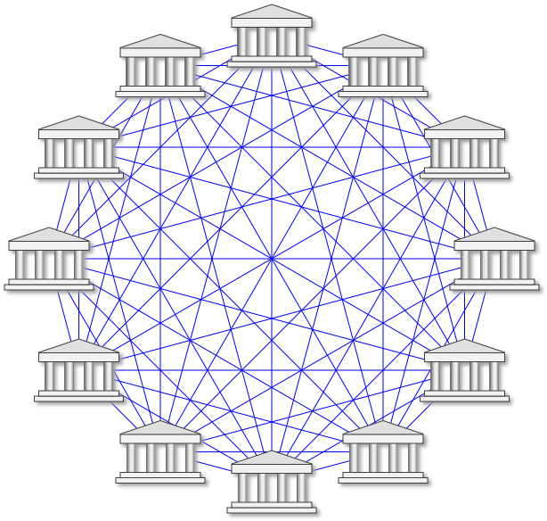

Mobile Payment Systems – Two Visions
“Ruling” Model – Scalability Issues
– “Challenger”
Indirectly presumes a “Winner takes it all”
strategy since Merchants need a contract
with each super provider
Decentralized operation, no intermediaries
Open design and reference implementation
Introduces additional transaction fees
complicating business arrangements
involving multiple parties
Powerful security solutions for banks, users
and merchants
Covers all scenarios where you today use a
payment card as well as P2P payments *
Builds on proprietary and secret technology
requiring unusual methods for development
and collaboration including signed NDAs
A single “Wallet” can support multiple and
independent payment networks
* P2P payments require a shared “account lookup” service
WebPKI.org 2017-10-07

