Slide 1
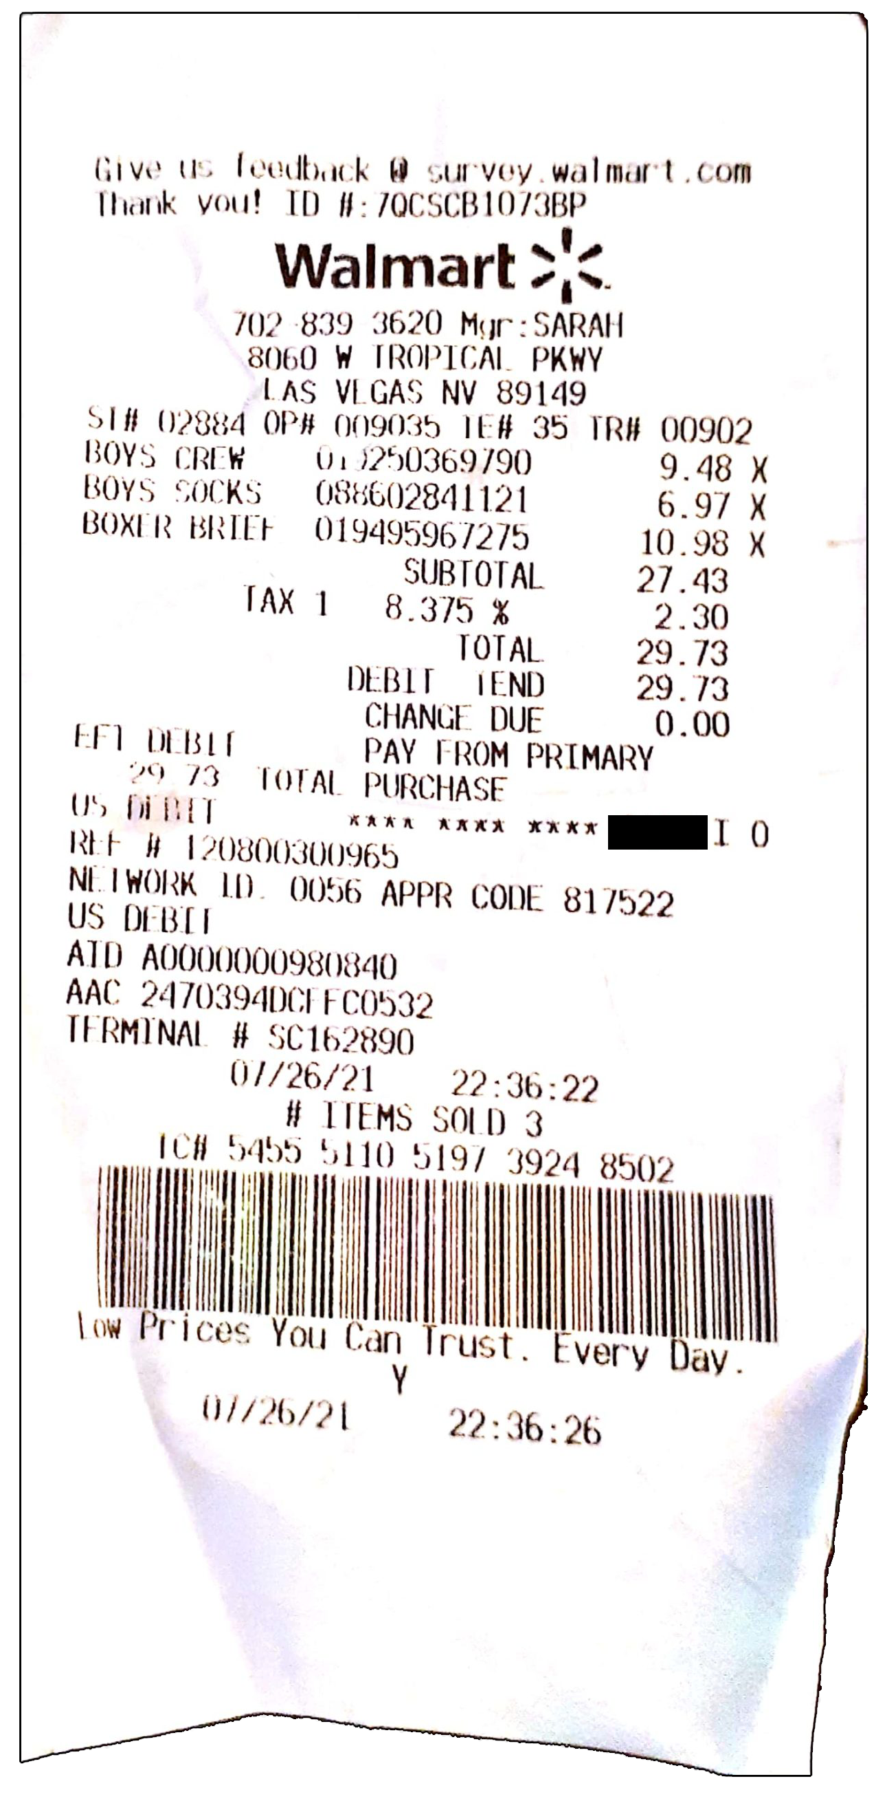
This invention is
herby put in the
public domain
e-Receipts – Invention Disclosure
1. When a User clicks a “Pay” button or swipes their phone, the Merchant activates the User’s
payment Wallet with a payment request message including a randomized receiptUrl.
{ "paymentRequest": { "commonName": "Space Shop", "amount": "550.00", "currency": "EUR", "referenceId": "20231007
}, "receiptUrl": "https://spaceshop.com/receipts/20231007j5lOEL2w9cWBFUwkbrFgjQ" }
Non-normative sample request
OBSOLETE
2. After authorization by the User, the Wallet responds with the authorization data.
3. The Payment process. Details are outside of this specification.
4. If step #3 is successful, the Merchant provides a Receipt at the receiptUrl. Note that a Receipt may have states like ready and inProgress since gas station payments are not finalized until the pump operation stops.
5. If step #3 is successful, the Merchant sends a confirmation message to the Wallet.
6. When the confirmation has been received, the Wallet polls the receiptUrl for the Receipt which is subsequently stored in the Wallet for easy retrieval by the User.

Slide 2
Summary of the Invention
Information Flow
The proposed information flow is supposed to be compatible with direct payments as well as multiphase-phase payments, and deposits.
The use of a randomized receiptUrl makes the proposed system aligned with privacy requirements with respect to the payer. No user registration is required either.
By supplying the receiptUrl together with the payment request, the proposed system becomes resilient to possible network errors, including a not received confirmation message. That is, the Wallet may start polling immediately after step #2.
Receipt Characteristics
The proposed system is supposed to be compatible with any technology for expressing a receipt, including XML, JSON, and CBOR.
Receipts may be digitally signed.
Receipts may contain any applicable information, all viewed trough a specific rendering facility in the Wallet.
Receipts may be “synched” to a cloud service making them available on multiple devices.

Slide 3
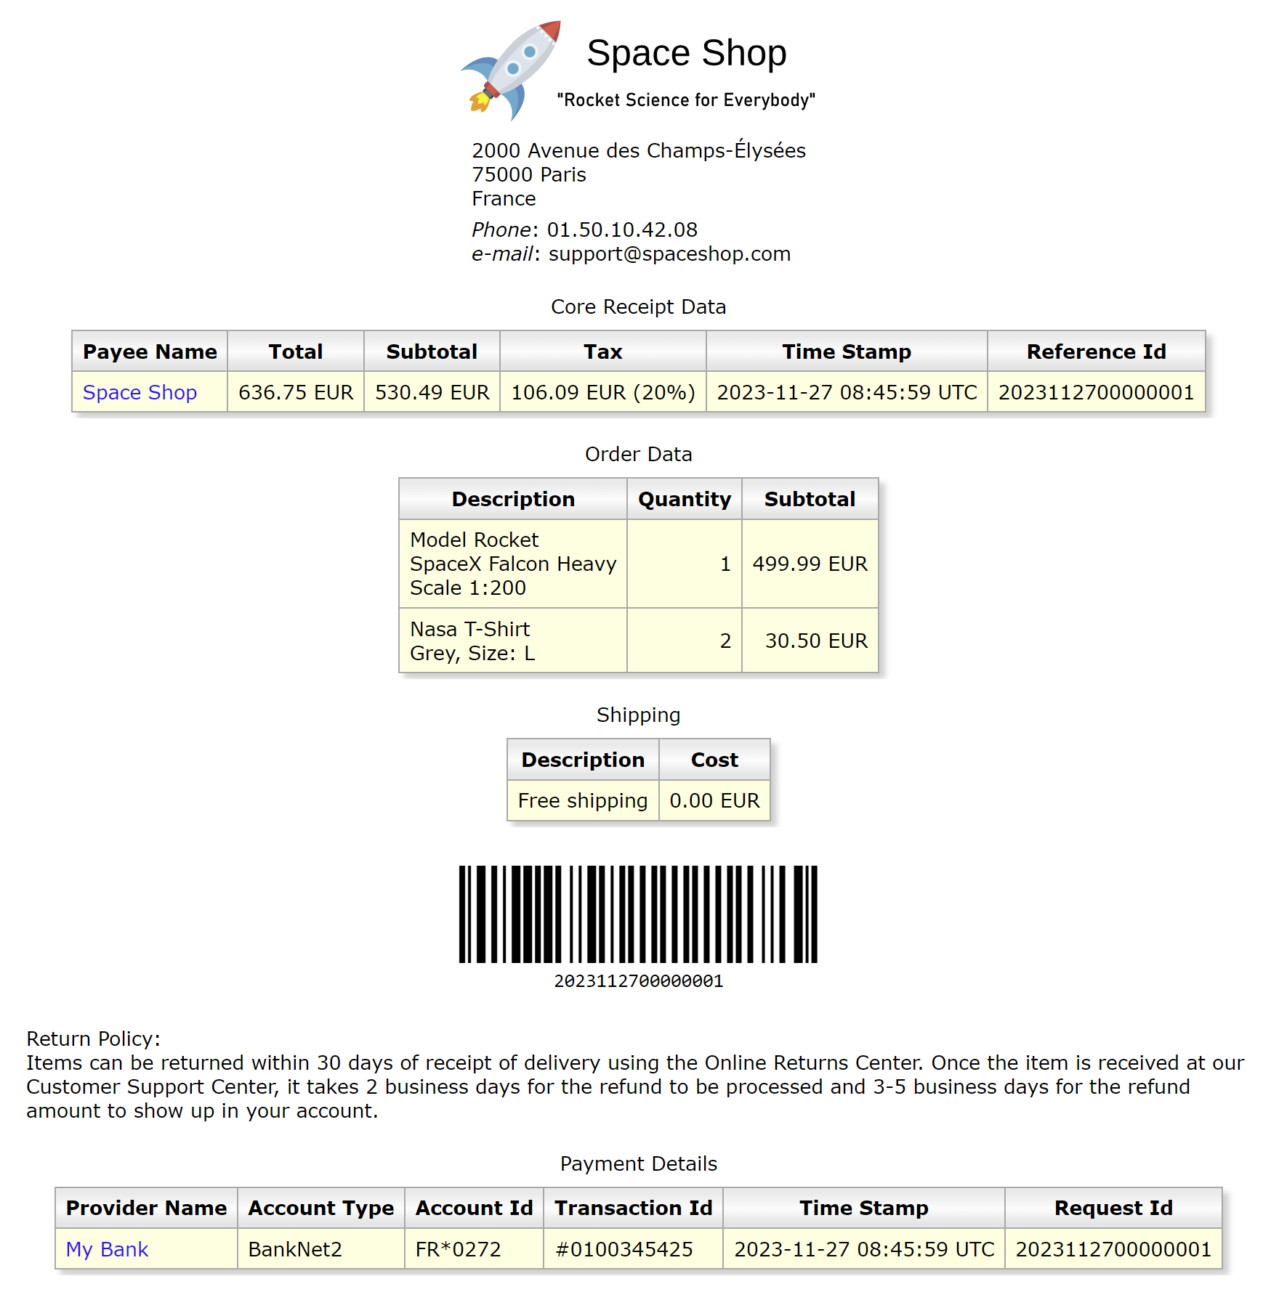
SAMPLE

