Slide 1
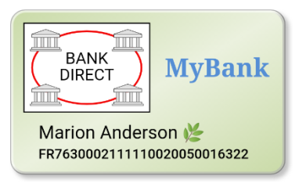
Saturn V3 - Payment Credentials
Name | Comment | Example/Implementation
paymentMethod | URI indicating payment method. | Fictitious bank driven payment network: https://bankdirect.net
accountId | Account identifier associated with the payment credential. | Fictitious French IBAN account: FR7630002111110020050016322
providerAuthorityUrl | Points to the issuer. Used for gathering information about methods and service end points. This data also plays a crucial role for establishing scalable trust between entities. | Fictitious bank URL: https://pay.mybank.com/authority See: https://cyberphone.github.io/doc/defensive-publications/authority-objects.pdf
encryptionParameters | Holds an object with parameters (including a bank specific public key), telling the local client application how to encrypt user authorization data (an alternative to “tokenization”). | Object based on IETF’s JOSE standards: EC or RSA public key in JWK format Content encryption algorithms like A256GCM Key encryption algorithms like ECDH-ES
authorizationKey | Private key (including public key) used for authorizing payment requests associated with accountId. This key must be explicitly activated by the user through a PIN code or biometric operation. | Generated and stored in a TEE. Only the corresponding public key is ever transmitted in clear.
accountBalanceKey | Private key (including public key) used for authorizing balance requests associated with accountId. This key is used in the background and does not require user interaction since balance access is read only and limited to a specific account. | Generated and stored in a TEE. Only the corresponding public key is ever transmitted in clear.
imageData | SVG image holding a visual representation of the payment credential.
V0.8, A.Rundgren 2019-08-12

