Slide 1
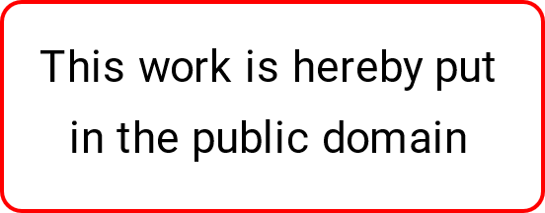


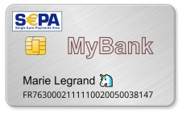
Presumed EPI Front-end * Architecture
Wallet / User
Acceptance Network
Issuer Banks
Wallet / User
Issuer Banks
€100
€100
Acquirer
Payment Request
3
Merchant
1
Merchant
2
Acquirer
Merchant Bank
Merchant Lookup
TS
SEPA Card
In the traditional architecture for card-based payment authorizations, Merchants are connected to Acquirers who handle the communication with the Issuer Banks (or card networks). An Acquirer is usually the entity that has the business agreement with a Merchant as well.
The infrastructure needed to support card transactions depends on a huge number of statically configured security parameters and paths, illustrated by the arrows in the diagram.
This model also relies on databases holding card-number to Issuer Bank “routing” tables.
.
In the Saturn architecture, Merchants are bound by business agreements with their account-holding Bank, who also provides a simple public trust service (TS), that vouches for the Merchant’s legitimacy including its claimed account number and signature key.
The data provided by a TS is digitally signed by the Merchant Bank and is thus to be trusted by all Banks sharing a specific payment schema like SEPA Inst.
Security with respect to payment requests [2] is maintained through mutually signed digital contracts resulting from the Merchant and User authorization step [1], combined with TS Merchant lookups [3].
The arrows in the diagram are transient; there is no need for externally configured security, path, or routing information.
Acquirer services are covered by additional fees on top of the fees required by the Banks running the payment scheme like SEPA Inst.
Due to technical and commercial challenges, the EPI acceptance network would most likely result in a copy of the VISA/MC duopoly.
By eliminating front-end * intermediaries, the payment business remains in the hands of the fully decentralized network of Banks running a specific payment scheme.
* Payee and payer authorization

Slide 2
Existing Features
Planned Features

