Slide 1


Dual Mode - Extending the Reach of Open Banking APIs
Financial Service(s)
AISP/PISP
SCA
+
Consents
Open Banking API
TTP Certificate
SCA and Consents
Bank
Consumer Payments
Dedicated Payment API
Local Integration Service (LIS)
or
Payment Gateway
Locally Trusted Certificate
In theory Open Banking APIs can support Consumer Payments. However, the server centric OAuth security concept makes UX quite challenging compared to schemes like Apple Pay where SCA and account selection are integral parts of the “Wallet”.
This presentation outlines an open, light-weight, synchronous API dedicated for Consumer Payments. Due to the use of account-specific authorization keys in the associated “Wallet” as well as encrypted user authorizations, the API does not expose (or depend on) personal information to external parties, removing “consents” from the plot. This arrangement also enables a (with respect to the user), fully end-to-end secured payment authorization protocol.
Since APIs for external consumption come with considerable development and maintenance costs this represents a major hurdle to adoption. By rather reusing Open Banking APIs in a novel way integration costs can be kept reasonable as well as spread over multiple banks having the same flavor of Open Banking API.
Note: The API is unchanged, the only update needed is recognizing that the caller is a locally installed and trusted service. User login is though required during virtual card enrollment. This is preferably accomplished through the bank’s regular on-line login.

Slide 2





Using a Payment Gateway
User with
Mobile “Wallet”
Payment Request
Merchant
①
Buy!
②
€100
Signature
③
“Virtual” Payment Cards
④
Signed and Encrypted User Authorization (SCA+)
Account ID
Trust
Signature
Signed “Commit”
(Payment Order)
Payment Gateway
Trust
Encryption
See note
Payment Method
…
User Bank URL
Trust
Issues Credentials
Trust
Decryption
Merchant Bank
Existing “Payment Rails”
User Bank
The Payment Gateway setup is quite similar to traditional card processing solutions. There are though some notable differences:
The User Bank URL supplied by the “Wallet” eliminates the database for finding out associated User (Issuer) Bank.
Since no personal information (except User Bank URL) is revealed to the Payment Gateway, its sole mission is vouching for the authenticity of the Merchant. Only User Bank can “decipher” a user authorization and match it with the supplied Payment Request.
Note: The Payment Gateway may either counter-sign messages or authenticate through mutual TLS to the User Bank.

Slide 3
Using
ID
Public, Bank Signed, periodically updated JSON Authority Objects bind each Merchant to their Bank and an for each Merchant specific Public Key and unique Identifier
ID
Authority Object
Authority Object
ID
Authority Object
URL
User with
Mobile “Wallet”
Payment Request
“Virtual” Payment Cards
Merchant
①
Buy!
②
€100
Signature
③
Account ID
④
Signature
Signed and Encrypted User Authorization (SCA+)
Encryption
Trust
Trust
Payment Method
Signed “Commit”
(Payment Order)
Derived Trust
User Bank URL
Publishes Objects
Issues Credentials
Trust
Signature
Decryption
Merchant Bank
Existing “Payment Rails”
User Bank
Using Saturn the functionality of a Payment Gateway is “emulated” by the Merchant’s Bank. However, the Merchant’s Bank only indirectly vouches for the authenticity of the Merchant.
Note: This drawing is slightly simplified, succeeding steps as well as Service Discovery are not shown here.
Note: The “Wallet” is identical for Saturn and Payment Gateway setups.

Slide 4
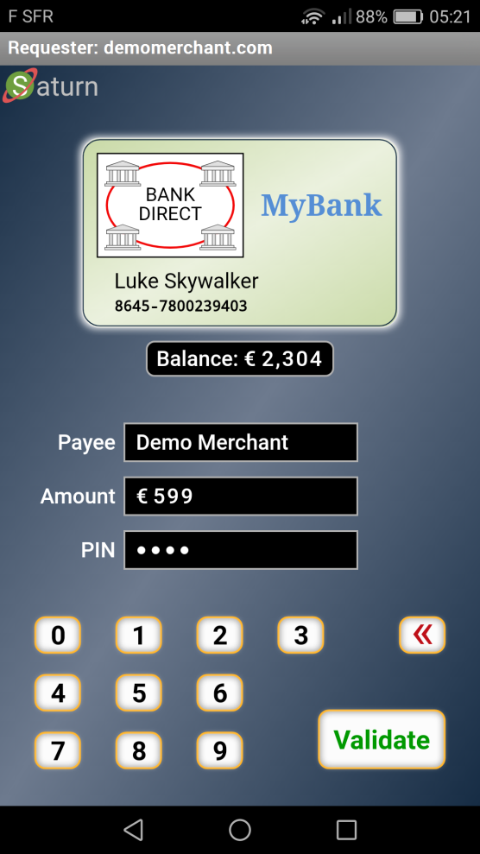
End-User Experience - Personal Payment Terminal
High level End-to-End Secured 360° Web Protocol
Adapted to: Your Language & Your Disability
Virtual Card Logo
Optional: Real-Time Account Balance
UI Showing:
Direct Payment
Booking
Gas Station
Etc.
TEE Protected Keys
PIN or Biometric for User Authorization

