Slide 1
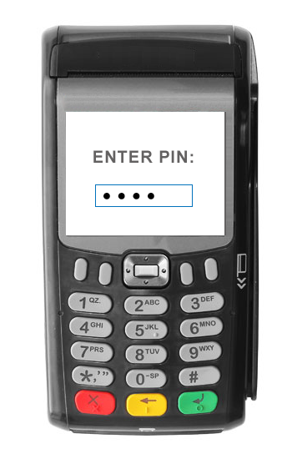
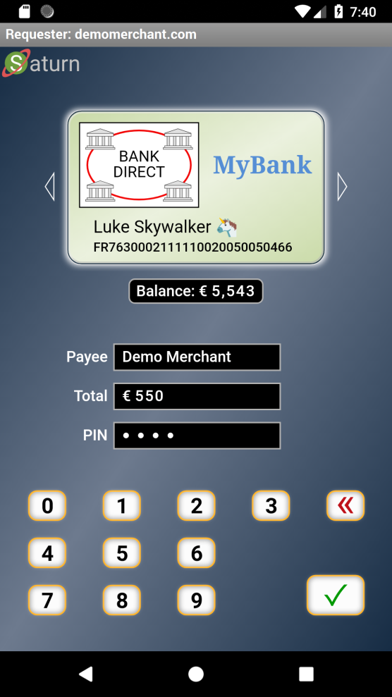

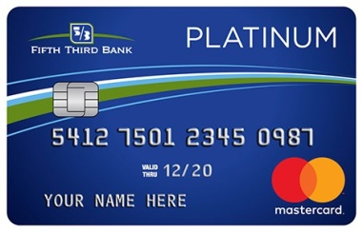
Payment Terminal + Card
Personal Payment Terminal
Non-normative sample layout
Medium level Security Protocol
Unified High level End-to-End Secured JSON based Web Protocol
POOF!
Adapted to:
Your Language
Your Disability
Virtual Card Logotype & Account Selection (ïSwipeð)
Real-Time Account Balance
UI Showing:
Direct Payment
Booking
Gas Station
Subscription
Etc.
Low level “Trusted” Card Protocol
POOF!
TEE Protected Keys
PIN or Biometric for User Authorization (as defined by the virtual card issuer)
A.Rundgren 2020-04-18

