Slide 1
Saturn™
End-to-End Secured Payment Authorization System
Decentralized operation accomplishes similar goals as 3D Secure and “Tokenization” but without registries or additional services
Facilitates the design of brand/bank independent, “rich UI” wallets, supporting both card- and account-to-account payments
Equally applicable on the mobile Web, locally in a shop, at an automated gas station, or as a “PC companion” on the Web
Eliminates the traditional payment terminal and reduces merchant PCI requirements to a minimum
Requires a single “active” method on the issuer side to function*
* Reservations and recurring payments will in non-card-based scenarios need a second method as well
Disclaimer: This is a system in development and specifications are subject to change without notice

Slide 2







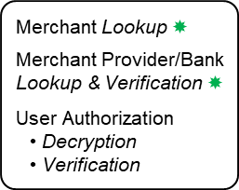
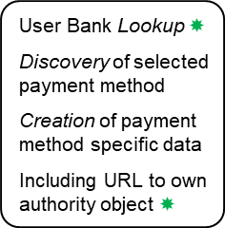
Merchant
User + Wallet
Virtual Card Properties
€ 550
Virtual Cards
Signature Key
Push (A2A) Payments
State Diagram
“Checkout/Pay”
①
Encryption Public Key
(Scenario dependent)
Payment Method URL
Bank Authority URL
Account ID
Card Logotype
…
②
PaymentClientRequest
(Scenario dependent “channel” technology used for Merchant to Wallet communication)
Select Card
User Bank Lookup $$
Discovery of selected payment method
Creation of payment method specific data
Including URL to own authority object $$
Merchant Bank
Total:
€ 550
User Bank
User Authorization using a PIN or Biometric operation
PayerAuthorization
③
Encryption Private Key
(Signed & Encrypted user authorization + Clear text Payment Method and Bank URL)
Merchant Lookup $$
Merchant Provider/Bank Lookup & Verification $$
User Authorization
Decryption
Verification
Request Signature
④
AuthorizationRequest
(HTTPS POST)
⑤
Existing Payment Rails
(Bank-to-Bank Payments)
AuthorizationResponse
⑥
Authorization Signature
User Bank Verification
(HTTP Response)
All transaction steps are now available in a single object where each layer is signed and embeds inner layers
⑦
“Result”
(Scenario dependent)
$$ See Authority Objects. The rationale for encrypting user authorizations is for enabling such data to pass through Merchants which simplifies the Wallet as described in the Saturn FAQ. Step #5 does not apply when running under the conditions outlined in Hybrid Mode.

Slide 3
② Merchant Invokes the Wallet with a PaymentClientRequest Message
{ "@context": "https://webpki.github.io/saturn/v3", "@qualifier": "PaymentClientRequest", "supportedPaymentMethods": [{ "paymentMethod": "https://bankdirect.net", "payeeAuthorityUrl": "https://payments.bigbank.com/payees/86344" },{ "paymentMethod": "https://supercard.com", "payeeAuthorityUrl": "https://secure.cardprocessor.com/payees/1077342" }], "paymentRequest": { "commonName": "Space Shop", "amount": "550.00", "currency": "EUR", "referenceId": "2020100700000013", "timeStamp": "2020-10-07T08:31:44Z", "expires": "2020-10-07T09:02:00Z" }, "receiptUrl": "https://spaceshop.com/receipts/2020100700000013j5lOEL2w9cWBFUwkbrFgjQ" }
Payment method URLs to be matched against stored virtual cards
The Merchant (Payee) invokes the Wallet (after a user action) with a list of supported payment methods. Those who are matching the user’s virtual cards will be shown in the Wallet UI to select from. The payeeAuthorityUrl properties are used to securely bind the Merchant’s request signature to a particular payment method / network. The paymentRequest object contains the actual request data to be reflected in the wallet UI. The optional receiptUrl points to a Web address where an associated digital receipt will be published. To limit misuse, the receiptUrl is supposed to be randomized as well. See Receipt Processing.

Slide 4
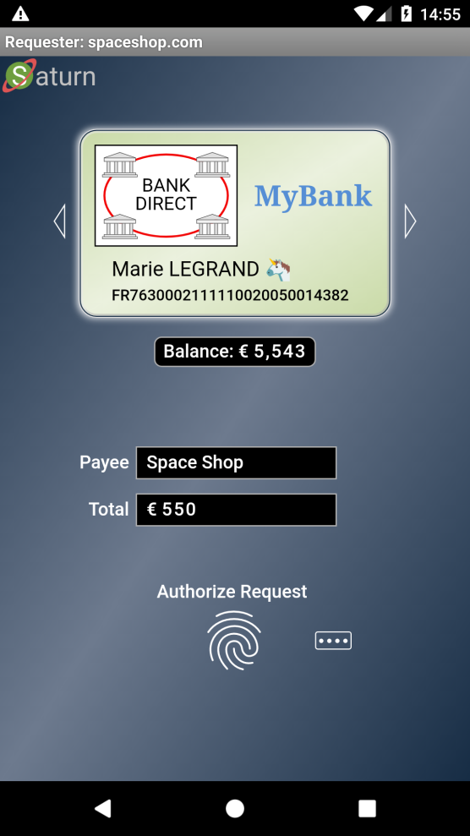
② Wallet Receives the PaymentClientRequest
Adapted to:
Your Language
Your Disability
Virtual Card Logotype &
Account Selector (⇦ Swipe ⇨)
Optional: Real-Time Account Balance
UI Showing:
Direct Payment
Booking
Gas Station
Subscription
Etc.
TEE Protected Keys
PIN or Biometric for User Authorization (as defined by the virtual card issuer, not the Wallet)
When PaymentClientRequest has been received by the client, the Wallet user interface is launched. The authorization method may consist of a PIN but could also be a biometric option such as touching a fingerprint reader. The authorization is only used to unlock the Signature Key as described in next slide. Note that the Saturn authorization concept not only emulates payment cards, but payment terminals as well.

Slide 5
③ Internal Wallet Processing – Creation of Signed Authorization Data
{ "requestHash": { "algorithm": "S256", "value": "5MPHvmWLuOGRAm00Z78C7KW5f1kKPMW9OrI2D4VK1Oo" }, "payeeAuthorityUrl": "https://payments.bigbank.com/payees/86344", "payeeHost": "spaceshop.com", "paymentMethod": "https://bankdirect.net", "credentialId": "54674448", "accountId": "FR7630002111110020050014382", "encryptionParameters": { "algorithm": "A256GCM", "encryptionKey": "9MdPM5jEnPRtk-yYGIMmYaQLrk0gTXVQNhQQIHQ0aQk" },
"userAuthorizationMethod": "PIN", "timeStamp": "2020-10-07T10:32:35+02:00", "software": { "name": "WebPKI Suite/Saturn", "version": "1.38" }, "platform": { "name": "Android", "version": "10", "vendor": "Huawei" }, "authorizationSignature": { "algorithm": "ES256", "publicKey": { "kty": "EC", "crv": "P-256", "x": "censDzcMEkgiePz6DXB7cDuwFemshAFR90UNVQFCg8Q", "y": "xq8rze6ewG0-eVcSF72J77gKiD0IHnzpwHaU7t6nVeY" }, "value": "EaGSWKQK6DFHVe8RJHlhA5c3qKSN1Gjh....Pdi6vaxdA8ofiAW6Py-wxWUNFxybSTAA" } }
Hash of received paymentRequest object based on RFC 8785
Copied from PaymentClientRequest
Acquired by the Wallet software
Core data of selected virtual card
Input to Risk Based Authentication
Authorization signature based on JSF
Signature key of selected virtual card
When the user has authorized the transaction the Signature (private) key associated with the selected card is used to sign a JSON object holding authorization data as follows : requestHash holds the hash of the paymentRequest object (see PaymentClientRequest slide), while accountId holds the actual Account ID of the selected card. For more information about encryptionParameters, turn to the slide Risk Based Authentication.

Slide 6
③ Wallet Processing – Creation and Sending of PayerAuthorization Message
{ "@context": "https://webpki.github.io/saturn/v3", "@qualifier": "PayerAuthorization", "providerAuthorityUrl": "https://payments.mybank.com/authority", "paymentMethod": "https://bankdirect.net", "encryptedAuthorization": { "algorithm": "A256GCM", "keyEncryption": { "algorithm": "ECDH-ES", "publicKey": { "kty": "EC", "crv": "P-256", "x": "TfCrhFwZRU_ea7lUWwRi3HkuyT2yF9IxN5xKh2khjlk", "y": "nZFwxLP0TvFXD2xPKzRTIGevgLjpiMw2BP86hszj5x4" }, "ephemeralKey": { "kty": "EC", "crv": "P-256", "x": "80mByDxNt213LAKLjTC7VWLg0HwgZoyrxdf33Cvpk1c", "y": "73oDKxbAYxFVbWckvxHY8gO2NY_nK8nCVwWUoP8GBy0" } }, "iv": "9AXDHPcmNNn77jK8", "tag": "qpUpZZRD0K1JRCyJui_9mw", "cipherText": "yUrV2yfBwUoylw2GE-0dsbmT1wbrWhmn....F-7jHwRlVlt6Cvpj0Ok7FD2Kcon_TjiQ" } }
“Non-secret” data of selected virtual card
Encryption object based on JEF
Encryption key of selected virtual card
Encrypted user authorization
PayerAuthorization messages provide the URL to the issuing bank’s “Authority” object and the selected payment method which both are featured in virtual cards. This data is used by Merchants (Payees) for routing payment authorization requests to the applicable Bank. The actual authorization data (see previous slides) is encrypted by the Wallet using an Issuer (not User) specific Encryption key (with a matching private key only known by the issuing Bank), which also is stored in the virtual card. That is, Merchants do not get any information concerning Users (Payers) except their Bank and associated payment method.

Slide 7
Bank/Acquirer ProviderAuthority Object
{ "@context": "https://webpki.github.io/saturn/v3", "@qualifier": "ProviderAuthority", "httpVersions": ["HTTP/1.1", "HTTP/2"], "providerAuthorityUrl": "https://payments.mybank.com/authority", "commonName": "My Bank", "homePage": "https://mybank.com", "logotypeUrl": "https://mybank.com/images/logotype.svg", "serviceUrl": "https://payments.mybank.com/service", "supportedPaymentMethods": { "https://bankdirect.net": ["https://sepa.payments.org/saturn/v3#account"], "https://supercard.com": ["https://sepa.payments.org/saturn/v3#account"] }, "extensions": { "https://webpki.github.io/saturn/v3/extensions#hybrid": "https://payments.mybank.com/hybridpay", "https://webpki.github.io/saturn/v3/extensions#balance": "https://payments.mybank.com/balancereq" }, "signatureProfiles": ["https://webpki.github.io/saturn/v3/signatures#ES256.P-256", "https://webpki.github.io/saturn/v3/signatures#RS256.2048"], "encryptionParameters": [{ "dataEncryptionAlgorithm": "A128CBC-HS256", "keyEncryptionAlgorithm": "ECDH-ES", "publicKey": { "kty": "EC", "crv": "P-256", "x": "TfCrhFwZRU_ea7lUWwRi3HkuyT2yF9IxN5xKh2khjlk", "y": "nZFwxLP0TvFXD2xPKzRTIGevgLjpiMw2BP86hszj5x4" } }], "timeStamp": "2020-10-07T08:05:46Z", "expires": "2020-10-07T09:05:47Z", "issuerSignature": { "algorithm": "ES256", "certificatePath": ["MIIBtTCCAVmgAwIB....3FwxFeOawwmz1bM6", "MIIDcjCCAVqgAwIB....e_-5TddhlTUMNPvw"], "value": "ibiFHsP9DizZQ8k6DUjP9zrR3Mkg5v1L....xiL58nHozxZUOWJODQ4MNqBxWWiooMpw" } }
Authority object (self) URL of a virtual payment card issuer
Payment network, [Payment rails, …]
Accepted signature types
Encryption parameters adapted for JEF
Issuer signature based on JSF
“Authority” objects hold Keys, Payment methods, and URLs which are used by Merchants, Banks, and Acquirers as Secure Distributed Entity Databases creating the foundation for scalability including Delegated Trust. “Authority” objects are published on the Internet and accessed by HTTP GET operations. A Bank/Acquirer “Authority” object is signed by the Bank/Acquirer itself. The supportedPaymentMethods object declares the payment methods understood by the Bank. The encryptionParameters are used by Issuers for encrypting user account data.

Slide 8
Merchant (Payee) PayeeAuthority Object
{ "@context": "https://webpki.github.io/saturn/v3", "@qualifier": "PayeeAuthority", "payeeAuthorityUrl": "https://payments.bigbank.com/payees/86344", "providerAuthorityUrl": "https://payments.bigbank.com/authority", "localPayeeId": "86344", "commonName": "Space Shop", "homePage": "https://spaceshop.com", "logotypeUrl": "https://spaceshop.com/images/logotype.svg", "accountVerifier": { "algorithm": "S256", "hashedPayeeAccounts": ["kUwpqk-cbkDaBjwDD_etPSh_FtC-Ap2K_A2MQzXNy_U"] }, "signatureParameters": [{ "algorithm": "ES256", "publicKey": { "kty": "EC", "crv": "P-256",
"x": "8VY09NWUy-aVGNHZZQDIyy-H3RxLfXbiPR2SVlEubjE", "y": "OuHehTNjMbphW0s3nBBVdAALLdzE9x-hup4CnJ1gM-o" } }],
"timeStamp": "2020-10-07T08:49:57Z", "expires": "2020-10-07T09:49:58Z", "issuerSignature": { "algorithm": "ES256", "publicKey": { "kty": "EC", "crv": "P-256", "x": "-Vr8Wk3ygt5J2_J3R8TrRaa-AWW7ZiXa6q1P7ELs6gc", "y": "Vuc6z3WiZ3tgXTXvU6F5qdiiYePWeUI1q9Tx83ySDcM" }, "value": "Xb_yLOpGbmboDjufFnCDdRfyAJiNm1-U....8ou__kr_izI05kOnJshpd-JkpcWcP4kw" } }
URL to the Merchant “Authority” object itself
URL to the Merchant Bank/Acquirer “Authority” object
Merchant core data
Merchant account verification data
Merchant signature key
Issuer signature based on JSF
The same public key as in the Bank/Acquirer “Authority” object signature certificate
A Merchant (Payee) “Authority” object is like a short-lived, automatically updated, X.509 certificate not requiring a CA. Such an object is published on the address payeeAuthorityUrl hosted by the party (Bank or Acquirer) which vouches for the Merchant. If a Merchant is to be “revoked”, the object is simply removed. To automate revocation checks, there is an expires attribute which also is used to clear caching of Merchant “Authority” objects. The signatureParameters list enable key renewals as well as validation of signatures using old keys.

Slide 9
④ Merchant Creates and Sends an AuthorizationRequest Message
{ "@context": "https://webpki.github.io/saturn/v3", "@qualifier": "AuthorizationRequest", "recipientUrl": "https://payments.mybank.com/service", "payeeAuthorityUrl": "https://payments.bigbank.com/payees/86344", "paymentMethod": "https://bankdirect.net", "paymentRequest": { Copy of the paymentRequest object }, "encryptedAuthorization": { Copy of the encryptedAuthorization object }, "payeeReceiveAccount": { }, "clientIpAddress": "220.13.198.144", "timeStamp": "2020-10-07T08:32:38Z", "software": { "name": "WebPKI.org - Payee", "version": "1.00" }, "requestSignature": { "algorithm": "ES256", "publicKey": { "kty": "EC", "crv": "P-256", "x": "8VY09NWUy-aVGNHZZQDIyy-H3RxLfXbiPR2SVlEubjE", "y": "OuHehTNjMbphW0s3nBBVdAALLdzE9x-hup4CnJ1gM-o" }, "value": "91wNxmoZt-TKUGD1R7prluueL2DSv9iZ....TqYipTRDXSewSlfWgnoxsTkjkw07pJog" } }
Where the message is actually sent
URL to Merchant “Authority” object
Payment method (must match user authorization)
Sample data for a SEPA payment method:
"@context": "https://sepa.payments.org/saturn/v3#account", "iban": "FR7630004003200001019471656", "nonce": "nZFwxLP0TvFXD2xPKzRTIGevgLjpiMw2BP86hszj5x4"
The nonce is adding privacy protection to the account verification hashes published in the accountVerifier object of PayeeAuthority.
Request signature based on JSF
Merchant signature key
The AuthorizationRequest is sent by a Merchant (Payee) to the serviceUrl of the “Authority” object given by the user’s choice of payment card (method). See providerAuthorityUrl. The inclusion of payeeAuthorityUrl enables the targeted User Bank to verify that the Merchant belongs to a known payment network.

Slide 10
⑤ User Bank Responds with an AuthorizationResponse Message
{ "@context": "https://webpki.github.io/saturn/v3", "@qualifier": "AuthorizationResponse", "accountReference": "FR*0504", "encryptedAccountData": {
Parameters removed for brevity… "cipherText": "okjRig8y97oHa0kw7buu17XcTZOZAtS1....XG4BoMqDwY0e2fxlGPSHzko5Hs_0UHXz" }, "referenceId": "#0100345648", "logData": "CT100006", "timeStamp": "2020-10-07T08:32:38Z", "software": { "name": "WebPKI.org - Bank", "version": "1.00" }, "authorizationRequest": {
Copy of the entire AuthorizationRequest message
}, "authorizationSignature": { "algorithm": "ES256", "certificatePath": ["MIIBtTCCAVmgAwIB....3FwxFeOawwmz1bM6", "MIIDcjCCAVqgAwIB....e_-5TddhlTUMNPvw"], "value": "b03W5RPCmoA2ARILtbdvCrlrAj5i0Cr4....hib3XUqun9KxpbL6Ig7i4pA_ko7Gf4yA" } }
Optional short form of the user account to be featured in receipts etc.
Encryption object based on JEF
Encrypted user account data
Authorization signature based on JSF
User Bank certificate path
After received the AuthorizationRequest, User Bank performs an extensive list of operations to verify the validity of the request, including fetching the Merchant’s (Payee) PayeeAuthority and ProviderAuthority objects. If the verification succeeds, User Bank responds with an AuthorizationResponse message which in addition to the original AuthorizationRequest, also holds the user’s account data (ID) encrypted by the Merchant provider’s encryption key. This information is used for Card Payments and Refunds.

Slide 11


Merchant
User + Wallet
User Bank
€ 550
Card Payments
State Diagram
① ② ③ ④ Identical to Bank-to-Bank Payments
Acquirer
Acquirer Lookup $$
Card Data Encryption
AuthorizationResponse
⑤
User Bank Verification
(HTTP Response)
Authorization Signature
Merchant Verification Card Data Decryption
TransactionRequest
⑥
Request Signature
(HTTPS POST)
Card Network
⑦
See also Hybrid Mode
Authorization Signature
All transaction steps are now available in a single object where each layer is signed and embeds inner layers
⑧
TransactionResponse
(HTTP Response)
⑨
“Result”
(Scenario dependent)
$$ See Authority Objects. The flow may stop after step #5 resulting in a Secure Authorization Object which only can be activated by another Request. This scheme supports hotel bookings, upfront reservations for automated gas stations, as well as recurring payments. The card data Encryption and Decryption processes enable standard card data to securely pass through Merchants from Issuers to Acquirers.

Slide 12
Merchant
User + Wallet
User Bank
€ 550
Hybrid Mode
State Diagram
① ② ③ ④ Identical to Bank-to-Bank Payments
AuthorizationResponse
⑤
Authorization Signature
User Bank Verification
(HTTP Response)
Merchant Bank
Request Signature
TransactionRequest
⑥
(HTTPS POST)
Merchant Verification
⑦
Existing Payment Rails
(Bank-to-Bank Payments)
All transaction steps are now available in a single object where each layer is signed and embeds inner layers
TransactionResponse
⑧
Authorization Signature
(HTTP Response)
⑨
“Result”
(Scenario dependent)
In the Hybrid mode traditional card payment methods are “emulated” including support for hotel bookings, upfront reservations for automated gas stations, as well as reoccurring payments. For three-corner payment schemes like PayPal and Alipay as well as for payments where the User and Merchant have the same bank, step #7 is not applicable.

Slide 13
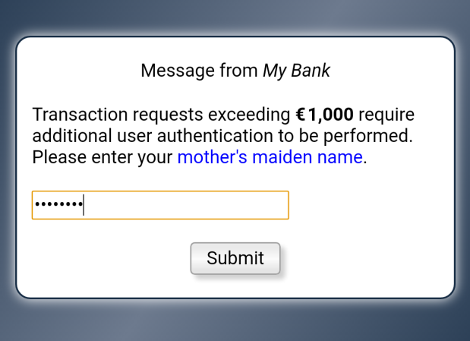
Private Messaging and Risk Based Authentication
{ "@context": "https://webpki.github.io/saturn/v3", "@qualifier": "ProviderUserResponse", "encryptedMessage": { "algorithm": "A256GCM", "iv": "_K4Sgt5y1uKhwiSi", "tag": "Xmqyx5XZWmxSFfypag-y_A", "cipherText": "qXIsLsZ-zIxVllV920dpxPmTOwGRghU_....fsxbw1LX61Tu6GbsSw1gXEcwkW8S4fOQ" } }
Encryption object based on JEF
Encrypted message from User Bank
Decrypted and rendered by the Wallet
(non-normative sample)
Occasionally a User Bank needs to inform the user of something related to an AuthorizationRequest like an account overdraft. Another situation requiring an action from the user’s side is when the amount requested is unusually high or when “suspicious” user patterns have been identified. In both cases the request is ignored and the normal response is replaced by a message which only the (Wallet) user can read while still being delivered through the Merchant’s “channel” to the Wallet. Privacy is accomplished by the User Bank encrypting the message contents with the symmetric key supplied in encryptionParameters (see Creation of Signed Authorization Data). This key is a random value generated for each Wallet invocation.
A private message like above (requiring an action), forces the Wallet adding the response to the user authorization data and then performing a full signed and encrypted User Authorization request again. This process may be repeated if necessary.

Slide 14
RefundRequest Option
{ "@context": "https://webpki.github.io/saturn/v3", "@qualifier": "RefundRequest", "recipientUrl": "https://payments.bigbank.com/refund", "amount": "550.00", "payeeSourceAccount": { "@context": "https://sepa.payments.org/saturn/v3#account", "iban": "FR7630004003200001019471656" }, "referenceId": "#1000004", "timeStamp": "2020-10-07T22:07:50Z", "software": { "name": "WebPKI.org - Payee", "version": "1.00" }, "authorizationResponse": { Copy of the entire AuthorizationResponse message }, "requestSignature": { "algorithm": "ES256", "publicKey": { "kty": "EC", "crv": "P-256", "x": "8VY09NWUy-aVGNHZZQDIyy-H3RxLfXbiPR2SVlEubjE", "y": "OuHehTNjMbphW0s3nBBVdAALLdzE9x-hup4CnJ1gM-o" }, "value": "rrqbEkm7ZM6uGjnIWg-3c2YHPXsDhzVz....FsMSNotc7QvAsvn2sTFJ-GGdN5Fx6EfQ" } }
Request signature based on JSF
Merchant signature key
By including the account ID of the user (but encrypted with the Merchant’s payment provider key), in the AuthorizationResponse object the Merchant can (aided by their payment provider), transfer money in the opposite direction. A RefundRequest message consists of an embedded AuthorizationResponse and an amount, signed by the Merchant. Note that the Merchant must send the refund request to its own bank. The Merchant’s Bank is supposed to respond with (a here not shown) RefundResponse object.

Slide 15
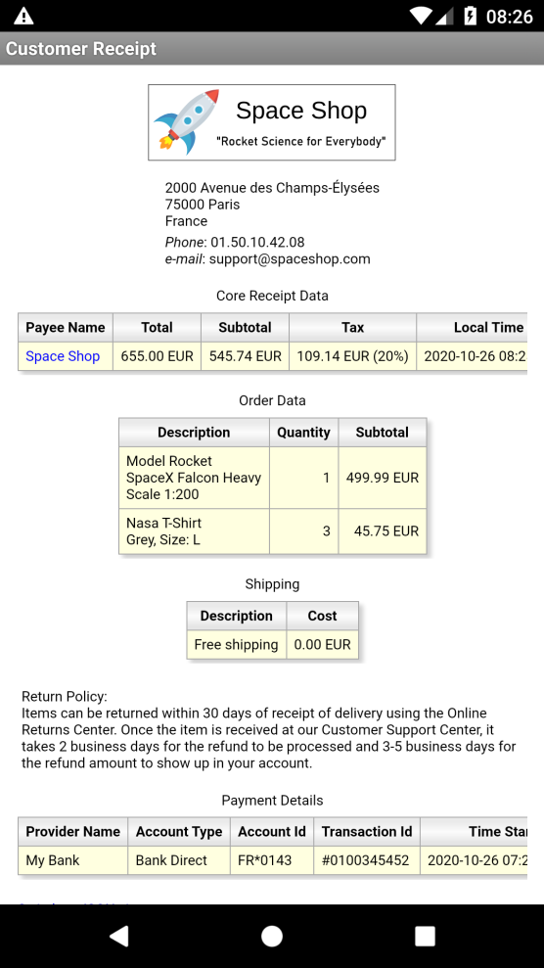
Receipt Processing
If a receiptUrl is included in the PaymentClientRequest the Saturn wallet begins polling the URL after a successful payment operation. If succeeding, the wallet stores the JSON-formatted receipt object locally. Receipt can subsequently be viewed with a built-in receipt rendering application. The receipts may also be “synched” to a cloud service of the user’s choice. Since receipts are digitally signed they can also be securely verified as being created by the merchant in question. Receipts objects may also be transferred to other parties like employers.

Slide 16
JSON Receipt Object
{ "@context": "https://webpki.github.io/saturn/v3", "@qualifier": "Receipt", "status": "AVAILABLE", "referenceId": "2020102600000002", "timeStamp": "2020-10-26T07:25:33+00:00", "commonName": "Space Shop", "physicalAddress": ["2000 Avenue des Champs-Élysées", "75000 Paris", "France"], "phoneNumber": "01.50.10.42.08", "emailAddress": "support@spaceshop.com", "amount": "655.00", "currency": "EUR", "subtotal": "545.74", "tax": { "amount": "109.14", "percentage": "20" }, "shipping": { "description": ["Free shipping"], "amount": "0.00" }, "barcode": { "type": "CODE_128", "value": "2020102600000002" }, "freeText": [ "Return Policy:", "Items can be returned within 30 days of receipt of delivery using the Online Returns Center. Once the item is received at our Customer Support Center, it takes 2 business days for the refund to be processed and 3-5 business days for the refund amount to show up in your account." ], "lineItems": [{ "description": ["Model Rocket", "SpaceX Falcon Heavy", "Scale 1:200"], "quantity": "1", "subtotal": "499.99"
},{ "description": ["Nasa T-Shirt", "Grey, Size: L"], "quantity": "3", "subtotal": "45.75" }], "paymentMethodName": "Bank Direct", "accountReference": "FR*0143", "payeeAuthorityUrl": "https://payments.bigbank.com/payees/86344", "payerProviderData": { "commonName": "My Bank", "providerAuthorityUrl": "https://payments.mybank.com/authority", "referenceId": "#0100345452", "payeeRequestId": "2020102600000002", "timeStamp": "2020-10-26T07:25:34+00:00" }, "receiptSignature": { "algorithm": "ES256", "publicKey": { "kty": "EC", "crv": "P-256", "x": "8VY09NWUy-aVGNHZZQDIyy-H3RxLfXbiPR2SVlEubjE", "y": "OuHehTNjMbphW0s3nBBVdAALLdzE9x-hup4CnJ1gM-o" }, "value": "_17N4_ZhdDgSBtV-Q9QzVqu….BrQijgVNJGR3c0-gTeB3NdV18zckw" } }
Receipt signature based on JSF
Merchant signature key

Slide 17
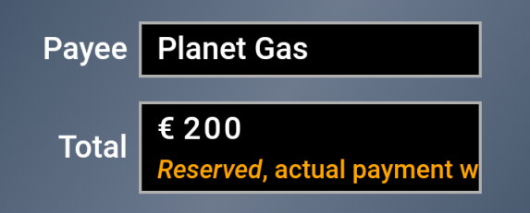
Gas Station Option (Reserve/Capture)
{ "@context": "https://webpki.github.io/saturn/v3", "@qualifier": "PaymentClientRequest", "supportedPaymentMethods": [
Parameters removed for brevity… ], "paymentRequest": { "commonName": "Planet Gas", "amount": "200.00", "currency": "EUR", "nonDirectPayment": { "type": "RESERVATION", "subType": "GAS_STATION", "fixed": true, "expires": "2020-09-25T06:22:00Z" }, "referenceId": "#1000017", "timeStamp": "2020-10-07T06:22:59Z", "expires": "2020-10-07T06:53:00Z" } }
Additional object
User Interface Implications
(non-normative sample using rotating text)
Gas Station payments presume Card Payments or Hybrid Mode to be carried out.

Slide 18
Real Time Account Balance Option
Virtual Card Properties
Signature Key
Encryption Public Key
Balance Key
Payment Method URL
Bank Authority URL
Account ID
Card Logotype
…
Retrieve the ProviderAuthority extensions object
{
"@context": "https://webpki.github.io/saturn/v3", "@qualifier": "ProviderAuthority", .... "extensions": { "https://webpki.github.io/saturn/v3/extensions#balance": "https://payments.mybank.com/balance" }
....
}
The real time account balance option presumes that the virtual card also is equipped with a dedicated balance key. This key does unlike the signature key not require any user authorization because it can only be used to read the balance of the account associated with the virtual card. The process starts by the Wallet using the virtual card’s “Bank Authority URL” to retrieve the ProviderAuthority object using an HTTP GET. In that object there should be an extensions object as shown above. After that the Wallet creates a BalanceRequest (as shown on the next slide), signs it with its balance key, and POSTs it to the URL provided by the specific balance extension.

Slide 19
BalanceRequest Message
{ "@context": "https://webpki.github.io/saturn/v3", "@qualifier": "BalanceRequest", "recipientUrl": "https://payments.mybank.com/balance", "credentialId": "54674448", "accountId": "FR7630002111110020050014382", "currency": "EUR", "timeStamp": "2020-10-07T10:43:05+02:00", "requestSignature": { "algorithm": "ES256", "publicKey": { "kty": "EC", "crv": "P-256", "x": "kiTXwSkkNag5RPjFyPgSNmhPl_97qQPCbPQ2GFmMSp4", "y": "g8-4ymBfTg8o14EaJluDE8QmRfkrEy3M0VP61-TsoXg" }, "value": "jstrRDK-2n5FfpiAOr896f1TKuc6wTSU….5zHmAJWMkAIsnA0E679es5KgBiRIH0Ha70XejQUw" } }
Core data of selected virtual card
Request signature based on JSF
Balance key of selected virtual card
BalanceResponse Object
{ "@context": "https://webpki.github.io/saturn/v3", "@qualifier": "BalanceResponse", "accountId": " FR7630002111110020050014382", "amount": "5543.00", "currency": "EUR",
"timeStamp": "2020-10-07T10:43:07+02:00" }
The resulting response object holds the current balance (available funds) of the specified account.

Slide 20
Saturn - FAQ
Q: Doesn't Saturn’s Merchant-to-User Bank AuthorizationRequest introduce security risks?
A: Yes, similar risks as on-line bank applications which effectively are open to requests from anywhere. Security features include:
Small and strict message format
All messages are signed using industry standard cryptographic algorithms
AuthorizationRequest is signed by the Merchant and vouched for by the Merchant's Bank/Acquirer through the PayeeAuthority object which also enables verifiable Merchant account data
User signs a hash of paymentRequest with a key which only the User Bank knows about
Only mutually signed authorizations are considered valid for processing
Integral support for RBA (Risk Based Authentication)
Tokenization of payment authorizations makes attacks on Merchant databases useless
Q: Can you trust the Wallet key storage?
A: Saturn depends on hardware backed keys like the AndroidKeystore.
Q: Doesn't Saturn effectively requires new client-side technology to fly?
A: Yes indeed, exactly like Apple Pay did. W3C’s https://www.w3.org/TR/payment-request/ is instrumental.
Q: Wouldn't it be better sending requests from the Wallet directly to the User Bank and then handing over responses to the Merchant?
A: Not really, see https://cyberphone.github.io/doc/defensive-publications/payment-authorization-scheme.pdf for more details on this matter which also is a prerequisite for Wallet payment method independence.
Q: Is Saturn a “Push" or “Pull" payment system?
A: Saturn is not a payment system, it is rather a scheme where a User authorizes Merchant-initiated requests * which are transported back to the User Bank via the Merchant. That is, the actual payment system is not a part of the depicted scheme.
Q: How does Saturn relate to ISO 20022, ISO 8583, and SEPA?
A: Only the actual payment systems need payment-system specific security, format, names, conventions, and processing. The ability including payment-system specific data in AuthorizationRequest makes Saturn compatible with just about any payment system.
Q: How are Virtual Cards enrolled?
A: Virtual Cards would typically be enrolled from the User Bank’s Web site using a secure enrollment protocol like: https://cyberphone.github.io/doc/security/keygen2.html
Q: Is Saturn a REST API?
A: No, because a payment is not a resource but rather an event with transactional behavior. In addition, messages are uniquely defined by their JSON contents making digitally signing, embedding, debugging, and documenting straightforward. Wallet communication is based on an interactive, scenario-dependent, asynchronous, bi-directional message channel. See: https://cyberphone.github.io/doc/web/yasmin.html
* Enabling Saturn supporting not only direct payments, but bookings, recurring payments, and automated gas station payments without modifications to the underlying payment system

