Slide 1

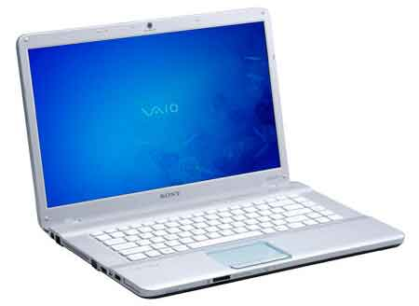



Service
(mybank.com)
Browser in PC
NFC in PC
NFC in Phone
Phone + App
User
This invention is herby placed in the Public Domain
Server Certificate and Private Key
Clicks “Login” Button
1
Initiate Login Process
2
Create Web Session
Create Login Session
(HTTP GET Request)
Login Cache *
3
Initiate User Login Process
HTML5/JavaScript page including NFC data and WebSocket code
(HTTP Response)
Web Session Cookie (in HTTP header)
Write URL
Application (protocol) specific session URL having the same host as the holding Web page otherwise the Web NFC driver must reject the request:
auth://mybank.com/login/w646fw62
Login Page State Service
4
(Web NFC API )
Open Login Page State Service
(WebSocket Creation)
5
Taps Phone on PC
(needed because the login “App” does not talk directly to the invoking login page)
NFC
6
(RF)
Read URL
App Login Request
7
(NFC App API)
10.1 Verify Hash Of Server
Certificate
(HTTP POST Request)
Error (“Phishing”)
Automatic Start of Login (auth) App
8
User Private Key in TEE or SE
Login Request
X
10.2 Verify Login Session using Received Session Data
mybank.com
Error (“Missing”)
Associated User Certificate
PIN
● ● ● ●
OK
9
Authorizes Login Request
Login Cache *
Transformed URL like:
https://mybank.com/login/w646fw62
Request = Sign (User Private Key,
(Transformed URL +
Hash of Server Certificate +
Local Time Stamp +
Client Certificate))
10
10.3 Verify User Credentials and Signature
Error (“Unknown”)
Wi-Fi, Bluetooth
or Mobile Network
OOB Session Validated
App Login Status
Notification
Login Success Actions
11
(HTTP Response)
Logged in to: mybank.com
12
Login Page State Change
(WebSocket Message)
Close Login Page State Service
Get Application Page + Cookie
13
“Phone Token”
13.1 Verify Web Session
(HTTP GET Request)
Error (“Session”)
14
Application Page
(HTTP Response)
Interacts with Web Application
* Entry is removed either by login session timeout or after being used once
15
A.Rrundgren 2018-07-08

