Slide 1

Finally brings SEPA SCT/Inst to the POS, On-line and P2P
UX and Security-wise on par with Apple Pay
Currently available for public testing using Android
Completely Open and Free from licensing
Builds on enhanced Open Banking APIs
Eliminates intermediaries like Card networks (VISA, MC, CB), Acquirers (Stripe, Worldline), and “BigTech” (Google, Apple)
Effectively a “fusion” of established mobile phone payment systems like Swish(SE), Vipps(NO), MobilePay(DK), PayLib(FR), TWINT(CH), etc.
Designed for compatibility with ECB/EPI and EMPSA goals.
https://cyberphone.github.io/openbankingwallet/

Slide 2
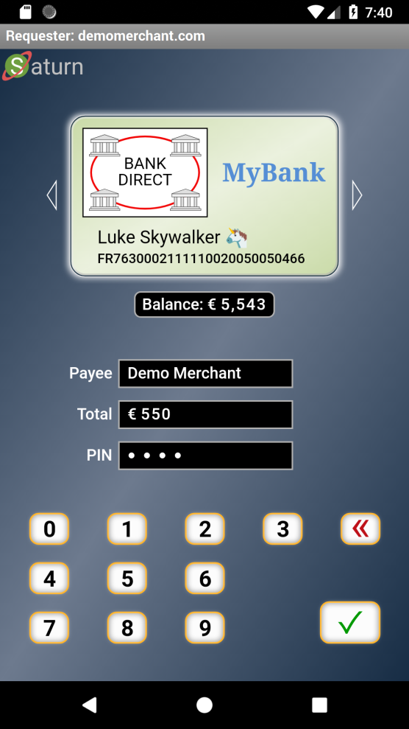
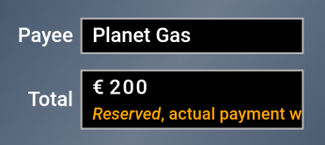

End-User Experience - Personal Payment Terminal
Non-normative sample layout
Unified High level End-to-End Secured JSON based Web Protocol
Adapted to:
Your Language
Your Disability
Virtual Card Logotype & Account Selection (ïSwipeð)
Real-Time Account Balance
UI Showing:
Direct Payment
Booking
Gas Station
Subscription
Etc.
TEE Protected Keys
PIN or Biometric for User Authorization (as defined by the virtual card issuer)

