Slide 1


KeyGen2
KeyGen2* – “Universal Provisioning”
KeyGen2 is an effort creating a standard for browser-based on-line provisioning of PKI user-certificates and keys.
In addition, KeyGen2 supports an option for “piggybacking” symmetric keys like OTP (One Time Password) seeds on PKI, which is a way of leveraging KeyGen2 as well as providing higher security, more sophisticated key-management facilities, and improved flexibility compared to most current symmetric-key-only provisioning systems.
Using a generic credential extension mechanism, KeyGen2 can support things like Microsoft InfoCards and downloadable code associated with a specific key.
One of the core targets for KeyGen2 are mobile phones equipped with TPMs (Trusted Platform Modules), which properly applied, can securely emulate any number of smart-cards.
* KeyGen2 is a tribute to KeyGen which was the first browser-based PKI provisioning protocol, introduced by Netscape 1996.

Slide 2


KeyGen2 – Core Features
Supports all the authentication and signature keys a consumer, citizen, or employee may need (any organization + any technology)
Supports user-key lifecycle management operations ranging from semi-automatic renewals to credential policy updates
Supports issuer-specific PIN-codes, policies, and PUKs
Supports a Browser as well as a “Web Service” interface
Builds on established Internet standards such as HTTPS, MIME, XML Schema, XML Signature, and XML Encryption
Works equally well in a non-managed device as well as in a managed device
Supports cryptographic containers vouching for generated keys through
key-attestation signatures, which enable issuers verifying that keys actually reside in a "safe harbor" rather than in unknown territory
560241
OTP (One Time Password)
PKI (Public Key Infrastructure)
Microsoft CardSpace

Slide 3
Browser-based Key Provisioning - 1/2
https://mybank.com
https://mybank.com/keys
https://mybank.com/keygen
Key Provisioning Dialog
non-normative GUI
Home
Key Center
M Y B A N K
M Y B A N K
mybank.com
wants to provision a key in your phone
AccountID
1236577
Home
Your Account
Get your bank key
[1]

Password
• • • • • •
Cancel
OK
OK
Using a mobile browser makes the enrolment procedure and authentication method independent of the final key provisioning step
A browser scheme is most suited for entities that do not manage the device
A browser-based key provisioning system can be made compatible with traditional e-mail loop back address verification over the Internet as well as with strict procedures in a passport office using an NFC/Bluetooth connection to a local provisioning server
1] Additional key provisioning steps left out for brevity

Slide 4


Browser-based Key Provisioning - 2/2
Arbitrary GET or POST operation through the mobile browser
Response using the MIME-type application/xbpp+xml
Check if the returned data contains an XML object with the KeyGen2
namespace and a PlatformNegotiationRequest top element
Key Provisioning Dialog
mybank.com
wants to provision a key in your phone
KeyGen2 protocol invocation!
Cancel
OK
The rest of the KeyGen2 protocol exchanges

Slide 5

Device Managed Key Provisioning
DM Server
Key Server
SMS-activated DM-operation
Request an OMA-DM KeyGen2 “bootstrap” object [1]
Get user authentication data and provisioning URL using a trusted connection between the DM and Key servers [3]
Receive OMA-DM data
Invoke mobile browser with the received data as POSTed payload [2]
Standard KeyGen2 protocol
Notes: 1. User authentication may be limited to what OMA-DM offers but may also be augmented (2) with OOB-provided information given to the user. 3. Directory servers typically also needs to be a part of a key provisioning scheme but this does not change the principle.

Slide 6
KeyGen2 Protocol Phases
Platform
Negotiation
Key Generation
Key Management
Credential
Deployment
1..n
1
1
The number in the circle tells how many times the actual phase may occur. Platform Negotiation essentially deals with figuring out what cryptographic container to use as well as algorithm capabilities of the client-platform (like if it does it supports ECDSA).
The last phase, Credential Deployment may run as a separate task in the case there is a certification-period or similar between the Key Generation and the actual issuance of credentials.

Slide 7
KeyGen2 - Protocol Basics
Note: Platform Negotiation is currently TBD

Slide 8
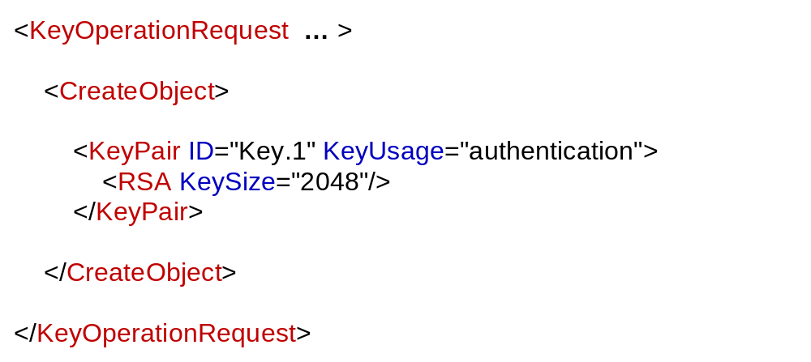
1
2
3
In the beginning there was an empty key-store…
A key-issuer requests the owner (client) to “mint” a fresh RSA key-pair

Slide 9
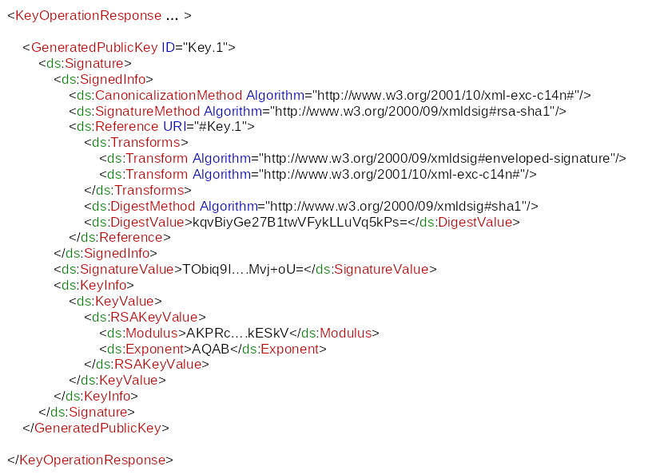
The client’s response
1
2
3
This is the generated RSA public key. The XML- signature functions as a
“proof-of-possession” of the matching private key which only the client has access to. A conforming KeyGen2 implementation SHOULD also include a Reference to the KeyInfo object (i.e. signing the public key itself).
Private Key

Slide 10
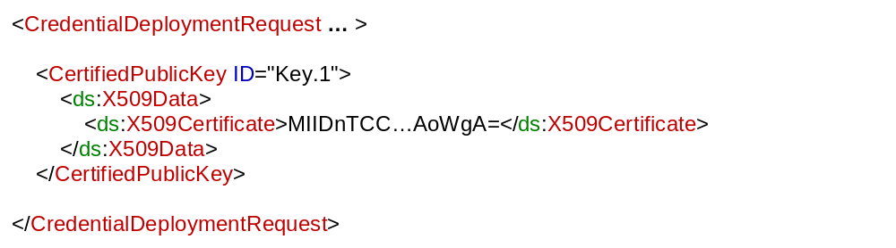
1
2
3
Install the certified key returned by the issuer in the key-store
The private key and associated public
key certificate are now ready to use!
Private Key

Slide 11
KeyGen2 - Advanced Protocol Examples

Slide 12
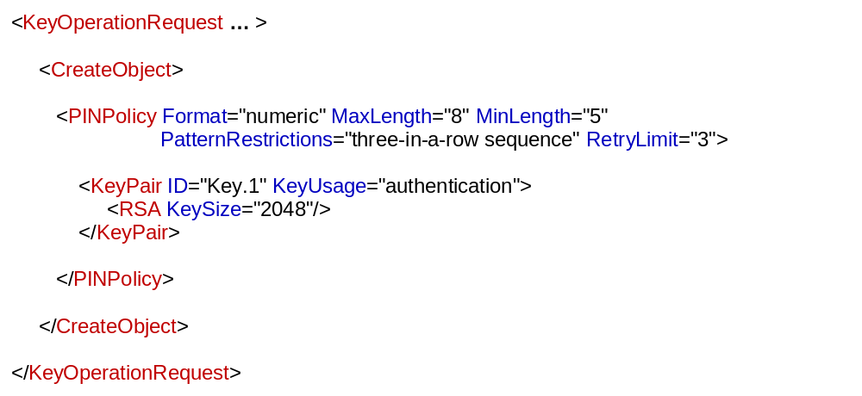
Adding PIN-code protection and associated policies to a key
The sample above only shows a part of the possible options regarding PIN-codes. You may also have the PIN preset as well as enclosing multiple keys. The policy specified in the sample would flag the following PINs as invalid:
654321 Sequence
11123 Three in a row
1A567 Not numeric
4097 Too short

Slide 13
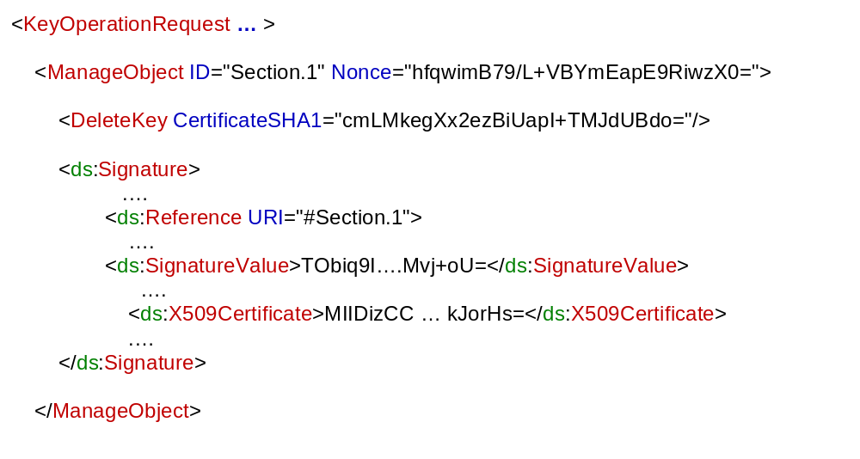
Performing object-management operations on a remote key-store in a secure, robust, and issuer-independent way
Target key
“Certifies”
KeyGen2 builds on the [fairly reasonable] idea that an issuer should only be able to manage keys that is has actually issued. To maintain this integrity requirement, management operations like DeleteKey must be augmented with a fresh “proof-of-issuance” enveloped signature where the signing certificate holds the actual CA certificate of the key to be managed. Due to this arrangement there is no need for end-users installing root certificates, since it is technically infeasible for an issuer to manipulate keys from other issuers. Because PINs and PUKs are bound to provisioned keys, secure remote management is facilitated for these objects as well. That “piggybacked” symmetric keys and Information Cards also “hang” on such keys, makes the scheme universal.
In addition to DeleteKey, KeyGen2 management operations include: CloneKey, ReplaceKey, DeleteKeysByContent, UpdatePINPolicy, UpdatePUKPolicy and UpdatePresetPIN.

Slide 14
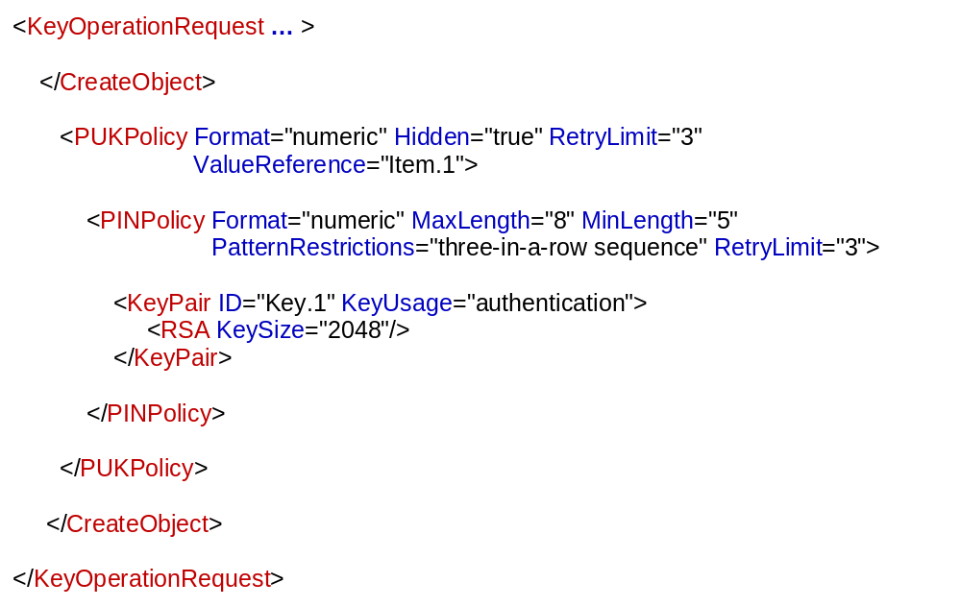
Adding a PUK (Personal Unlock Key) and associated policies to a key
KeyGen2 enables PUKs to be created and managed on an issuer-basis which is important for creating a scheme that “emulates” a set of independently issued smart cards. Note that Hidden="true″ makes the provisioned PUK code unknown for the user which is a possible issuer policy. ValueReference points to a table with encrypted values.

Slide 15
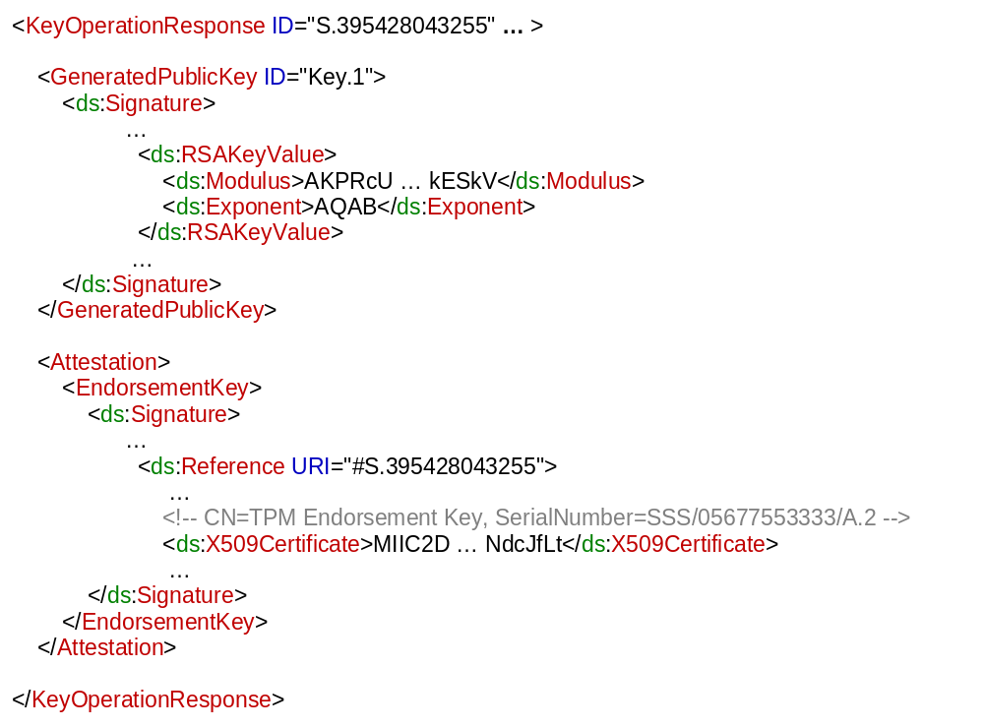
Adding a TPM endorsement signature to a generated key
The purpose of an embedding TPM endorsement signature using a TPM (or similar) platform certificate is to vouch for that the matching private keys actually are stored and “executed” in a secure environment rather than in software. An attestation signature may also vouch for that the device operating system has been “measured” as secure.

Slide 16
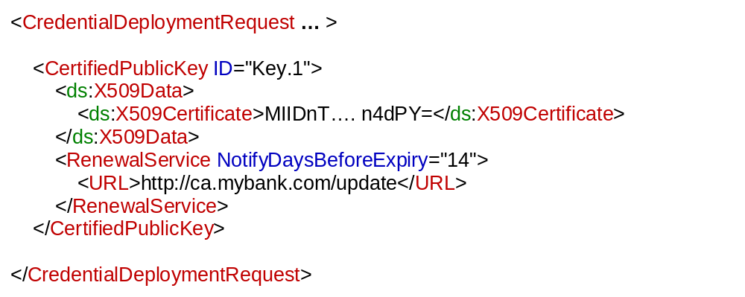
Supporting semi-automated key-renewals
The assumption is that there is a local service that checks if a credential is about to expire and optionally asks the user if he/she wants to renew which simply opens the browser to the specified URL. The URL may contain information concerning the specific key, further reducing the number of steps that the user has to perform in order to renew. This scheme is similar to the update schemes used by software vendors like Microsoft, Adobe and SUN.

Slide 17
Provisioning of Symmetric Keys using
PKI “Piggybacking”

Slide 18
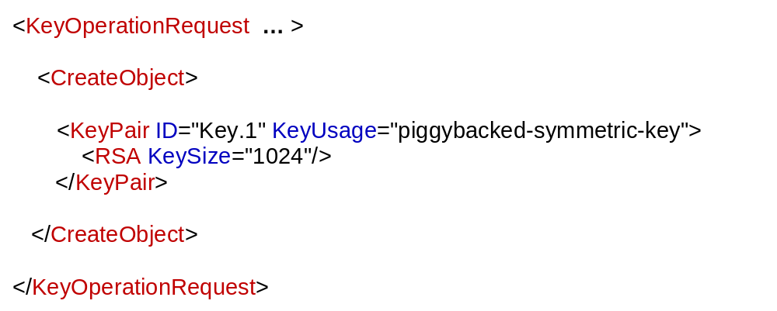
1
2
3
Provisioning an OTP “seed” or similar symmetric shared key
For the initial request nothing particular has to be performed (in the client platform NB), compared to PKI. However, for preserving consistency over the provisioning session, the requester MUST set the key-usage attribute to "piggybacked-symmetric-key".

Slide 19
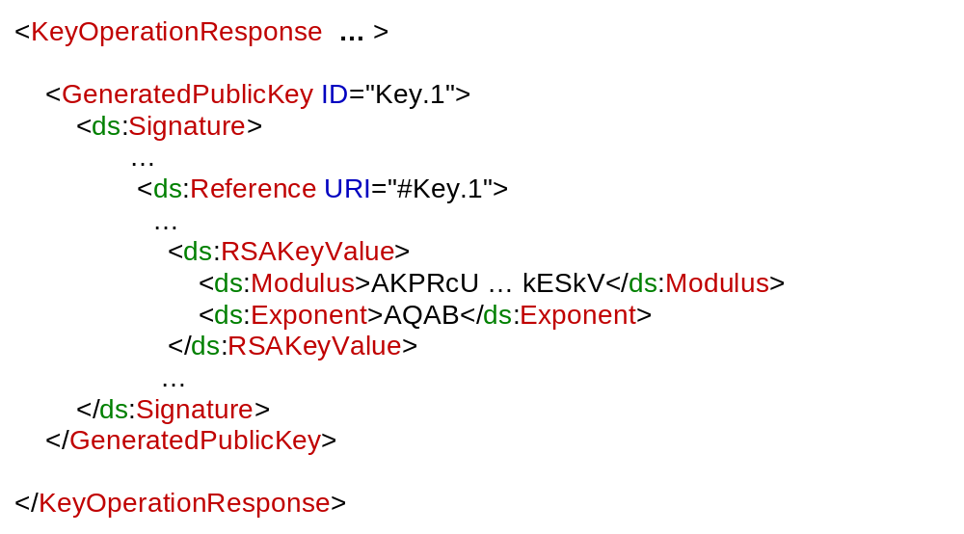
1
2
3
Provisioning an OTP “seed” or similar symmetric shared key
Self-signed public key and core request data
This step is identical to that of PKI. On the next page you can see what the provisioning protocol is eventually supposed to return.
Private Key

Slide 20
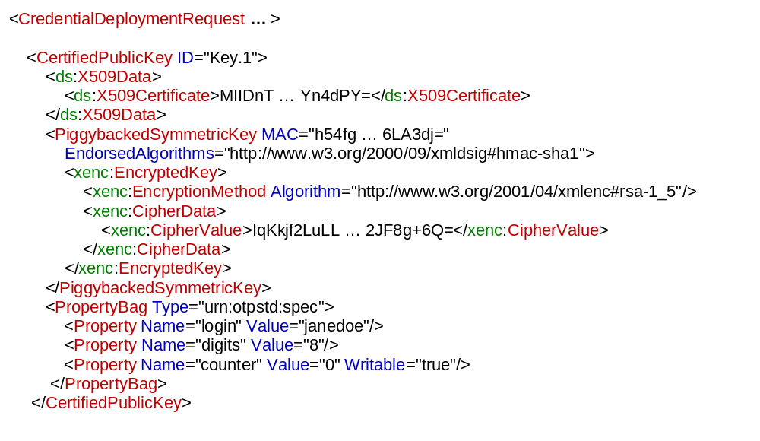
1
2
3
Provisioning an OTP “seed” or similar symmetric shared key
Public Key
(X509v3 Cert)
Wrapped
Symmetric Key
In order to fully provision a symmetric key, you now need to decrypt the wrapped symmetric key with the matching private key as well as storing possible additional key attribute-data (Property objects). To benefit from KeyGen2’s object-management scheme you also need to make a link between the “piggybacked” certificate and the symmetric key. EndorsedAlgorithms holds a list of issuer-endorsed algorithms.
Note: The X509 certificate functions as a universal key ID for all credential types.
Private Key

Slide 21
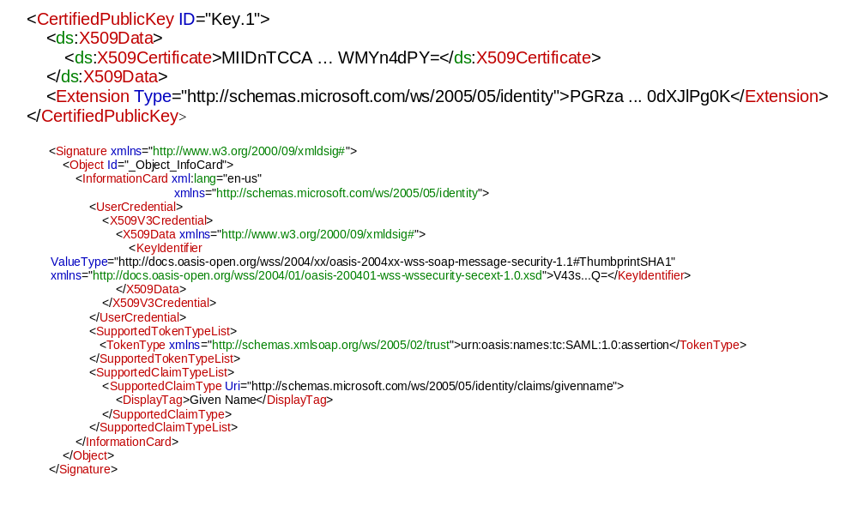
Supporting Microsoft’s Managed InfoCards
1
2
3
Base64-encoded InfoCard
A managed InfoCard using an X.509 credential for authentication to the STS (IdP) needs to be “synchronized” with the certificate since the KeyIdentifier holds the certificate hash. Using the KeyGen2 credential extension mechanism the certificate and associated managed InfoCard(s) can be conveniently issued and managed “in parallel”. This of course requires that the particular extension is recognized by the client software (which is found out during the platform negotiation phase).
Note: The InfoCard sample was cut-down substantially in order to fit the page.

Slide 22
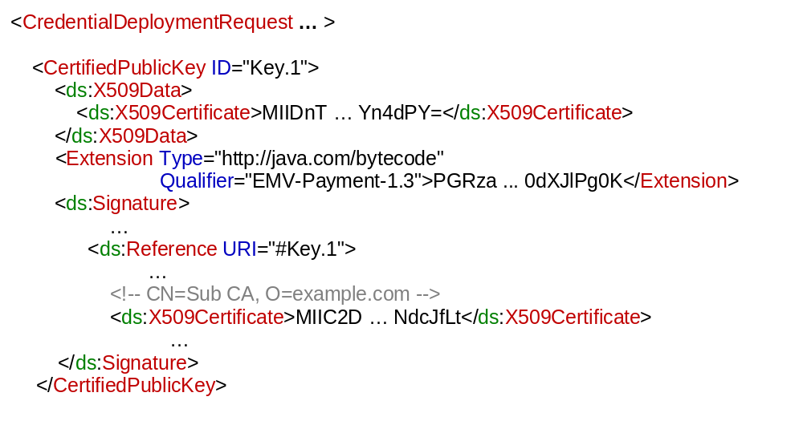
Dealing with downloadable code that is trusted for usage with a specific key
“Certifies”
The similarity between the standard case is that the key (which can be a PiggybackedSymmetricKey as well) itself is always provisioned the same way. The difference is that the Extension object contains downloadable code (which has been identified as being executable on the target platform during the initial platform negotiation phase), that is trusted by the issuer of the key but not necessarily by the platform. That the code is trusted for use with the key is indicated by the added enveloped signature. The signature certificate MUST be verifiable as the issuer of the lowest member of CertifiedPublicKey but does not have to be trusted (known) by the client platform. Key-management operations should include downloaded code as well since such code is just another kind of key attribute.
Note: This arrangement still requires that the downloadable code is executed in a sandbox!

Slide 23
Deferred User Validation/Authentication -
Increasing security, while reducing RA costs

Slide 24
Traditional Signup (Upfront Validation)
https://mybank.com/keys
https://mybank.com/keygen
https://mybank.com/commit
Key Provisioning Dialog
Key Center
Key Center
M Y B A N K
mybank.com
wants to provision a key in your phone
M Y B A N K
AccountID
1236577
Congratulations! You are now ready to use our truly amazing on-line services:
https://mybank.com/online
Password
• • • • • •
Cancel
OK
OK
The signup password must be distributed OOB which is expensive as well as making the scheme vulnerable to identity theft
The signup password is susceptible to “phishing” attacks
Long (=secure) passwords are inconvenient for users
Single-use passwords tend to create helpdesk issues
For brevity reasons the PIN-code creation dialog was omitted.

Slide 25
Deferred User Validation
https://mybank.com/keys
https://mybank.com/keygen
https://mybank.com/next
Key Provisioning Dialog
Key Center
Key Center
M Y B A N K
mybank.com
wants to provision a key in your phone
M Y B A N K
Name
Jane Doe
A confirmation message has now been sent to the e-mail address: jane.doe@example.com where the next step is described as well
E-mail
jane.doe@example.com
Cancel
OK
OK
For brevity reasons the PIN-code creation dialog was omitted.
After the step above, the issuer has a “phish-free”, cryptographically secured link to the user (the user’s device to be entirely correct…) without having distributed any kind of secret. The address verification URL on the next page may seem like a contradiction to this but the variable part is typically an HMAC of a master secret and the user’s certificate which has no value except for the owner of the matching certificate.
The provider now has a number of options regarding the rest of provisioning. One option is treating the issued credential as a specific sign-up credential which is subsequently replaced with the real credential after the e-mail address has been verified. Another option is putting the issued credential “on hold” until the address has been validated.

Slide 26
Deferred User Validation, continued
Mail: Inbox
https://mybank.com/verify
https://mybank.com/commit
From:
registry@mybank.com
Key Center
Dear Customer,
Now you need to show that you are the owner of the
e-mail address: jane.doe@example.com
Do that by clicking on the link below:
https://mybank.com/verify/78rf4steK5d04fycz30x7gq0mj26528qdjxkepkp3kdp276
Key Activation
M Y B A N K
Please wait while keys are being activated...
Congratulations! You are now ready to use our truly amazing on-line services:
https://mybank.com/online
Cancel
No secrets need to be distributed OOB or on the wire (=nothing to steal except for the device itself)
Aligned with the most established way of establishing user-identity on the Internet as well as supporting “in person” validation options
Can also be used with SMS to achieve similar bindings
“Self-service” oriented

