Slide 1
WASP (Web Activated Signature Protocol)
Application Note #2 – Signature container considerations
WASP was designed to support What You See Is What You Sign (WYSIYS) which is quite logical but also have consequences for how you actually design information systems.
It important to keep in mind that whatever method you deploy, a reasonable signature scheme should not hold the user responsible, except for data which the user have seen.
In addition, user considerations also makes it reasonable to limit the user’s signature view to the core of the transaction rather than requiring the user to view and accept data which the user have little knowledge of, or no control of. This include things like order IDs and similar which are only of significance to internal or external bookkeeping processes.
Note that WASP is based on the use of “dry signatures” which means that the requesting service already have a copy of the data to sign. I.e. WASP is exclusively intended for user confirmation of a transaction (or agreement etc), while the transaction is supposed to have been created in an earlier phase of the current web session. That WASP displays data in the same fashion as the rest of the web application, makes signatures appear as integrated processes.
The following pages show how information systems can deal with WASP signatures and signature views.
V0.6, © 2005 by Anders Rundgren (anders.rundgren@telia.com)

Slide 2
The user’s view of a transaction…
Customer-supplied signature request (typically HTML)
Signature request by: secure.acmestores.com
Purchase order application
Authorized by
Supplier
Name: MegaToys AB
Address: Storgatan 3
City: Stockholm
Zip: 11100
Country: Sweden
Name: John Smith
Phone: +1.415.555.3453
Acme Stores
Item ID
Description
Price
Quantity
Subtotal
1-556-442
Teddy bear, 30cm
$4.46
100
$446.00
Total: $446.00
!
Cancel...
By digitally signing the document shown
above, you confirm that you have read and
understood the implications of its content
Sign...
WASP application frame (fixed)

Slide 3
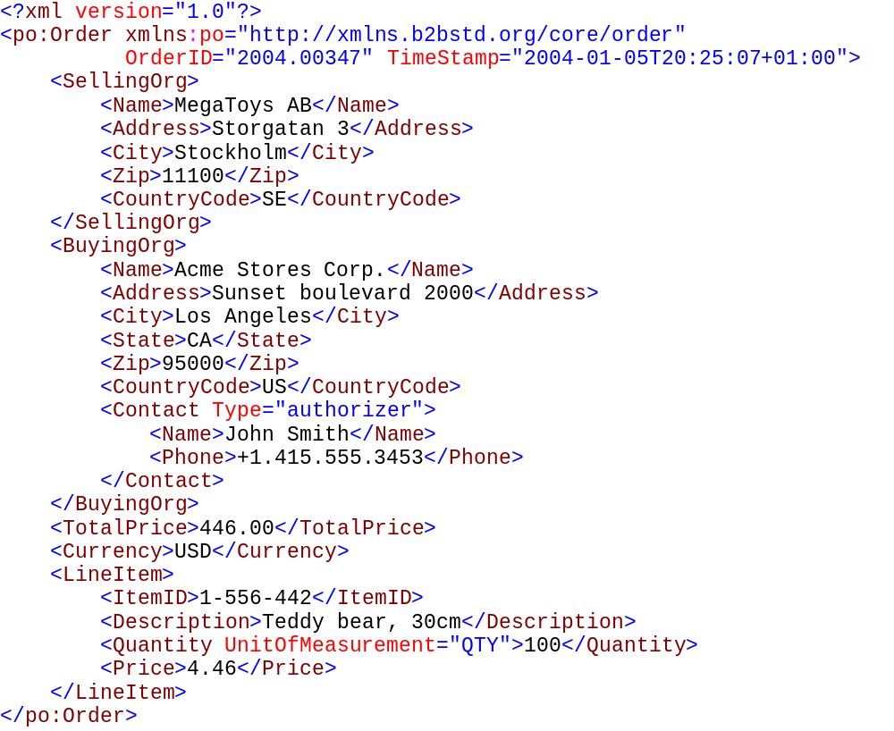
The computer’s view of the same transaction…

Slide 4
So how do you combine these views in a signature enabled application?
User View
+
Computer View
Solution 1: combine the views at the information system layer only (loose/non-cryptographic binding)
Signature
process
Verify signature (accept)
Create computer view
Save computer view
Save signed user view
linked to the computer view
U
C
This scheme assumes that the computer view is what an eventual receiver is interested in, not what the (to them maybe unknown) user did. Such an arrangement is applicable to for example B2B purchasing where order authorization for all but unusual or high-value orders, is supposed to be handled within the purchasing organization. How the computer view is secured when sent outside of the enterprise is not a part of this application note but an organizational “stamp” signature is always an option. Note that the scenario above may often be the only way to add signatures to existing processes due to a legitimate wish to create order IDs only for committed and authorized orders. Otherwise there may be “holes” in the sequence of order IDs.

Slide 5
Solution 2a: Sign the user view as well as a hash of the computer view
Create a hash of
the computer view
C
+
Signature process
U
“Composite” signature
This scheme binds the two different objects cryptographically together which may at first sight seem ideal but also puts restrictions on the computer view as it must be created in whole, before the signature can be applied. Note that the computer view is not downloaded to the signing user (as it can’t make any use of it), only the pre-calculated hash.
Due to the fact that the hashes of the user view and the computer view appear as as two separate objects in a signature, an external receiver can verify the signature with respect to the computer view without necessarily having the user view.
A variation (2b) on the basic theme is shown on the next slide where only the elements of the computer view that has a direct counterpart in the user view is actually hashed and subject to signing.

Slide 6
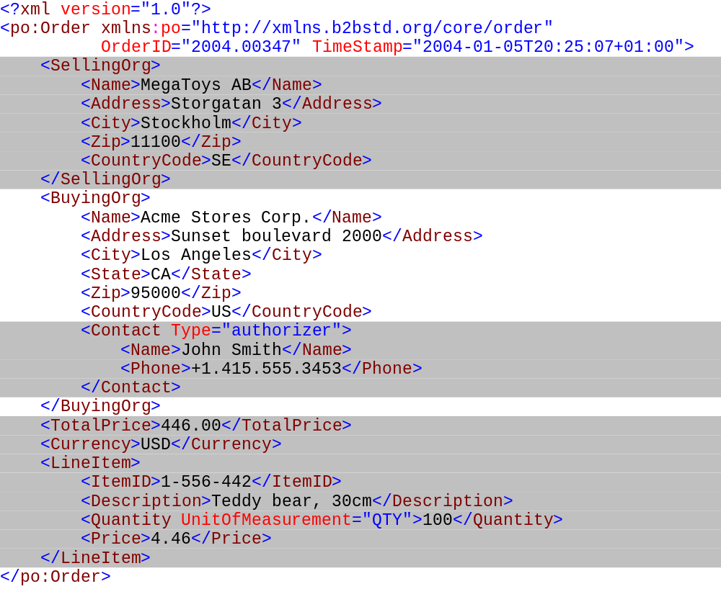
Solution 2b: Sign the user view as well as a hash of the pieces of the computer view that matches the user view

