Slide 1



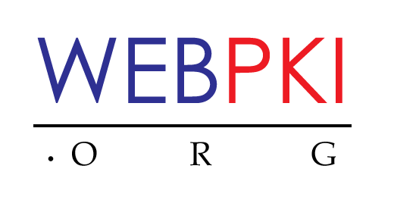
SKS – Secure Key Store
KeyGen2 –Token Provisioning Protocol
Executive Level Presentation

Slide 2
The Token Enrollment Enigma
Certificate Enrollment
Cryptographic APIs
Enrollment Using Browsers
CMP
JCE
<keygen>
SCEP
PKCS #11
“CertEnroll”
CMC
CryptoAPI
Smart Card Standards
Smart Card Middleware
“MiniDriver”
GlobalPlatform
PKCS #15
PIV
OpenSC
EMV
ISO7816
ICCD
SIM
JavaCard
CCID
PKCS #11
.NET Card
Token Containers
Mobile Devices
Discrete Smart Cards
Networked Devices
Other Requirements
End-To-End Security
PIN Deployment
Etc.
Non-PKI Credentials
OTP “Seeds”
Information Cards
Etc.
Q: How can you make this work?
A: By using tons of time, money and professional services!
There simply must be a better way…

Slide 3


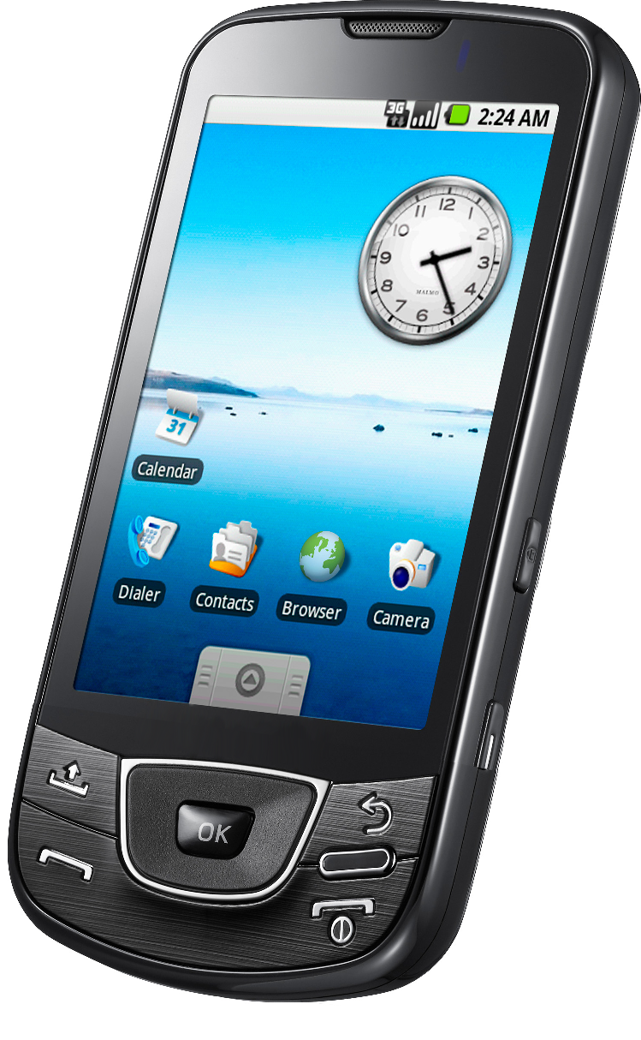
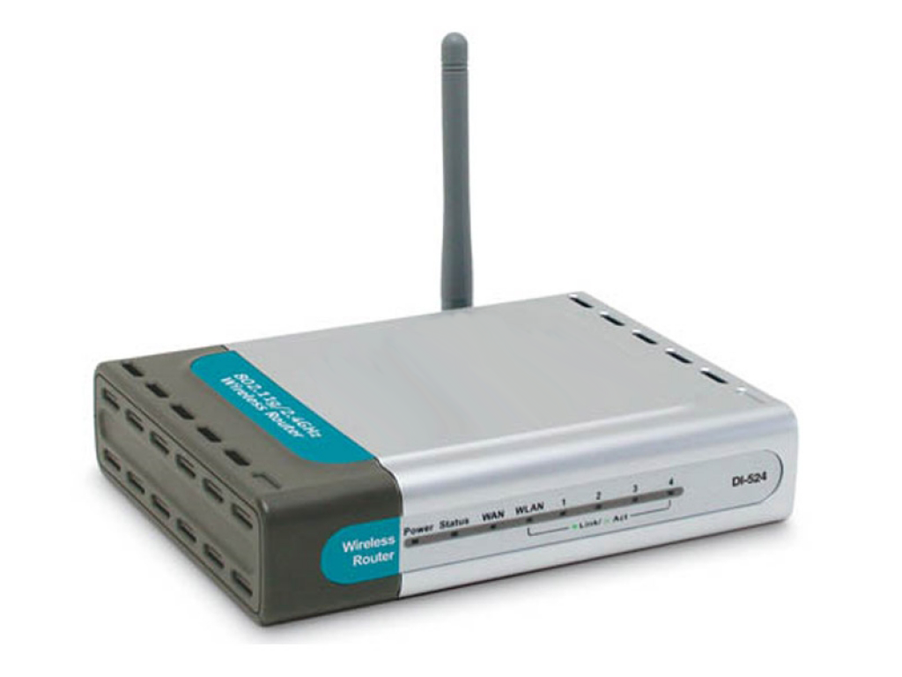
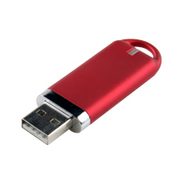
Unified Token Provisioning
Issuer (CA)
KeyGen2 – Token Provisioning Protocol
Enhanced mobile device with
embedded SKS-compliant
security hardware
SKS-compliant smart card
or USB memory stick
SKS-compliant networked device (router, switch, etc.)
Security tokens come in many “form factors”

Slide 4


Universal Authentication Technology Support
PKI (Public Key Infrastructure)
The current gold standard for strong authentication
OTP (One Time Password)
Excellent alternative to static passwords for accessing
moderately critical services from arbitrary computers
560241
Information Cards
Powerful way dealing with federated logins by for example providing the attributes (claims) required for accessing a resource rather than the user’s identity
Why select when you can have them all using a single enrollment process?

Slide 5

• Compatible with Existing Applications
• Dedicated Provisioning Scheme
Issuer (CA)
Applications Using Cryptographic Keys
KeyGen2
End-To-End Security (E2ES)
protocol where the issuer and
the SKS exploit a cooperatively
created shared secret
JCE (Java)
CryptoAPI
PKCS #11
Provisioning Proxy
SKS Native API
Networking
XML Processing
Content Aggregation
User Interaction
SKS - Secure Key Store
Device
Certificate
Attestation
Private Key
Credential
Database
Crypto
Engine
Embedded or
Connected Device
Client Platform

Slide 6
For more information….
http://webpki.org/auth-token-4-the-cloud.html
The separation between authentication and payment solutions is only due to historical reasons, using SKS “a key is a key” ☺
V0.53, Anders Rundgren, 2011-10-15

