Slide 1
WASP - Web Activated Signature Protocol
A “Web Sign” standards proposal
Anders Rundgren, anders.rundgren@telia.com
Background: Currently e-government C2G services and online banks rely on proprietary schemes for on-line signatures. A major reason for this is that there is no standard for this particular task in spite of the fact that the original EU signature directive was issued back in 1999. This “standards deficit” leads to high costs, platform dependencies, limited interoperability, and is indeed thwarting major rollout of online signatures. WASP, a general-purpose on-line signature standards proposal, represents an attempt to solve this problem. The long-term goal is that on-line signatures should be supported by browsers in the same way as S/MIME is supported by e-mail clients (=built-in).

Slide 2
What is Web Signing?
A secure data input application in which the user signs and optionally also encrypts “live” form data
OR
A secure “sign-off” utility for augmenting interactive web applications and processes
WASP adheres to the latter definition which is also
the foundation for the various national and proprietary
Web Signing schemes, currently used by millions of people in the EU

Slide 3
What does Web Signing offer?
An integrated web browser process combining:
A unified “acceptance and signing procedure”
A “user view” of a document or transaction request
Strong authentication of the user
and then binding these things together by the use of cryptography, giving a persistent stamp of authenticity
Web Signing is ≈ “OK-buttons on steroids” ☺

Slide 4
Primary application space for Web Signing
e-Governments (C2G): Tax declarations, Permit applications, Confirmed mail, Company registrations, etc.
Enterprises: Purchase applications, Expense declarations, General authorizations, etc.
Consumer banking: On-line banking, 3D Secure payments, Loan applications, etc.
e-Health: Doctor appointments, e-Prescriptions, Role assignments, etc.
It is actually incorrect talking about “primary” applications as essentially all web applications requiring some kind of authorization and strong user authentication, are candidates for using Web Signing. The #1 application may indeed long-term turn out to be for local payments using mobile phones and 3D Secure-like protocols.

Slide 5
Why not use secure e-mail (S/MIME) instead?
(which unlike Web Signing in fact already is standardized)
E-mail is static and non-interactive making it awkward to use except for sender-initiated messaging
Form template distribution (e.g. Excel files), and form data validation is hard to do using e-mail, while being an integral part of a web application
Last but not least, S/MIME encryption has proved to be
non-workable on a wider scale for a multitude of reasons including: 1) Limited interest by organizations and individuals in “publishing” certificates. 2) Encryption key handling by novice users. SSL/HTTPS has therefore become the de-facto standard for creating encrypted channels between a user and a server

Slide 6
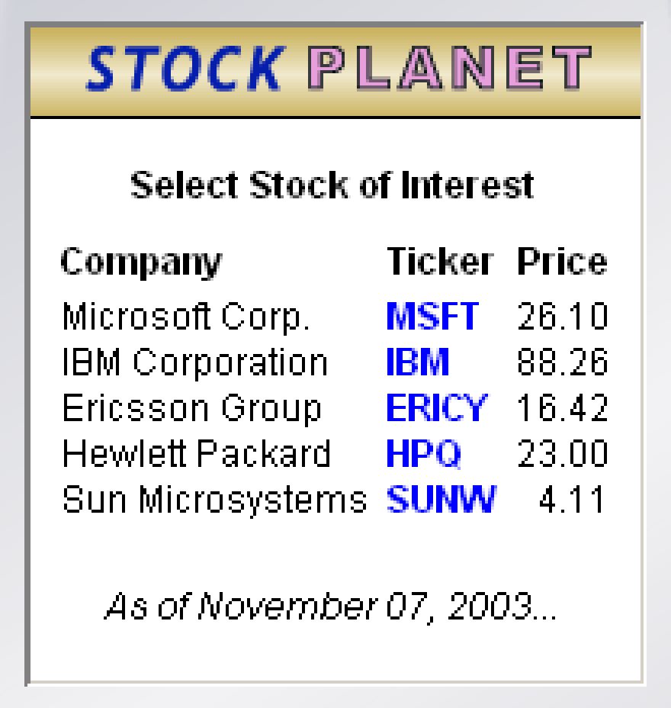
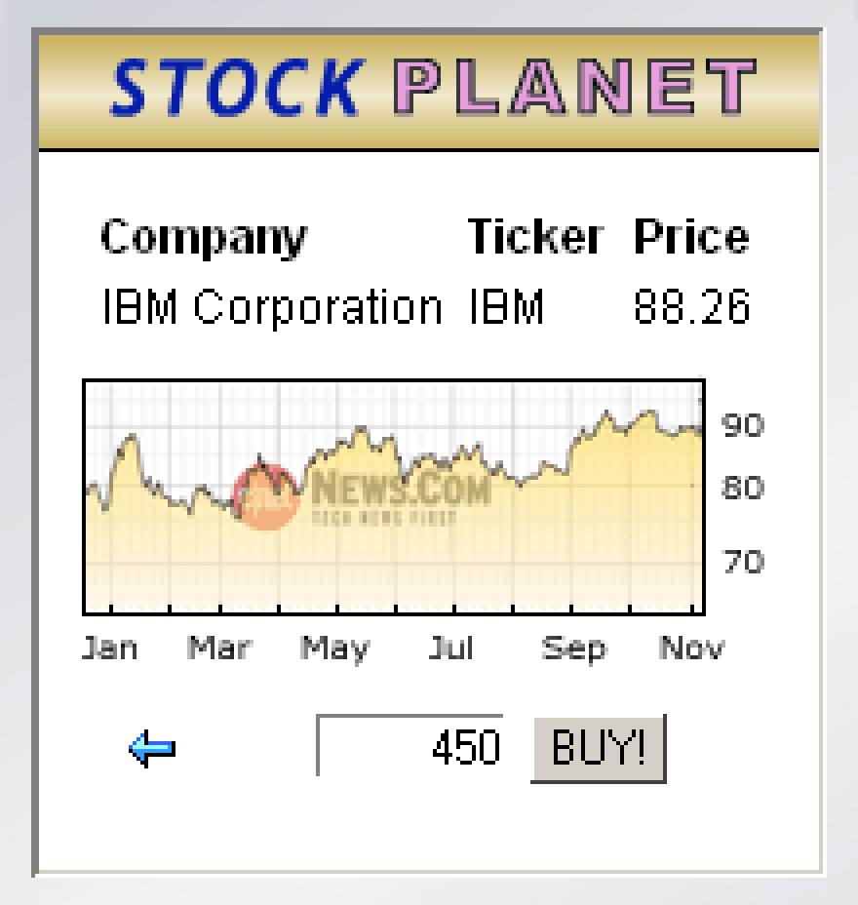
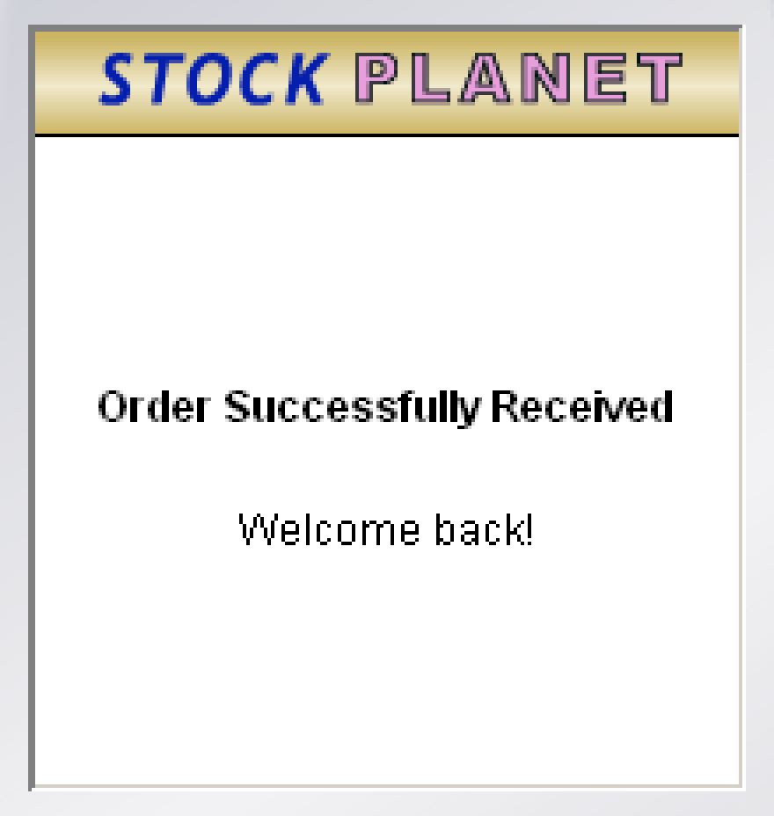
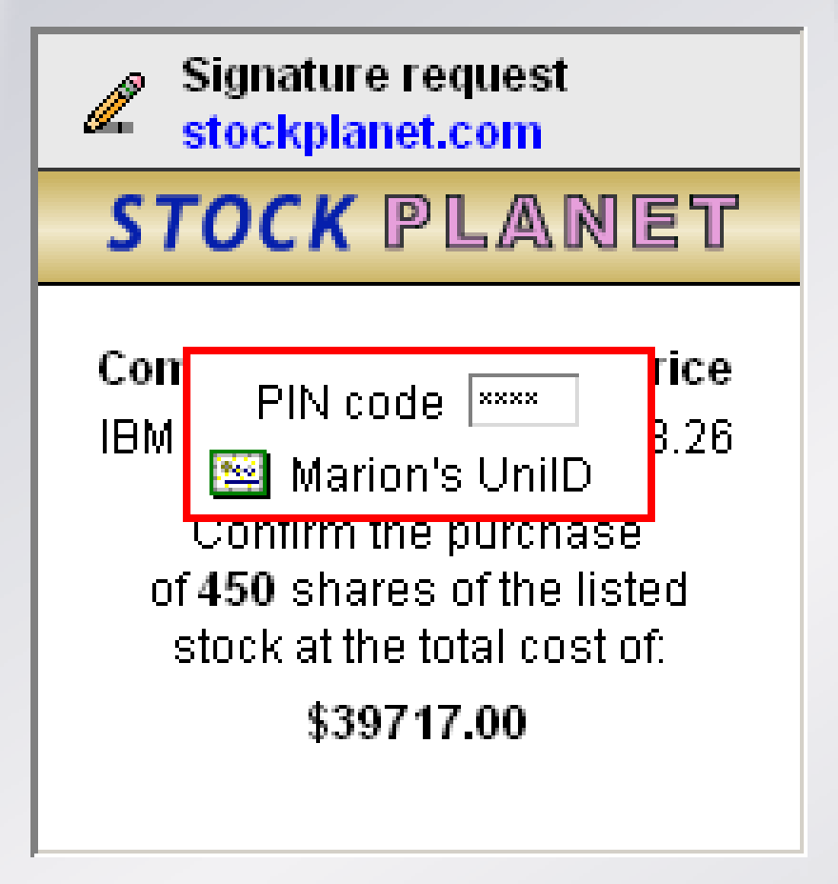
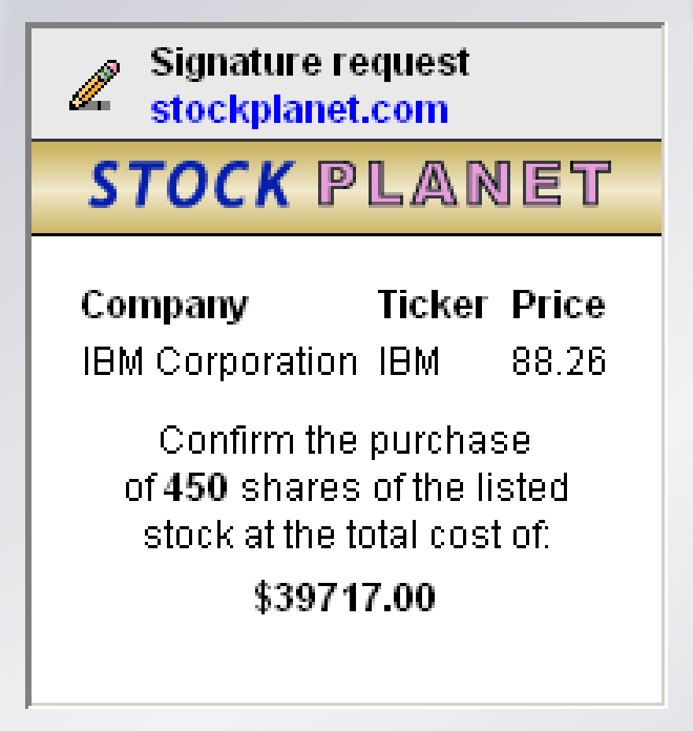
WASP Demo…

Slide 7


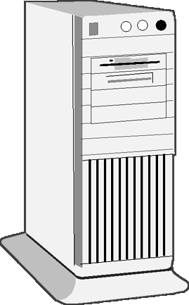
WASP - Protocol State Diagram: Initiation
Local crypto support (API)
User with WASP-
enhanced browser
Web Service
HTTP GET or POST
T0
The user accesses a URL
requiring a “sign-off” operation
SignatureRequest
T1
The service responds with
a SignatureRequest
object containing one or more
document objects to be signed.
Before the response is returned
to the user, a hash is calculated
for each document object.
The hash values are saved as a
part of the current web “session”.

Slide 8
WASP - Protocol State Diagram: T1 Close-up
Signature request
control object in XML
SignatureRequest
Calculate document hashes
and save the hash values in
the current web session
Main “user view” document in HTML, TXT, PDF, JPEG etc.
Pay $2350 to
XYZ computers?
76FrDwwWWkloF45GnLSfk
kl95d6664scGlO9643Jd6DD
3dEEhje579k9769996gd324
Optional attachments and embedded document objects (e.g. images and style sheets).

Slide 9
WASP - Protocol State Diagram: T1 Close-up (continued)
SignatureRequest
+
Pay $2350 to
XYZ computers?
Return the composite object to the user’s browser using a WASP-specific MIME-type to “trigger” the browser
+
Optional hashes
of associated
“real” transaction data
(see slide 15)

Slide 10
WASP - Protocol State Diagram: Signature request alert
Local crypto support (API)
User with WASP-
enhanced browser
Web Service
T2
The browser activates the WASP
signature dialog (holding the
“user view”), when the WASP-
specific MIME trigger type is
encountered.
The exact GUI is dependent on
the device and operating system,
but three components are
mandatory:
1) Signature request alert
2) The main document view
3) Cancel/OK buttons (or similar)
www.mybank.com
Pay $2350 to
XYZ computers?
Cancel
OK

Slide 11
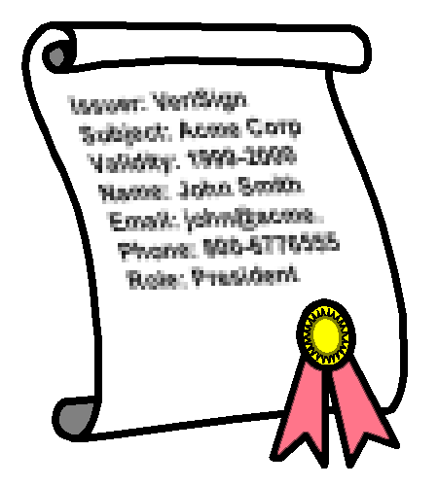
WASP - Protocol State Diagram: Signature accept
Local crypto support (API)
User with WASP-
enhanced browser
Web Service
T3
After clicking OK (or similar), the
user is requested to select
signature certificate* and to key
in the associated signature PIN
code.
*) this may be pre-selected since
the signature requesting service
can define signer certificate “filter”
parameters.
Signature PIN code:
• • • • • •
Digital certificate:

Marion’s ID
Cancel
OK

Slide 12

WASP - Protocol State Diagram: Signature creation and return
Local crypto support (API)
User with WASP-
enhanced browser
Web Service
T4
After the user has clicked OK
(or similar), the system creates a
SignatureResponse
object and subsequently sends it
back to the requesting service
using a standard HTTP POST.
The SignatureResponse
object is essentially a signed
container holding the header*
of the received
SignatureRequest object
and the locally calculated hashes
of the associated documents.
*) the format is also dependent
on selected signature profile.
PIN + Data to sign
Raw RSA signature
SignatureResponse
T5
Signature validation by the service

Slide 13
WASP - Protocol State Diagram: T5 close-up
SignatureResponse
Signed container
of locally calculated
hashes of received
documents
Compare the received hashes with the hashes saved in the current web session. If there is a mismatch the user has apparently not received the proper data to “sign-off”
Verify the integrity of the signature itself
Perform path validation on the signer certificate
Look-up signer certificate status
If any of these tests fail, the signature should be rejected, and the user be notified in the confirmation phase (T6) of the signature process.

Slide 14
WASP - Protocol State Diagram: Confirmation
Local crypto support (API)
User with WASP-
enhanced browser
Web Service
Standard HTTP response
T6
When the signature requester has
validated the received signature,
it responds the result back to the
user in a service-defined way.
That is, only the
SignatureRequest
and the SignatureResponse
messages are subject to
standardization in the WASP
scheme.
Thank you.
The payment has been
successfully performed!

Slide 15
Optional: Binding a user view to an internal computer view
User view (U) typically in
HTML, PDF, etc
Computer view (C), not interpretable by a user.
Typically an XML, SQL, or serialized Java object
Pay $2350 to
XYZ computers?
<Payment>
<To account=″5654″>XYZ Computers</To>
<From account=″3421″>Bob Smith</From>
<Amount currency=″USD″>2350</Amount>
</Payment>
C
C
U
U
Saved in the
web session
Hash()
SignatureRequest
Hash()
H(C)
H(U)
U
Signature process
(performed in the browser)
C
Compare during validation
Hash()
Hash()
H(U)
SignatureResponse
H(C)
Signed container with separate
H(U) and H(C) entries (and more…)

Slide 16
Optional: Binding a user view to an external computer view
User view (U) typically in
HTML, PDF, etc
Computer view (C), not interpretable by a user.
Typically an XML, SQL, or serialized Java object
Pay $2350 to
XYZ computers?
<Payment>
<To account=″5654″>XYZ Computers</To>
<From account=″3421″>Bob Smith</From>
<Amount currency=″USD″>2350</Amount>
</Payment>
C
U
U
H(C)
Hash()
Saved in the
web session
Hash()
SignatureRequest
H(C)
H(U)
U
Signature process
(performed in the browser)
Compare during validation
Hash()
H(C)
H(U)
SignatureResponse
Signed container with separate
H(U) and H(C) entries (and more…)

Slide 17
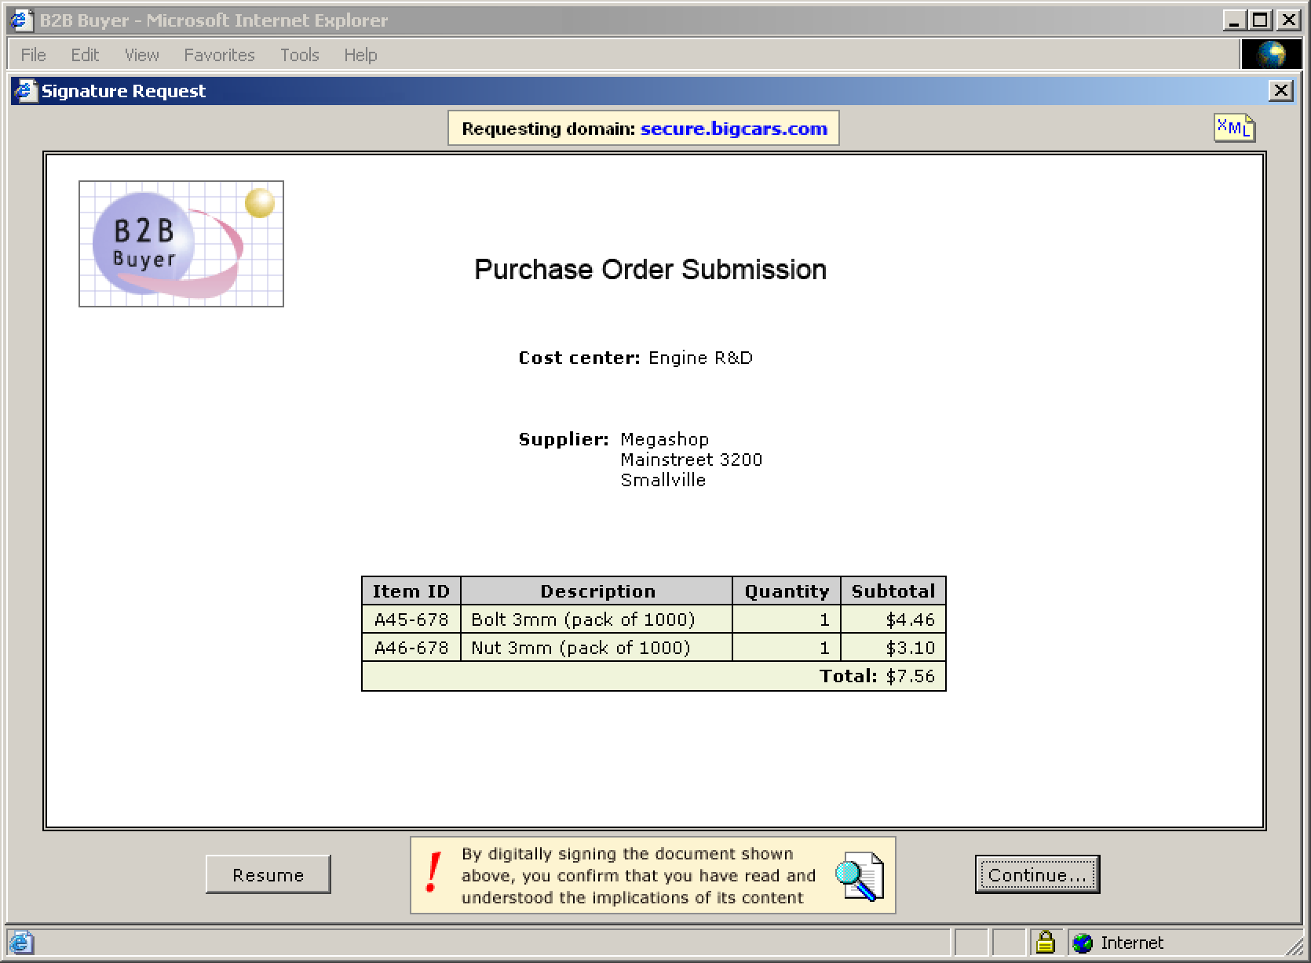

Device & OS characteristics affect GUIs (but not the protocol)

Slide 18
WASP signature storage/format: Two basic options
Minimum
Full
Signed object
.
Document: Hash, Metadata
.
.
Container object
Signed object
.
Document: Hash, Metadata
.
.
The minimum storage model is suitable when the data objects associated by the signature can be restored by external data linked to the signature. Due to versioning issues regarding both viewable content as well as underlying transaction data, this model requires more planning than the full model but can also reduce storage requirements considerably.
The full storage model is intended for signatures that are to be transported outside of the original environment, or when there is no easy way to recreate signature data.
Link
.
Document: Data
.
Signed data

Slide 19
Additional issues addressed by the WASP standards proposal
Operating system independence. WASP only relies on standard web technologies such as XML, MIME and X.509
Device independence. WASP is designed to run on smartphones to workstations
Document format independence. Signs any browser-viewable media like TXT, HTML, JPEG, MS-Word, Adobe-PDF, etc., as well as attachments in arbitrary formats
Unified signature procedure. WASP unifies on-line signature procedures in the same way as is already the case for signed e-mail
Multiple signature formats. WASP supports XML DSig and ETSI’s XAdES (specifiable by the signature requester)
What you see is what you sign (WYSIWYS). In harmony with legal and user requirements
Thin client design. WASP adheres to the web paradigm. A browser distribution would be about 100K bigger in order to support WASP

Slide 20
The WASP “unsupported” page ☹ ⇨ 😐 ⇨ ☺
Explicit message encryption
Signing “live” form data
Signature validation
Multiple signatures
Signature client API scripting
RATIONALE: Although these shortcomings may appear unbearable, the items listed (except scripting), are already fully supported by existing web technology and would not gain by being “reinvented” for this particular purpose. On the contrary, the things above taken together would make it considerably harder to create a true standard as the complexity would increase by a magnitude as well as forcing such a scheme into document-specific signature formats like featured in PDF.
Explicit message encryption indicates that the web application neither is the actual recipient, nor is trusted, but then you are very close to e-mail-like functionality, which a Web Sign standard-to-be should not need to duplicate. HTTPS already offers mutual encryption at no extra cost.
Supporting “live” form data would constrain format independence while also being redundant, since form input preferable is performed (and validated) before entering any kind of “sign-off” procedure. This is also the de-facto standard way of handling such scenarios on the web.
A major reason for not supporting signature validation and multiple signatures (at the client level NB), is that these features add nothing but hassles for users who may have to process certificate paths from unknown PKIs as well as dealing with expired certificates. This seems to be a job tailored for the web server application, including returning signature data in a user-interpretable manner.
The reason for leaving out client scripting is that scripting would effectively disable a well-defined signature GUI and process, require additional server roundtrips, as well as impeding document format independence.

