Slide 1
Digital Portfolio
STUDENT NAME:
REGISTER NO AND NMID:
DEPARTMENT:
COLLEGE: COLLEGE/ UNIVERSITY
NAVEEN KUMAR .S
2426j1529 /asbruaz2426j1529
B.Sc information technology
KPR college of atrs science and research /Bharathiyar University

Slide 2
PROJECT TITLE

Slide 3


AGENDA
Problem Statement
Project Overview
End Users
Tools and Technologies
Portfolio design and Layout
Features and Functionality
Results and Screenshots
Conclusion
Github Link
3/21/2024 Annual Review

Slide 4

PROBLEM STATEMENT
In today’s competitive environment, traditional static portfolios fail to fully showcase an individual’s skills, experience, and personality. Recruiters and potential collaborators often have to navigate lengthy resumes or portfolio websites to extract relevant information. This makes the process time-consuming and less engaging.There is a need for an interactive and intelligent portfolio system that allows users to quickly access personalized information about the individual through natural conversation. By integrating a chatbot powered by AI or a simple FAQ script, the portfolio can provide instant answers to questions such as skills, projects, achievements, and career goals, making it more engaging, efficient, and user-friendly compared to conventional portfolios.

Slide 5

PROJECT OVERVIEW
This project aims to develop an AI-Powered Portfolio integrated with a chatbot that provides interactive responses about the portfolio owner. Instead of going through a static resume or portfolio, users can directly ask the chatbot about skills, projects, education, achievements, and contact details, and receive instant answers.The chatbot will be built using simple AI or FAQ-based scripts, making the portfolio more dynamic, engaging, and easy to navigate. This approach not only improves user experience but also demonstrates the creator’s knowledge in AI, web development, and personal branding, giving a modern touch to traditional portfolios.

Slide 6
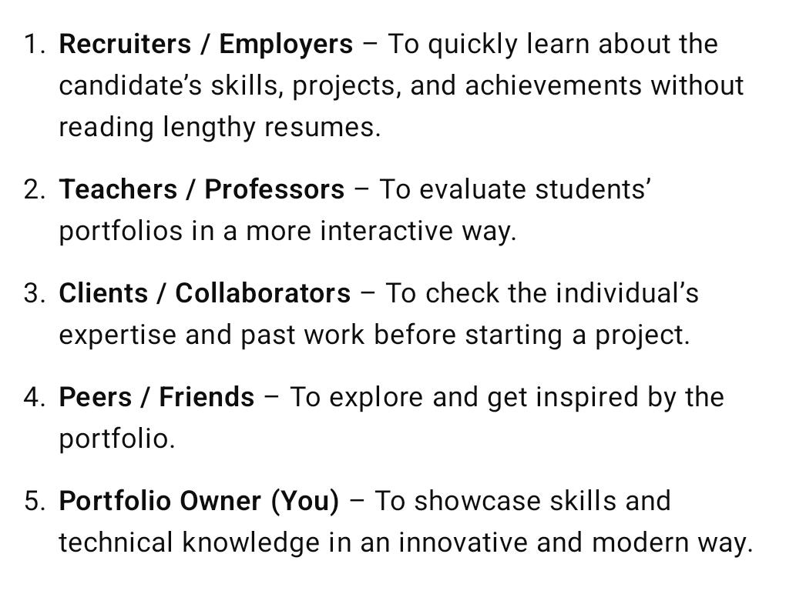

WHO ARE THE END USERS?

Slide 7
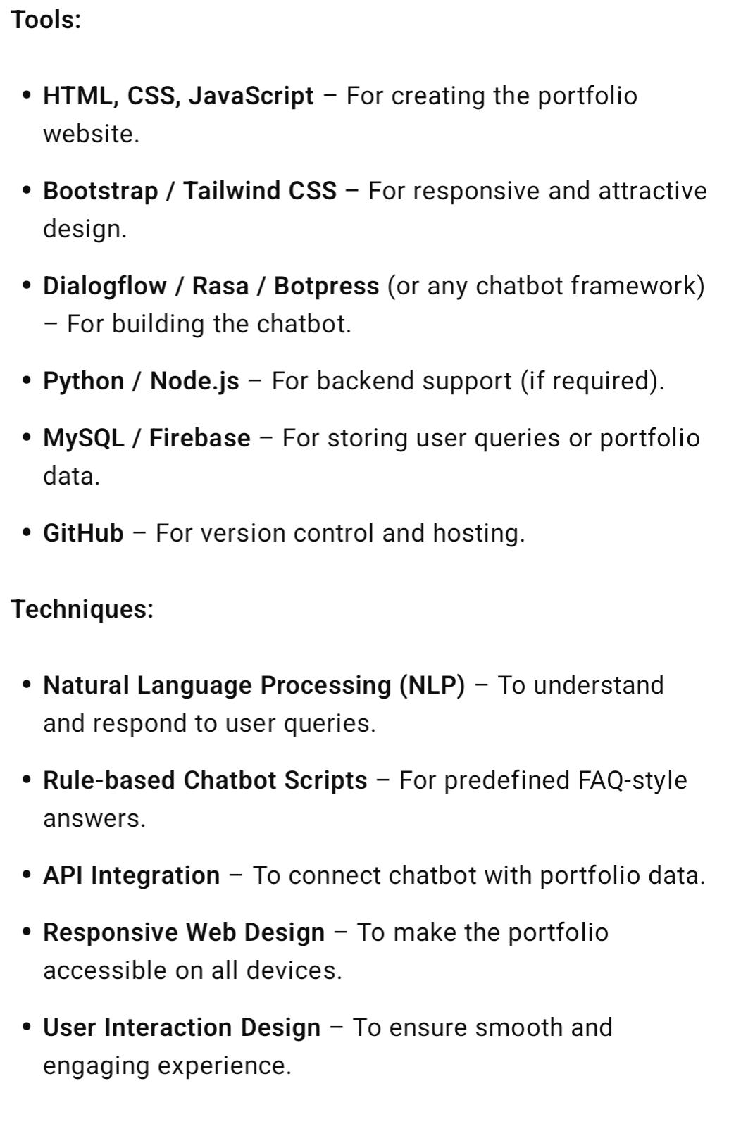
TOOLS AND TECHNIQUES

Slide 8
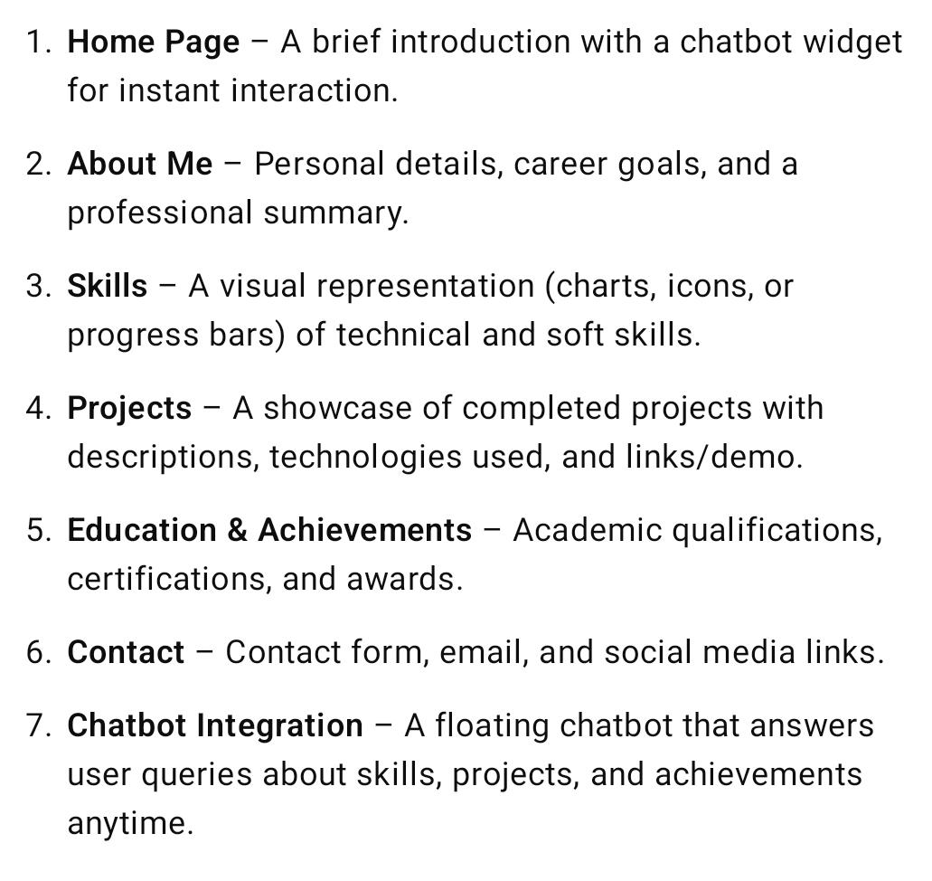
POTFOLIO DESIGN AND LAYOUT
8

Slide 9
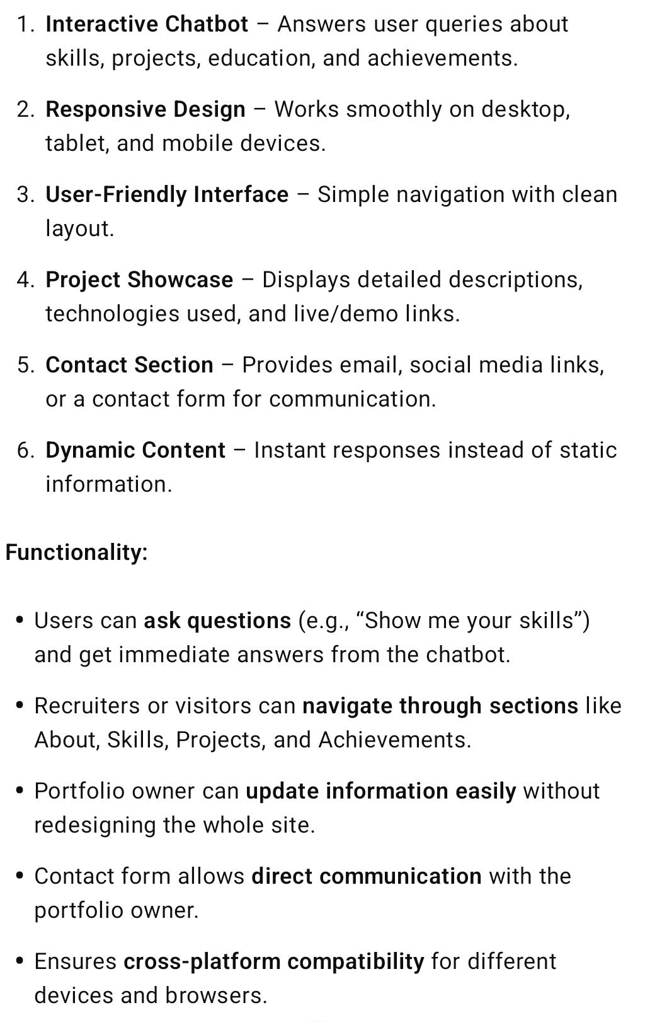
FEATURES AND FUNCTIONALITY

Slide 10
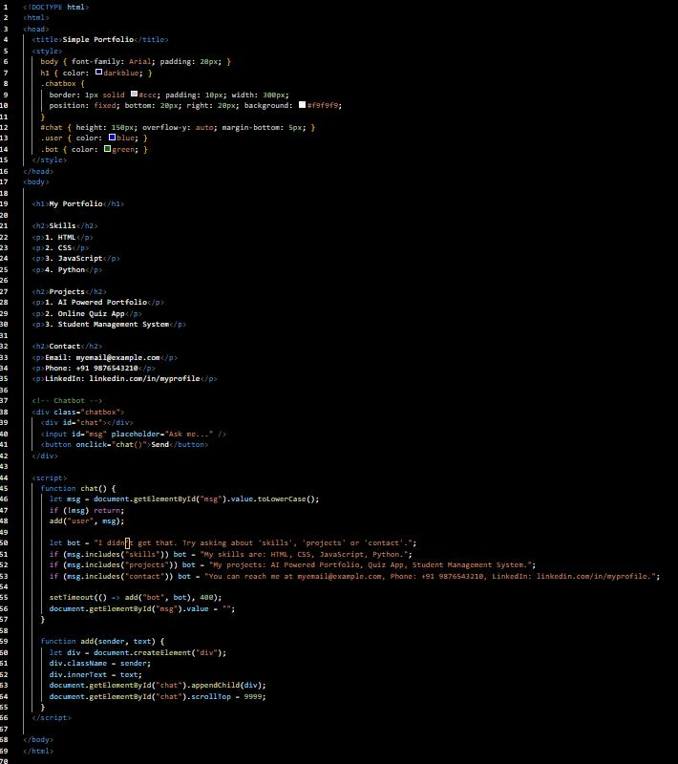
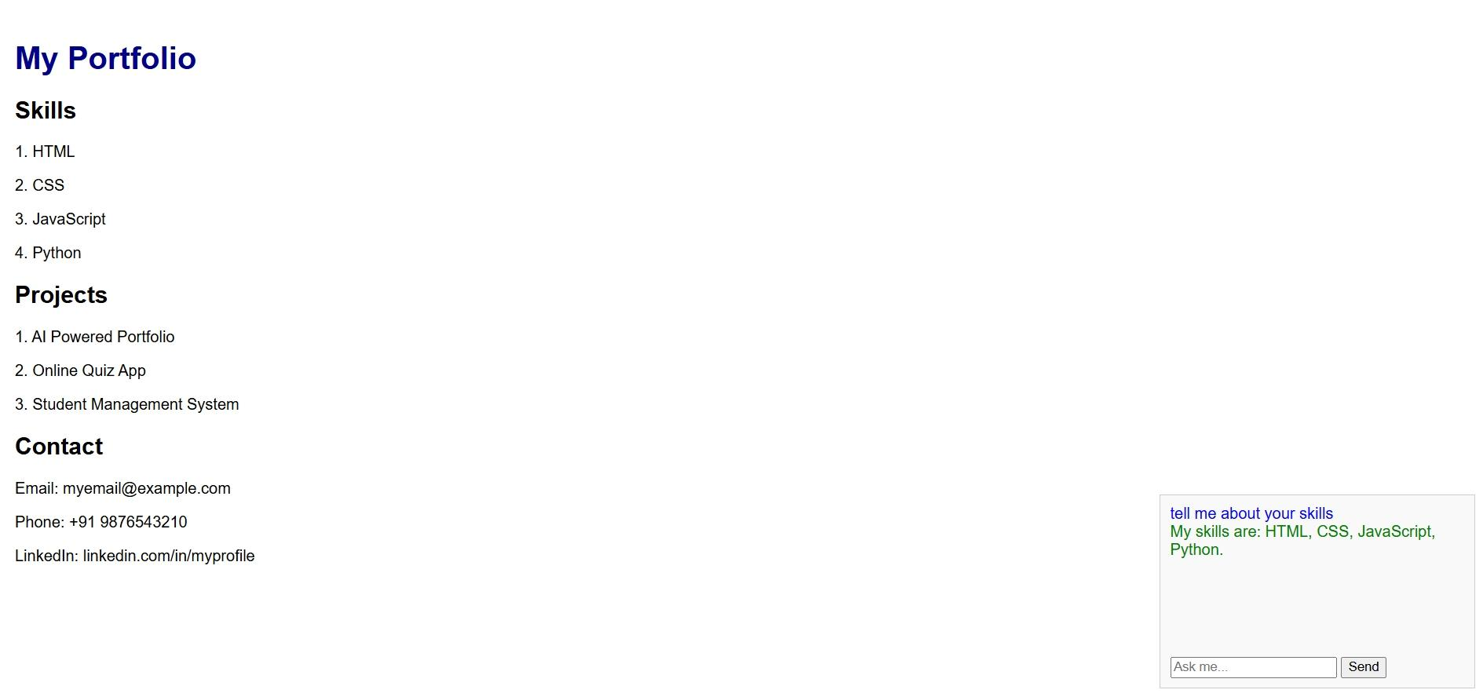
RESULTS AND SCREENSHOTS
3/21/2024 Annual Review
10

Slide 11
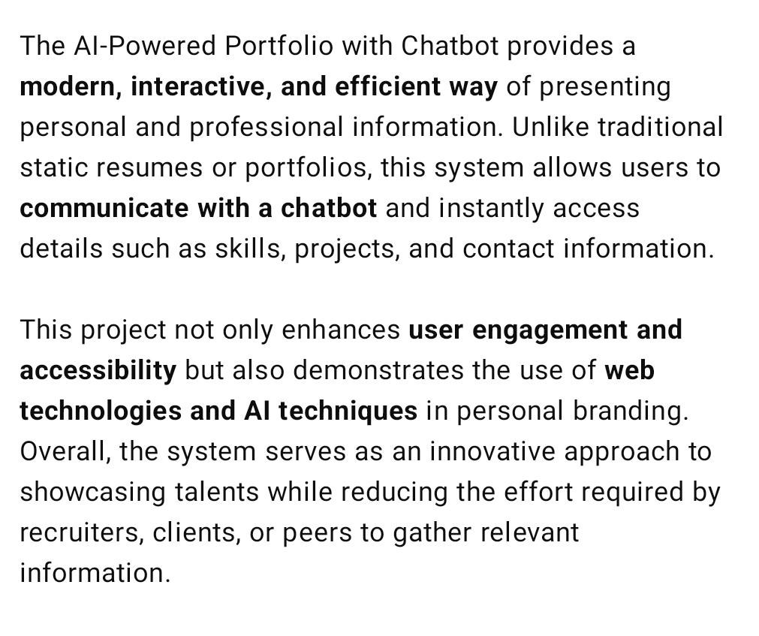
CONCLUSION
https://cyberpunk-nk.github.io/Naveen/
11

