Slide 1
INDIVIDUAL CYBER SECURITY PROJECT
TEXT ENCRYPTION
& DECRYPTION TOOL
🔐
SECURE
YOUR TEXT
A Python-based application to protect text using cryptography
Presented by: Rahul Kumar
Course: Cyber Security

Slide 2
Project Overview
What the application does
A simple command-line application developed in Python.
Demonstrates encryption (hiding readable text) and decryption (recovering it).
Includes two methods: Caesar Cipher and Fernet encryption.
Can save Fernet encrypted output in a text file.
Built as an individual Cyber Security learning project.
RAHUL KUMAR | CYBER SECURITY PROJECT
2

Slide 3
Why Is This Project Needed?
Problem statement
Sensitive information may include private messages, passwords and personal notes.
Plain text can be read directly if an unauthorised person gains access.
Encryption transforms readable text into ciphertext.
Only someone with the correct method and secret key can recover protected content.
Encryption is one important part of a wider cyber security strategy.
RAHUL KUMAR | CYBER SECURITY PROJECT
3

Slide 4
Real-World Cyber Security Connection
How cryptography helps defend information
Attackers may try to observe network traffic in a Man-in-the-Middle attack.
If information is sent without protection, it may be readable to an attacker.
Encrypted data is not directly understandable without the required key.
Real secure communication also needs authentication, trusted protocols and endpoint security.
This project demonstrates the encryption concept locally; it is not a network messaging system.
RAHUL KUMAR | CYBER SECURITY PROJECT
4

Slide 5
Basic Cryptography Terms
The main concepts used in this project
Plaintext
Original readable message
Ciphertext
Encrypted, unreadable representation
Encryption
Converts plaintext into ciphertext
Decryption
Restores ciphertext to plaintext
Secret key
Required to decrypt Fernet-protected data
RAHUL KUMAR | CYBER SECURITY PROJECT
5

Slide 6
Encryption Methods Used
The project compares a basic cipher with a modern library-based method
Caesar Cipher
Fernet Encryption
Classical substitution cipher
Authenticated symmetric encryption
• Shifts alphabetic letters by a fixed number
• Uses a secret key stored in key.key
• Punctuation and digits remain unchanged
• Encrypts and authenticates the message
• Easy to understand, but very weak
• Suitable for demonstrating modern cryptography
RAHUL KUMAR | CYBER SECURITY PROJECT
6

Slide 7
Caesar Cipher – Working Example
A shift value moves letters through the alphabet
Encryption: E(x) = (x + k) mod 26
Decryption: D(x) = (x − k) mod 26
IMPORTANT
Example: HELLO → KHOOR (shift 3)
Caesar Cipher is for learning only. It is not secure enough for real passwords or confidential messages.
In the supplied test, Rahul!@#$% with shift 15 becomes Gpwja!@#$%. Punctuation remains unchanged.
RAHUL KUMAR | CYBER SECURITY PROJECT
7

Slide 8
Fernet Encryption – Working
Modern authenticated symmetric encryption
Fernet is provided by the Python cryptography package.
A secret key is generated once and saved in key.key.
The message is encoded into bytes before encryption.
Fernet encrypts and authenticates the data, producing a token.
The same key is used to decrypt the token and recover the original text.
The token can be saved in encrypted.txt for later use.
RAHUL KUMAR | CYBER SECURITY PROJECT
8

Slide 9
Technology Stack
Tools and files used to build and run the project
Python 3
Main programming language
cryptography
Provides the Fernet API
Visual Studio Code
Code editor and integrated terminal
key.key
Stores the Fernet secret key
encrypted.txt
Stores encrypted output
Install dependency: python -m pip install cryptography
RAHUL KUMAR | CYBER SECURITY PROJECT
9

Slide 10
Program Logic / Flow
Input → Select method → Encrypt → Decrypt → Display / Save
1
→
2
→
3
→
4
→
5
Enter message
Choose method
Apply cipher
Recover original
Display result
Fernet mode also loads key.key and saves the encrypted token to encrypted.txt.
RAHUL KUMAR | CYBER SECURITY PROJECT
10

Slide 11
Python Code – Main Operations
Simplified view of the core Fernet logic
from cryptography.fernet import Fernet
key = Fernet.generate_key()
f = Fernet(key)
message = "Hello Rahul"
encrypted = f.encrypt(message.encode())
decrypted = f.decrypt(encrypted).decode()
print("Encrypted:", encrypted)
print("Decrypted:", decrypted)
In the actual project, the key is saved in key.key and reused. This is necessary to decrypt previously created tokens in future runs.
RAHUL KUMAR | CYBER SECURITY PROJECT
11

Slide 12
Testing and Results
Observed results from the project screenshots
Caesar test: input Rahul!@#$%, shift 15 → output Gpwja!@#$%.
Caesar decryption restored the exact original input.
Fernet test: input Rahul#425 → encrypted token generated.
Fernet decryption restored Rahul#425.
The program saved the encrypted token in encrypted.txt.
Both supplied terminal runs completed successfully.
RAHUL KUMAR | CYBER SECURITY PROJECT
12

Slide 13
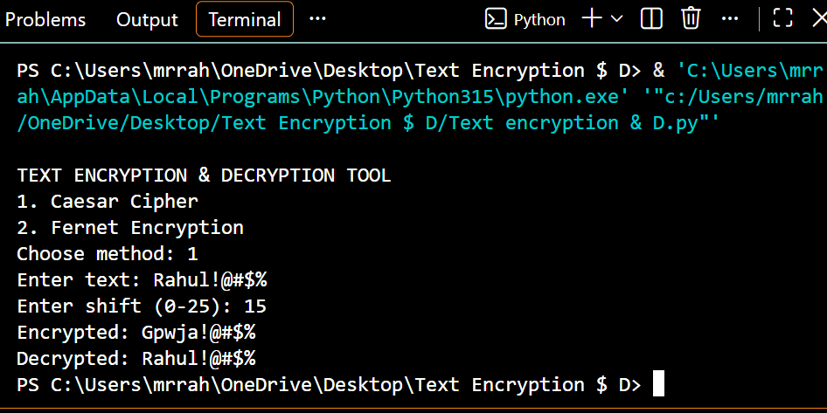
Practical Demo – Caesar Cipher
Original terminal screenshot supplied for the project
RAHUL KUMAR | CYBER SECURITY PROJECT
13

Slide 14
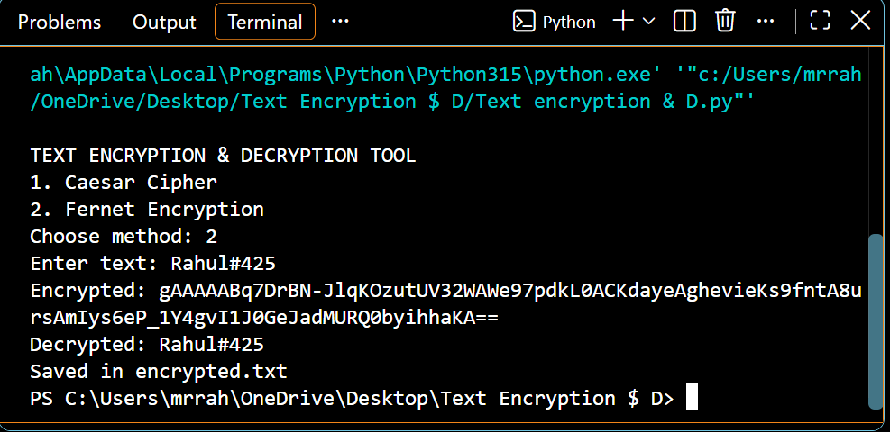
Practical Demo – Fernet Encryption
Original terminal screenshot supplied for the project
RAHUL KUMAR | CYBER SECURITY PROJECT
14

Slide 15
Security Considerations & Limitations
Responsible use of cryptography
Keep key.key private; anyone with the key and token can decrypt the message.
Back up the key securely. If it is lost, old Fernet ciphertext cannot be recovered.
Caesar Cipher is weak and must not protect real sensitive information.
The current project is a local CLI demo, not a complete secure messaging application.
Real-world protection also needs secure devices, access controls and trusted communication protocols.
RAHUL KUMAR | CYBER SECURITY PROJECT
15

Slide 16
Learning Outcomes
Skills gained through the project
Understood plaintext, ciphertext, encryption and decryption.
Compared a weak classical cipher with modern authenticated encryption.
Practised Python functions, loops, conditions and file handling.
Learned to install and use an external Python library.
Understood why secret-key management is essential.
RAHUL KUMAR | CYBER SECURITY PROJECT
16

Slide 17
Conclusion & Future Enhancements
Summary
The project demonstrates two methods of text encryption and decryption.
Both test cases successfully recovered the original message.
Fernet provides stronger protection than Caesar Cipher when the key is kept secure.
Future work: add a separate decrypt option and load ciphertext from a file.
Future work: create a Tkinter GUI and improve input validation and error handling.
RAHUL KUMAR | CYBER SECURITY PROJECT
17

