Slide 1
PASSWORD STRENGTH
CHECKER & GENERATOR
Cyber Security Project | Python CLI Application
Submitted by: Rahul Kumar
Course: Cyber Security
Institution: Future Finder

Slide 2
Project Overview
A simple command-line tool for learning password security
Checks a password using basic complexity rules.
Generates a random password using Python’s secrets module.
Can optionally copy the generated password to the clipboard.
Designed as a beginner-friendly Cyber Security project.
PASSWORD STRENGTH CHECKER & GENERATOR • 02

Slide 3
Problem Statement
Why password quality matters
Short or predictable passwords are easier to guess.
Users may reuse simple passwords across multiple accounts.
People need a quick way to check basic password complexity.
A generator can help create longer, less predictable passwords.
PASSWORD STRENGTH CHECKER & GENERATOR • 03

Slide 4
Objectives
What the project aims to achieve
Classify passwords as WEAK, MEDIUM, or STRONG.
Display a simple complexity score out of 5.
Generate passwords with lowercase, uppercase, digits, and symbols.
Provide a clear and interactive menu in the terminal.
PASSWORD STRENGTH CHECKER & GENERATOR • 04

Slide 5
Technology Stack
Tools and libraries used
Language: Python
string: provides character groups such as letters, digits, and punctuation.
secrets: generates cryptographically stronger random choices.
tkinter: supports optional clipboard copying on compatible systems.
Execution: terminal / command line in Visual Studio Code.
PASSWORD STRENGTH CHECKER & GENERATOR • 05

Slide 6
System Workflow
How the application works
01
Choose option
Check / Generate / Exit
02
Enter input
Password or desired length
03
Process
Evaluate rules or generate
04
Show result
Strength label and score
PASSWORD STRENGTH CHECKER & GENERATOR • 06

Slide 7
Password Strength Rules
Basic educational complexity checks
Length: at least 8 characters.
Lowercase letters: a–z.
Uppercase letters: A–Z.
Digits: 0–9.
Special characters: punctuation / symbols.
Each satisfied rule contributes to the score (maximum 5).
PASSWORD STRENGTH CHECKER & GENERATOR • 07

Slide 8
Password Generation
Using Python’s secrets module
The user selects a password length from 8 to 256 characters.
At least one character is selected from each required character group.
Remaining characters are selected securely at random.
The resulting characters are shuffled before display.
The generated password is then checked by the same strength rules.
PASSWORD STRENGTH CHECKER & GENERATOR • 08

Slide 9
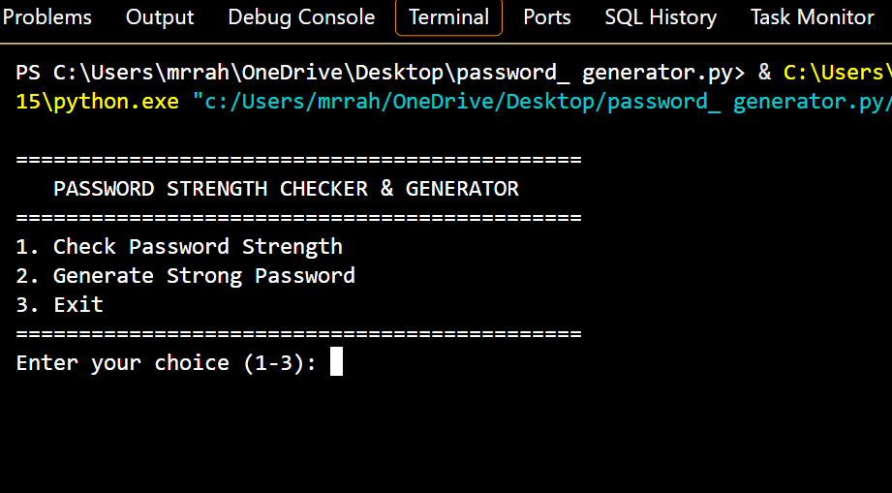
Program Screenshot: Main Menu
Actual terminal screenshot supplied for the project
PASSWORD STRENGTH CHECKER & GENERATOR • 09

Slide 10
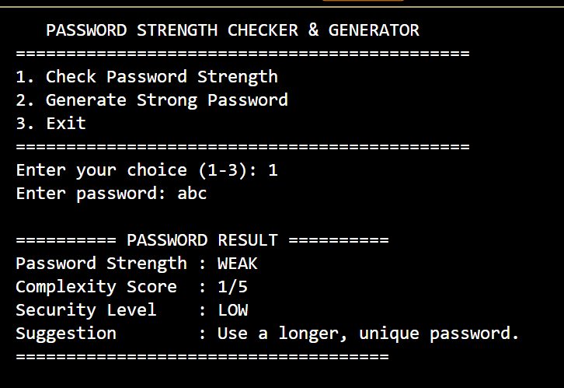
Program Screenshot: Weak Password
Example input: abc — the program reports WEAK
PASSWORD STRENGTH CHECKER & GENERATOR • 10

Slide 11
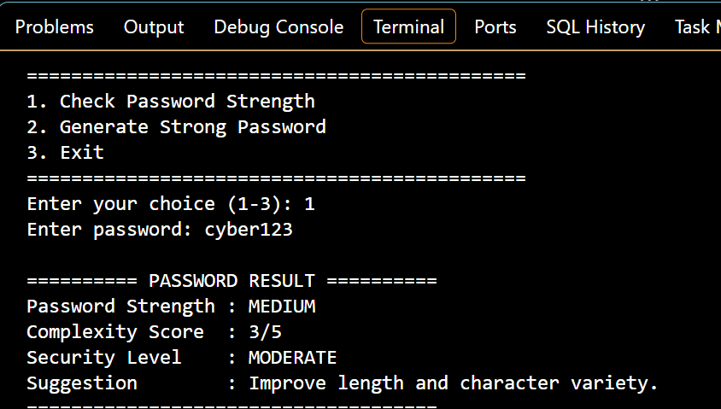
Program Screenshot: Medium Password
Example input: cyber123 — the program reports MEDIUM
PASSWORD STRENGTH CHECKER & GENERATOR • 11

Slide 12
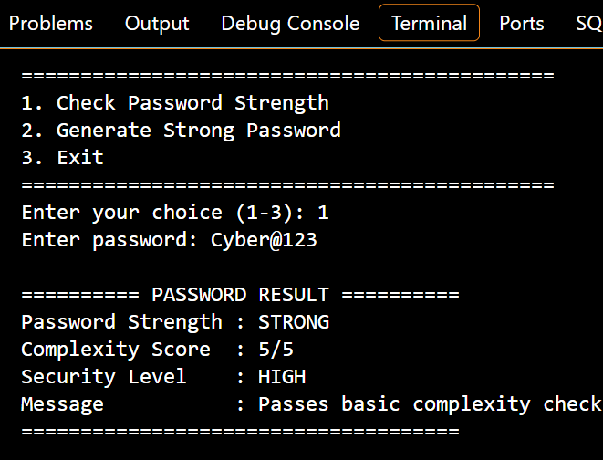
Program Screenshot: Strong Password
Example input: Cyber@123 — the program reports STRONG
PASSWORD STRENGTH CHECKER & GENERATOR • 12

Slide 13
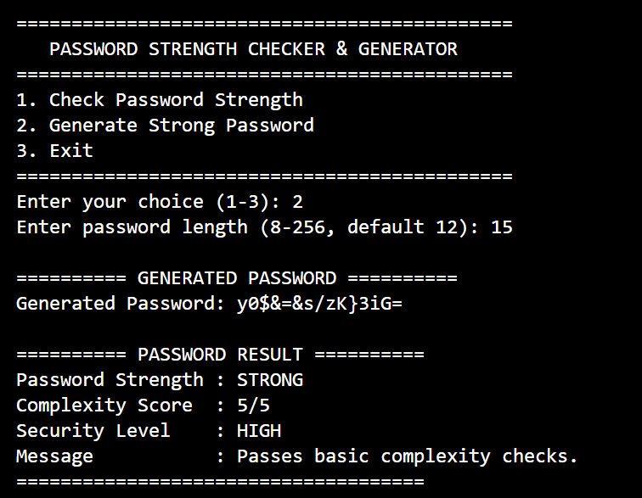
Program Screenshot: Password Generation
Actual generated-password terminal output
PASSWORD STRENGTH CHECKER & GENERATOR • 13

Slide 14
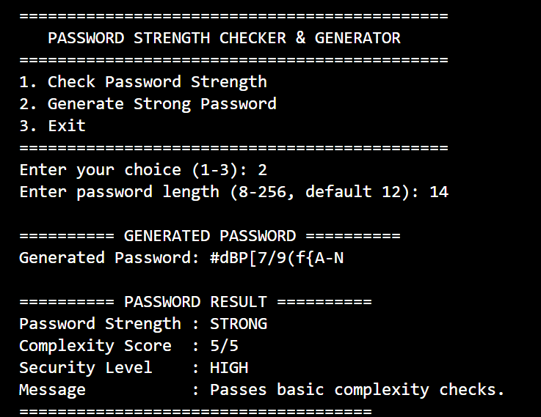
Program Screenshot: Second Generation Example
A second generated-password terminal output
PASSWORD STRENGTH CHECKER & GENERATOR • 14

Slide 15
Testing & Results
Representative test cases
Input / Action | Expected behaviour
abc | WEAK; low complexity score
cyber123 | MEDIUM according to configured rules
Cyber@123 | STRONG; all five checks pass
Generate length 15 | Returns a 15-character random password
Invalid length | Shows validation message and asks again
PASSWORD STRENGTH CHECKER & GENERATOR • 15

Slide 16
Limitations & Future Scope
Possible improvements
Current score checks character variety and length, not actual password breach history.
A password may pass complexity checks yet still be predictable or reused.
Future versions could add a graphical interface and automated tests.
A future version could check compromised-password databases without transmitting passwords insecurely.
Use a password manager and unique passwords for every account.
PASSWORD STRENGTH CHECKER & GENERATOR • 16

Slide 17
Conclusion
Key takeaways
The project demonstrates basic password-complexity checking.
It generates random passwords using Python’s secrets module.
It combines practical coding with essential cyber-security awareness.
Strength labels are educational indicators, not a guarantee of account security.
PASSWORD STRENGTH CHECKER & GENERATOR • 17

Slide 18
THANK YOU
Questions & Discussion
Rahul Kumar | Cyber Security | Future Finder

