Slide 1
Demo presentation
Rasmus Salmela
Niklas Anttila
Santeri Salmela
Hamid Aebadi

Slide 2
Features
Load network from text files
Send packets between nodes
Change node capacity mid-execution
Print useful information along the way
Some real network features, such as:
Packets wait propagation and transmission delays based on link speed
Packets can be dropped if receiving node is full
Establishing routing tables based on lowest cost (Dijkstra's algorithm)
GUI and its animations

Slide 3
Design
Two main components, classes and "services"
Services:
main_map, access nodes by their id
DNS, access correct server by server name
Node, abstract parent class for:
Client, Router and Server
Class Packet, transmitted between nodes
GUI

Slide 4
Implementation
Cmake
External libraries:
QT 5 or 6

Slide 5
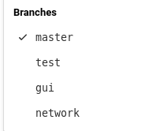
Working practices
Branches were used, but late roll out complicated
Telegram, not so much Gitlab
No (shared) issue tracking etc.

