Slide 1
Less is More: Semi-Supervised Causal Inference for Detecting Pathogenic Users in Social Media
Hamidreza Alvari, Elham Shaabani, Soumajyoti Sarkar, Ghazaleh Beigi, Paulo Shakarian Arizona State University halvari@asu.edu CyberSafety’19
* Featured in the Wall Street Journal (August 10, 2018)
** Non-provisional patent filing (PCT/US19/17287): “Detecting Pathogenic Social Media Accounts without Content or Network Structure.”

Slide 2
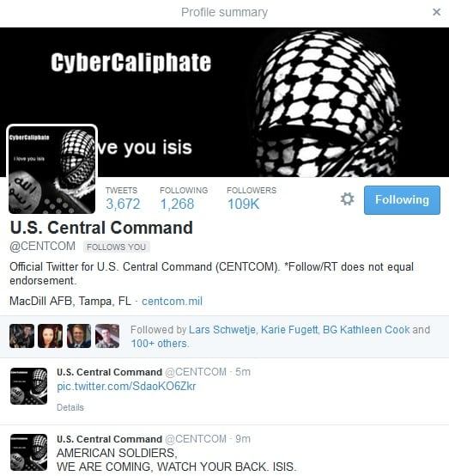


Who are PSMs?
Pathogenic Social Media (PSM) accounts:
Bots or humans who perform malicious activity to viral proportions
e.g., ISIS supporters, fake news writers, water armies, etc.
Exploit supporters to promote/degrade ideas
PSMs are key users to propagation of malicious information
Notes:
PSMs are key users or causal users to propagation of malicious information to viral proportions
That’s why we use causal inference here to detect PSMs

Slide 3
Challenges
Social media are primarily based on the reports from users (e.g. @TwitterSafety)
Very slow!
Training data is imbalanced
Number of normal users are higher than PSMs
It takes significant time to collect user profile, content and network structure
PSMs cultivate large number of communities of users to spread as much harmful messages as they can

Slide 4
Contributions
We cast the problem of identifying PSMs as an optimization problem
We use causal inference for assigning causality scores to users
We propose Laplacian semi-supervised SVM which uses causality vectors of users as features
Our method is only based on retweet activity (cascades of retweets)

Slide 5
Causal Inference
Theories of causality enjoy a prolific literature [Pearl’09]
Mostly computationally intractable
Suppes’ probabilistic causal theory [Suppes’70]
Time, logic and probability
An event is a cause if it:
Occurs before the effect (temporal priority)
Leads to an increase in the probability of observing the effect (probability raising)
Notes:
We have many causality theories in the literature but most of them are computationally interactable
In this work we will focus on Suppes prob causal theory which is more efficient and less complex
According to Suppes theorem, to have a cause and effect, an event should
Occur before the effect
And should lead to an increase in the probability of observing the effect

Slide 6
Existing Causal Metrics
Causal metrics based on Suppes’ theory [Kleinberg’09]
Notes:
Based on Suppes probabilistic causal theory, some causal metrics have been proposed that try to measure the causality of users
Kleinberg & Mishra: All this metric does is, it measures the average increase in probability of a cascade going viral when a given user is present or not not.
For example, see the two cascades here with two users c and c’. This metric measures the difference in the likelihood of this message going viral when user c is present or not
We have also other variants such as relative and neighborhood causality metrics that try to complement each other
We say c and c’ are m-related if c’ appears after c
Other variants: Relative Likelihood causality, Neighborhood-based causality
Rel: helps find new uses which may not have been prioritized by K&M
Neighborhood: user retweeting several PSMs might be PSM as well
Weighted Neighborhood: to capture different impact of users

Slide 7
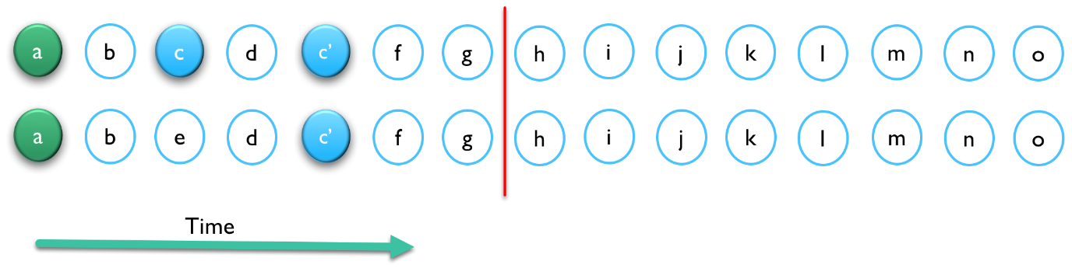
Existing Causal Metrics
Causal metrics based on Suppes’ theory [Kleinberg’09]
Notes:
Based on Suppes probabilistic causal theory, some causal metrics have been proposed that try to measure the causality of users
Kleinberg & Mishra: All this metric does is, it measures the average increase in probability of a cascade going viral when a given user is present or not not.
For example, see the two cascades here with two users c and c’. This metric measures the difference in the likelihood of this message going viral when user c is present or not
We have also other variants such as relative and neighborhood causality metrics that try to complement each other
We say c and c’ are m-related if c’ appears after c
Other variants: Relative Likelihood causality, Neighborhood-based causality
Rel: helps find new uses which may not have been prioritized by K&M
Neighborhood: user retweeting several PSMs might be PSM as well
Weighted Neighborhood: to capture different impact of users

Slide 8
Existing Causal Metrics
Causal metrics based on Suppes’ theory [Kleinberg’09]

Slide 9
Changes Over Time
PSMs causality scores change significantly over time
i.e., abrupt changes in causality indicate malicious activity
However, previous metrics cannot capture these changes
They do not consider time
Consequently, they are not able to find PSMs early enough
Also, more recent activity of users is more important

Slide 10
Time-Decay Causal Metric
Compute causality over sliding windows
Weigh more recent activity of user more by using Exponential decay function
Take the average
Notes:
Break entire timeline for all users into shorter time periods
Weigh the distances by exponential decay function
Take the average of the causality values computed over sliding windows
The more recent activity of each user is more important for us, so we use exponential function to capture that
We apply the same procedure for all previous metrics

Slide 11
Semi-Supervised Causal Inference for PSM Detection
Labeled data is expensive
Unlabeled data is cheap and abundant
Previous studies have demonstrated the effectiveness of unlabeled data
Causality was shown to be effective in distinguishing PSMs from normal users
Joint framework of semi-supervised learning and causal inference

Slide 12
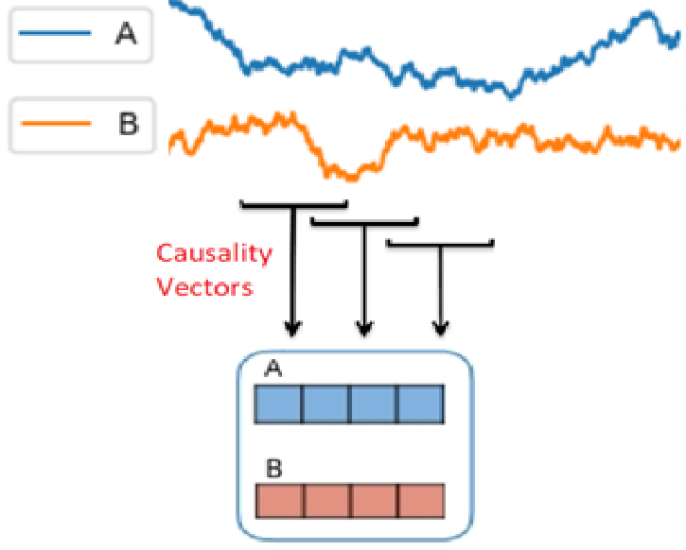
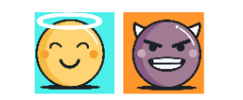
SemiPSM
Semi-Supervised Pathogenic Social Media Accounts Detection
Causal-based Feature Space F
Notes:
We feed labeled data to regular supervised SVM
Next, we introduce Laplacian regularization terms based on labeled and unlabeled data
The regularization term forces similar examples (in terms of features) to have same label

Slide 13
Dataset
Collected 53 M ISIS related tweets/retweets in Arabic
Feb 22, 2016-May 27, 2016
290 hashtags such as: #ISIS, #Daesh
35 K cascades, 10 M tweets/retweets
6 K viral cascades with size of at least 100

Slide 14
Experimental Setup
Semi-supervised Methods
LabelSpreading (KNN/RBF)
Graph inference-based LabelSpreading
Supervised Baselines
Account-level features (Random Forest) [Ferrara’18]
e.g., followers/friends counts, geo enabled, verified, protected
Tweet-level features (Random Forest) [Ferrara’18]
e.g., retweet/reply counts, number of hashtags/URLs/mentions
SentiMetrix (Random Forest) [Subrahmanian’16]
e.g., tweet syntax (number of hashtags/URLs/mentions), tweet semantics (LDA topics)
Word-level LSTM
Inputs are the vectors of words in each tweet. We use pre-trained word2vec.
Notes:
Account: Statuses Count, Followers Count, Friends Count, Favorites Count, Listed Count, Default Profile, Geo Enables, Profile Uses Background Image, Verified, Protected
Tweet: retweet count, reply count, favorite count, number of hashtags, number of URLs, number of mentions.
Dataset: ISIS Twitter dataset (about 65 K normal and 20 K PSM users)

Slide 15
Experimental Setup
Effectiveness
Supervised: we use entire labeled data
Training set
100%
Labeled
Notes:
Account: Statuses Count, Followers Count, Friends Count, Favorites Count, Listed Count, Default Profile, Geo Enables, Profile Uses Background Image, Verified, Protected
Tweet: retweet count, reply count, favorite count, number of hashtags, number of URLs, number of mentions.
Dataset: ISIS Twitter dataset (about 65 K normal and 20 K PSM users)

Slide 16
Experimental Setup
Effectiveness
Supervised: we use entire labeled data
Semi-supervised: we make 10% of labeled data unlabeled (original data does not have unlabeled data)
Training set
Training set
100%
90% 10%
Labeled
Unlabeled
Labeled
Notes:
Account: Statuses Count, Followers Count, Friends Count, Favorites Count, Listed Count, Default Profile, Geo Enables, Profile Uses Background Image, Verified, Protected
Tweet: retweet count, reply count, favorite count, number of hashtags, number of URLs, number of mentions.
Dataset: ISIS Twitter dataset (about 65 K normal and 20 K PSM users)

Slide 17
Results
Supervised methods use the entire training set
For semi-supervised 10% of training has been unlabeled
Time-decay causality features are used
Notes:
For the first expr I used only 10% for semi-supervised methods, but supervised methods are using whole training set
Sentimetrix: tweet syntax (avg number of hashtags, avg number of links) and semantics (lda topics)

Slide 18
Results
Repeat with different portions of unlabeled data
With up to 50% of unlabeled data
SemiPSM outperforms supervised methods
Notes:
For the first expr I used only 10% for semi-supervised methods, but supervised methods are using whole training set
Sentimetrix: tweet syntax (avg number of hashtags, avg number of links) and semantics (lda topics)

Slide 19
Results
Repeat with different portions of unlabeled data
With up to 20% of unlabeled data
LabelSpreading (KNN) outperforms supervised methods
Notes:
For the first expr I used only 10% for semi-supervised methods, but supervised methods are using whole training set
Sentimetrix: tweet syntax (avg number of hashtags, avg number of links) and semantics (lda topics)

Slide 20
Conclusion
PSMs are users who are promoters of misinformation
We cast the problem as an optimization and utilized a semi-supervised causal approach to detect PSMs
Causality features were extracted from users’ activity and fed to the semi-supervised learner
In future, we would like to examine time-series and LSTM-based features
* Some of the authors are supported through the DoS and DoD Minerva program.

Slide 21
References
[Ferrara’18] Kudugunta, Sneha, and Emilio Ferrara. "Deep neural networks for bot detection." Information Sciences 467 (2018): 312-322.
[Subrahmanian’16] Subrahmanian, V. S., Amos Azaria, Skylar Durst, Vadim Kagan, Aram Galstyan, Kristina Lerman, Linhong Zhu et al. "The DARPA Twitter bot challenge." arXiv preprint arXiv:1601.05140 (2016).
[Kleinberg’09] S. Kleinberg and B. Mishra, “The temporal logic of causal structures”, UAI 2009.
[Suppues’70] P. Suppes, “A probabilistic theory of causality,” 1970.
[Pearl’09] Pearl, Judea. Causality. Cambridge university press, 2009.

