Slide 1
Detecting Cyberbullying using Latent Semantic Indexing(LSI)
Jacob Bigelow, April Edwards, Lynne Edwards
Ursinus College

Slide 2

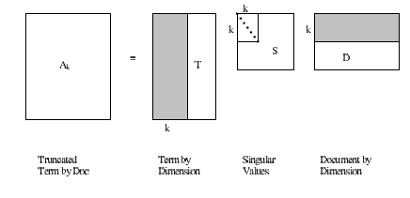
Motivation for using LSI
Latent Semantic Indexing is thought to bring out the latent semantics amongst a corpus of texts
Breaks a term by document matrix down and reduces the sparseness adding values that represent relationships between words
w=qA_{k}

Slide 3
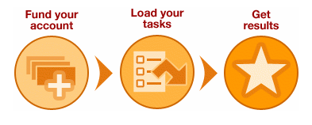
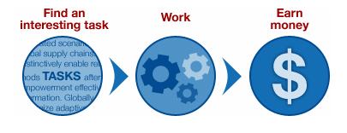
Our Dataset
Data gathered from 18,554 users on Formspring.me
13,159 posts
Amazon Mechanical Turk used for HIT (human intelligence tasks)
Needed workers to label posts as cyberbullying due to computers inability to
848 identified bullying posts

Slide 4

Methods for Pruning
Started with 40,000 unique terms
Normalize emoticons
Remove punctuation
Remove one character words
Then deal with spelling issues
:), (:, :], :D, etc. smileyface
:(, :[, etc. frownyface
;) winkyface
<3 heart
:p, :P, etc. tongueoutface

Slide 5
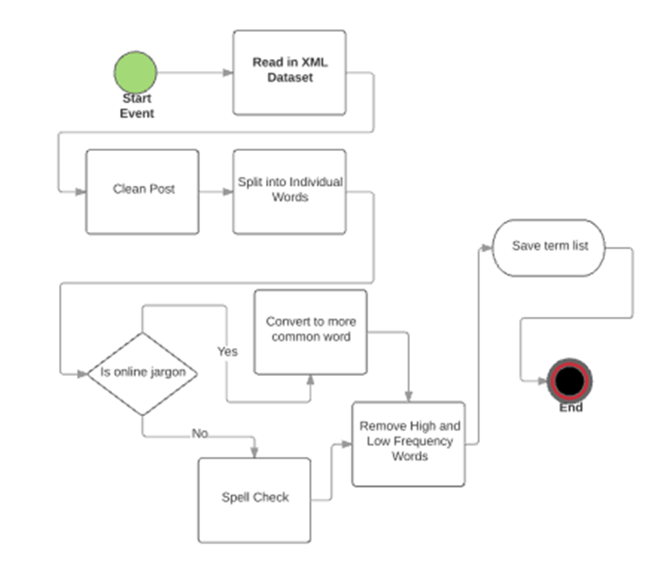
Spellchecking
Check against list of commonly misspelled internet terms ex. Lol, idk, hahah, wht
Using Language Tools, open source spell checking software
wht what
u you
Okie okay

Slide 6
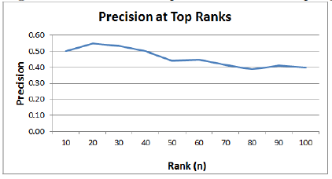
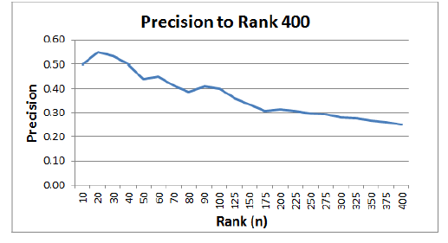
Results for precision
Initial simple query: “you dirty, ugly, piece of shit. I hope you die”
First match found: “Q: Hi asslee asshole :D A: Hi anonymous”
Precision measured as number of true positives divided by n
For top ranks our precision is 7-9 times the baseline

Slide 7
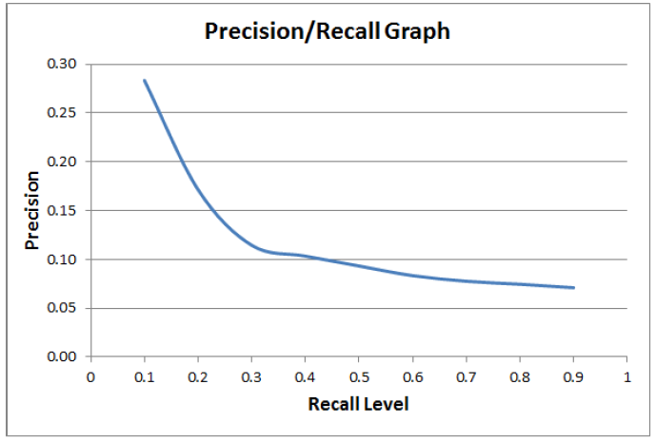
Recall vs. Precision
Large decline after recall of .1
Leads us to believe our system pushes some cyberbullying posts to the top but still missing quite a few

Slide 8
Conclusion
We’ve developed a system to detect cyberbullying in short posts littered with spelling errors, abbreviations, and odd punctuation.
Do not need bullying terms database
Uses LSI to find posts by highlighting relationships between terms
Preliminary results look promising

Slide 9

Future research
Adding different weights to terms
More extensive pruning
Testing on other domains
Work with larger data set

Slide 10
Acknowledgements
NSF acknowledgement
This material is based upon work supported in part by the National Science Foundation under Grant Nos. 0916152 and 1421896. Any opinions, findings, and conclusions or recommendations expressed in this material are those of the author(s) and do not necessarily reflect the views of the National Science Foundation.
My advisor, Dr. April Edwards

