Slide 1




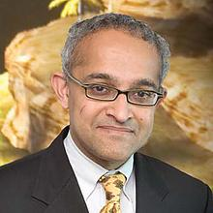
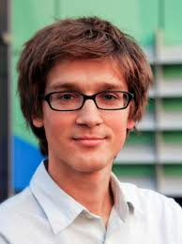
Vandals and Hoaxes on the Web
Srijan Kumar
PhD candidate
University of Maryland, College Park
Prof. Francesca Spezzano
Prof. Robert West
Prof. V.S. Subrahmanian
Prof. Jure Leskovec

Slide 2
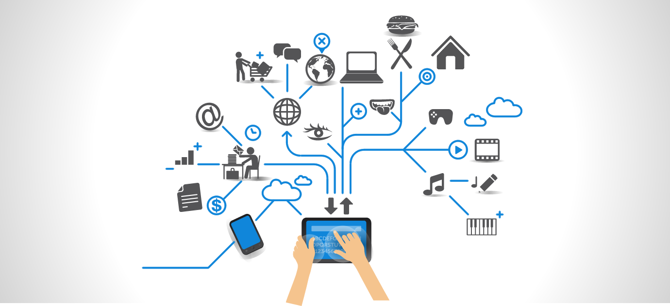
Web: Source of information

Slide 3
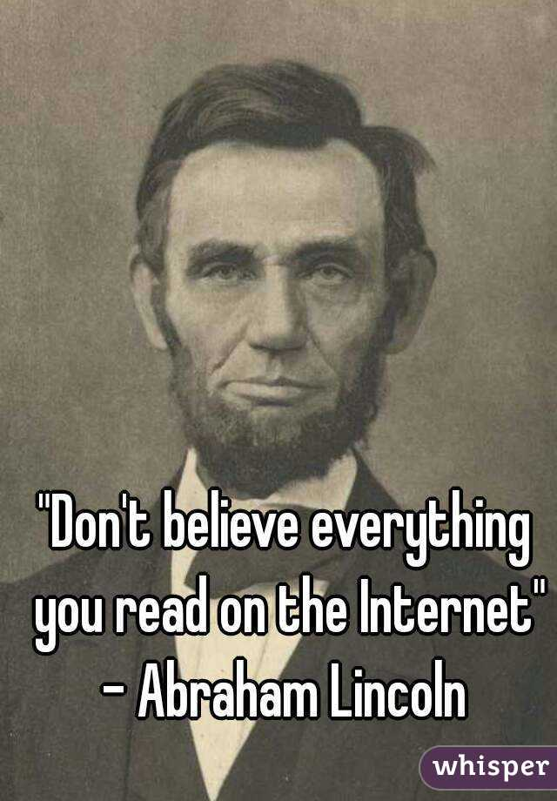



Web: Source of false information

Slide 4

Wikipedia as a source of information
Freely accessible
Large reach
Major source of information for many
Easy to add (false) information
The free encyclopedia that anyone can edit

Slide 5
Today’s talk
Vandals on Wikipedia
Hoaxes on Wikipedia
How to identify malicious editors?
KDD’15¹
How to identify fake articles?
WWW’16²
VEWS: A Wikipedia Vandal Early Warning System. S. Kumar, F. Spezzano, V.S. Subrahmanian. KDD 2015
Disinformation on the Web: Impact, Characteristics and Detection of Wikipedia Hoaxes. S. Kumar, R. West, J. Leskovec. WWW 2016

Slide 6
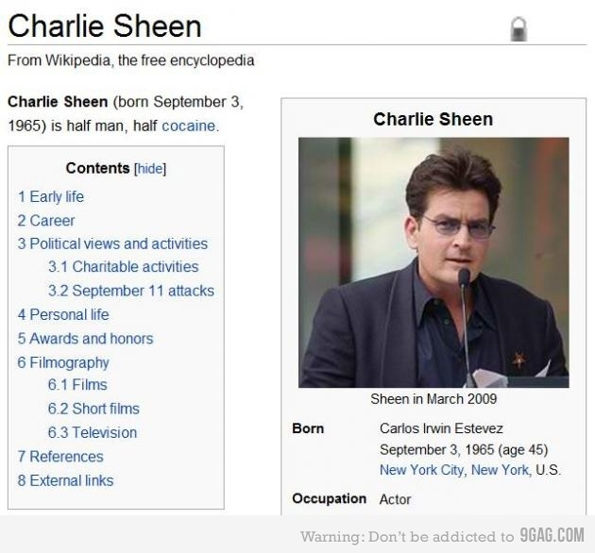
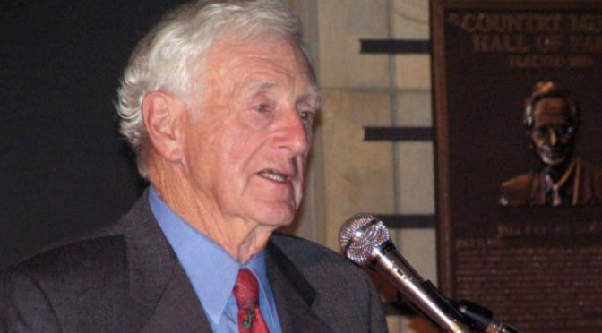
Vandals on Wikipedia
Task: Detect vandals before they are detected by other Wikipedia users or bots
VEWS:
Use editing behavior difference to identify vandals

Slide 7
Data: Wikipedia Vandals
34,000 Editors Half are vandals
770,000 Edits 160,000 edits by vandals
Jan 2013 - July 2014

Slide 8
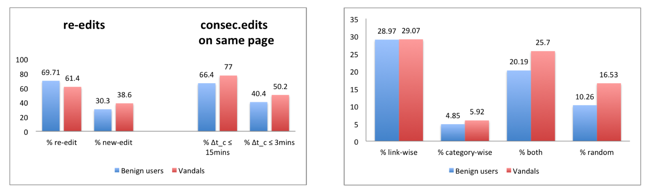
Editing Similarities
All editors are more likely to re-edit a previously edited page, than to edit a new page
All editors select similar next article to edit similarly (link-wise vs topic-wise)
Re-edits
Consecutive edits on same page
Relation of consecutive edit
All editors re-edit same page quickly

Slide 9
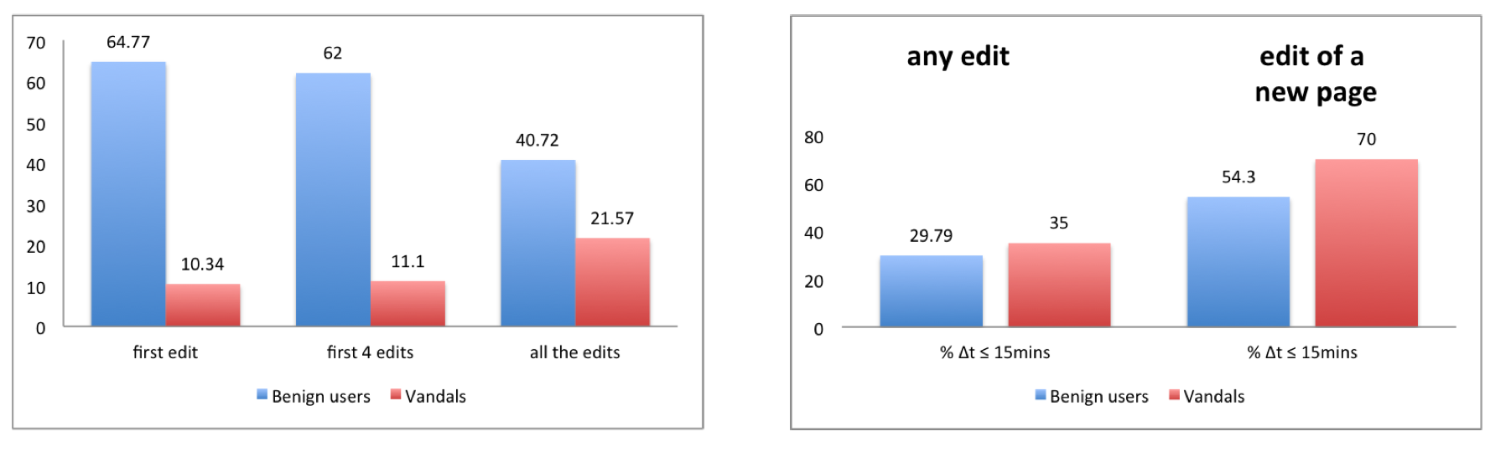
Editing Differences
Benign users edit more non-article pages than vandals, even in the first edit
Vandals spend less time in editing a new page
Article vs non-article page edits
All edits
Edits on all new pages
Vandals make faster edits than benign users
*All results are statistically different with very low p-values

Slide 10
VEWS: Vandal Early Warning System
Behavioral Features
Aggregated features of all benign and all vandal editors
State Transition Features
Individual editor’s pattern in sequence of edits

Slide 11
Features
User:
Edit 1
Edit 2
Edit 3
Edit 4
Edit 5
Feature 1
Feature 2
Feature 3
Feature 4
< 3 min, < 15 min, > 15 min
Article page, Non-article page
Yes, No
<= 3 hops, > 3 hops, unreachable
0 categories vs 1 category
Time x Type of page x First edit x Distance x Similarity x Reverted
Yes, No
Each edit pair can be in one of 60 categories

Slide 12
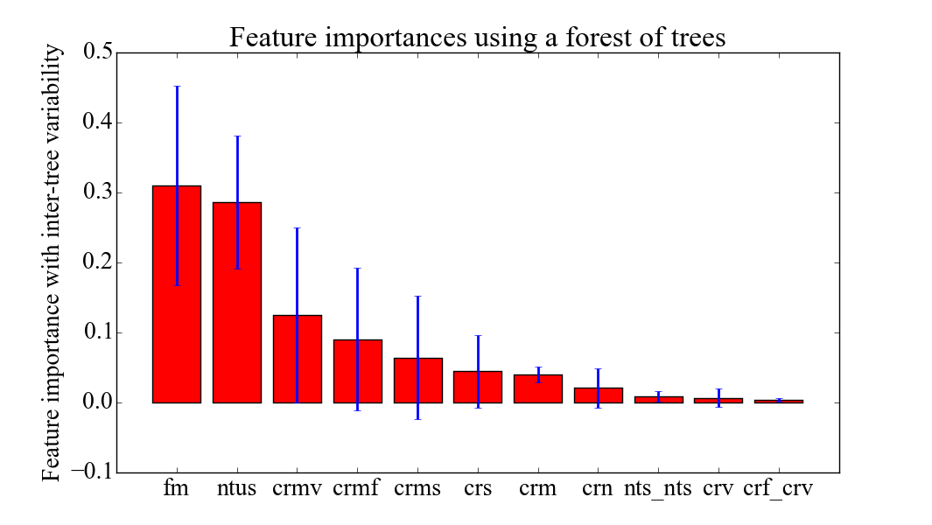
Behavioral Features
Frequent pattern mining to identify differences between benign editors and vandal editors
First edit is on a non-article page?
Slow when editing new page?

Slide 13
State Transition Features
Create compressed representation of each editor’s edit sequence
User: Feature 1, Feature 2, Feature 3, Feature 4, …
Feature M
 | #
Auto-encoder
400 x 1 vector
Feature N
60x60

Slide 14
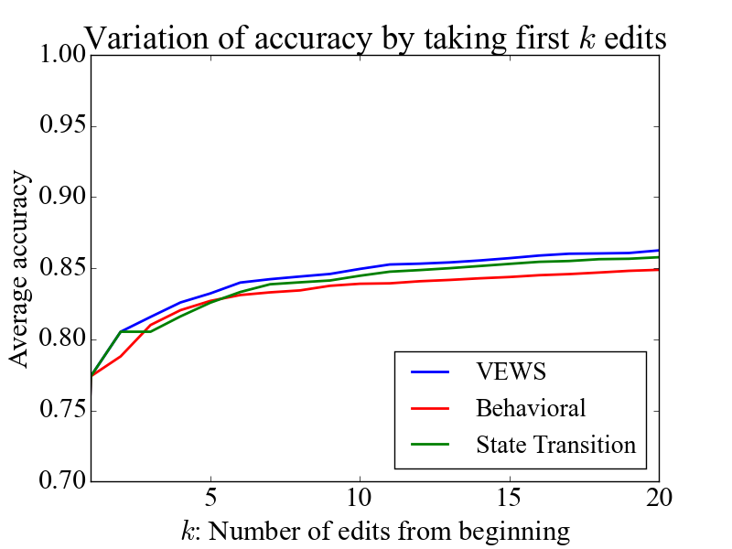
VEWS: An Early Warning System
78% accuracy with first edit only.
44% cases vandal identified before first reversion.
VEWS detects vandals 2.39 edits before ClueBot NG, on avg.
With all edits, VEWS = 88% accuracy

Slide 15
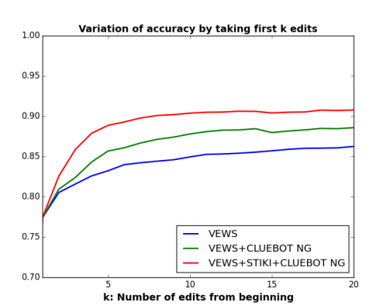
VEWS + ClueBot NG + STiki
Overall combination is the best.
VEWS + ClueBot NG is fully automated.

Slide 16
Today’s talk
Vandals on Wikipedia
Hoaxes on Wikipedia
How to identify malicious editors?
KDD’15¹
How to identify fake articles?
WWW’16²
VEWS: A Wikipedia Vandal Early Warning System. S. Kumar, F. Spezzano, V.S. Subrahmanian. KDD 2015
Disinformation on the Web: Impact, Characteristics and Detection of Wikipedia Hoaxes. S. Kumar, R. West, J. Leskovec. WWW 2016

Slide 17
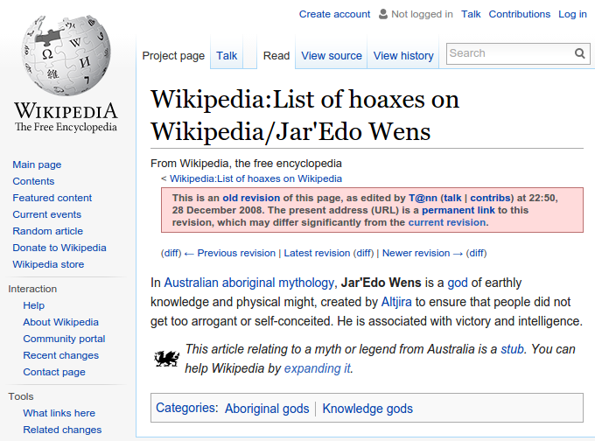
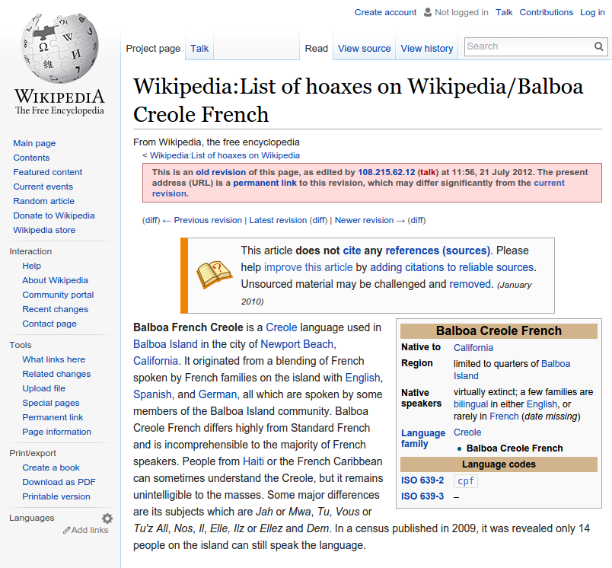
Hoaxes on Wikipedia
Hoax:
“deliberately fabricated falsehood made to masquerade as truth”
Wikipedia

Slide 18
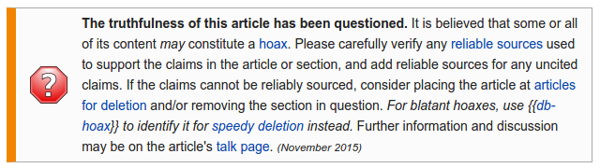
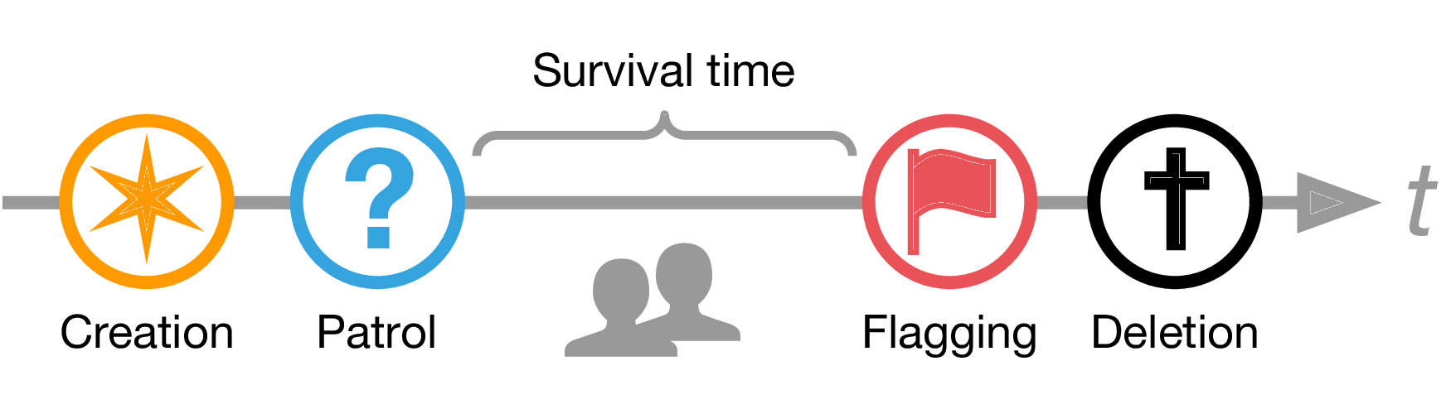
Data: Wikipedia Hoaxes
Hoax article vs hoax facts
21,218 hoax articles
Hoax lifecycle:

Slide 19
Wikipedia hoaxes
Impact
of hoaxes
Characteristics
of hoaxes
Detection
of hoaxes
Quantify their impact?
What are the hoaxes like?
Can we find them?

Slide 20
Impact of hoaxes
Jimmy Wales:
“The worst hoaxes are those which
(a) last for a long time,
(b) receive significant traffic,
(c) are relied upon by credible news media.”
Survival time: 1% survive more than 1 year
Pageviews: 1% receive 100 per day
Clicklogs: 1.08 inlinks from across the web.
Most hoaxes are caught soon, but some are very impactful!

Slide 21
Wikipedia hoaxes
Impact
of hoaxes
Characteristics
of hoaxes
Detection
of hoaxes
Most hoaxes are caught soon, but some hoaxes are impactful
What are the hoaxes like?
Can we find them?

Slide 22


Successful hoax
pass patrol
survive for a month
viewed frequently
Failed hoax
flagged and deleted during patrol
Hoax
Legitimate articles
never flagged
Wrongly flagged temporarily flagged
Non-hoax

Slide 23
Characteristics of hoaxes
Appearance: how the article looks | Link-network: how the article connects | Support: do other articles contain article title | Editor: how the article creator looks

Slide 24
Characteristics of hoaxes
Appearance: how the article looks | Link-network: how the article connects | Support: do other articles contain article title | Editor: how the article creator looks
Features:
Plain-text length
Plain-text-to-markup ratio
Wiki-link density
Web-link density
Hoax articles are longer, but
they mostly have plain text and
have lesser web and wiki links.

Slide 25
Characteristics of hoaxes
Appearance: hoaxes mostly have text and few references. | Link-network: how the article connects | Support: do other articles contain article title | Editor: how the article creator looks
CC = 0
incoherent article
CC > 0
coherent article
Legitimate articles are more coherent than successful hoaxes

Slide 26
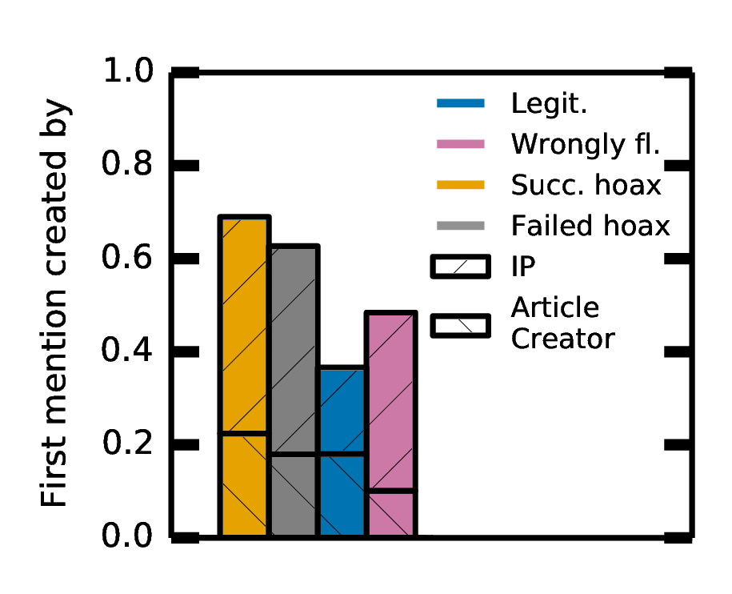
Characteristics of hoaxes
Appearance: hoaxes mostly have text and few references. | Link-network: hoaxes have incoherent wikilinks. | Support: do other articles contain article title | Editor: how the article creator looks
Features:
Number of prior mentions
Time since first mention
Creator of first mention
Hoax mentions are less in number,
more recently created, and
mostly created by IP addresses or article creator

Slide 27
Characteristics of hoaxes
Appearance: hoaxes mostly have text and few references. | Link-network: hoaxes have incoherent wikilinks. | Support: hoaxes have few, recent, suspicious mentions. | Editor: how the article creator looks
Features:
Creator’s age
Creator’s experience
Hoax creators are more recently registered, and
have lesser editing experience.

Slide 28
Wikipedia Hoaxes
Impact
of hoaxes
Characteristics
of hoaxes
Detection
of hoaxes
Most hoaxes are caught soon, but some hoaxes are impactful
Hoaxes are different from non-hoaxes in many respects
Can we find them?

Slide 29
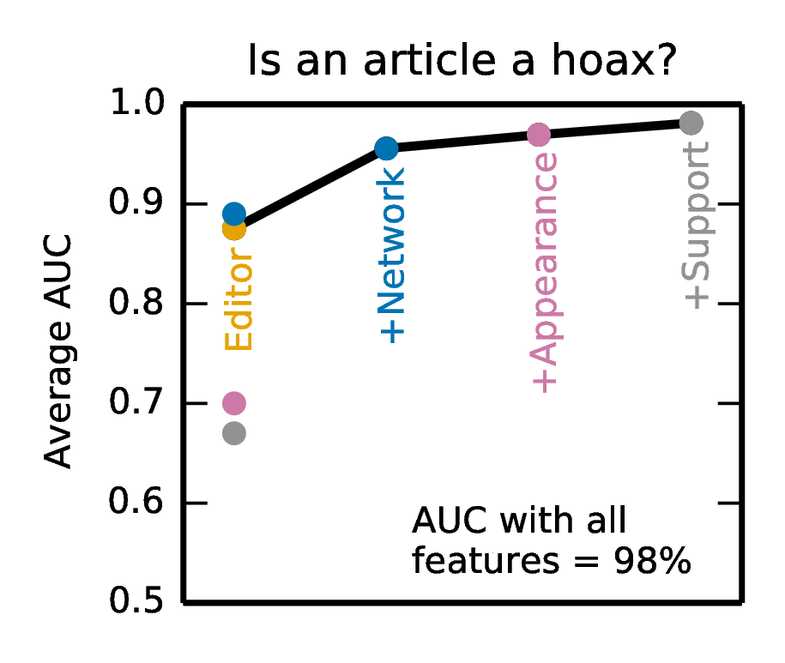
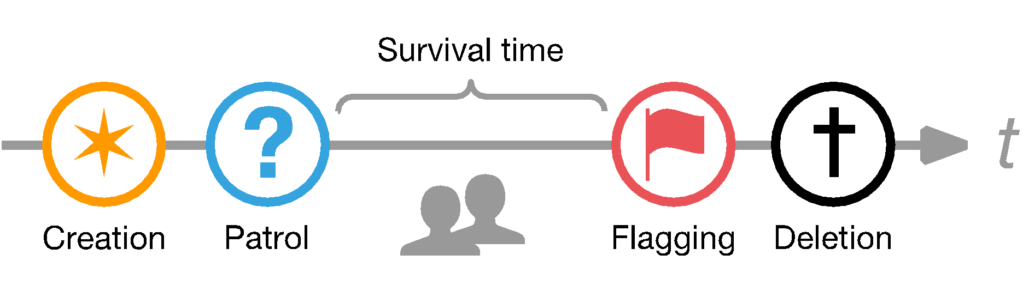
Detection of hoaxes
AUC = 98%
Editor and
Network features
Is an article a hoax?
AUC = 86%
Editor and support features
AUC = 71%
Appearance features
Will a hoax get past patrol?
Is an article flagged as hoax really one?

Slide 30
We discovered previously unknown hoaxes!
Flagged by us and deleted by Wikipedia administrators
Maurice Foxell
Children’s book author and Knight Commander of Royal Victorian Order
1 year 7 months!
Steve Moertel
Popcorn entrepreneur
6 years 11 months!

Slide 31
Wikipedia Hoaxes
Impact
of hoaxes
Characteristics
of hoaxes
Detection
of hoaxes
Most hoaxes are caught soon, but some hoaxes are impactful
Hoaxes are different from non-hoaxes in many respects
Non-appearance features are important to
detect hoaxes

Slide 32
Conclusions
Vandals on Wikipedia
Hoaxes on Wikipedia
Editing behavior mining to detect vandals
Non-superficial features to identify hoaxes
VEWS: A Wikipedia Vandal Early Warning System. S. Kumar, F. Spezzano, V.S. Subrahmanian. KDD 2015
Disinformation on the Web: Impact, Characteristics and Detection of Wikipedia Hoaxes. S. Kumar, R. West, J. Leskovec. WWW 2016

Slide 33
Thank you!
srijan@cs.umd.edu
http://cs.umd.edu/~srijan
VEWS (code + data): cs.umd.edu/~vs/vews/
Hoax (code + data): cs.umd.edu/~srijan/hoax/
Bad Actor Tutorial (papers, codes, datasets): cs.umd.edu/~srijan/badactorstutorial/

Slide 34
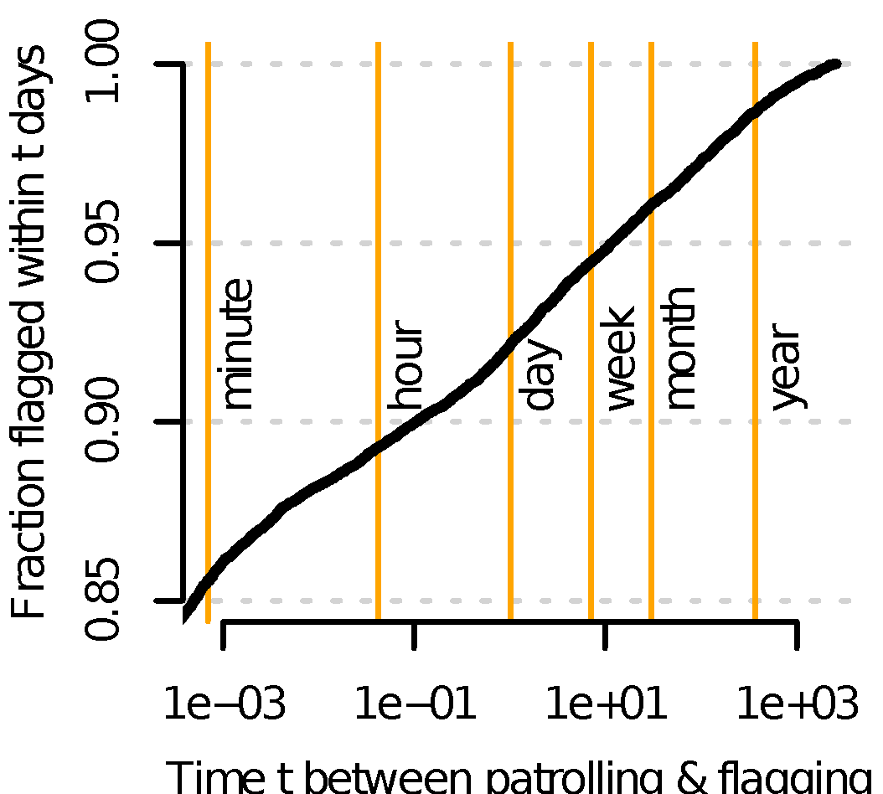
Impact of hoaxes
“The worst hoaxes are those which
(a) last for a long time”
0.99
Time t between patrolling and flagging

Slide 35
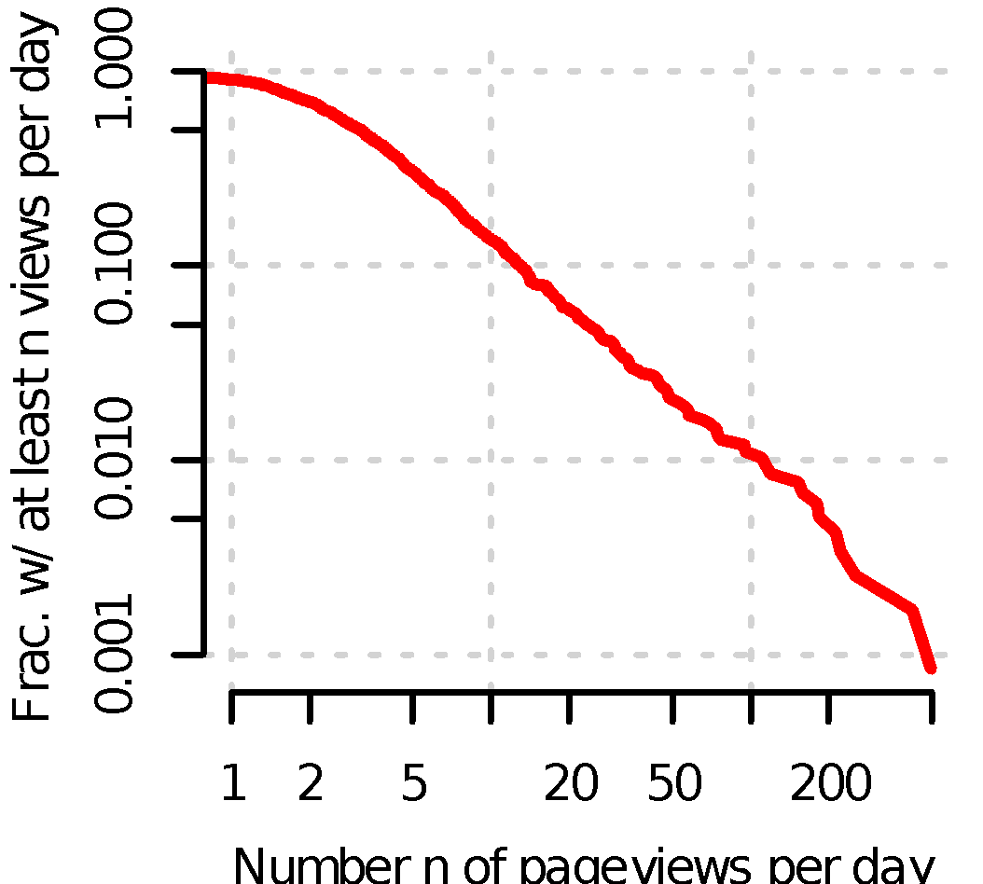
Impact of hoaxes
“The worst hoaxes are those which
(b) receive significant traffic”
10
100
500
Number n of pageviews per day

Slide 36
Impact of hoaxes
“The worst hoaxes are those which
(c) are relied upon by credible news media”
1.08
active inlinks
from entire web

