Slide 1

Ransomware
Bad Rabbit is a locally self-propagating ransomware, spreading via SMB once inside.
Requires User Interaction
Mostly targeted Russia and the Ukraine.
Primary affected Windows XP thru 7.
$ echo -e "\nLance Magnanao \nConstantine Politis \nHenry Lueders" > authors.txt
$ cat authors.txt

Slide 2
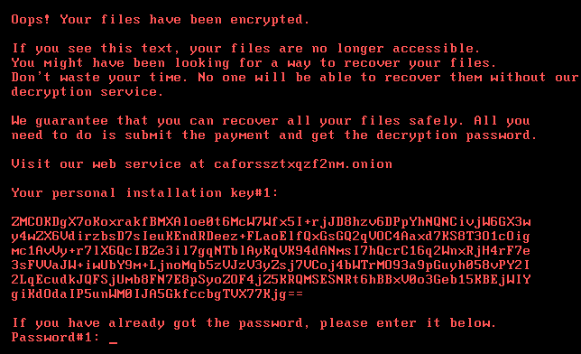
What damage was done?
When Bad Rabbit infects a computer; it will distribute or block access to data for ransom.
Individuals that are victimized by this ransomware are directed to a payment site and given 40 hours to pay or the data will be spread across the net; or an increase of ransom for additional time.
Usually the amount would start around 0.05 bitcoins or around $285 (with the price of bitcoin back then).

Slide 3
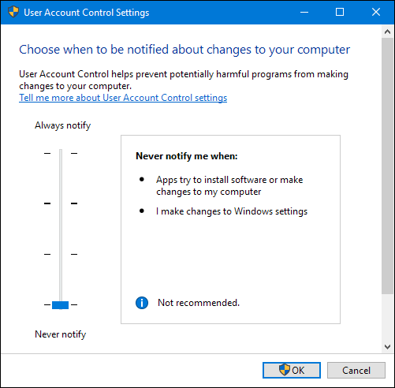
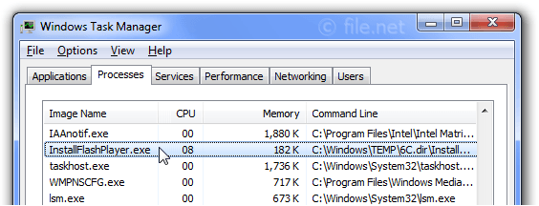
How was the damage done?
Bad Rabbit Uses Social Engineering to Infect: The infection vector starts by visiting a compromised website requesting an Adobe Flash update that downloads the malware. Various reports suggest that the initial infection is caused by compromised web servers that delivered the malicious file (under the name “install_flash_ player.exe”). In order to start the infection, a user will need to download the file from the infected web server and execute it. Depending on User Access Control (UAC) settings, most users will have to accept a popup in order to execute the file. Also, when the user has no admin privileges (high integrity), the malware would not perform malicious actions.

Slide 4
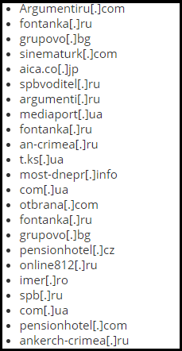
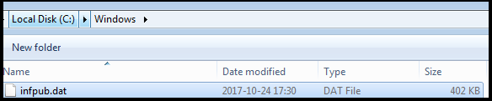

How was the damage done?
Installation: The executable “install_flash_player.exe” contains the payload of an encrypted copy of the “infpub.dat” file; so, the first stage of the “BadRabbit” malware is to deploy the second stage of the malware:
Sample Sites of compromised sites delivering Bad Rabbit:
Disclaimer:DON’T VISIT THESE SITES!

Slide 5
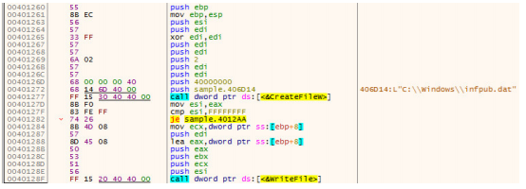
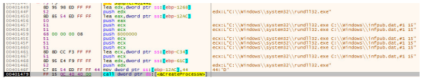
How was the damage done?
After the payload is decrypted in memory, the “infpub.dat” file is created and the decrypted data is written to the file.
After the file is dropped, it is executed using rundll32.exe: “C:\\Windows\\system32\\rundll32.exe C:\\Windows\\infpub.dat,#1 15”

Slide 6
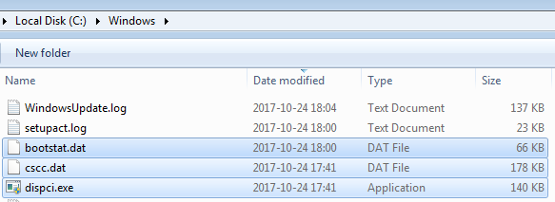
How was the damage done?
“infpub.dat” Functionality: “infpub.dat” - the main DLL performs a major portion of the malicious functionality of BadRabbit. The use of the “.dat” file extension is familiar from the “NotPetya” attack that dropped a “.dat” file (perfc.dat) to perform most of the malicious functionality. To perform its tasks, infpub.data drops three additional files into the C:\Windows Directory:
• “C:\Windows\cscc.dat” - cscc.dat – legitimate driver used for the disk encryption (diskcryptor.net)
• “C:\Windows\dispci.exe” - dispci.exe – installs the bootlocker, communicates with the driver
• “C:\Windows\<random-name>.tmp” - mimikatz binary used for obtaining passwords

Slide 7
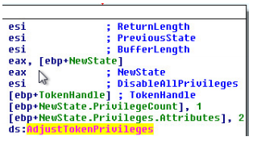
How was the damage done?
First, the malware enables privileges using AdjustTokenPrivileges().
The malware enables the following privileges:
• “SeShutdownPrivilege” - gives the ability to shut down local system.
• “SeDebugPrivilege” - gives the ability to debug.
• “SeTcbPrivilege” - its holder is recognized as part of the trusted computer base.

Slide 8
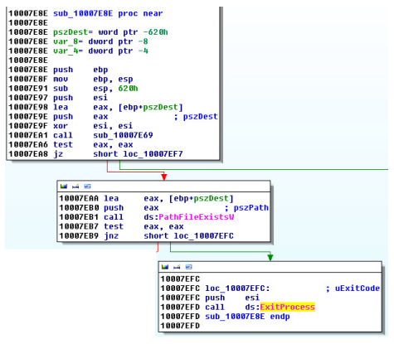
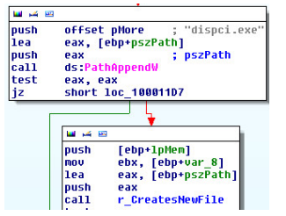
How was the damage done?
Next, the malware drops additional files. The first is “cscc.dat” that will be used as an encryption/decryption driver:
If “cscc.dat” does not exist it is created. If “cscc.dat” already exists the malware terminates. Next, the “dispci.exe” file is created. Its main purpose is to perform part of the encryption and the decryption using “DiskCryptor” driver utilities.

Slide 9
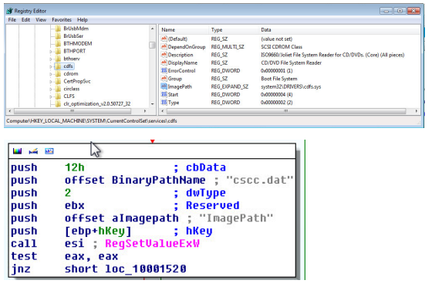
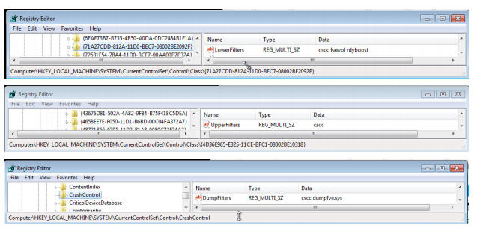
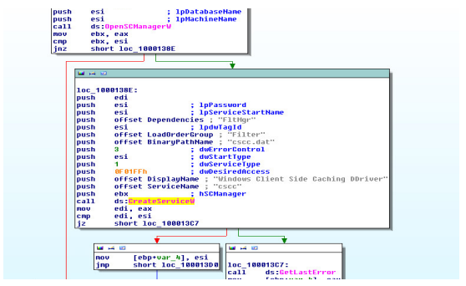
How was the damage done?
Registering ‘cscc.dat’ as a Service In order to utilize the open source DiskCryptor, infpub.dat registers a new service as a driver under the name “cscc” with the description “Windows Client Side Caching DDriver”:
Then the registry keys: “LowerFilters”, “UpperFilters” and “DumpFilters” are added.
Then the malware adds the following registry entries: Key:“HKEY_LOCAL_MACHINE\SYSTEM\CurrentControlSet\services\cdfs”

Slide 10

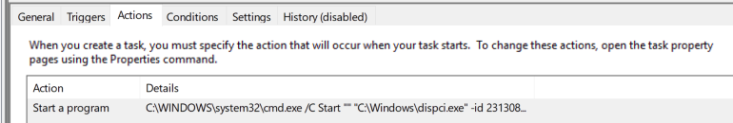
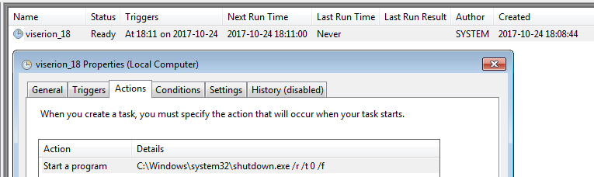
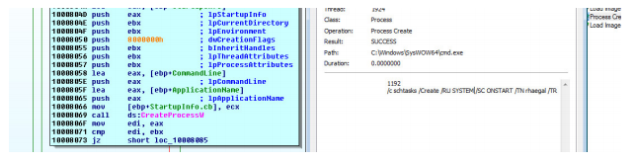
How was the damage done?
After the driver is registered, the malware adds two new scheduled tasks:
1. The first scheduled task that is added makes sure that after a reboot the dispci.exe file will be executed using a random id generated for the encryption. The scheduled task is set using the command: ‘cmd.exe /c schtasks /Create /RU SYSTEM /SC ONSTART /TN rhaegal / TR “c:\windows\system32\cmd.exe /C Start “c:\windows\dispci.exe -id && exit”’
2. Another scheduled task is later set with the purpose of shutting down the machine: ‘cmd.exe /c schtasks /Create /SC once /TN drogon /RU SYSTEM /TR “C:\Windows\system32\shutdown.exe /r /t 0 /f /ST ’

Slide 11
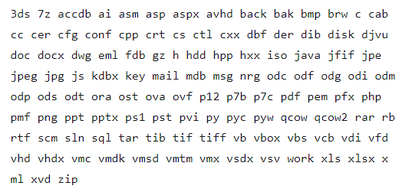
How was the damage done?
File Encryption Process:
The dropped application “dispci.exe” (DiskCryptor) is run with the help of one of the scheduled task:
The malware encrypts files with the selected extensions. All the files are encrypted with the same key (the same plaintext gives the same ciphertext).

Slide 12
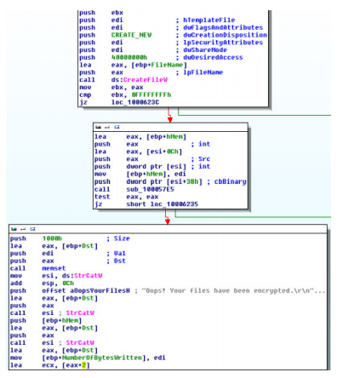
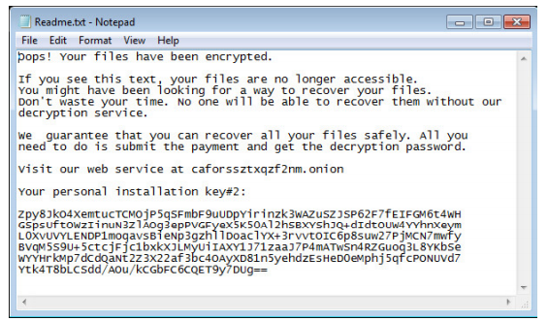
How was the damage done?
Some of the system directories are exempted from the attack:
\\Windows
\\Program Files
\\ProgramData
\\AppData
File Encryption Process:
“infpub.dat” also performs a major part of the file encryption. First, it retrieves the list of the drives on the machine. Next, it iterates through the disks, searching for DRIVE_FIXED (e.g. hard disk drive or flash drive). Then the file would be encrypted and FindNextFileW() will be called. An “.encrypted” extension will be added to encrypted files.
Next, the malware drops “Readme.txt” in each root directory

Slide 13
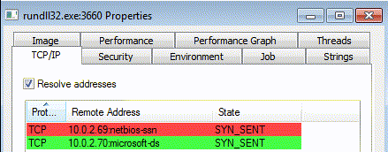
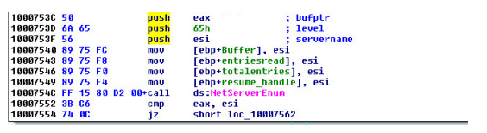
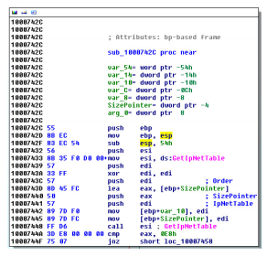
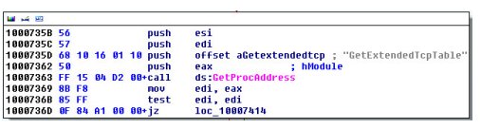
How was the damage done?
Lateral Movement:
1. GetExtendedTcpTable - which returns a list of active TCP connections.
2. GetIPNetTable - which gets the computer’s ARP table, listing IP addresses and MAC addresses of computers in the same network segment
3. NetServerEnum - used to enumerate servers in the domain using a windows API function.
Enumerating Nearby Hosts

Slide 14
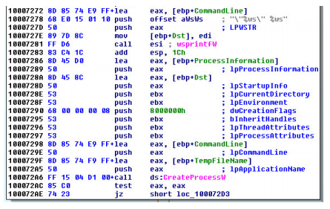
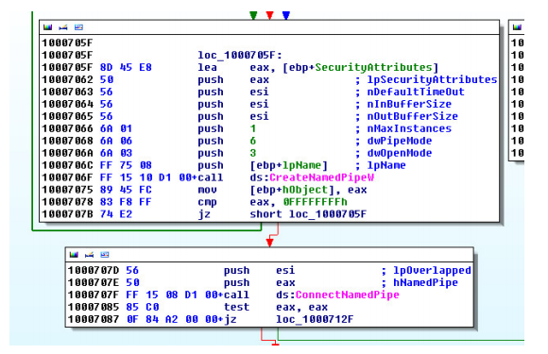
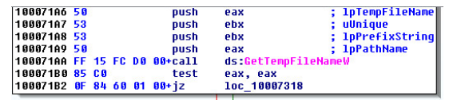
How was the damage done?
Lateral Movement:
Next, the malware writes mimikatz to a temporary file inside the C:\Windows\ folder, The malware then creates and connects to a named pipe that will be used to communicate with mimikatz.
Gaining local credentials using Mimikatz
Mimikatz is then executed from the temporary location with the named pipe as a parameter to obtain credentials stored in the local machine.

Slide 15
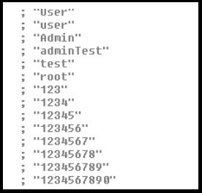
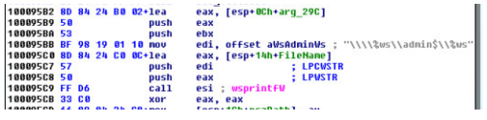
How was the damage done?
Lateral Movement:
The malware now attempts to connect to the enumerated servers using obtained credentials. In addition, the malware contains a list of hardcoded usernames and passwords that are used as backup in order to authenticate (so it would not miss out on easily vulnerable targets).
Executing BadRabbit in new hosts
Sample usernames and passwords:
After the malware authenticates, it drops “cscc.dat” and “infpub.dat” in the “\\ admin$” share:
And, the saga continues...

Slide 16
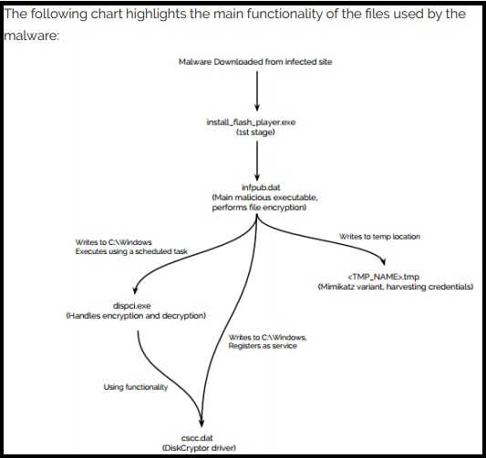
Installation in a nutshell:

Slide 17
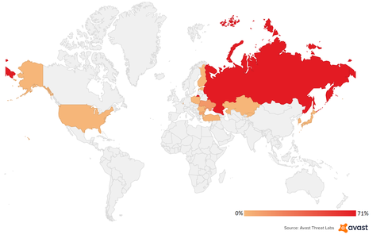
What and Where were the targets?
May have been a targeted attack aimed at corporate networks.
Targeted Eastern European countries.
It infected government, media, transportation and corporate networks in 15 countries, including Russia's Interfax and Fontanka (news agencies), Ukraine's Kiev Metro, the Odessa International Airport, the Odessa naval port and various ministries of infrastructure and finance.

Slide 18

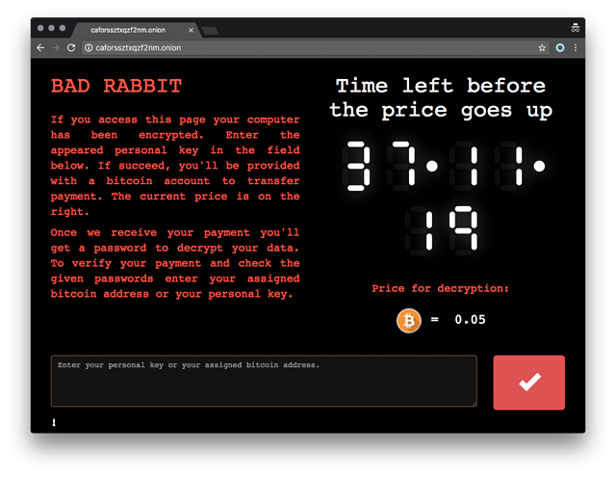
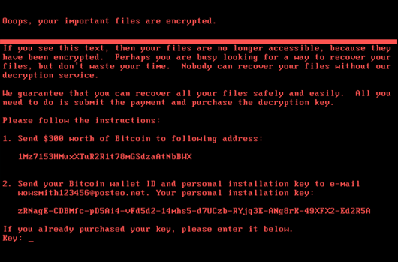
Frankensteined Petya/NotPetya (aka EternalPetya) Clone ?
Stolen petya kernel has been substituted with a more advanced DiskCryptor with a legitimate driver (stuxnet strategy?)
Non destructive attack. The disk can be decrypted with a valid password.
Does not use the EternalBlue and EternalRomance exploits.
NotPetya was used a Ukraine-based company’s update server, while Bad Rabbit uses drive-by downloads as an attack vector.
Both NotPetya and Bad Rabbit use SMB to spread.
Similar Ransom Screens.
Bad Rabbit and NotPetya's DLL (dynamic link library) share 67 % of the same code.
The two campaigns are “linked” to a cybercriminal group named TeleBots. (aka Sandworm group aka BlackEnergy) believed to be a subunit of APT28/PawnStorm/Fancy Bear/Sofacy/Tsar Team/Strontium/Sednit.
Associated with Russian military intelligence (GRU)

Slide 19
How to Mitigate Damage
Block the execution of files c:windowsinfpub.dat and c:Windowscscc.dat using Group Policy.
Disable WMI service (if it’s possible in your environment) to prevent the malware from spreading over your network.
Tips for everyone:
Backup your data.
Don’t pay the ransom.
Lock down admin accounts. Run as a standard user.
Educate Users.
Don’t just click. Double check.

Slide 20
Sources & Reports:
https://blog.malwarebytes.com/threat-analysis/2017/10/badrabbit-closer-look-new-version-petyanotpetya/
https://securelist.com/bad-rabbit-ransomware/82851/
https://threatpost.com/badrabbit-ransomware-attacks-hitting-russia-ukraine/128593/
https://www.bleepingcomputer.com/news/security/bad-rabbit-ransomware-outbreak-hits-eastern-europe/
https://unit42.paloaltonetworks.com/threat-brief-information-bad-rabbit-ransomware-attacks/
https://threatvector.cylance.com/en_us/home/threat-spotlight-bad-rabbit-ransomware.html
https://www.nyotron.com/collateral/Nyotron-BadRabbit-Report_FINAL.pdf
https://sourceforge.net/projects/diskcryptor/
https://www.offensive-security.com/metasploit-unleashed/mimikatz/
https://arstechnica.com/information-technology/2017/06/notpetya-developers-obtained-nsa-exploits-weeks-before-their-public-leak/
https://blog.skyboxsecurity.com/bad-rabbit-uses-social-engineering/
https://www.darkreading.com/endpoint/bad-rabbit-dies-down-but-questions-remain/d/d-id/1330224
https://www.tripwire.com/state-of-security/featured/october-2017-the-month-in-ransomware/
https://www.theregister.co.uk/2017/10/26/bad_rabbit_post_mortem/
https://www.zdnet.com/article/bad-rabbit-ten-things-you-need-to-know-about-the-latest-ransomware-outbreak/
https://threatpost.com/bad-rabbit-linked-to-expetrnot-petya-attacks/128611/
https://www.welivesecurity.com/2017/10/24/kiev-metro-hit-new-variant-infamous-diskcoder-ransomware/

