Slide 1

Basic Details of the Team and Problem Statement:-
Organization Name:- Department of Sports (DoS), Ministry of
Youth Affairs & Sports
PS Code:- AK1105
Problem Statement Title:- Prohibited substances and Therapeutic
Use Exception (TUE) for sportspersons.
TUE is granted if the drugs have been
prescribed by a authorized doctor to the
athlete.
Team Name:- Beyond Infinity
Team Leader Name:- Prashant Kumar
Institute Code (AISHE):- C-46231
Institute Name:- Greater Noida Institute Of Technology
Theme Name:- Fitness & Sports

Slide 2
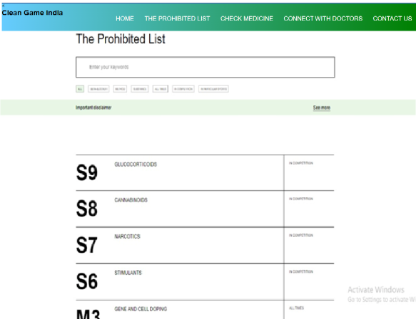
Idea/Approach Details:-
Prototype:-
Solution:-
A web-platform that spreads awareness about the sports related medicine and methods.
provide data about prohibited drugs.
Analysis prescribed medicine and check whether it contains salts that are prohibited.
Doctor consultancy for alternate medicines and supplements.
Provide health tips and diet plans.
FAQs related to sports medicines and methods.
Technology stack:-
HTML 5
CSS
JavaScript
Node.JS

Slide 3
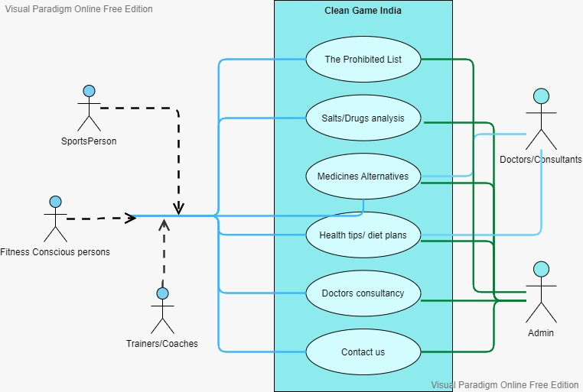
Idea/Approach Details:-
Use Case diagram:-
Dependencies:-
Doctors
Consultants
Medicinal Data
Prohibited List Data
Sportsperson/Trainers/Coaches
Show stopper:-
Doctors Unavailability
Consultants Unavailability
Medicinal Data Problems
Analysis Problems

Slide 4
Team Member Details:-
Team Leader Name:- PRASHANT KUMAR
Branch :- B.Tech Stream ( CSE ) Year(III)
Team Member 1 Name: - PRAGYA KAUSHIK
Branch :- B.Tech Stream ( CSE ) Year(III)
Team Member 2 Name: - MINAY GHAI
Branch :- B.Tech Stream ( CSE ) Year(III)
Team Member 3 Name: - NAVEEN SINGH
Branch :- B.Tech Stream ( CSE ) Year (III)
Team Member 4 Name: - ANKUL CHAUDHARY
Branch :- B.Tech Stream ( CSE ) Year(III)
Team Member 5 Name: - SHIVAM TIWARI
Branch :- B.Tech Stream ( CSE ) Year(III)
Team Mentor 1 Name: DURGESH KUMAR
Category : Academic Expertise : Web development, Pharma industry Domain Experience : 7 Years
Team Mentor 2 Name: ASHWINI VERMA
Category : Academic Expertise : Web development, Pharma industry Domain Experience : 7 Years

