Slide 1
“Secure CI/CD Pipeline for an Application Deployment and Vulnerability Analysis”
PG-DITISS Aug-2024Bin
ay
Submitted By :
Sakshi Sawant (248445)
Tejal Deshmukh (248451)
Guided By :
Mrs. Sushma Hattarki

Slide 2


Introduction
A secure Continuous Integration/Continuous Delivery (CI/CD) pipeline is crucial for rapid, reliable, and secure application deployment. This introduction explores key security measures integrated throughout the CI/CD process, ensuring vulnerability analysis and risk mitigation at every stage. GitHub manages source code securely, while Jenkins automates build, test, and deployment. SonarQube performs static code analysis to detect vulnerabilities early. Docker provides a secure, consistent environment through containerization. Security tools like IDS and the ELK stack enable real-time monitoring, while SCA and SAST identify code risks. Robust access controls and secrets management further enhance security, ensuring safe and efficient software delivery.

Slide 3
Problem Statement
CI/CD pipelines are vulnerable to security breaches, making them attractive targets for malicious actors. A compromised pipeline can lead to the injection of malicious code, resulting in system compromise and operational disruptions. For a web application like a hash calculator, ensuring a secure CI/CD pipeline is crucial to protect against potential threats. Integrating security measures such as static code analysis with SonarQube, container scanning, and log analysis using tools like IDS and ELK is essential. This problem statement addresses the need for a robust, secure CI/CD pipeline that incorporates vulnerability analysis to safeguard web applications from code commit to production.

Slide 4
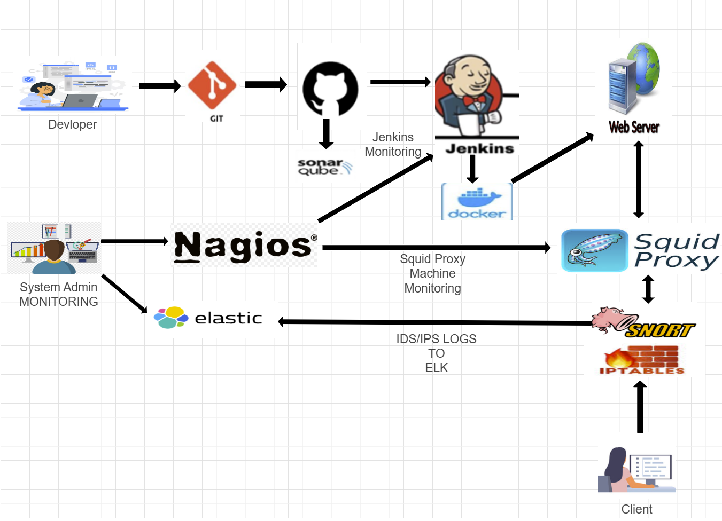
Workflow

Slide 5










Technologies
Version Control System : Github
Code Quality Checker : SonarQube
Containerization Tool : Docker
Automation Tool : Jenkins
Linux Firewall : IPTABLES
Monitoring System : Nagios
IDS : Snort
Log Analysis : ELK Stack

Slide 6
Implementation
Step 1: Developer Pushes Code to GitHub (VCS)
The developer initializes a Git repository, clones it locally, modifies the code, commits changes, and pushes updates to GitHub.
Step 2: Static Code Analysis Using SonarQube
SonarQube is set up, integrated with GitHub Actions, and runs automated scans on code pushes to detect bugs, vulnerabilities, and code quality issues.
Step 3: Automating Builds and Tests Using GitHub Actions & Jenkins
GitHub Actions triggers CI/CD workflows, installs dependencies, runs tests, and invokes a Jenkins pipeline for code analysis, Docker builds, and deployments.
Step 4: Containerizing the Application Using Docker
A Dockerfile is created, a container image is built, pushed to a registry, and deployed on a target environment.
Step 5: Deploying on a Web Server
The web server is set up with NGINX/Apache, the containerized application is deployed, and SSL is configured for secure access.

Slide 7
Step 6: Configuring Squid Proxy as a Reverse Proxy
Squid is installed, configured to forward requests securely, enforces access control, and logs incoming traffic for security monitoring.
Step 7: Implementing Iptables for Traffic Analysis
Firewall rules are set to allow necessary traffic, block unwanted connections, enforce rate limits, and log traffic for analysis.
Step 8: Monitoring Machines Using Nagios
Nagios monitors system health, network services, and infrastructure, sending alerts on downtime and performance issues.
Step 9: Intrusion Detection with Snort
Snort is deployed to detect cyber threats, logs suspicious activities, triggers alerts, and forwards data to ELK for analysis.
Step 10: Log Analysis Using ELK Stack
The ELK stack collects logs from multiple sources, processes them with Logstash, visualizes them in Kibana, and generates security alerts.

Slide 8
Conclusion
Integrating GitHub, SonarQube, GitHub Actions, Jenkins, Docker, Squid Proxy, Iptables, Nagios, Snort IDS, and the ELK Stack ensures a secure and automated CI/CD pipeline for Hashify. GitHub enables efficient version control, while SonarQube detects vulnerabilities early. GitHub Actions and Jenkins streamline builds, testing, and deployment, reducing manual effort. Docker enhances scalability and consistency across environments. Squid Proxy and Iptables strengthen network security, while Snort IDS detects intrusions. Nagios monitors system performance, and the ELK Stack provides deep log analysis. Despite management challenges, this pipeline ensures Hashify remains secure, resilient, and reliable for seamless user experience.

Slide 9
Thank You

