Slide 1

Container Managed Security
Prepared By: Darshit & _HarShaL_
Notes:
1

Slide 2
Objectives
What is Security ?
What is Container ?
What is Container Managed Security ?
Security Constraints
Authentication Mechanisms
What is Realm ?
Configuring server.xml
Benefits and limitations of container managed security
Notes:
2

Slide 3
What is security ?
Usually ensuring that only authenticated and authorized users can access specific parts of a website belongs to security.
Security has two basic concepts:
Authentication : who is it?
Authentication is the process of identifying a user interacting with an application.
Authorization : what can they do?
Authorization is the process of verifying that a user has permission to take a specific action.
Notes:
3

Slide 4
Categories of Security Mechanism
Application-managed security :
Independent of the container
However, you have to write the code yourself (or use some other mechanism)
Framework-managed security (e.g. Spring Security Framework):
All actions handled indirectly by framework
Container-managed security (e.g. Tomcat) :
Specified as part of the Java Servlet Specification
However, the implementation is container specific (and therefore not necessarily portable between containers)
Notes:
4

Slide 5
Container Managed Security
What is Container ?
A container is an environment in which our application runs.
It is also synonymous with a J2EE application server.
In terms of J2EE container , a J2EE application runs inside the container which has specific responsibilities with respect to the application.
Container Managed Security :
Container managed security provides to block unauthenticated and unauthorized access to the internal resources of the application, as configured in the “web.xml” file.
All the Authentication and Authorization is provided by Web Server itself .
Notes:
5

Slide 6
Container Managed Security
Container Authentication :
Container authentication is the process of telling the container the identity of the user making the current request.
The way a user gains access to web content.
Container Authorization :
Container authorization is the process of telling the container to grant the permission for accessing the particular resource to the authenticated user making the current request.
Notes:
6

Slide 7
Container Managed Security
All the security constraints in container managed security are in “web.xml” file.
Subelements of security-constraint:
Web resource collection (web-resource-collection)
Authorization constraint (auth-constraint)
User data constraint (user-data-constraint)
Authentication Mechanisms
Notes:
7

Slide 8
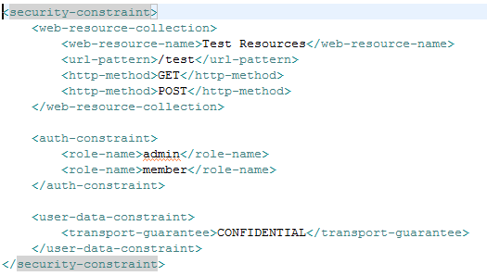
Container Managed Security
Web resource collection (web-resource-collection) : A list of URL patterns (the part of a URL after the host name and port you want to constrain) and HTTP operations (the methods within the files that match the URL pattern you want to constrain) that describe a set of resources to be protected.
Notes:
8

Slide 9
Container Managed Security
Authorization constraint (auth-constraint) :
An authorization constraint (auth-constraint) contains the role-name element. You can use as many role-name elements as needed here.
An authorization constraint establishes a requirement for authentication and names the roles authorized to access the URL patterns and HTTP methods declared by this security constraint.
Notes:
9

Slide 10

Container Managed Security
User data constraint (user-data-constraint) :
Specifies how data is protected when transported between a client and a server. User data constraints are discussed in Specifying a Secure Connection.
CONFIDENTIAL : when the application requires that data be transmitted so as to prevent other entities from observing the contents of the transmission.
INTEGRAL : when the application requires that the data be sent between client and server in such a way that it cannot be changed in transit.
NONE : to indicate that the container must accept the constrained requests on any connection, including an unprotected one.
Notes:
10

Slide 11
Authentication Mechanisms
Java EE platform supports the following authentication mechanisms :
Basic authentication
Form-based authentication
Digest authentication
Client authentication
Mutual authentication
Notes:
11

Slide 12
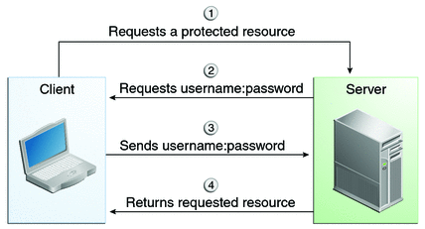

HTTP Basic Authentication
HTTP basic authentication requires that the server request a user name and password from the web client and verify that the user name and password are valid by comparing them against a database of authorized users in the specified or default Realm.
The username and password are encoded using the Base-64 algorithm and sent to the server. The Base-64 algorithm is a common Web encoding scheme that is often used to encode e-mail attachments and so on.
Notes:
12

Slide 13
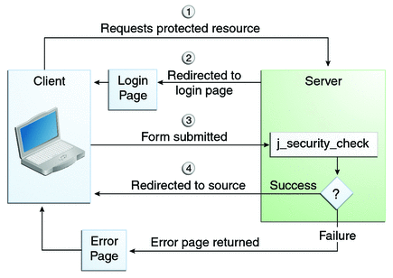
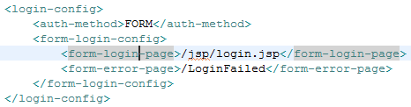
Form-based Authentication
Form-based authentication allows the developer to control the look and feel of the login authentication screens by customizing the login screen and error pages that an HTTP browser presents to the end user.
Notes:
13

Slide 14


Container Managed Security
Digest authentication : Similar to BASIC authentication except that the username and password are encrypted into a message digest value. This configuration may not be supported by all browsers.
Client authentication : The client is required to provide a digital certificate for authentication. This is the most secure configuration. However, it also is the most costly. Certificates for production use must be purchased from a certificate authority.
Notes:
14

Slide 15
What is Realm ?
A Realm is a "database" of usernames and passwords that identify valid users of a web application .
It also provides enumeration of the list of roles associated with each valid user.
There are total 5 types of Realm Attributes that is listed as below :
MemoryRealm
JDBCRealm
DataSourceRealm
UserDatabaseRealm
JAASRealm
Notes:
15

Slide 16
Tomcat Realm
MemoryRealm - Accesses authentication information stored in an in-memory object collection, which is initialized from an XML document (conf/tomcat-users.xml).
JDBCRealm - Accesses authentication information stored in a relational database, accessed via a JDBC driver.
DataSourceRealm - Accesses authentication information stored in a relational database, accessed via a named JNDI JDBC DataSource.
JNDIRealm - Accesses authentication information stored in an LDAP based directory server, accessed via a JNDI provider.
UserDatabaseRealm - Accesses authentication information stored in an UserDatabase JNDI resource, which is typically backed by an XML document (conf/tomcat-users.xml).
JAASRealm - Accesses authentication information through the Java Authentication & Authorization Service (JAAS) framework.
Notes:
16

Slide 17
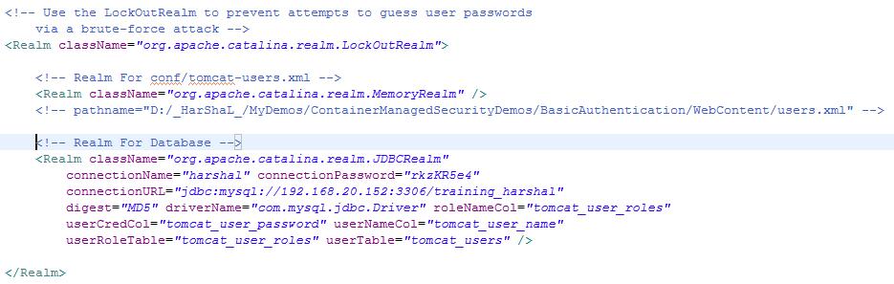
Configuring server.xml
Digest algorithms supported by the java.security.MessageDigest class (SHA, MD2, or MD5).
Notes:
17

Slide 18
Benefits of Container Managed Security
It is declarative. Authentication and authorization are specified in the web.xml file. Container-specific details, such as the security realm, typically are configured in server-specific XML configuration files.
It supports multiple authentication schemes, such as FORM-based authentication, authentication using client-side digital certificates etc.
Using container-specific security realms, user data can be provided by a variety of stores, including flat files, relational databases, and Lightweight Directory Access Protocol (LDAP) servers.
Redirects are handled automatically. In other words, the container determines when a user is accessing a protected URL, prompts for user credentials, and, if authenticated, redirects to the requested page. This is a powerful mechanism, particularly for applications that publish links to protected pages in e-mail communications.
Notes:
18

Slide 19
Limitations of Container Managed Security
The implementation of container-managed security varies by container. An application using container-managed security generally requires modification at some level when ported from one application server to another.
The login flow does not allow any additional processing performed in the authentication process.
Authorization can only use a flat, role-based approach. Access to Web pages cannot be granted based on multiple factors, for example, a managerial level and a department number.
Container-managed authentication requires changes to the application server's configuration that may not be allowed in a hosted environment.
Notes:
19

Slide 20

Notes:
20

Slide 21

Thank You
Lolz

