Slide 1
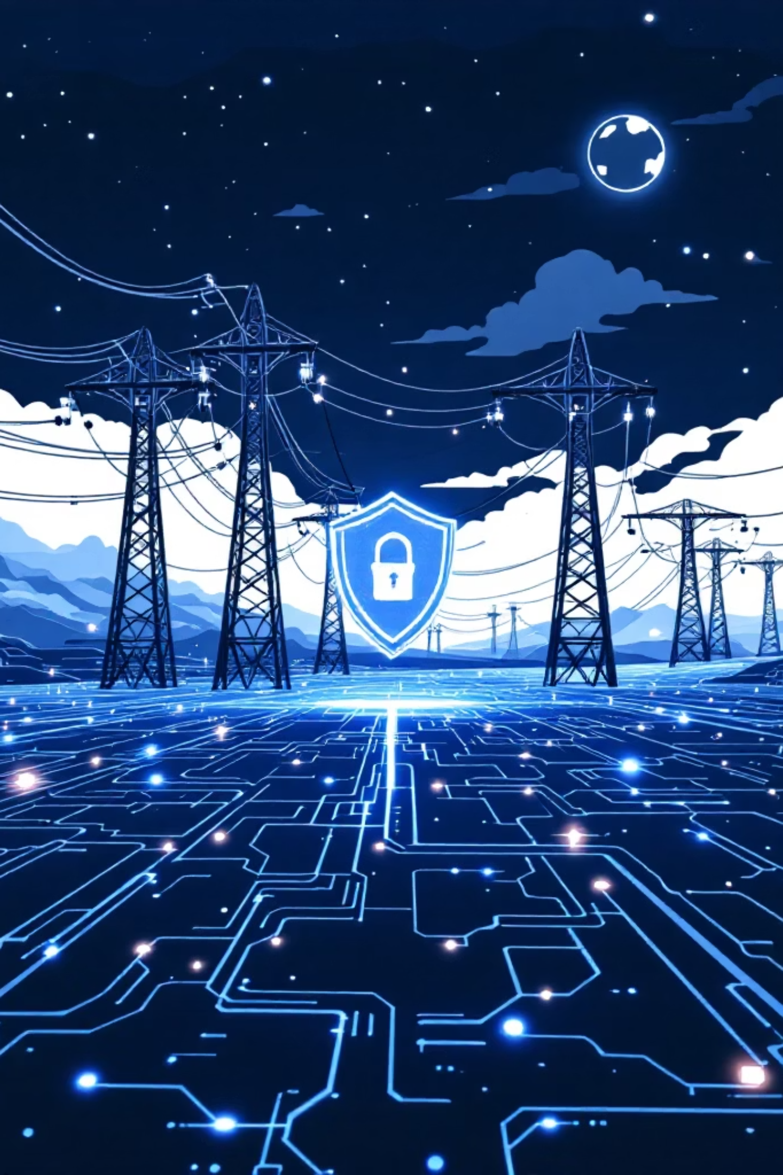

CYBER THREAT INTELLIGENCE
2026 SECTORIAL ASSESSMENT
Cyber Risk Sectorial Assessment: Utilities Sector 2026
A comprehensive threat landscape analysis for risk executives evaluating credit and operational counterparty exposure across the European Union's critical infrastructure.

Slide 2
CHAPTER 1
KEY THREATS & ATTACK VECTORS
Top 5 Cybersecurity Threats in the Utilities Sector
As power generation, water distribution, and environmental systems adopt IIoT, 5G, and cloud-integrated control loops, the attack surface has expanded exponentially. Threat actors have evolved from passive espionage to actively mapping industrial control loops with capability to manipulate physical processes remotely.
AI-Accelerated Attacks
Identity-Driven Intrusions
Supply Chain Exploits
87% of investigations flag AI vulnerabilities as the fastest-growing risk. Lateral breakout time has plummeted to 48 minutes — a 22% acceleration.
Identity weaknesses factor in ~90% of investigations. AI-generated deepfakes account for 37% of all AI-driven breaches, bypassing MFA via social engineering.
65% of large organizations cite third-party vulnerabilities as a massive barrier. State-aligned actors embed malware via trusted vendor software repositories.
Ransomware & Extortion
Legacy OT Vulnerabilities
Ransomware targeting critical infrastructure spiked 149% in early 2025. Double and triple extortion tactics now exfiltrate SCADA configs and customer data.
45% of utilities operate severely outdated systems. Zero-days are weaponized within days of disclosure — legacy environments cannot be patched without unacceptable downtime.
Utilities-Specific Architectural Vulnerabilities
OT systems — PLCs, DCS, HMIs — were engineered decades ago to prioritize physical availability over digital security. Foundational protocols like Modbus and DNP3 transmit commands in plain text without encryption, authentication, or session validation, enabling adversaries to spoof commands or launch replay attacks.
Modbus Protocol
The rapid deployment of IIoT edge devices for "smart grids" has introduced massive, unmonitored attack surfaces. Many remote terminal units rely on hardcoded firmware with critical vulnerabilities that cannot be patched due to hardware limitations. Devices lacking firmware verification can be permanently bricked by attackers — an irreversible loss of view and control.
Plain text, no encryption, no authentication — highly susceptible to interception and spoofing
IIoT Edge Devices
The unchecked proliferation of "shadow AI" — unsanctioned public AI models used by engineers — accounts for 20% of recent data breaches, stripping governance over proprietary industrial data.
Hardcoded firmware, no verification — permanent destruction possible via software attacks
Shadow AI Risk
20% of breaches linked to unsanctioned AI model usage by operational staff

Slide 3
CHAPTER 2
FINANCIAL IMPACT
Financial Impact of Cyber Incidents in the Utilities Sector
The cost of a cyber breach is no longer a localized IT expense — it is a material financial event capable of eroding years of profitability and triggering intense regulatory sanctions.
$4.44M
$10.22M
$5.56M
$4.83M
Global Average
U.S. Record High
Industrial Sector
Energy Sector
Average cost of a data breach globally (2025)
Driven by aggressive regulatory penalties and forensic costs
18% YoY increase — 3rd most expensive industry globally
Penalizing operators who fail to secure distributed networks
Extended Incident Lifecycle in Industrial Environments
199 Days
73 Days
Key Financial Metrics
Average time to identify a network intrusion in OT environments
Additional time to fully contain the threat
Malicious insiders: $4.92M avg. cost — costliest attack vector
Skills shortage penalty: $5.22M vs. $3.65M for fully staffed orgs
Shadow AI liability: +$670K added per breach
This extended dwell time grants adversaries unmitigated access to escalate privileges and exfiltrate sensitive data, exponentially increasing financial impact.
AI-automated defense savings: $1.9M saved per breach
Cost Breakdown by Category
Detection & Escalation
Specialized ICS forensic experts, board-level crisis management, physical response teams deployed to remote substations to secure air-gapped systems
Notification
NIS2 and GDPR compliance — specialized legal counsel for cross-border regulatory disclosures within rigid 24-hour and 72-hour reporting windows
Post-Breach Response
Heaviest burden: rebuilding corrupted OT architecture, identity protection, regulatory fines (NERC CIP penalties up to $1M/day/violation)
Lost Business
86% of breached orgs experience physical operational disruption — revenue loss during downtime, reputational destruction, customer churn

Slide 4
CHAPTER 3
WORST-CASE SCENARIOS
Financial Impact: Catastrophic Cyber Incident Scenarios
The true threat profile of the utilities sector is defined by exposure to catastrophic, worst-case scenarios. Because power, water, and telecommunications are the foundational bedrock of all economic activity, severe utility compromises generate massive macroeconomic shocks.
$300B+
$172B+
$43.5B/Day
Total modeled financial impact from a severe, coordinated cyber event targeting global OT
Direct business interruption costs from cascading supply chain failures and systemic paralysis
U.S. economic activity jeopardized by a single day of disrupted water service
Supply Chain Cascading Failures
A recent cyberattack on a major automotive manufacturer illustrates utility interconnectedness: production halted for five weeks, paralyzing over 5,000 downstream suppliers. Direct cost: $260M with a 25% quarterly revenue drop. The wider regional economy absorbed an estimated $2.5B in macroeconomic losses.
Water Sector
This magnitude of disproportionate, asymmetric economic damage is the precise strategic goal of nation-state actors targeting power grids and water treatment facilities. Incidents in the financial sector triggered by power or communication outages could lead to severe "cyber runs" on banks, undermining confidence in the global financial system.
Adversaries target PLCs to manipulate chemical dosages to toxic levels or destroy pipeline infrastructure
Financial Contagion
Power outages could trigger severe liquidity crises and systemic banking instability
Long-Term Financial Consequences
Credit Downgrades
Capital Structure Erosion
Moody's and S&P now integrate cyber risk into credit analysis. Ratings remain depressed for up to 3 years post-breach — comparable to a major natural disaster.
Downgraded utilities face heightened cash flow volatility, forced to issue debt at longer maturities and significantly higher interest rates — crippling infrastructure investment.
Insurance Market Constriction
Permanent Revenue Loss
Astronomical premium spikes, reduced coverage limits, ambiguous cyberwarfare exclusions, and protracted litigation with insurers compound the initial financial shock.
Industrial customers seek decentralized energy alternatives for supply security — leading to permanent, unrecoverable revenue erosion for the compromised utility.

Slide 5
CHAPTER 4
CASE STUDY
Case Study: Poland Energy Sector Attack — December 29, 2025
A definitive illustration of modern OT cyber risk: a coordinated cyber sabotage campaign targeting Polish energy and manufacturing during severe winter storms and sub-zero temperatures. This incident demonstrates the complete transition of threat actors from intelligence gathering to outright physical destruction.
Attack Profile
Operational Impact Timeline
Attribution: Russian state-sponsored threat cluster Static Tundra (Sandworm / Berserk Bear / FSB Center 16)
March 2025
Targets: 30+ renewable energy facilities, a major CHP plant serving ~500,000 customers, and a private manufacturer
Initial infiltration of CHP plant. Nine months of stealthy reconnaissance — mapping architecture, harvesting credentials, escalating privileges.
Nature: Purely destructive — described as "coordinated cyber arson"
Dec 2025 (Pre-Execution)
Initial Access: Exploiting vulnerable, internet-facing edge devices with unpatched vulnerabilities and default credentials
Widespread exploitation of end-of-support edge devices across 30+ renewable farms. DynoWiper payload staged on compromised RTUs.
Payload: Custom-built "DynoWiper" malware — engineered to irreversibly destroy data, corrupt firmware, and permanently damage remote terminal units
Dec 29, 2025
Coordinated simultaneous detonation across all targets — timed with severe winter storms to maximize humanitarian impact.
Financial Impact & Outcome
At renewable farms, DynoWiper destroyed HMI data and corrupted firmware — total loss of view and control. However, physical generation continued autonomously via local PLC logic. At the CHP plant, the catastrophic intent to disrupt heating for 500,000 citizens failed completely — the payload was intercepted by the plant's internal EDR software. Financial impact was contained to incident response costs, forensic investigations, and capital-intensive replacement of permanently bricked edge devices.
Key Lessons Learned
1
2
3
4
Retire Vulnerable Edge Devices
Hardware-Based Recovery
EDR at the OT Boundary
Proactive Threat Hunting
Internet-facing, end-of-support hardware that cannot support modern cryptographic standards must be aggressively identified and retired.
OT devices lacking firmware verification are subject to permanent physical destruction — offline backup and recovery strategies are essential.
The CHP plant's successful containment was entirely dependent on properly configured EDR — deep network visibility is mandatory in legacy environments.
Adversaries dwell within critical networks for nearly a year — shift from reactive perimeter defense to continuous exposure management.

Slide 6

CHAPTER 5
MITIGATION STRATEGIES
Evidence-Based Cybersecurity Strategies for Utilities 2026
Utilities must abandon legacy compliance-based approaches and adopt fundamentally aggressive, evidence-based mitigation strategies. Cybersecurity is now a core pillar of operational resilience, capital preservation, and regulatory adherence.
NIS2 Directive: The Regulatory Foundation
The NIS2 Directive (mandatory since October 2024) classifies energy, water, wastewater, and digital infrastructure as "Sectors of High Criticality". It mandates all-hazards cyber risk management including incident handling, supply chain security, cryptography, and continuous vulnerability auditing.
Critical: Regulatory compliance does not equal active security. True cyber resilience demands evidence-based controls that yield quantifiable, verifiable risk reduction beyond NIS2 minimums.
NIS2 establishes direct personal legal liability for C-level executives and boards for gross negligence, enforced alongside penalties of up to €10M or 2% of global annual revenue. Initial IT/OT gap bridging frequently consumes up to 70% of first-year compliance budget.
Implementation Metrics
Strategy
Effectiveness
Implementation Cost
Expected ROI
Micro-Segmentation & Purdue Model
Cryptographically isolates PLCs/SCADA from corporate IT. Prevents lateral ransomware movement into physical plant.
High upfront CAPEX. Full architecture redesign, industrial firewalls, planned OT downtime.
High (4x–10x): Modeled $850K ransomware incident averted by $200K investment.
MFA & Secure Remote Access
Neutralizes credential harvesting and unauthorized vendor access. Top insurer-ranked control.
Low-to-Medium. Identity management licensing, hardware tokens for restricted environments.
Very High: Closes primary vector for ~90% of identity-driven intrusions.
Passive OT Monitoring & Asset Inventory
100% real-time visibility into edge devices. Detects anomalous Modbus/DNP3 traffic without disrupting operations.
Medium. Ruggedized OT sensors, traffic mirroring, continuous SOC analyst engagement.
Medium-High: Slashes MTTD — contains threats in minutes vs. months.
CEM & EDR Deployment
Predicts attack paths and neutralizes malware at endpoints before reaching control logic. Proven in Poland CHP case.
Medium-High. AI-driven platforms, skilled threat hunters for tuning and false positive management.
High: 3x less likely to suffer breaches. Avoids NIS2 penalties and preserves credit ratings.
Security ROI Framework
The shift toward proactive, intelligence-driven defense is not merely a technological upgrade — it is a fundamental economic requirement for the survival of the utilities sector. Translating cyber risks into quantifiable financial metrics ensures continuous, safe operation while protecting financial solvency in an increasingly hostile and heavily regulated digital landscape.
Risk Reduction Value = Probability of incident × Total estimated financial damage (regulatory fines + operational downtime + asset replacement + reputational loss)

