Slide 1

CYBER RISK SECTORIAL ASSESSMENT
AUTOMOTIVE SECTOR 2026
Automotive Cybersecurity: Threat Landscape & Risk Assessment
A comprehensive intelligence briefing for Risk Executives on the evolving cyber threat environment targeting the automotive and smart mobility ecosystem — based on 494 publicly reported incidents in 2025 and the landmark Jaguar Land Rover systemic event.
Prepared by Cyber Threat Intelligence | February 2026

Slide 2

CHAPTER 1
KEY THREATS & VULNERABILITIES
Top 5 Cybersecurity Threats & Automotive-Specific Vulnerabilities
Analysis of 494 incidents across the automotive ecosystem in 2025 reveals five dominant threat categories demanding immediate executive attention. The convergence of software-defined vehicles, AI integration, and API-driven connectivity has created an attack surface extending far beyond traditional vehicle boundaries.
Ransomware Dominance
API-Centric Attacks
Supply Chain Compromise
44% of all incidents — more than doubling from 2024. 108 attacks with 214 associated data breaches. Average demand: $5.08M. Vehicle-level ransomware demonstrated mid-2025.
67% of incidents involved telematics/cloud systems. CDK Global breach hit 15,000 dealerships — $1.02B losses. LLM prompt injection emerging as new vector.
Third-party involvement nearly doubled to 30% of incidents. Inverse relationship between supply chain depth and security maturity creates structural vulnerability.
Data Exfiltration
EV Charging Infrastructure
68% of incidents involved data theft. 530 vulnerabilities identified in 2024, including 174 zero-days from Pwn2Own Automotive. Location/telemetry data at highest risk.
Cross-sector risk: V2G Evil tool demonstrated grid manipulation. Botnet-driven grid destabilization via coordinated chargers poses national security implications.
Automotive-Specific Structural Vulnerabilities
Software-Defined Vehicle Risks
Third-Party & Open-Source Risks
OTA update mechanisms create persistent attack vectors. Innovation velocity inversely correlates with security maturity at higher abstraction layers — hypervisor and container runtime layers remain low maturity.
Modern vehicles incorporate 100M+ lines of code, majority from third-party and open-source sources. SBOM adoption remains inconsistent — often compliance artifacts rather than operational tools.
IT/OT Convergence Gaps
AI/ML System Vulnerabilities
Manufacturing systems connected to enterprise networks without corresponding security evolution. IT incidents automatically become OT incidents — a fundamental architectural vulnerability across the industry.
Adversarial examples against AV perception, prompt injection in voice assistants, data poisoning in predictive maintenance. Security methodologies for AI remain less mature than traditional software.

Slide 3
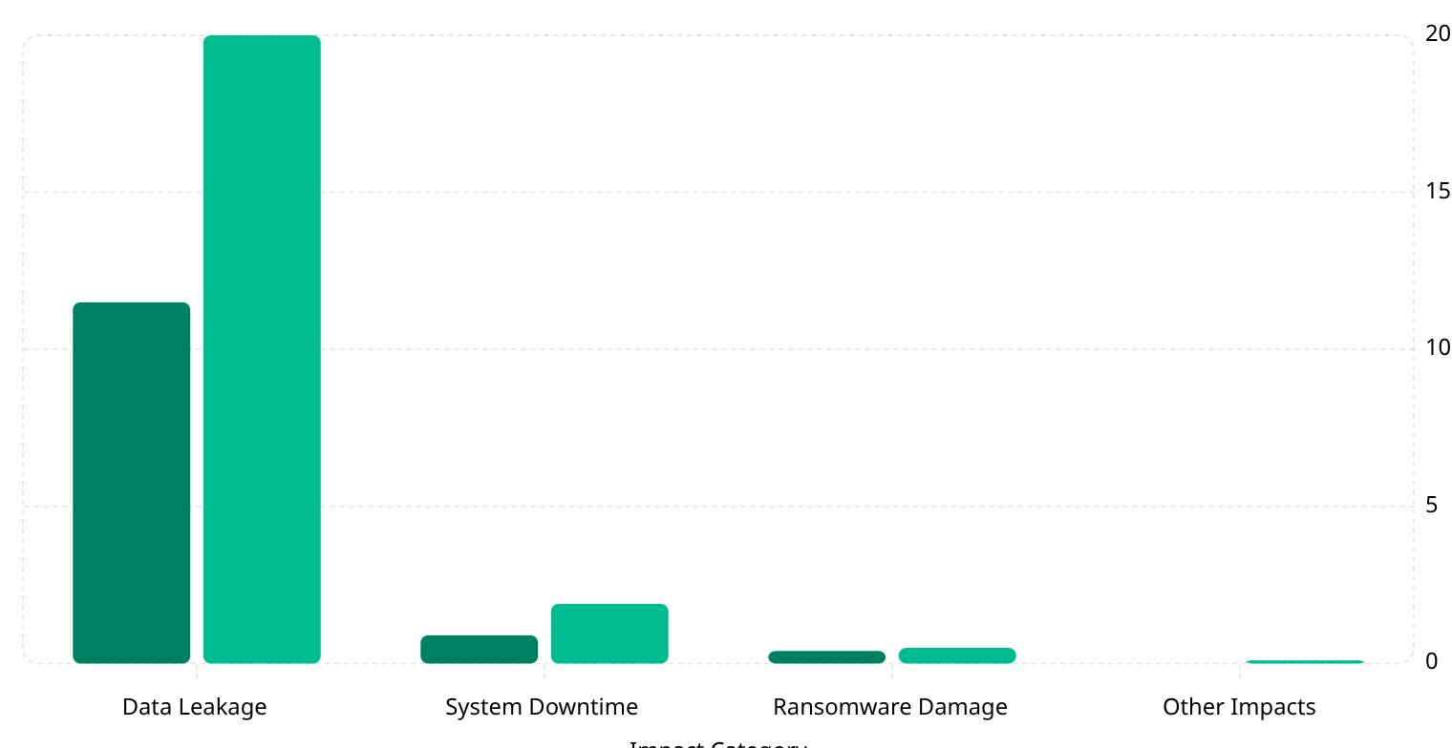
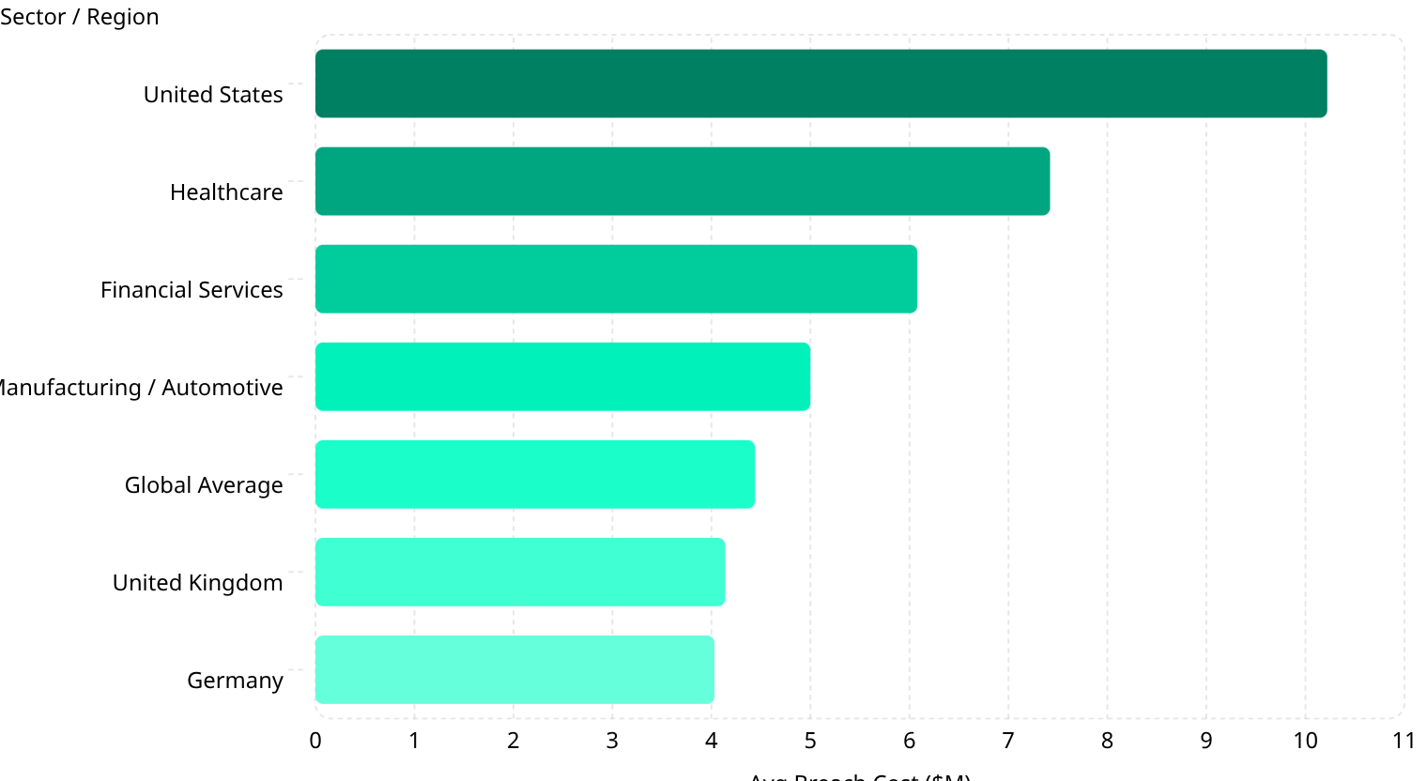
CHAPTER 2
FINANCIAL IMPACT
Financial Impact of Cyber Incidents in the Automotive Sector
Total estimated impact reached $22.5 billion in 2024 — a 76% year-over-year increase from $12.8 billion. This growth substantially exceeds general cyber risk trends, indicating automotive-specific amplification factors.
2023 ($B)
2024 ($B)
Data leakage dominates at 89% of total impact. System downtime costs doubled (+111%), indicating attackers increasingly target operational systems. Ransomware damage grew modestly (+25%) despite volume doubling — operational disruption, not ransom payment, is the primary financial driver.
Cost Breakdown by Category
1
2
3
Direct Costs
Indirect Costs
Automotive-Specific Drivers
Business disruption: $3.26M (59%). Detection & response: $1.44M (28%). Regulatory fines: ~$0.53M. JLR recognized £260M in direct cyber costs vs. £485-795M revenue losses.
Supply chain penalties: £127M. Supplier support: £156M + £1.5B guarantee. Customer compensation, increased insurance premiums, and multi-year market share loss with 43% wholesale decline.
Production shutdown: ~£50M/week. Vehicle recall: $500M-1B per campaign. Engineering security overhead: 10-15%. Fixed cost structure with no substitution amplifies losses.
Average Breach Cost: Automotive vs. All Industries (2025)
The automotive sector carries a 12.6% premium over the global average, driven by OT integration, IP value, and supply chain complexity. The composite automotive premium is estimated at +75-120% vs. pure IT, with tail risk unbounded — JLR's £882M company losses far exceeded any average.

Slide 4

CHAPTER 3
WORST-CASE SCENARIOS & LONG-TERM CONSEQUENCES
Catastrophic Cyber Incident Scenarios
The JLR Category 3 event — £1.9 billion UK economic impact — established empirical foundation for scenario calibration. However, evolving connectivity creates potential for incidents that substantially exceed historical experience.
Mass Fleet Immobilization
Critical Infrastructure Failure
AV Safety System Compromise
100,000+ vehicles compromised simultaneously. $40-115 billion total estimated impact. 61% of 2025 incidents had potential to impact thousands to millions of assets. Vehicle-level ransomware is no longer theoretical.
Coordinated EV charging attack exploiting grid integration. $5-15 billion estimated impact. Tens of millions of V2G-capable vehicles by 2030 create sufficient capacity to overwhelm grid balancing.
Adversarial manipulation of autonomous perception systems. $60-210 billion estimated impact. Potential for permanent AV deployment halt. Transferability across architectures creates common mode failure risk.
Long-Term Financial Consequences: JLR Evidence
Period
Metric
Impact
Systemic & Macroeconomic Effects
Q2 FY26
Pre-tax loss
£485M (vs. £398M profit prior year)
GDP impact: -0.17 percentage points (Bank of England attribution)
Employment: 104,000+ supply chain jobs at risk
Government intervention: £1.5B loan guarantee — public risk absorption precedent
Insurance market: JLR reportedly underinsured; sector-wide capacity contraction
Q2 FY26
Revenue decline
24%
Q3 FY26
Wholesale decline
43.3%
Q3 FY26
Retail decline
25.1%
YTD FY26
Cumulative loss
£444M (vs. £1.6B profit prior year)
Full financial recovery extends well beyond operational recovery. Market share erosion may be potentially permanent — customers substitute and may not return.

Slide 5
CHAPTER 4
CASE STUDY
Case Study: Jaguar Land Rover Cyberattack (August–November 2025)
The most financially damaging cyber event in UK history. Classified CMC Category 3 — the highest severity ever assigned. £1.9 billion ($2.5B) total UK economic impact across 5,000+ organizations. Ciaran Martin, former NCSC CEO: "By some distance, the single most financially damaging cyber event ever to hit the UK."
Late Aug 2025
1
Intrusion detected. Social engineering vector by "Scattered Lapsus$ Hunters."
2
Sep 1, 2025
Proactive global IT shutdown. All production halted — UK, Slovakia, China, India, Brazil.
Sep 28, 2025
3
Government announces £1.5B loan guarantee and supplier financing.
4
Oct 1-14
Phased restart attempts. Multiple setbacks from system contamination.
Mid-Nov 2025
5
Normal production restored. ~11 weeks total from detection to full restoration.
Financial Impact Summary
£882M
£1.9B
27%
£1.5B
Total Company Impact
UK Economic Impact
UK Car Production Drop
Government Guarantee
Recognized costs + revenue loss + supply chain support
CMC estimate across 5,000+ affected businesses
September 2025 — worst since 1952
UK Export Finance loan to stabilize supply chain
Key Lessons Learned
IT/OT Convergence Failure
Supply Chain Cascade
Insurance Gap
Governance Elevation Required
Manufacturing fully dependent on IT — single point of failure with no graceful degradation. Binary shutdown decision required.
5,000+ organizations affected. £156M direct supplier support + £1.5B government guarantee required to prevent economic contagion.
Reportedly no active cyber insurance policy at time of attack. Failed finalization attempts indicate market capacity constraints for automotive risk.
Board-level cyber risk committee with CEO accountability. Pre-negotiated government intervention frameworks and structured supplier notification protocols.

Slide 6



CHAPTER 5
MITIGATION & RECOMMENDATIONS
Mitigation Strategies & Implementation Framework
Evidence-based cybersecurity approaches for the automotive sector, with ROI benchmarked against demonstrated incident costs. JLR's £50M/week downtime provides compelling justification for proactive investment.
Implementation Metrics Summary
Strategy
Effectiveness
Cost
ROI
Priority
Zero Trust IT/OT
60% risk reduction
$2-5M (mid-size OEM)
3:1 / 24 mo
CRITICAL
AI Threat Detection
25% incident reduction
$1-3M + $500K/yr
4:1 / 18 mo
High
Supply Chain Security
40% supply chain risk reduction
$500K-1.5M
5:1 / 12 mo
CRITICAL
SSDLC / ISO 21434
50% vulnerability reduction
10-15% dev overhead
6:1 / 24 mo
High
OT Resilience
70% downtime reduction
$5-15M (major facilities)
2:1 / 12 mo
CRITICAL
Bank-Specific Risk Mitigation Recommendations
Due Diligence
Credit Risk Management
Portfolio & ESG Integration
Mandatory cybersecurity assessment: IT/OT segmentation, insurance adequacy, supply chain risk. Explicitly evaluate coverage gaps — JLR had no active policy.
Cyber risk covenants, supply chain financing limits, stress testing for Category 3+ scenarios with cascade multiplier effects and extended recovery timelines.
Board-level cyber accountability as governance factor. Valuation adjustments for cyber exposure. Active engagement on incident preparedness and recovery investment.
Regulatory & Standards Foundation
UN R155/R156
ISO/SAE 21434
EU Cyber Resilience Act
Mandatory for new vehicle types since 2024. Cybersecurity management systems and software update governance. Market access requirement — intensifying enforcement.
Road vehicle cybersecurity engineering standard. Becoming procurement prerequisite across Tier 1-3 suppliers. Contractual requirement in major OEM programs.
Phased implementation 2024-2027. Product security requirements and mandatory vulnerability disclosure. Expanding scope with penalty escalation.
Executive Summary: The automotive sector's cyber risk profile has fundamentally transformed. Ransomware dominance (44%), API attack surface explosion (67%), supply chain systemic risk (JLR: £1.9B), and cyber insurance market failure demand mandatory cybersecurity due diligence, sectoral concentration limits, and Category 3+ stress testing for all EU financial institution automotive exposure. Investment priority: Zero-trust and supply chain security programs deliver 3-5:1 ROI within 24 months.

