Slide 1
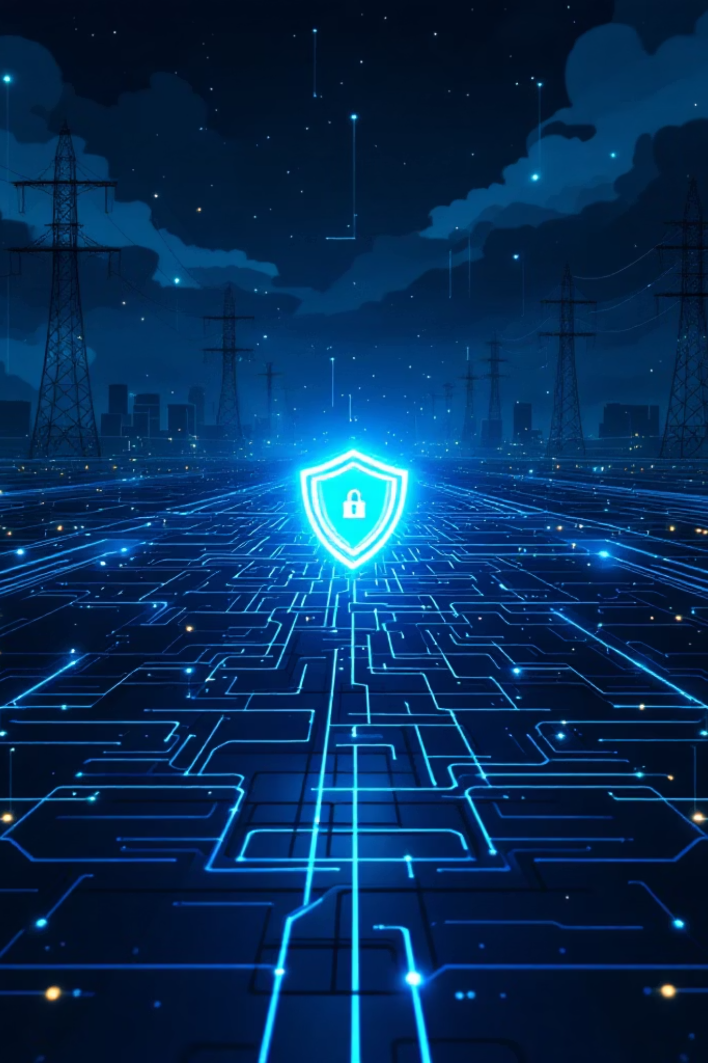

CYBER THREAT INTELLIGENCE
2026 SECTORIAL ASSESSMENT
Cyber Risk Sectorial Assessment: Utilities Sector 2026
Prepared for Risk Executives — European Union Financial Institution
February 2026

Slide 2
CHAPTER 1
KEY THREATS & ATTACK VECTORS
Top 5 Cybersecurity Threats in the Utilities Sector
The convergence of legacy OT infrastructure with IIoT, 5G, and cloud-integrated control loops has exponentially expanded the attack surface. Threat actors have evolved from passive espionage to actively mapping industrial control loops and manipulating physical processes remotely.
01
02
03
AI-Accelerated Attacks
Identity-Driven Intrusions
Supply Chain & Third-Party Dependencies
87% of incident response investigations cite AI vulnerabilities as the fastest-growing risk. Agentic AI automates reconnaissance and rewrites malicious code dynamically. Average lateral movement breakout time: 48 minutes (22% faster than prior years).
Identity weaknesses are a material factor in ~90% of investigations. AI-generated deepfakes and advanced phishing account for 37% of all AI-driven breaches, bypassing MFA through social engineering of third-party contractors.
65% of large organizations cite third-party vulnerabilities as a massive barrier to resilience. State-aligned adversaries infiltrate trusted vendor software repositories to embed stealthy malware deep into OT networks.
04
05
Ransomware & Targeted Extortion
Unpatched Software & Legacy OT Vulnerabilities
Ransomware targeting critical infrastructure spiked 149% in early 2025. Threat groups now employ double and triple extortion — encrypting data, exfiltrating SCADA configurations, and threatening public release.
45% of utility organizations operate severely out-of-date, unsupported systems. Zero-days are weaponized within days of disclosure — legacy environments cannot be patched without unacceptable operational downtime.
Utilities-Specific Architectural Vulnerabilities
Unlike standard IT environments, OT systems — PLCs, DCS, and HMIs — were engineered decades ago to prioritize physical availability over digital security. Foundational protocols like Modbus and DNP3 transmit commands in plain text without encryption, authentication, or session validation, enabling command spoofing and replay attacks.
IIoT Edge Device Exposure
Shadow AI Risk
Rapid "smart grid" deployment has introduced massive, unmonitored attack surfaces. Many remote terminal units rely on hardcoded firmware with critical vulnerabilities that cannot be patched due to hardware limitations. Devices lacking firmware verification can be permanently bricked by attackers.
Engineers utilizing unsanctioned public AI models to optimize code or process operational data account for 20% of recent data breaches, stripping the organization of governance over proprietary industrial data and introducing hidden, unmonitored exposure.

Slide 3
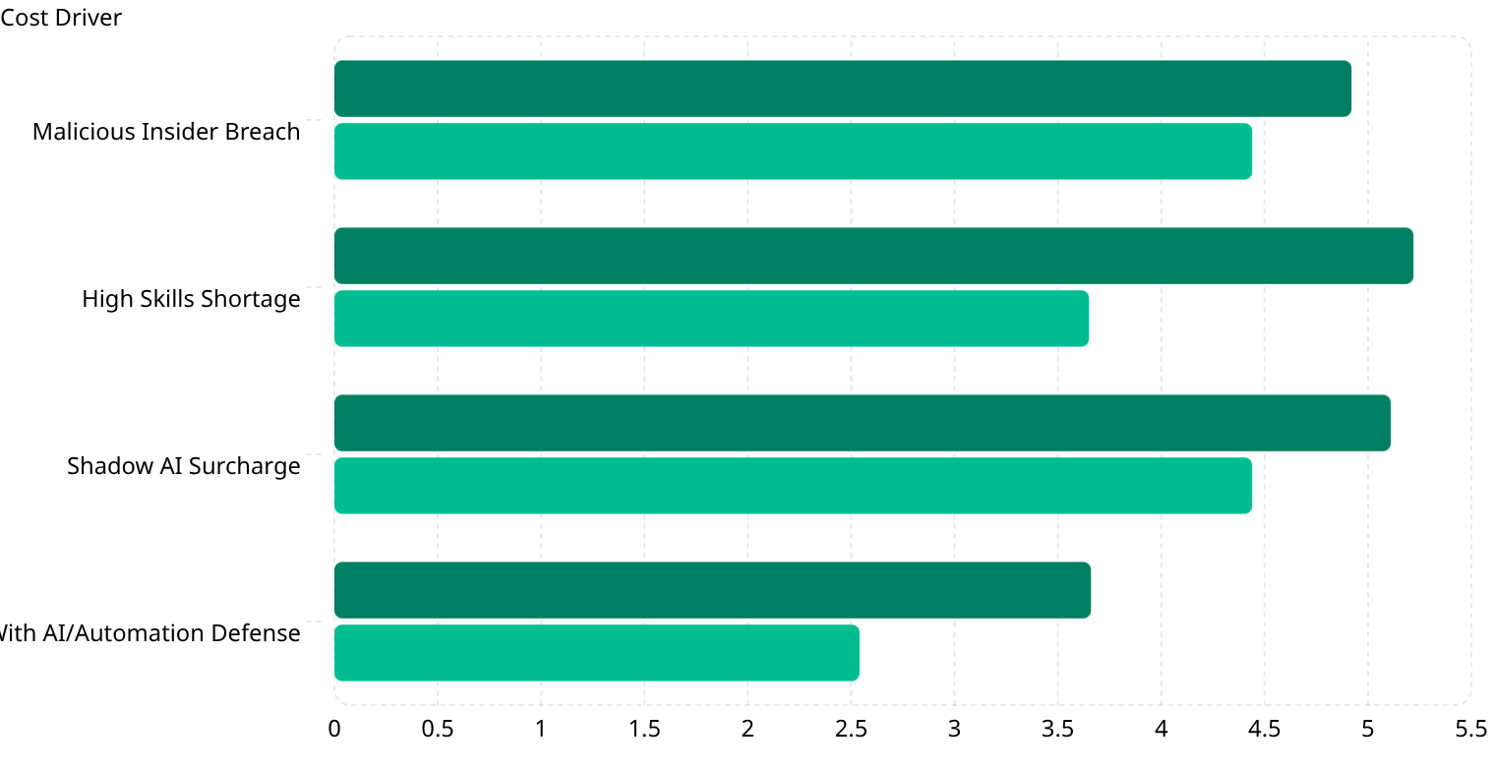
CHAPTER 2
FINANCIAL IMPACT
Financial Impact of Cyber Incidents in the Utilities Sector
The cost of a cyber breach is no longer a localized IT expense — it is a material financial event capable of eroding years of profitability and triggering severe regulatory sanctions. Extended incident lifecycles in industrial environments amplify damages exponentially.
$4.44M
$10.22M
$5.56M
$4.83M
Global Average
U.S. Record High
Industrial Sector
Energy Sector
Average cost of a data breach globally (2025)
Driven by aggressive regulatory penalties and forensic costs
18% YoY increase — 3rd most expensive industry globally
Penalizing operators with complex distributed networks
Industrial organizations take an average of 199 days to identify an intrusion and 73 additional days to contain it — granting adversaries unmitigated access to escalate privileges and exfiltrate sensitive data.
Cost Breakdown by Category
Detection & Escalation
Notification
Post-Breach Response
Lost Business
Specialized ICS forensic experts, board-level crisis management, physical response teams to remote substations
NIS2 & GDPR compliance — cross-border regulatory disclosures within rigid 24-hour and 72-hour reporting windows
Heaviest burden: rebuilding OT architecture, regulatory fines up to $1M/day per NERC CIP violation
86% of breached orgs experience physical disruption — revenue loss, reputational destruction, customer churn
Key Financial Metrics: Utilities vs. All Industries
Utilities / Industrial ($M)
Global Average ($M)
Organizations extensively utilizing security AI and automated threat response save an average of $1.9M per breach. Shadow AI adds ~$670K in hidden liabilities per incident. The cybersecurity skills shortage inflates costs by up to 43%.

Slide 4

CHAPTER 3
WORST-CASE SCENARIOS
Financial Impact: Catastrophic Cyber Incident Scenarios
The true threat profile of the utilities sector is defined by exposure to catastrophic, worst-case scenarios. Power, water, and telecommunications are the foundational bedrock upon which all economic activity rests — severe compromise generates massive macroeconomic shocks far beyond the targeted entity.
$300B+
$172B+
$43.5B/day
Total modeled financial impact of a severe, coordinated global OT cyber event
Direct business interruption costs from cascading supply chain failures
U.S. economic activity jeopardized by a single day of disrupted water service
Cascading Failure: The Asymmetric Damage Model
A recent cyberattack on a major automotive manufacturer illustrates utility interconnectedness: production halted for five weeks, paralyzing 5,000+ downstream suppliers.
Direct financial impact: $260M, 25% quarterly revenue drop
Wider regional macroeconomic losses: $2.5B
This disproportionate, asymmetric damage is the precise strategic goal of nation-state actors targeting power grids and water treatment facilities
Power or communication outages could trigger severe "cyber runs" on banks, undermining confidence in the global financial system and causing liquidity crises.
Long-Term Financial Consequences
Credit Rating Depression
Insurance Market Constriction
Permanent Revenue Erosion
Moody's and S&P have integrated cyber risk into credit analysis. Post-breach, ratings remain severely depressed for up to 3 years. Utilities must issue debt at longer maturities and higher interest rates, crippling renewable energy investment capacity.
Underwriters are selectively retreating from the market. Post-breach utilities face astronomical premium spikes, reduced coverage limits, and ambiguous cyberwarfare exclusions — leading to protracted litigation and massive reserve requirements.
Loss of market confidence triggers behavioral shifts: enterprise and industrial customers seek alternative decentralized energy solutions, leading to permanent, unrecoverable revenue loss for the compromised utility.

Slide 5
CHAPTER 4
CASE STUDY
Case Study: Poland Energy Sector Attack — December 29, 2025
During severe winter storms and sub-zero temperatures, a coordinated cyber sabotage campaign targeted Polish energy and manufacturing sectors — demonstrating the complete transition from intelligence gathering to outright physical destruction using tailored malware.
Attack Profile
Threat Actor
Operational Impact Timeline
Static Tundra (aka Sandworm / Berserk Bear / FSB Center 16) — Russian state-sponsored
March 2025 — Initial Infiltration
Targets
CHP plant compromised. Threat actors began 9-month stealthy reconnaissance — mapping architecture, harvesting credentials, escalating privileges across deeply embedded industrial systems.
30+ renewable energy facilities, a major CHP plant serving ~500K customers, a private manufacturer
December 2025 — Pre-Execution
Malware
Widespread exploitation of end-of-support edge devices across 30+ renewable farms. DynoWiper payload staged on compromised remote terminal units.
DynoWiper — custom-built to irreversibly destroy data, corrupt firmware, and permanently brick remote terminal units
December 29, 2025 — Detonation
Nature
Simultaneous coordinated detonation across all targets — deliberately timed with severe winter storms to maximize humanitarian and economic impact.
Purely destructive — classified as deliberate, coordinated cyber arson
Financial Impact & Outcome
At renewable farms, HMI data was destroyed and firmware corrupted — causing total loss of view and control. However, physical generation continued autonomously via local PLC logic. At the CHP plant, the DynoWiper payload was successfully intercepted and blocked by EDR software, completely preventing catastrophic heating disruption for 500K citizens. Financial impact was contained to incident response costs, forensic investigations, and capital-intensive replacement of permanently bricked edge devices.
Key Lessons Learned
Retire Vulnerable Edge Devices
Hardware-Based Backup for OT
Internet-facing, end-of-support hardware that cannot support modern cryptographic standards must be aggressively identified and retired.
Devices lacking firmware verification are subject to permanent physical destruction via software — offline recovery strategies are mandatory.
EDR at the IT/OT Boundary
Proactive Threat Hunting
The CHP plant's survival was entirely dependent on properly configured EDR — deep network visibility and behavioral analysis are mandatory controls.
Adversaries dwelled for 9 months undetected. Organizations must shift from reactive perimeter defense to continuous exposure management.

Slide 6
CHAPTER 5
MITIGATION STRATEGIES
Evidence-Based Cybersecurity Strategies for the Utilities Sector
Utilities must abandon legacy compliance-based approaches and adopt fundamentally aggressive, evidence-based mitigation strategies. Cybersecurity is now a core pillar of operational resilience, capital preservation, and regulatory adherence.
NIS2 Directive: The Regulatory Foundation
The NIS2 Directive (mandatory since October 2024) classifies energy, water, wastewater, and digital infrastructure as "Sectors of High Criticality". It mandates all-hazards cyber risk management including incident handling, supply chain security, cryptography, and continuous vulnerability auditing.
Critical Insight
Regulatory compliance does not equal active security. True cyber resilience demands evidence-based controls yielding quantifiable, verifiable risk reduction beyond minimum compliance thresholds.
Personal liability for C-level executives and boards for gross negligence
Penalties up to €10M or 2% of global annual revenue
IT/OT gap bridging consumes up to 70% of first-year compliance budget
Implementation Metrics: Core Security Controls
Strategy / Control
Effectiveness
Implementation Cost
Expected ROI
Micro-Segmentation & Purdue Model Architecture
Cryptographically isolates PLCs/SCADA from corporate IT. Prevents lateral ransomware movement into physical plant.
High upfront CAPEX. Full architecture redesign, industrial firewalls, planned OT downtime.
4x–10x return. Modeled $850K ransomware incident averted by $200K investment.
Multi-Factor Authentication & Secure Remote Access
Neutralizes credential harvesting and unauthorized vendor access. Top insurer-ranked control.
Low-to-Medium. Identity management licensing, hardware tokens for restricted environments.
Very High. Closes primary vector for ~90% of identity-driven intrusions.
Passive OT Network Monitoring & Asset Inventory
100% real-time visibility into edge devices. Detects anomalous Modbus/DNP3 traffic without disrupting operations.
Medium. Ruggedized OT sensors, traffic mirroring, continuous SOC analyst engagement.
Medium-High. Slashes MTTD — contains threats in minutes vs. months.
Continuous Exposure Management (CEM) & EDR
Predicts attack paths, neutralizes malware at endpoints before reaching control logic. Proven in Poland CHP case.
Medium-High. AI-driven platforms, skilled threat hunters for tuning and false positive management.
High. 3x less likely to suffer breaches. Avoids NIS2 penalties, preserves credit ratings.
Security ROI Formula
Cybersecurity ROI translates risk into financial language for executive boards and financial stakeholders:
Risk Reduction Value = Probability of incident × Total estimated financial damage (regulatory fines + operational downtime + asset replacement + reputational loss). Organizations with extensive AI-driven automated defenses save an average of $1.9M per breach.

