Slide 1
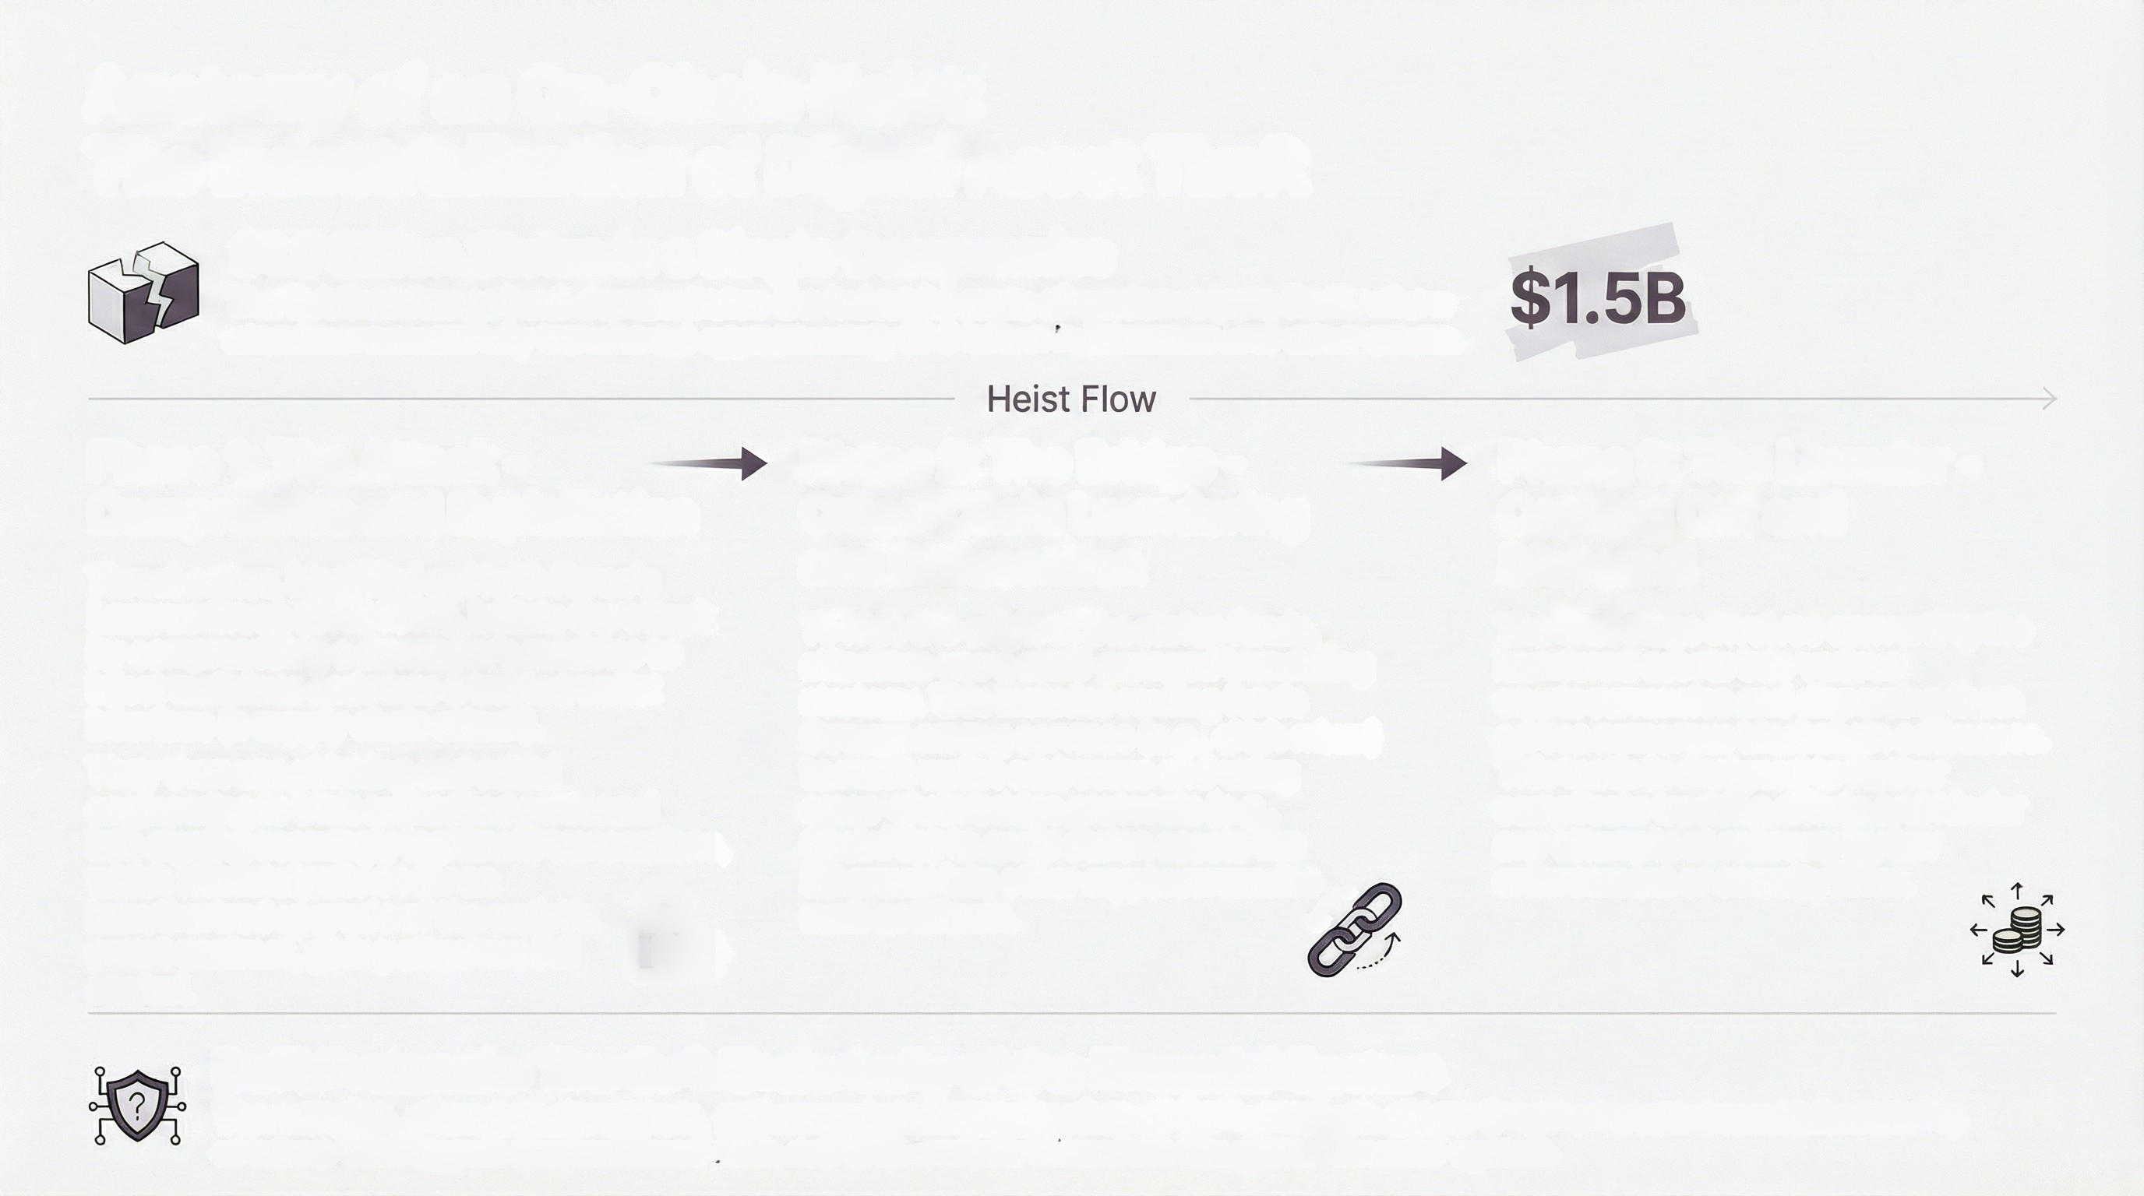
Anatomy of an On-Chain Heist:
The Industrialization of Digital Asset Theft
$1.5 Billion Stolen in a Single Compromise
The Bybit exchange hack demonstrates the industrial scale of modern crypto theft, where
attackers successfully transferred approximately $1.5 billion in Ethereum and other assets.
Phase 1: The Attack -
Compromise and Exploitation
Threat actors, identified as North Korea's Lazarus Group (UNC4899), initiate the attack by compromising a developer's machine to inject malicious code into a trusted wallet interface (a supply chain attack).
They then use phishing and social engineering to trick authorized personnel into signing seemingly legitimate transactions, which ultimately allows for an unauthorized upgrade of the wallet's smart contract, giving attackers full control
Phase 2: The Bridge -
Cross-Chain Laundering
and Obfuscation
To hide the origin of the stolen funds,
attackers use a multi-pronged laundering
strategy. This includes routing funds
through mixing services (e.g., eXch mixer)
to mask wallet addresses and using
cross-chain bridge protocols (e.g.,
ChainFlip) to swap stolen assets like
Ethereum into other cryptocurrencies
such as Bitcoin.
Phase 3: The Launder -
Cashing Out and
Dispersal
The final stage involves converting the
laundered assets into various
cryptocurrencies and dispersing them
across numerous blockchain addresses.
This tactic is designed to further
complicate tracking efforts and hinder
any attempts at recovery by law
enforcement or security firms.
DeFi Protocols: The Soft Underbelly of the Financial System
The complex, often pseudonymous, and cross-jurisdictional nature of DeFi protocols allows threat actors to execute laundering
schemes that bypass the traditional AML and KYC controls inherent in the global financial system.

Slide 2
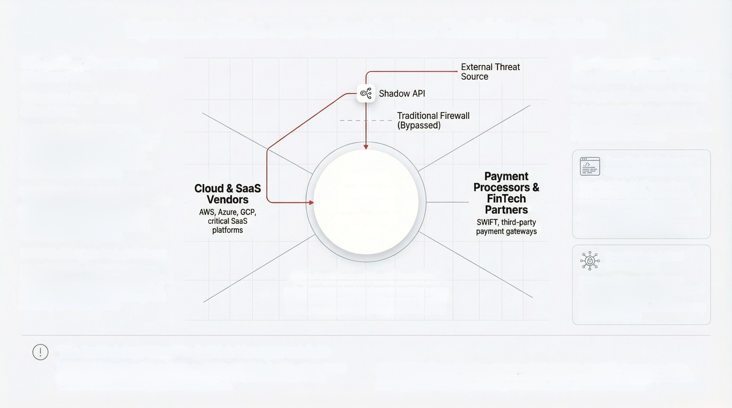
Systemic Risk: The Threat is Now Outside the Walls
The Hidden Threat Vector:
Shadow APIs
The Aggregation Effect:
One Breach, Many Victims
The Aggregation Effect in Action
A single compromise in the software or vendor supply chain creates a cascading failure, impacting thousands of downstream organizations simultaneously.
"Shadow APIs" are the Silent Risk
DEFINITION: "Shadow APIs" are the
Silent Risk. As businesses integrate Al and
microservices, unmanaged and insecure
APIs have become the central nervous
system of data flow, creating a creeping,
silent risk. (Source: STL Digital)
Case Study 1: Software
Supply Chain Compromise
Financial
Institution
Core infrastructure
and data.
The "Shal-Hulud 2.0" worm attack
compromised ~700 legitimate npm
packages, leading to the automated creation of over 25,000 millicious and widespread data exfilitation.
KEY FINDING: Invisible to Traditional
Security. These APIs are often created rapidly by development teams ("vibe coding"), bypassing normal security reviews and existing outside the visibility of network firewalls.
Case Study 2: Critical
Vendor Breach
EXAMPLE: Attack Path: Credential & Secret
Theft. Malware like the "Shal-Hulud" worm
uses compromised developer accounts to steal
API keys and credentials directly from cloud
environments like AWS Secrets Manager and
Azure Key Vault. (Source: Wiz)
The Perimeter Has Dissolved
A single compromised vendor can provide an entry
point for widespread disruption across this entire
interconnected ecosystem.
A breach at Dimensional Control Systems, a software provider, exposed sensitive data from its major manufacturing clients, including Boeing
The Control Gap: Why Vendor Risk Management Fails
KEY FINDING: Traditional Vendor Audits Are Too Slow. Point-in-time, compliance-based assessments and questionnaires cannot keep pace with dynamic, real-time threats embedded within software updates or cloud services.
RISK INSIGHT: Threats Now Move at the Speed of Automation. These attacks propagate at the speed of CI/CD pipelines, making traditional vendor management ineffective at catching malicious code injections or compromised API keys in real time. (Source: Palo Alto Networks)

Slide 3

Financial Fraud & Al Social Engineering:
How Al Weaponizes the Human Element
The Anatomy of a Deepfake CEO Fraud Attack
Step 1:
Step 2:
Impersonation
(Al-Generated Voice Call)
Step 3:
Step 4:
Transfer (Real-Time,
Irreversible Payment)
The employee, believing the request is legitimate, executes the transfer via an instant payment scheme. The funds are moved immediately and are often irrecoverable, as the speed of the transaction outpaces traditional fraud detection systems.
Reconnaissance
(Voice Sampling & Profiling)
Authorization (Social
Engineering & MFA Bypass)
The attacker, convincingly impersonating a trusted executive,
pressures the employee to authorize the payment. This social engineering can bypass standard Multi-Factor Authentication (MFA) by tricking the user into approving a prompt from a malicious sign-in page or downgrading to a less secure method.
Attackers use Al-powered Open-
Source Intelligence (OSINT) to scrape public sources like conference presentations, interviews, and social media videos to collect voice samples of C-suite executives and learn their speech patterns.
Using the collected voice samples,
attackers deploy generative Al to
create a realistic deepfake audio clone of the executive. This clone is used to place an urgent call to an employee in the finance department, requesting an immediate wire transfer.
Critical Threat Vectors and Risks
Al-Enabled Vishing: The New Frontier
of Impersonation
MFA is No Longer a Silver Bullet
The Payment Integrity Risk: Faster Payments, Faster Fraud
Sophisticated voice cloning technology can now recreate
speech patterns, tone, and emotional inflections, making
deepfake audio calls a highly effective tool for
impersonating executives and manipulating employees
into authorizing fraudulent actions.
Attackers are increasingly using social engineering to
bypass standard MFA, Many modern phishing kits include
features to manage MFA prompts or force a downgrade
to less secure methods, making phishing-resistant MFA
(e.g., FIDO2 keys) essential.
The rise of instant payment schemes creates a critical
vulnerability. Once an Al-driven social engineering attack
successfully triggers an authorization, the funds are
transferred and laundered faster than security teams can
investigate and respond.

Slide 4
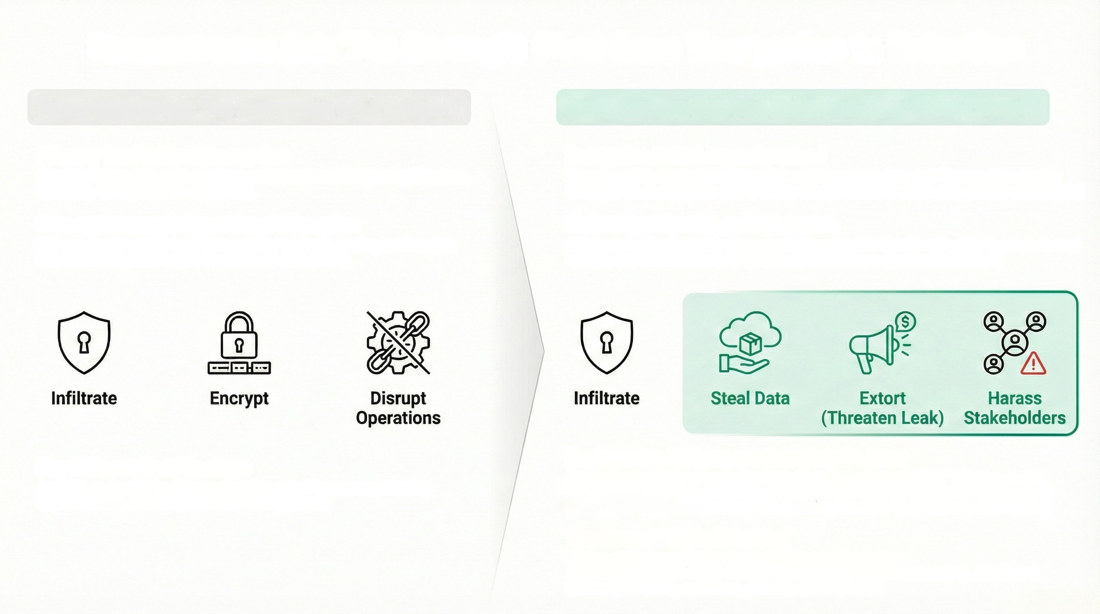
Ransomware 2.0: The Strategic Pivot from Encryption to Extortion
Ransomware 1.0: The Encryption Era ("Before")
Ransomware 2.0: The Extortion-Only Pivot ("After")
Primary Tactic: Mass Encryption
Attackers focused on making systems and files unusable by encrypting them, effectively halting business operations.
Encryption Is No Longer Required
A growing micro-trend shows adversaries omitting ransom notes and file encryption, moving directly to emails and phone calls to initiate extortion based on stolen data.
Primary Leverage: Operational Disruption
The core threat was the inability to conduct business, leading to immediate
financial losses and pressure to restore services quickly.
Shift to Intelligent Data Exploitation
Attackers are pivoting from pure encryption to using Al to identify and exfiltrate a victim's most valuable and sensitive assets to apply maximum pressure.
Key Defense: Data Backups
A reliable and recent backup was the primary tool for recovery, allowing
organizations to restore systems and avoid payment.
Backups Are No Longer a Complete Defense
Groups like 'LeakNet' are tracked as being 'data-broker/extortion first,' focusing on data exposure as their primary impact, with file encryption not being their main tactic.
The Rise of "Triple Extortion"
Modern campaigns often involve multiple layers of coercion:
1) Threatening to leak stolen data,
2) Threatening to disrupt services (e.g., DDoS), and
3) Directly harassing customers, partners, and employees.

Slide 5
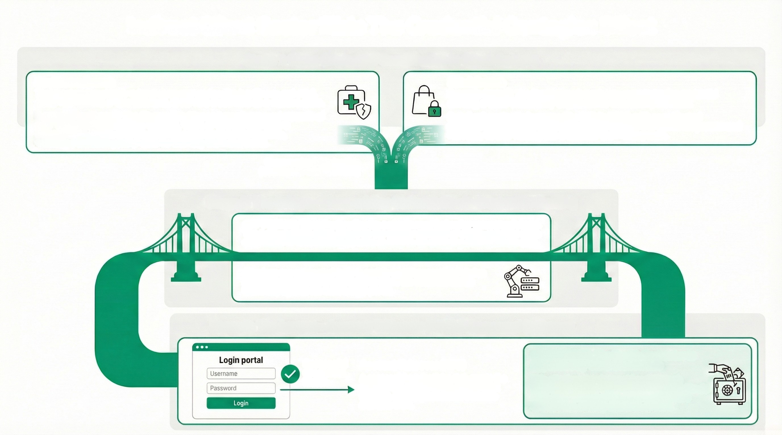
Indirect Client Sector Risk: The Credential Contagion Effect
Stage 1: Mass Credential Compromise in Client Sectors
Healthcare Breach
Retail Breach
Threat actors target high-volume consumer sectors like healthcare and retail, which hold millions of user accounts, to harvest credentials on a massive scale.
Example (Healthcare): The Change Healthcare breach exposed records of over 100 million individuals. In 2025, 100% of hacked healthcare records were stolen unencrypted via compromised credentials, creating a massive pool of data for identity theft and fraud.
Example (Retail): The North Face breach was executed using credential
stuffing, a tactic that directly targets clients who reuse passwords.
Retail cyberattacks increased by 34% in 2025, with coordinated ransomware campaigns hitting major UK brands like Marks & Spencer and Harrods, further fueling the credential theft ecosystem.
Compromised Credentials
(Username/Password Pairs)
Stage 2: The Bridge - Weaponizing Stolen Data via Credential Stuffing
KEY FINDING: The attack relies on a single user behavior: password reuse. The success of this tactic is built on the widespread habit of clients using the same credentials for their banking services as they do for shopping and healthcare sites.
Attackers use automated tools to rapidly test thousands of stolen username/password combinations (from the retail/healthcare breaches) against the bank's login portal.
Stage 3: The Impact - Account Takeover (ATO) & Bypassed Defenses
Successful
Credential
Match
Account Takeover (ATO)
A successful credential match grants the attacker full access to the client's bank account, enabling fraudulent transfers and data theft.
RISK INSIGHT: The Bank's Perimeter is Bypassed by Valid Credentials
This attack vector does not break through technical defenses like firewalls; it uses legitimate login credentials that the system recognizes as authentic, making detection difficult.

