Slide 1
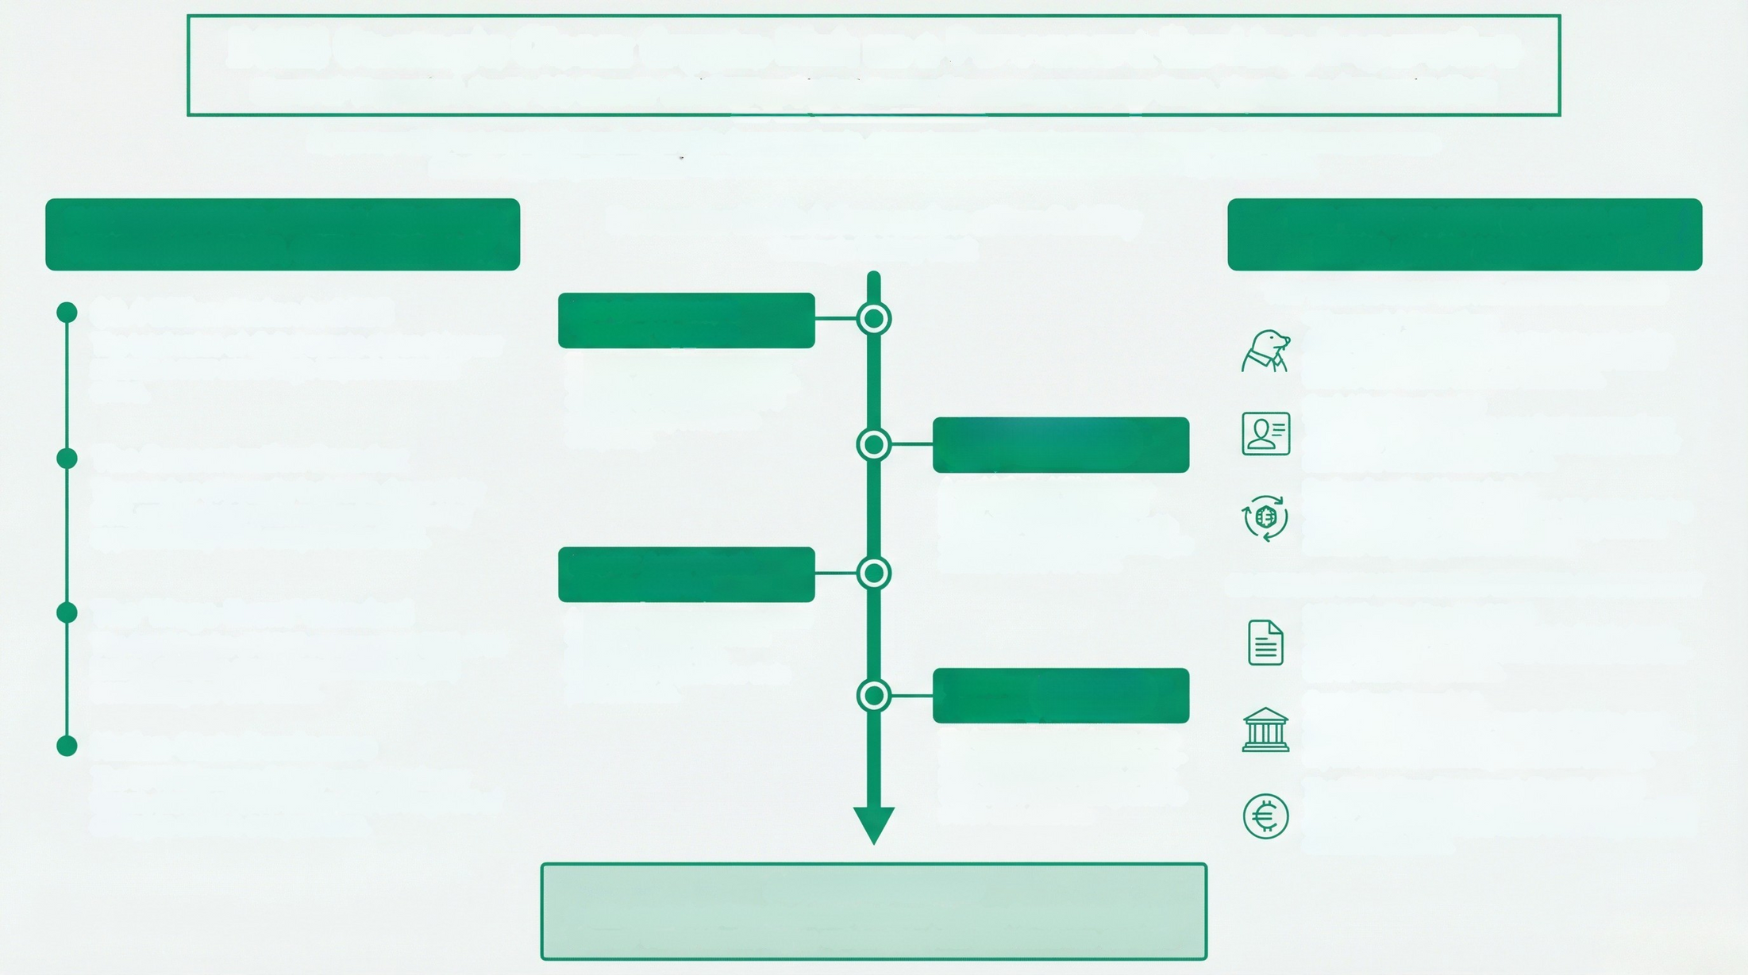
2025 Strategic Close: Crypto Risk as a Permanent Banking Imperative
State of the Union for G-SIB Board: Solidifying Digital Asset Threats as a Long-Term, Systemic Financial Risk
December 2025 culminated the definitive shift: fewer incidents, skyrocketed financial damage, and professionalized nation-state
attacks targeting centralized financial services. Crypto risk is now a permanent, systemic imperative.
THE 2025 MACRO-CRIME LANDSCAPE:
FEWER INCIDENTS, GREATER IMPACT
December 2025: A Succession of Inevitability
THE "INFILTRATOR TACTIC & EU
REGULATORY HARDENING
Strategic Ticking Clock
THE "INFILTRATOR" TACTIC: BEYOND HACKING
"Wagemole" Operations
$3.4 Billion Stolen in 2025
The total value of digital assets stolen this year
reflects a new era of high-impact financial
crime.
Dec 3: Ethereum's
"Fusaka" Upgrade
A strategic shift from external attacks to embedding
nation-state operatives as IT workers inside fintech
firms to steal source code and credentials.
Social Engineering 2.0
The network activated a major
upgrade, scaling its transaction
capacity to over 100,000 TPS
and increasing ecosystem
complexity.
Dec 5: USPD.io Exploit
($1M)
A sophisticated "Clandestine
Proxy" attack demonstrated
long-dwell-time infiltration, with
attackers gaining admin privileges
months before the theft.
Threat actors now use fake recruiter impersonations
and bogus "technical screening" interviews to deliver
malware to institutional developers.
The Concentration Paradox
The number of security incidents dropped by
50%, yet the total value stolen increased by
approximately 66% compared to 2024.
Professionalized Laundering
Stolen funds now enter a consistent 45-day laundering
cycle, moving from DeFi protocols to integration via
Chinese-language guarantee services.
Dec 13: Aevo Oracle
Attack ($2.7M)
A routine update to a price oracle
created a decimal precision
mismatch, which was
immediately exploited to drain
protocol funds.
EU REGULATORY HARDENING: THE NEW G-SIB REALITY
The "Mega-Event" Standard
The top 3 hacks of 2025 represented 69% of all
losses, with the single largest theft (Bybit)
accounting for $1.5 Billion.
MICA Finality (Dec 29, 2025)
Transitional periods for the Markets in Crypto-Assets
regulation ended, requiring firms without full authoriza-
tion to cease EU operations.
Late Dec: USDT Address
Poisoning ($50M)
The largest recorded scam of its
type highlighted extreme human-
layer vulnerability, where a user
was tricked into sending funds to
a look-alike address.
Centralized Oversight
A proposal is advancing to transfer all Crypto-Asset
Service Provider (CASP) supervision to a central autho-
rity like ESMA to eliminate jurisdictional arbitrage.
The Digital Euro Framework (Dec 19, 2025)
The EU Council finalized the legal framework for a 2029
launch, which will mandate future G-SIB integration and
resilience standards.
Nation-State Dominance
The DPRK (Lazarus Group) was the primary
threat, stealing $2.02 Billion and driving 76% of
all crypto service compromises.
ACTION REQUIRED
G-SIBS must pivot from 'Perimeter Defense' to 'Deep Forensic Audits' and
'Internal Threat Monitoring' as nation-state infiltration becomes standard.

