Slide 1
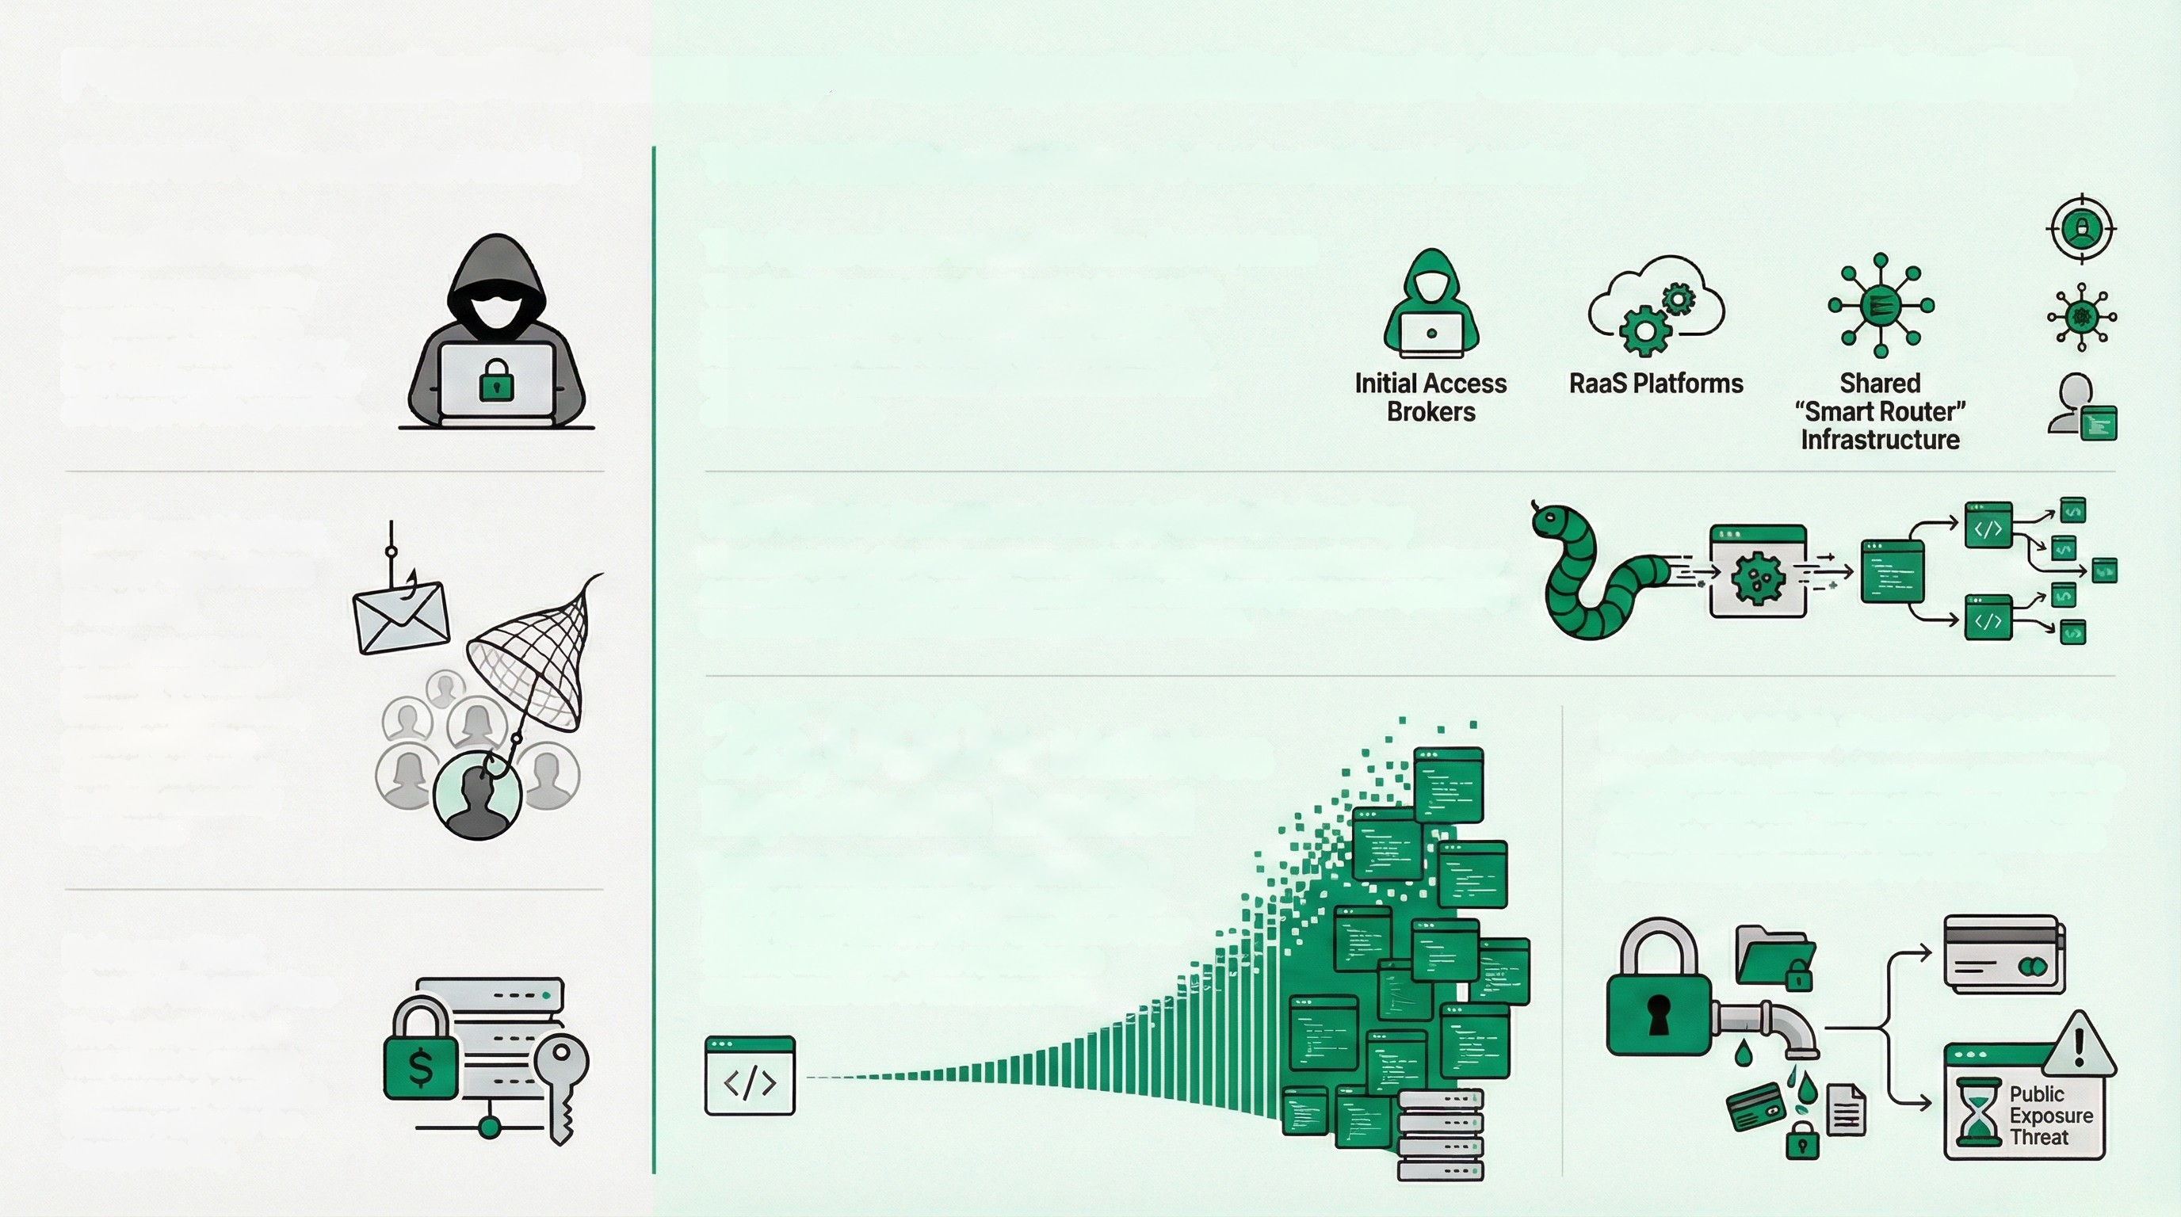
Executive Risk Summary: From Opportunistic Attacks to Industrialized Extortion
THE PAST: Opportunistic Attacks
THE PRESENT: Industrialized & Confrontational Extortion
Monolithic Actors
Attacks were typically
conducted by single,
self-contained groups or
individuals responsible for
all stages of the operation.
The Cybercrime-as-a-Service Ecosystem
The threat is now a professional industry with
specialized roles like Initial Access Brokers,
Ransomware-as-a-Service (RaaS) platforms,
and shared "smart router" infrastructure that
directs attacks.
Dominant Vector:
Broad-Spectrum
Phishing
Initial access was
primarily achieved
through high-volume,
generic phishing
campaigns hoping
to catch an unwary
employee.
New Vector: Automated Supply Chain Poisoning
Modern worm-like malware now automatically compromises developer
accounts and injects malicious code into software packages, spreading
exponentially without direct human intervention.
25,000+ Malicious
Repositories Exposed
Demonstrating massive industrial scale, a
single automated supply chain campsign
(Sha1-Hulud 2.0) led to the creation of over
25,000 malicious code repositories
across hundreds of user accounts.
New Goal: Multi-Faceted Extortion
The model has shifted from pure encryption to
"double extortion," where attackers first steal
sensitive data and then threaten public leaks
to maximize pressure on the victim.
Primary Goal:
Simple Encryption
The main objective
was often to encrypt
systems and demand a
ransom solely for the
decryption key.

Slide 2
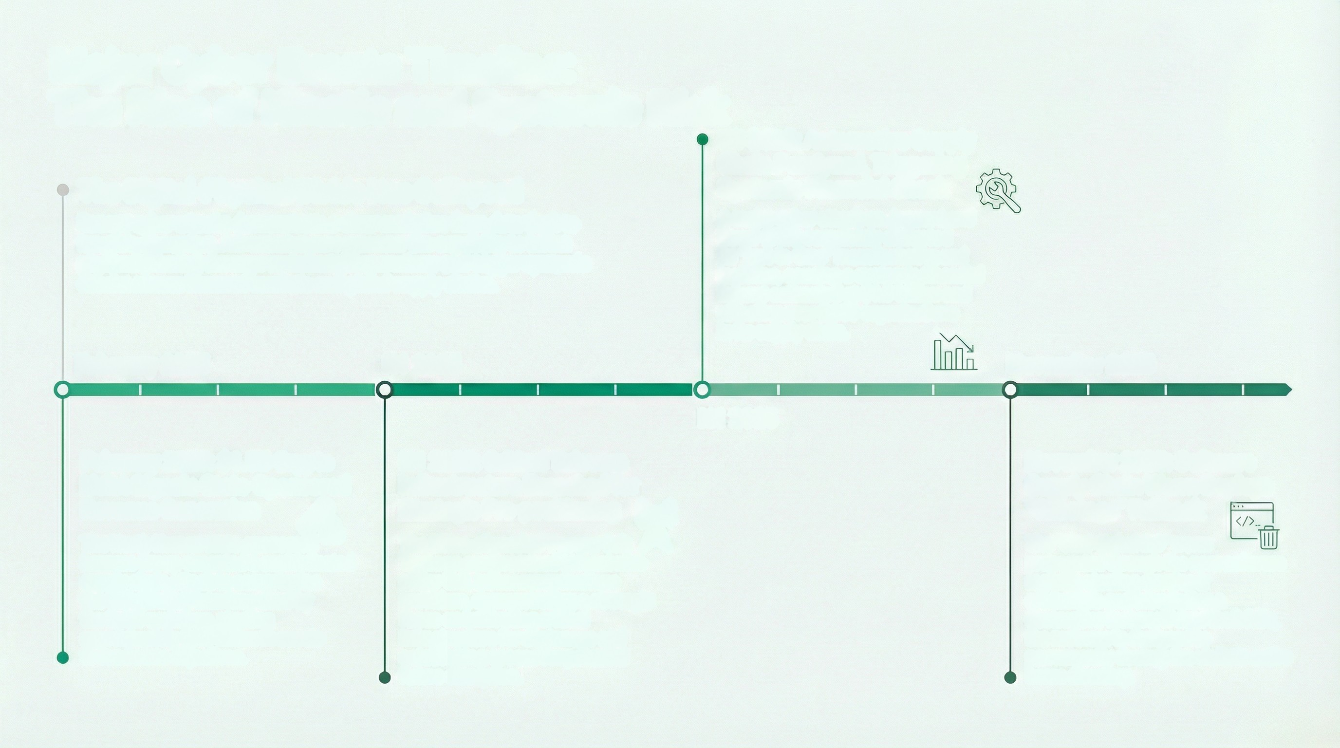
Major Cyber Events Timeline:
The Rise of Kinetic and Systemic Risk
H2 2025: Automotive Supply
Chain Paralyzed, Triggering
Systemic Financial Shock
A major cyber attack on Jaguar Land
Rover (JLR) completely disrupted
its "just-in-time" manufacturing and
logistics, causing a systemic financial
impact estimated at $1.9 billion and
affecting over 5,000 organizations
in its supply chain.
The Digital-Physical Divide Has Collapsed
Recent cyber attacks demonstrate a clear evolution from data theft to
tangible disruption. Adversaries now possess the capability to inflict
physical (kinetic) damage on industrial operations and trigger systemic
shocks across financial markets and global supply chains.
February 2025
H1 2025
November 2025
H2 2025
February 2025: $1.5B Crypto
Heist Signals State-Sponsored
Revenue Generation
The North Korean state-sponsored
Lazarus Group executed a sophisticated
supply chain attack to compromise
the Safe(Wallet) interface used by
the Bybit exchange, stealing
approximately $1.5 billion in assets
to fond state objectives.
H1 2025: Critical Telecom
Infrastructure Breached for
Strategic Pre-positioning
The China-aligned APT group Salt
Typhoon compromised at least nine
major U.S. telecommunications
providers, demonstrating a strategic
focus on infiltrating critical
infrastructure for espionage and
establishing access for potential
future disruption.
November 2025: Software
Supply Chain Worm Deploys
"Sabotage" Fallback
The "Shai-Hulud 2.0" worm
propagated through the npm software
registry, stealing developer
credentials and introducing a
destructive feature: if data theft fails,
the maiware is designed to
permanently destroy the victim's entire
home directory.

Slide 3
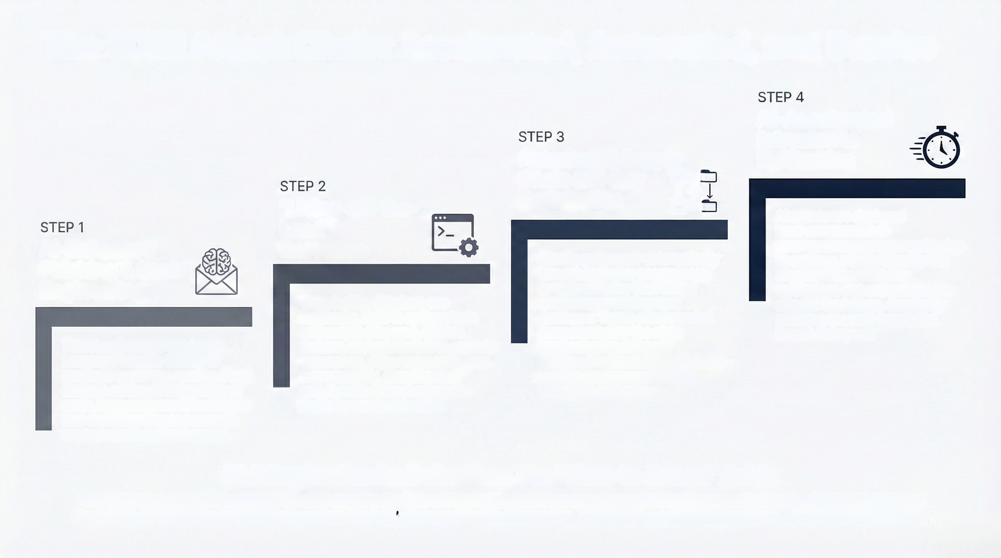

The 2025 Attack Chain: Accelerated, Automated, and Evasive
Al-Accelerated
Intrusion to
Exfiltration
Automated Supply
Chain & N-Day
Exploitation
"Living-off-the-
Land"
Execution
Al agents are deployed
post-compromise to
autonomously execute multi-step
operations, rapidly identify the
most sensitive data for
exfiltration, and orchestrate the
attack's final stage, drastically
reducing the time from initial
breach to impact.
Al-Enhanced
Phishing & Social
Engineering
Attacks propagate automatically
through software ecosystems,
as seen with the Shai-Hulud
worm compromising npm
packages. This is compounded
compounded by the rapid
weaponization of newly
disclosed vulnerabilities (N-Days)
in edge systems and critical
enterprise software.
Once inside, attackers use
legitimate, built-in system tools
and scripts (like npm, GitHub
Actions, or AppleScript) to execute
commands, discover secrets, and
move laterally, blending their
activity with normal enterprise
traffic to evade detection.
Threat actors now use Large
Language Models (LLMs) to
generate hyper-personalized and
context-aware phishing lures at
scale, bypassing traditional filters
and exploiting human trust with
unprecedented effectiveness.
Risk Implication for Defenders: The "Time-to-Detect" Crisis
The convergence of Al automation and evasive tradecraft has collapsed the response window for security teams. Attacks that once
took days or weeks to unfold now achieve their objectives in hours or minutes, demanding a shift to predictive, autonomous defense.

Slide 4
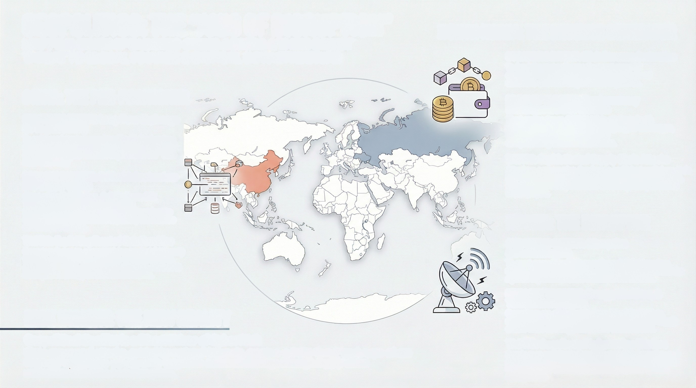
GEOPOLITICS: THE "AXIS OF DISRUPTION"
MAPPING STATE-SPONSORED CYBER ACTORS & THEIR DIRECT
THREAT TO GLOBAL FINANCE & CRITICAL INFRASTRUCTURE
NORTH KOREA: THE REVENUE GENERATOR
STRATEGIC INTENT: Illicit Revenue Generation
To fund the regime by stealing vast sume of
cryptocurrency, thereby bypassing international
sanctions and financing national objectives.
CHINA: THE PRE-POSITIONER
PRIMARY TARGETS: Cryptocurrency
Exchanges & DeFi Platforms
STRATEGIC INTENT: Long-Term Espionage
& Pre-positioning
To gain persistent access to critical infrastructure
and steal intellectual property, supporting national
development goals outlined in pians like the "15th
Five-Year Plan.
PRIMARY TARGETS: Critical
Infrastructure & IT Supply Chains
China-aligned APTs (e.g., Salt Typhoon, Silk
Typhoon) are actively compromising
telecommunications providers and IT services to
establish future operational capability and access
downstream victims.
TACTIC: Exploiting Trusted Relationships
Operators focus on compromising trusted third-party
vendors and exploiting software vulnerabilities to
gain initial sccess, making their activities dificult to
distinguish from legitimate network traffic.
The Lazarus Group (UNC4899) is attributed with
multiple large-scale helsts targeting crypto exchanges,
including the $1.5B Bybit hack, by compromising wallet infrastructure.
TACTIC: Sophisticated Supply Chain Attacks
Attackers compromise developers and inject malicious code into trusted software to authorize fraudulent transactions, as seen in the manipulation of the Safe (Wallet) interface used by Bybit.
RUSSIA: THE DISRUPTOR
STRATEGIC INTENT: Disruption & Destabilization
To exert geopolitical influence through hybrid warfare, which combines information operations with cyberattacks against key infrastructure sectors of adversaries.
RISK INSIGHT: THE NEW REALITY
Geopolitical Conflict is a Direct Driver of Cyber Risk State-sponsored attacks, guided by national interests, create a volatile threat landscape where financial institutions can become targets or collateral damage through supply chain and critical infrastructure disruption.
PRIMARY TARGETS: Energy, Maritime, & Telecommunications
Operations are often tied to geopolitical flashpoints, aiming to disrupt services critical to logistics and supply chains while creating political and social discord.
TACTIC: Coordinated Information Warfare
Russia runs well-funded, multi-lingual disinformation and propaganda campaigns to amplify narratives, undermine the standing of adversaries, and shape public opinion during crises.

Slide 5
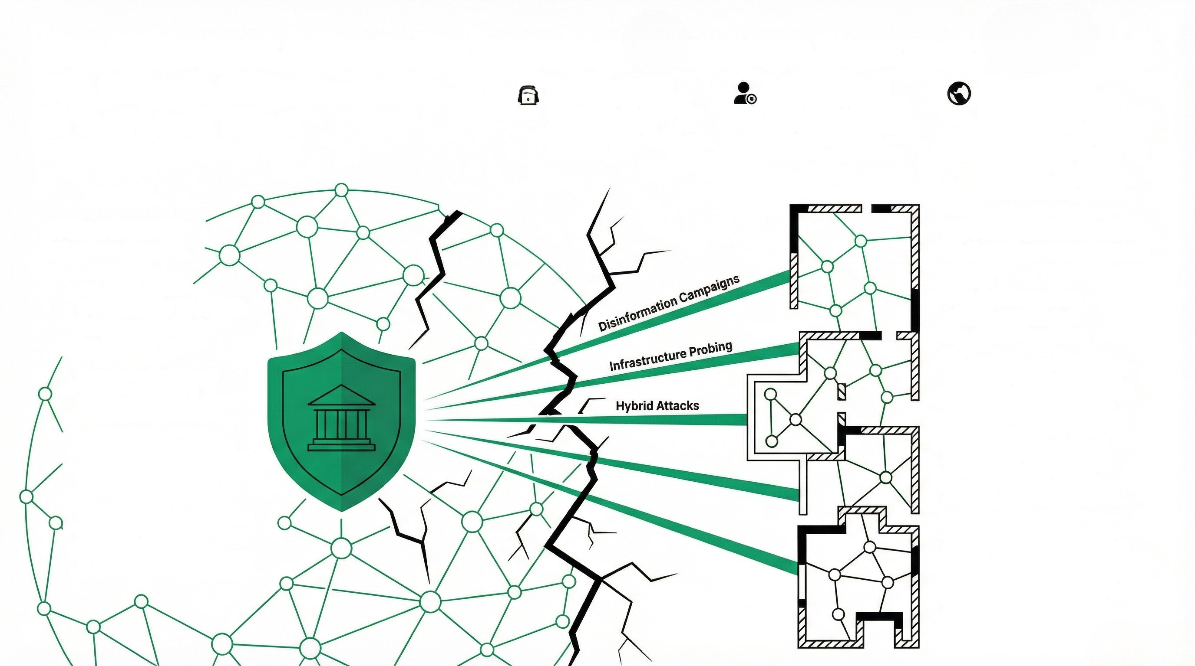
The Splinternet & Sovereign Targeting: Navigating a Fractured Digital World
The Strategic Shift: Emergence
Lines Between Threat
Actor Types are Blurring:
Nation-state actors (APTS),
cybercriminals, and
hacktivists share tactics and
infrastructure.
Political and Financial
Motives are Overlapping:
Threat actors combine
state-sponsored espionage
with broader political
messaging and extortion.
A Geopolitical Crisis
Becomes a Cyber Pretext:
Events like the Venezuela crisis
are used to loosely synchronize
Russian, Iranian, and Chinese
operators into campaigns
targeting the U.S. and its
partners with disinformation
and infrastructure probing.
of the Hybrid Threat
OPEN INTERNET
(Allied Democracies)
SOVEREIGN INTERNETS
(Authoritarian-Aligned States)
SOVEREIGN TARGET:
Western Financial
Institution
The Balkanization
of Cyberspace: A
Fractured Internet
Financial Institutions are
Proxies for the State:
Symbols of Western stability
and critical infrastructure.
The Global Internet is Fracturing
into "Digital Blocs": Geopolitical
tensions create separate internets
governed by national interests,
consership, and data localization.
The Threat Shifts from Data
Theft to Cognitive Attacks: Hybrid actors conduct disinformation campaigns to erode trust.
Data Sovereignty is Being
Redefined by "Digital Tariffs":
Governments fax or restrict
cross-border services, creating
economic and technical barriers.
Attacks Can Become Collateral
Damage in Wider Conflicts:
Institutions targeted in
widespread geopolitical attacks
to disrupt national infrastructure.
Al is Accelerating Divergence:
As Al becomes a pillar of national
defense, model behavior will trace the borders of political power, leading to region-specific censorship and divergent realities that reflect
competing value systems.

