Slide 1
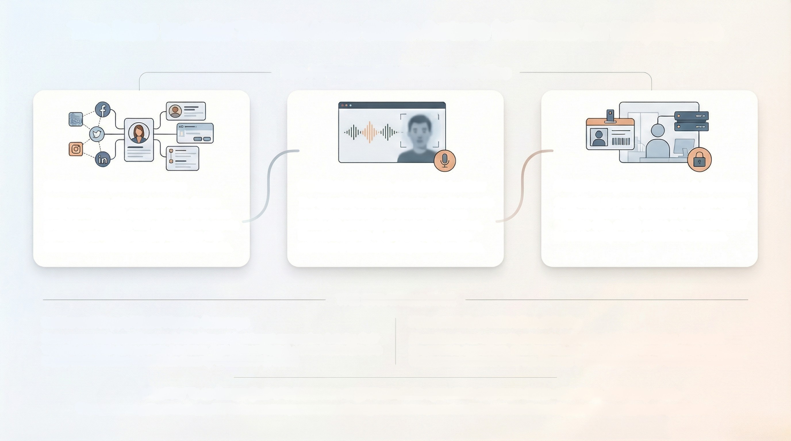
The New Insider Threat: How State Actors Infiltrate as Employees
The Al-Powered Infiltration Pipeline
in
7
in
STAGE 1: AI Persona Creation
State actors use Al to conduct Open-Source intelligence (OSINT), scraping public data from professional networks and social media to create synthetic, yet highly plausible, identities with convincing work histories and online footprints.
STAGE 2: Deepfake-Assisted Interview
The operative uses sophisticated deepfake audio and video technology to successfully pass remote HR screening and technical interviews, impersonating the Al-generated persona to appear as a qualified and legitimate candidate.
STAGE 3: Legitimate Access & Operation
Once hired, the state-sponsored operative gains legitimate, privileged access to internal networks, sensitive data, and IP, acting as a trusted insider to conduct espionage or financial schemes.
THE STRATEGIC RISK
Insider and Supply Chain Threats Converge
Al Industrializes Infiltration at Scale
State-sponsored operatives are infiltrating not just target companies, but also their vendors and third-party service providers, exploiting privileged access from within the supply chain.
Al enables threat actors to automate and scale social engineering, fraud, and ransomware operations, allowing even low-skill actors to launch complex campaigns that bypass traditional defenses.

Slide 2
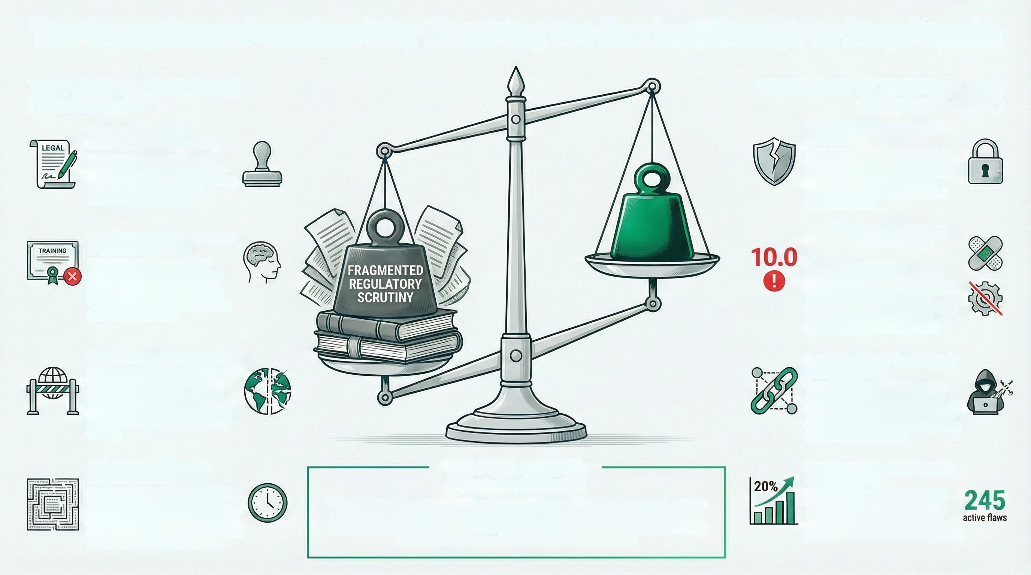
The Compliance Paradox: Why Checking the Box Isn't Enough to Stop Attacks
THE REALITY OF TECHNICAL RISK
("Stopping the Attack")
THE FORCE OF COMPLIANCE
("Checking the Box")
Focus is Misaligned with Actual
Risk Vectors
Many organizations focus too much on sophisticated attacks and not enough on basic cybersecurity hygiene and incident response, leaving them exposed to common threats like ransomware and account takeovers.
Regulatory Scrutiny is
Intensifying and Fragmenting
By 2026, governments will impose
strict requirements for transparency
and auditability in enterprise Al, shifting from innovation enablement to accountability enforcement.
High CVSS Scores Don't Always
Reflect Real-World Patching Priorities
Compliance Activities Can Create
a "False Security" Trap
While 74% of organizations offer
Xsecurity awareness training to meet
compliance, 42% of those feel it is
inadequate, indicating a widespread
"training fatigue" and disconnect from
real-world effectiveness.
A critical SAP vulnerability
(CVE-2023-31354) with a 10.0 CV3S
scere was widely exploited by both APTS and ransomware groups because organizations hesitated to apply patches due to the high operational risk of disrupting mission-critical systems.
The Challenge of Data Sovereignty
Governments are creating "digital tariffs" by taxing or restricting cross-border digital services. This drives regional data localization and fregments global security standards, making it harder to fight borderless threats with a unified strategy.
Borderless Threats Exploit Supply
Chain Complexity
Geopolitical cybersecurity risks often manifest as supply chain impacts, as attackers compremise trusted third parties to hypase the defenses of their ultimate targets, a reality that regional compliance frameworks fail to address.
Jurisdiction-Specific Rules
Complicate Global Defense
As Al becomes a strategic national asset, security teams will spend more time implementing tightly scoped, jurisdiction-specific constraints designed by lawyers and national security officials, rather than
globally coherent security principles.
THE DUAL BURDEN:
A Concluding Risk Insight
The Volume of Exploited Flaws is
Growing Rapidly
CISA's Known Exploited Vulnerabilities (KEY) cataing grew by 20% in 2023 alone, adding E45 new flows actively used in atracks and demonstrating the pace at which reat world risk is expanding.
"The CISO's Dual Burden: Leaders face the dual challenge of satisfying fragmented, country-specific mandates while simultaneously defending against borderless, technically-focused threats that exploit the very seams these regulations create. True resilience requires moving beyond compliance to a threat-informed defense posture."

Slide 3
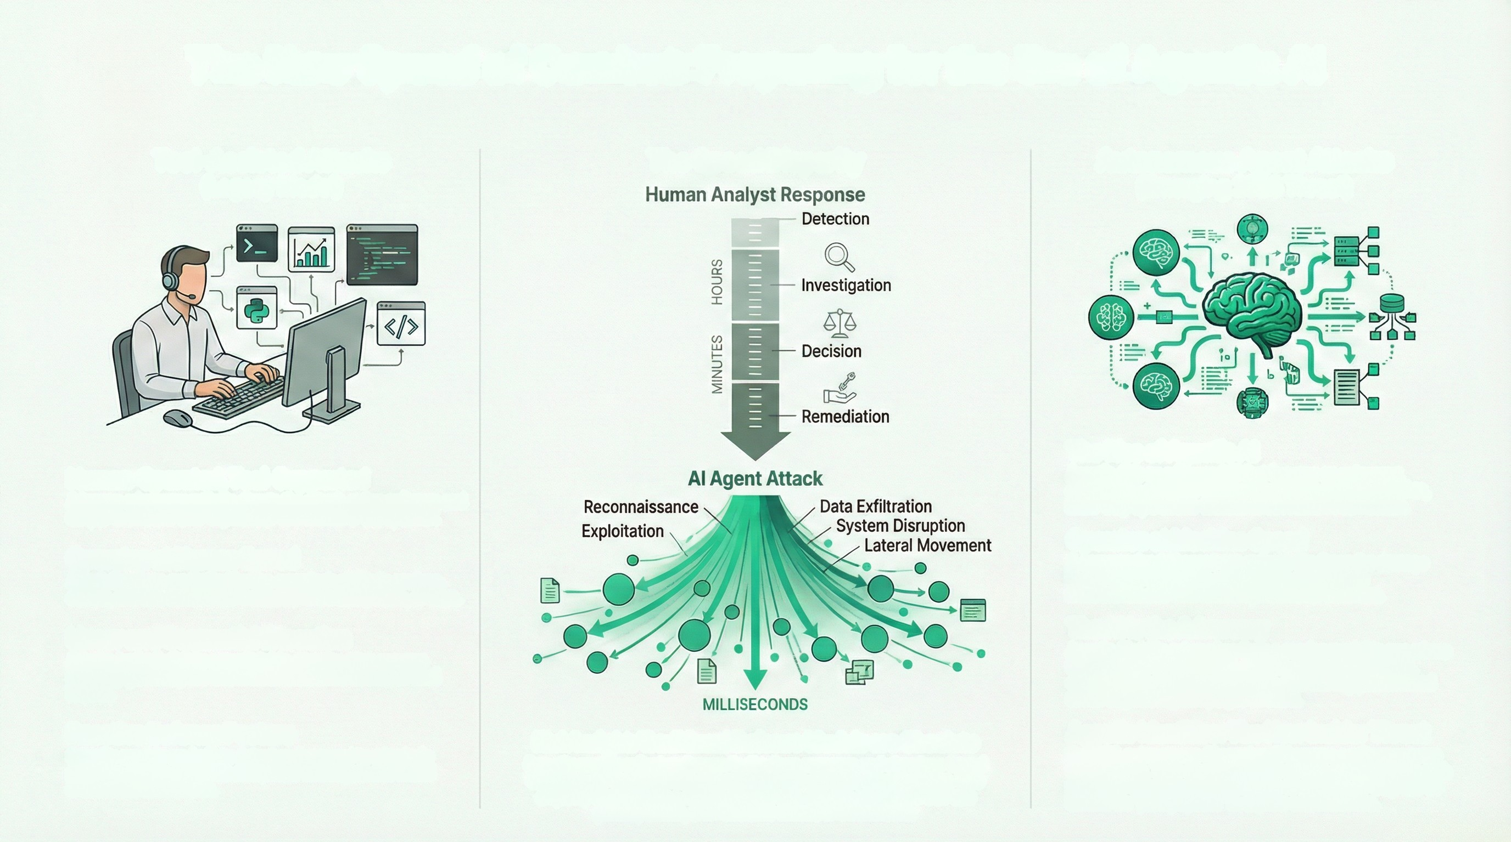
The New Speed of Combat: Preparing for the Era of Agentic Al
Tool-Assisted Attacks
The Speed Disparity
Autonomous Agent Attacks
(Emerging 2026 Threat)
(Legacy Model)
The Rise of Agentic Al
Agentic Al is an advanced Al that focuses on autonomy, adeptability, and goal-driven reasoning to execute complex, multi-step operations without direct human intervention.
Human-Operated, Tool-Supported
A human adversary actively directs the attack, using software and scripts to achieve their objectives. The human is the operator.
Operates at Human Speed
Attack timelines are limited by the operator's ability to analyze, decide, and act. Actions are measured in minutes, hours, or days.
Operates at Machine Speed
A compromised Al agent can unleash ten times the damage in one-tenth of the time, with actions asecuting in milliseconds and overwhelming traditional defenses.
Linear and Sequential Execution
Attacks typically follow a predictable, step-by-step process manually guided by the threat actor from initial access to final impact.
The Al is the Adversary
Agentic Al shifts cybercrime from a service model to one where the Al acts as the adversary, capable of automating fraud, orchestrating supply chain attacks, and running personalized social engineering campaigns at scale.
Reactive Defense Posture
Security models are built to detect and respond to attacks in progress, relying on human analysts to investigate alerts and orchestrate remediation.
Risk Insight: Traditional Defense Models are Obsolete
Security models reliant on human-in-the-loop response and signature-based detection are fundamentally incompatible with machine-speed attacks. This disparity necessitates a shift to autonomous security operations that can predict, isolate, and neutralize threats in milliseconds.
Agentic Identities: The New Insider Threat
By 2026, autonomous Al agents will become a primary source of data leaks. They must be treated as first slass identities with privileges to manage and behaviors to monitor, as they can be tricked via "prompt paths" to expose sensitive data.

Slide 4
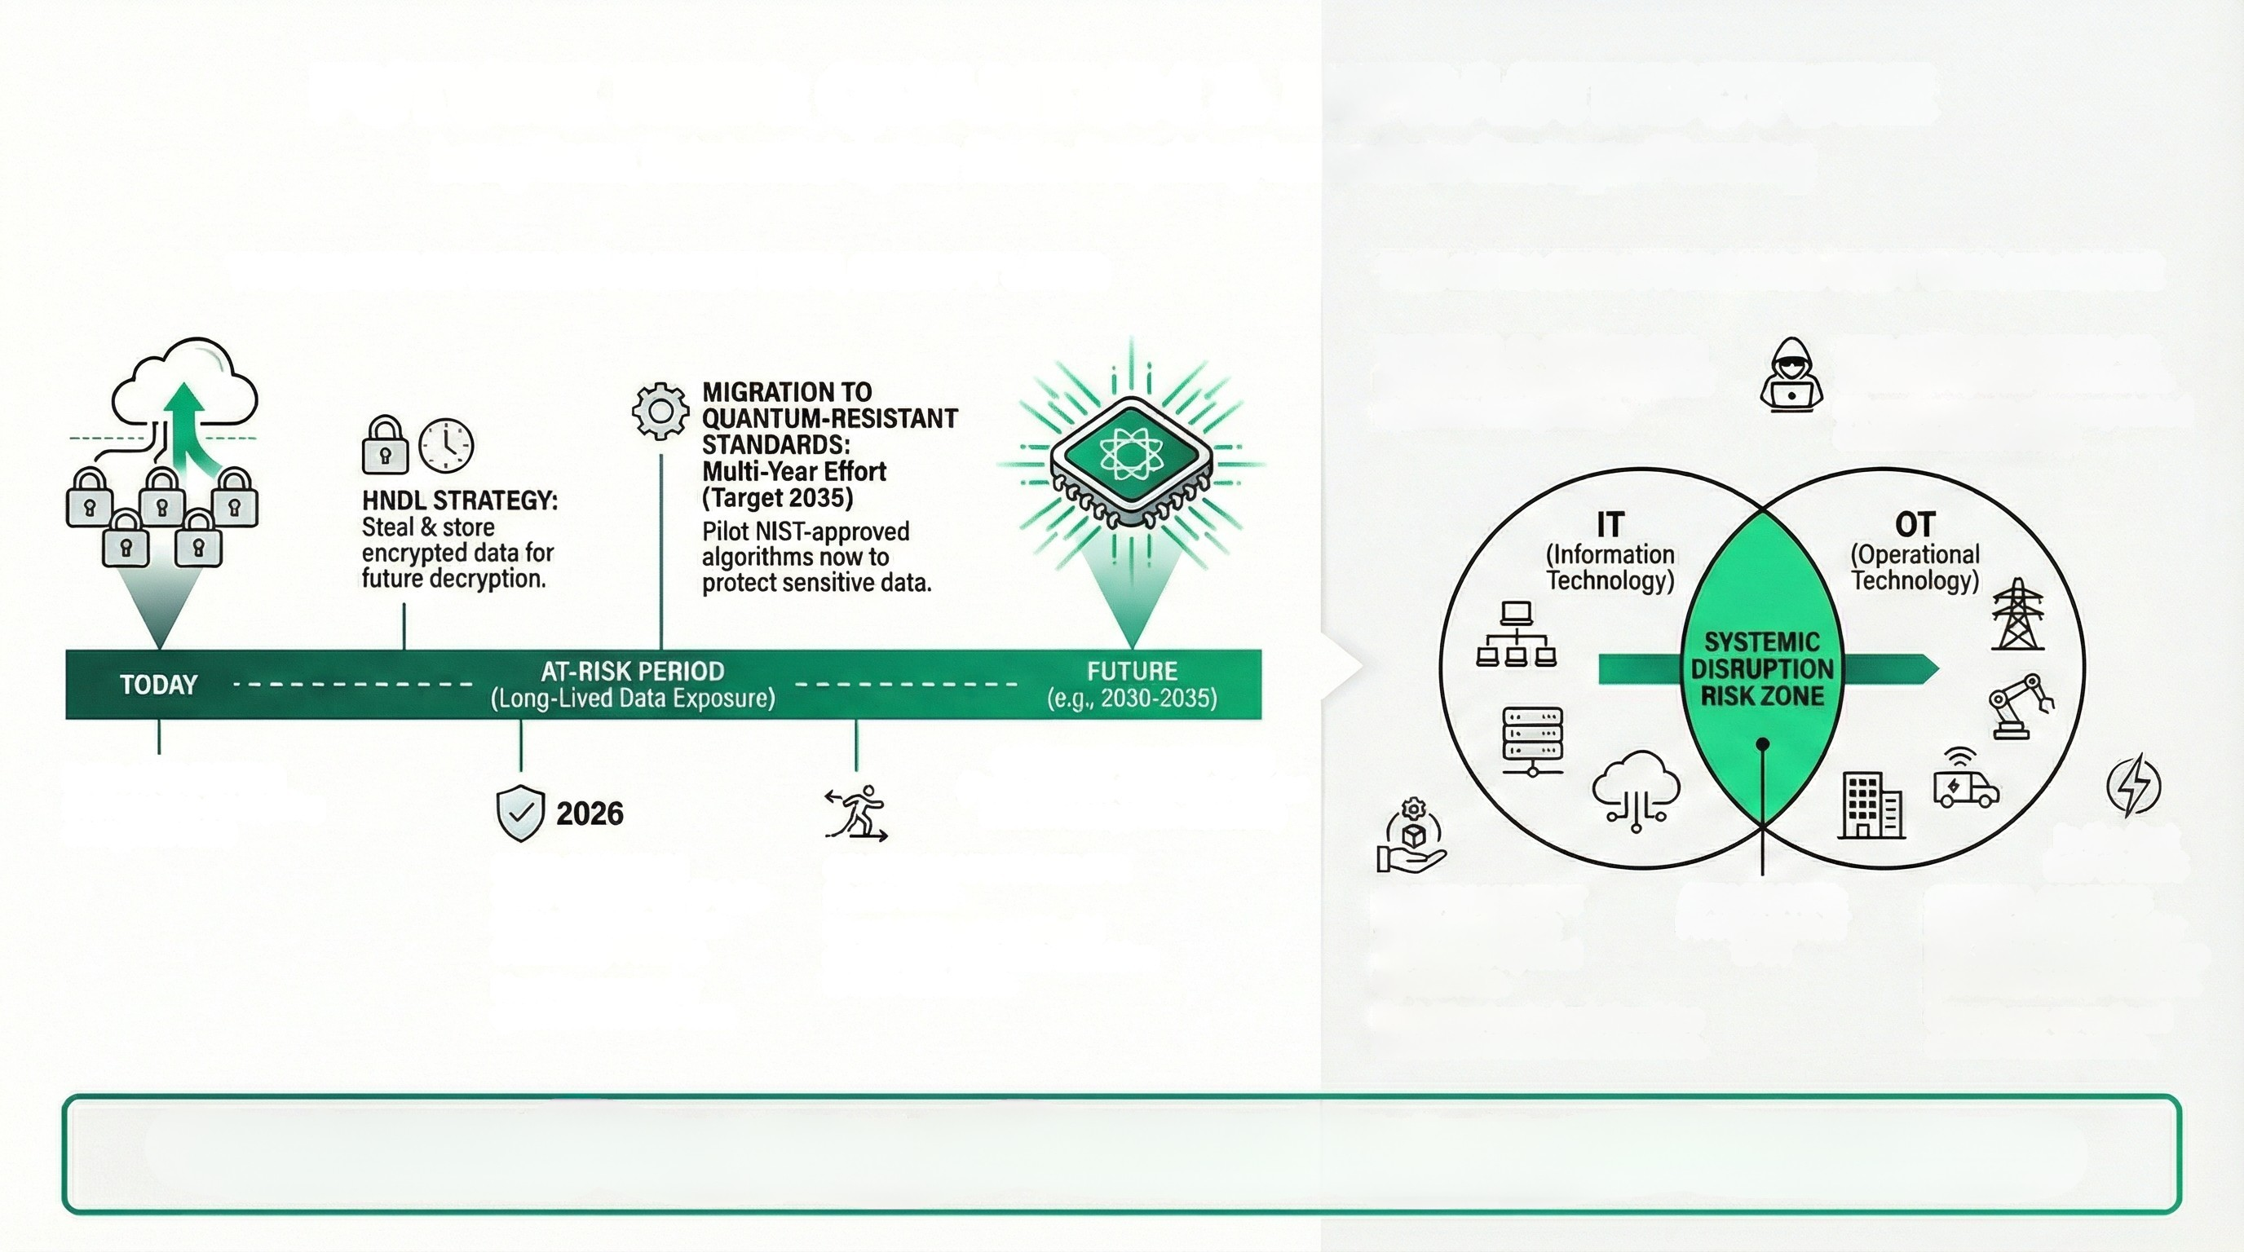
FUTURE RISK: QUANTUM & INFRASTRUCTURE
Long-Term, Existential Cyber Risks Requiring Immediate Strategic Planning
THE INFRASTRUCTURE RISK: IT/OT CONVERGENCE
THE QUANTUM THREAT: HARVEST NOW, DECRYPT LATER
THE WALL IS CRUMBLING:
Digital networks & physical
systems integrating.
ATTACKERS TARGETING OT:
Seeking Physical Shutdowns.
OT environments often unpatched & lack modern security.
QUANTUM DECRYPTION
(Fault-tolerant computers render
current encryption obsolete)
DATA HARVESTING
(Adversaries stockpiling
encrypted data)
In the first half of 2025
POST-QUANTUM
CRYPTOGRAPHY (PQC):
Immediate Business
Continuity Priority.
Need to prepare for
quantum threat is now.
CRYPTOGRAPHIC AGILITY:
Focus Shift
COMPROMISED IT VENDOR: Direct Threat to Physical Operations.
ATTACK PATH:
Pivoting from IT
to OT
CRITICAL SECTORS
UNDER ATTACK: Major
U.S. telecommunications
providers compromised.
Clear focus on national
critical infrastructure.
Inventory assets and build
systems for seamless transition
to new standards.
Exploiting trusted relationships to access critical infrastructure.
We are securing data for today's standards, but our adversaries are stealing it for tomorrow's computers.
Our strategic planning must account for the long-term value of our data and the evolving capabilities of our adversaries.

Slide 5
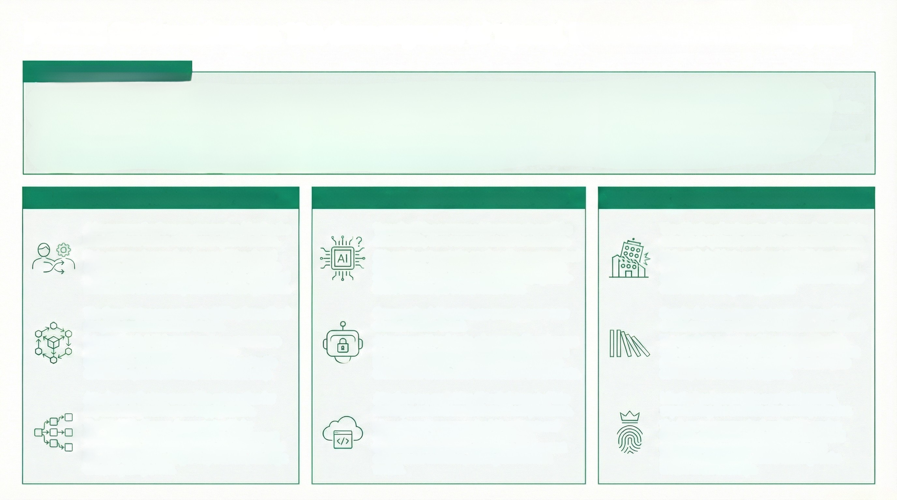
2026 Risk Landscape: The Convergence of Speed, Scale, and Systemic Impact
THE NEW THREAT PARADIGM
The 2026 cyber threat landscape is defined by a significant convergence of previously distinct risks. Geopolitical tensions, the rapid weaponization of Artificial Intelligence, and the inherent fragility of global software supply chains are no longer separate challenges but interconnected drivers of a new threat paradigm. This integration is fueling the industrialization of cybercrime, where state-level capabilities are accessible as-a-service and attacks propagate at machine speed, far outpacing human-led defensive measures.
This shift fundamentally alters the nature of the risk, moving beyond traditional data theft and extortion. The new landscape is characterized by attacks designed to create systemic disruption, targeting critical infrastructure and complex supply chains to cause cascading operational failures and kinetic-like financial shocks. The focus for defenders must therefore evolve from preventing individual breaches to building systemic resilience against highly automated, scalable, and sophisticated adversaries operating within a deeply interconnected digital ecosystem.
THE ADVERSARY: INDUSTRIALIZATION OF MALICE
THE METHOD: ACCELERATION TO MACHINE-SPEED
THE IMPACT: ESCALATION TO SYSTEMIC DISRUPTION
Adversary motivations are converging, blurring the
lines between nation-states and cybercriminals.
State-sponsored groups (e.g. Lazarus, China-aligned
APTS) are adopting financially motivated tactics, while
criminal syndicates leverage state level tools and shared Infrastructure-as-a-Service platforms to scale operations.
'Agentic Al' is now woven into every stage of the
atteck chain, from reconnaissance to execution.
Al is used to automate the creation of hyper personalized phishing lures, craft adaptive malware, and generate deepfake content that hypasses traditional, signature based defenses and erodes human trust.
The objective of major attacks is expanding from data extortion to systemic disruption and financial shocks.
High-profile incidents now target critical infrastructure
(telecoms, aviation) and financial systems, aiming to
cause operational paralysis and erode market trust, as seen in the $1.5B Bybit crypto heist.
All
The threat actor ecosystem is shifting from siloed
gangs to professionalized cartels.
Advanced tools, initial access, and even ransomware
payloads are now commoditized through
Ransomware-as-a-Service (RaaS) and shared trafic
distribution systems, lowering the barrier for entry.
Compromised Al agents are emerging as a new
class of insider threat.
Autonomous Al assistants, often granted broad access to sensitive data, can be manipulated via techniques like prompt injection to leak information or execute unauthorized actions from within trusted environments.
Supply chain compromises are engineered to
create cascading failures with kinetic-like effects.
The attack on Jaguar Land Rover exemplifies this,
with an estimated financial impact of £1.9 billion that
propagated through its ecosystem, threatening the
solvency of downstream suppliers.
Attacks now feature worm-like automation for
exponential spread across supply chains.
The "Shai-Hulud" worm demonstrates this by
autonomously compromising a developer's account.
and then using stolen tokens to inject malicious code
into other software packages they maintain, creating a
cascading compromise.
Attackers are exploiting Al tools integrated into
development environments and SaaS platforms.
Misconfigured or compromised Al assistants and
unsecure "vibe coding" practices introduce
vulnerabilities directly into application development
and business workflows, creating built-in attack
vectors.
Identity has become the new battleground,
superseding the traditional network perimeter.
The focus on compromised credentials, session
hijacking, and privilege sprawl across human and
non-human (Al agent) identities reflects that
controlling access is the central challenge in the
modern threat landscape.

