Slide 1
Key Threats & Top 5 Cyber Attacks
The telecommunications sector is the critical backbone of the global digital economy — a high-stakes target where threat actors have transitioned from isolated incursions to continuous, automated campaigns designed to compromise the inherent trust boundaries of modern networks.
Professionalized Ransomware & Extortion
AI-Enhanced Social Engineering
Edge & VPN Vulnerability Exploitation
Multi-extortion models and RaaS platforms now implicated in 44% of telecom breaches, driving up recovery timelines and median costs.
Generative AI has scaled targeted phishing volume by 4,151%, severely compressing the attack lifecycle and overwhelming human triage.
Systematic targeting of internet-facing gateways for initial access — exploitation of this vector has surged by 800%.
Third-Party & Supply Chain Compromise
State-Sponsored Espionage & Disruption
Adversaries bypass primary perimeters via trusted cloud integrations. This vector has doubled, now accounting for 30% of all breaches.
APTs targeting telecom for infrastructure pre-positioning and metadata theft have risen by 163%.
Telecommunications-Specific Vulnerabilities
Virtualization & SDN Risks
Legacy Protocol Exposure
5G SA cloud-native stacks and NFV expose API ecosystems and orchestration layers to centralized compromise.
SS7 and Diameter protocols lack built-in security, enabling location tracking, call interception, and SMS redirection.
"Shadow AI" Epidemic
IoT Botnet Proliferation
Unsanctioned use of public AI models by personnel is a critical data leakage vector, linked to 20% of recent breaches.
Unsecured IoT devices act as force multipliers, enabling terabit-scale DDoS attacks against 5G SA infrastructure.

Slide 2
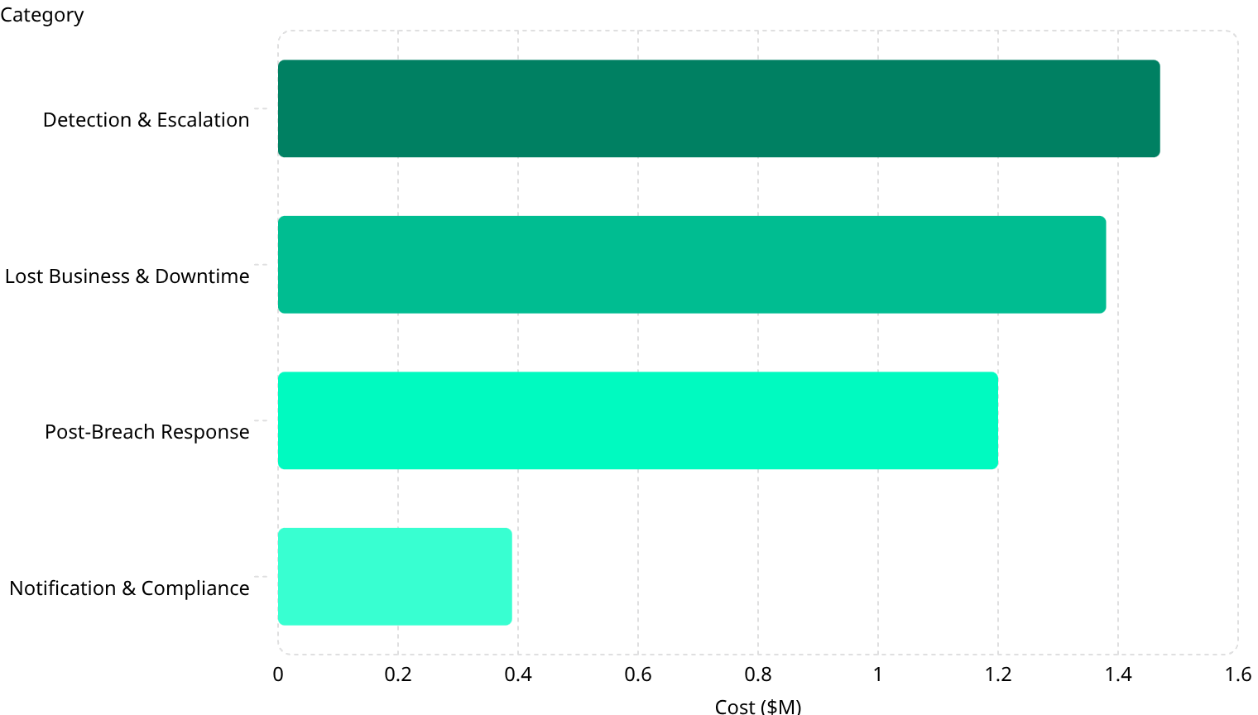
Financial Impact of Telecom Breaches
Cyber incidents in telecommunications have escalated from operational disruptions to systemic threats to market stability. The average breach costs $4.80 Million — with 51% of total costs materializing more than a year after the initial event.
Cost Breakdown by Category
Key Comparative Metrics
$4.80M telecom average vs. $4.44M global cross-industry — driven by supply chain complexity and high-value metadata theft at $168–$178 per compromised record.
1.47
1.38
1.2
Dwell Time Penalty: Breaches undetected beyond 200 days drive average costs to $5.46M, far exceeding the 241-day global average detection window.
0.39
AI Security ROI: Operators with heavy AI/automation integration achieve average savings of $1.9M per incident by accelerating time-to-contain.

Slide 3

Financial Impact: Worst-Case Scenarios
Catastrophic cyber events in telecommunications transcend immediate data loss, posing systemic risks to interconnected sovereign economies and critical national infrastructure.
Backbone / Undersea Cable Failure
Strategic Cross-Sector IT Failure
Satellite (NTN) Infrastructure Disruption
A coordinated attack disrupting 40% of regional capacity for one week: estimated $1.5 Billion in direct losses, with cascading failures to GPS-dependent logistics and global payment systems.
Compromise of a shared cloud provider triggering simultaneous failures across energy, finance, and telecom. Actuarial models estimate U.S./EU losses of $24.2B – $47.1B.
Malware injections or command-and-control hijacking of Non-Terrestrial Networks, stripping emergency service coverage and compromising military-grade backhauls.
Long-Term Financial Consequences
Regulatory "Nuclear Option"
Market Share Erosion
Systemic Stability Threats
Under NIS2 and emerging frameworks, operators face punitive fines up to 7% of total worldwide annual turnover for significant failures.
Data breaches precipitate severe subscriber attrition — operators risk a 21% permanent loss of their subscriber base following a major incident.
Major insurers are withdrawing "backbone" coverage for catastrophic events, forcing operators to absorb massive self-insurance costs and latent decryption-based extortion risks.

Slide 4

Case Study: AT&T / Snowflake Cloud Data Breach (2024)
In 2024, AT&T suffered one of the most consequential breaches in sector history — not through a direct perimeter compromise, but via a third-party cloud data warehouse lacking enforced MFA.
Attack Profile
Operational Timeline
Financially motivated threat actor UNC5537 leveraged credentials stolen via infostealer malware to access AT&T's Snowflake workspace. The absence of enforced Multi-Factor Authentication allowed effortless bypass of primary defenses.
Dec 2023
Initial unauthorized access achieved using stolen credentials — completely undetected.
Data Compromised
Apr 14–25, 2024
Metadata for approximately 110 Million customers — including cell site IDs, telephone numbers, and complete call/text logs spanning 2022–2023.
Attackers silently exfiltrate call logs of ~110M customers over 11 days.
Impacto Financeiro
Apr 19, 2024
The total financial impact of this incident transcends immediate settlement values. In addition to the $177 million collective agreement and the $373,646 bailout, AT&T faced substantial costs of technical remediation, deep forensic investigations, and mandatory safety notifications for 110 million individuals. The immediate drop of $130 million in market value reflects post-disclosure volatility, but hidden expenses include regulatory compliance fines, dramatic increases in cyber insurance premiums due to perceived systemic risk, and the long-term erosion of consumer confidence, which puts pressure on the costs of acquiring and retaining customers in a highly competitive market.
AT&T detects breach only after threat actors advertise the dataset on the dark web.
Jul 12, 2024
Public disclosure following a DOJ-approved delay to protect ongoing investigation.
Dec 2025
Settlement claims deadline — end of primary remediation phase.
$177M consolidated class-action settlement
$130M immediate market cap plunge on disclosure
$373,646 ransom paid for data deletion assurance
Key Lessons: Absence of MFA on third-party cloud integrations is a catastrophic failure point. Metadata carries immense privacy risk even without call audio. The Shared Responsibility Model demands rigorous security policy enforcement across all vendor platforms.

Slide 5
Mitigation Strategies for Telecom Resilience
Achieving structural resilience requires pivoting from legacy perimeter defense to automated, evidence-based security frameworks purpose-built for the complexity of modern telecom environments.
Regulatory & Standards Compliance
Zero Trust Architecture (ZTA) & SASE
AI-Powered Autonomous Response
NIS2 Directive
DNA & DORA
Micro-segmentation restricts lateral movement, ensuring compromised routing hardware cannot reach subscriber databases. High initial capex — but drastically limits breach "blast radius."
Counters agentic AI attacks by automating threat isolation faster than human triage. Proven savings of $1.9M per incident by accelerating time-to-contain.
Classifies telecom as "Essential Entities." Mandates supply chain risk assessments, management liability, and a strict 24-hour early warning for significant incidents.
The Digital Networks Act reinforces supply-chain security for network operators; DORA binds telecom providers to rigorous operational resilience testing as ICT third-party service providers.
GSMA MoTIF & NESAS
GSMA's Mobile Threat Intelligence Framework maps telecom-specific TTPs; NESAS validates the security posture of 5G supply chain equipment and vendors.

