Slide 1

Wholesale Sector Cybersecurity: Key Threats & Top 5 Attacks
Digital supply chains are scaling faster than security governance. The threat landscape is now defined by identity-centric, automated intrusions — posing systemic risks across distribution and logistics networks.
AI-Augmented Credential Exploitation
60% of wholesalers and 52% of their vendors have active credentials exposed in Stealer Logs — granting threat actors frictionless network access.
"Volume Games" Ransomware & Double Extortion
Extortion-only attacks have tripled, now representing 6% of all incidents. Attackers threaten data release to trigger regulatory penalties — no encryption required.
Supply Chain & Third-Party Compromise
Third-party breaches account for 30% of all incidents — a 100% year-over-year increase driven by systematic targeting of upstream service providers.
LotL & Agentic AI Intrusions
Using legitimate admin tools and autonomous AI, attackers persist undetected for an average of 80+ days before executing secondary payloads.
Weaponized API & Shadow AI
Shadow AI — unauthorized generative AI use by employees — contributed to 20% of overall breaches, compounded by poorly secured B2B portals.
Legacy ERP Exposure
Third-Party Risk Paradox
Traditional ERPs bolt web modules onto aging on-premises infrastructure, exposing systems of record to the public internet — bypassing MFA and modern encryption entirely.
78% of organizations acknowledge their cybersecurity programs cover fewer than half of all vendors. 53% of wholesale enterprises harbor unpatched vulnerabilities tracked in the CISA KEV catalog.

Slide 2
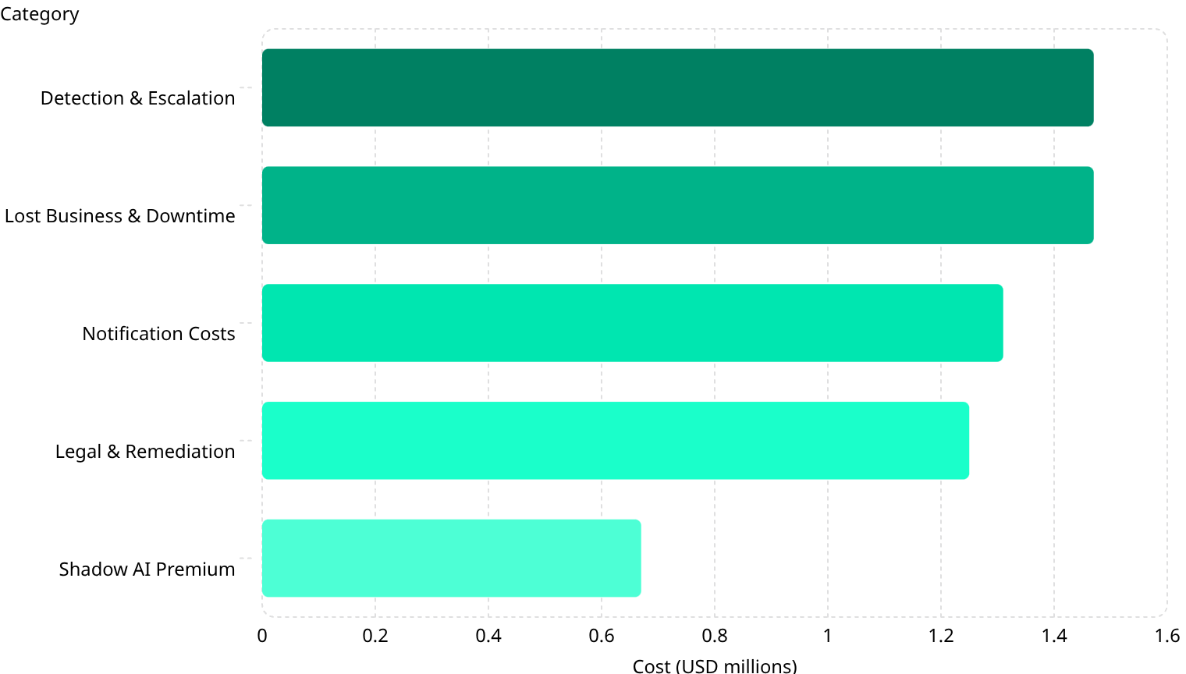
Financial Impact of Cyber Incidents
The average wholesale/retail data breach now costs $3.54 million — an 18% year-over-year increase. For U.S.-based multinationals, that figure escalates to $10.22 million, driven by aggressive litigation and strict notification mandates.
Cost Breakdown Per Breach
Key Benchmarks
1.47
$3.54M
$10.22M
Wholesale/retail sector average — below the global cross-industry average of $4.44M
U.S. regional average for multinational wholesalers due to litigation and notification mandates
1.47
1.31
1.25
0.67
$1.65M
241 Days
Average ransomware recovery cost — excluding the ransom payment itself
Global average to identify and contain a breach; supply chain compromises extend to 267 days — breaches exceeding 200 days cost an average of $5.01M

Slide 3



Worst-Case Scenarios: Catastrophic Incident Profiles
For major wholesale distributors, a catastrophic cyber event transcends internal disruption — it threatens systemic stability across the broader economic supply chain.
Systemic Supply Chain Collapse
Automated Fraudulent Procurement
Mega-Breach of Trade Data
Compromise of a central logistics API or cloud provider halts regional distribution networks, triggering cascading shortages and manual workarounds economy-wide.
Compromised ERP admin credentials override Segregation of Duties, initiating thousands of fraudulent POs — diverting funds to untraceable accounts before quarterly audits detect it.
Exfiltration of B2B algorithms, supplier contracts, and 50–60M customer records averages $375 million per incident in global remediation costs.
75% Client Attrition
NIS2 Fines Up to €10M
Inventory Decay & Shrink
Enterprise buyers terminate relationships post-breach, permanently eroding market cap and Customer Lifetime Value.
"Essential Entities" face fines up to €10M or 2% of global turnover. "Important Entities" (food, chemicals) face up to €7M or 1.4%.
Halted FIFO logic in food and pharma wholesale triggers inventory decay and forced manual tracking — adding tens of millions in unrecoverable shrink charges.

Slide 4

CASE STUDY
United Natural Foods, Inc. (UNFI) — June 2025
North America's premier grocery wholesaler and primary Whole Foods distributor suffered a devastating network intrusion — forcing a complete system shutdown that froze electronic B2B ordering and distribution nationwide.
Exact Financial Impact
$400M
$60M
$25M
$425M
Lost Sales Volume
Net Income Reduction
Direct Incident Costs
Total Gross Impact
Estimated $350M–$400M in unfulfilled orders
Decreased by $50M–$60M in fiscal Q4 2025
$20M inventory shrink + $5M forensic/cybersecurity firms
Initial analyst estimate before insurance offsets
Operational Timeline
June 5
Unauthorized activity detected on IT systems
June 6
Complete network shutdown initiated; nationwide out-of-stock events cascade upstream and downstream
June 16
Core online ordering platforms successfully restored
June 21
Unauthorized activity officially contained; standard shipping resumes
June 26
Broad return to normal capacity; regional service gaps persist into July
Key Lesson: Proactive network shutdown is an effective containment strategy — but carries immense operational cost. Following the disruption, major independent retail partners including Key Food defected to competing wholesalers, demonstrating that cyber incidents directly cannibalize long-term market share.

Slide 5

Mitigation Strategies: From Perimeter Defense to Cyber Resilience
Wholesale organizations must treat cybersecurity as a measurable operational investment — not compliance overhead. The following evidence-based strategies deliver the highest ROI against the sector's most critical threats.
NIS2 Regulatory Mandate
Wholesale food, chemicals, and manufacturing are classified as "Important Entities" under the EU NIS2 Directive. Compliance mandates:
Security AI & Automation
Proactive Incident Response Planning
Reduces breach lifecycle by 80 days on average. Yields $1.9M savings per incident. High implementation cost — typically bundled into core platform upgrades.
NIS2 shifts cybersecurity from a technical necessity to a non-negotiable pillar of corporate governance — with C-suite accountability at the core.
Enables 77% faster operational recovery. Investment: €15k–€75k. Mitigates damages by $1.49M per incident on average.
Continuous Security Awareness Training
Reduces phishing click-rates by 86% over 12 months. Investment: €20k–€80k. Delivers a proven 50x ROI.
Executive governance accountability — leadership personally liable for framework failures
Mandatory supply chain risk management across the full vendor network
Strict incident reporting: early warning within 24 hours, full assessment within 72 hours
First-year compliance budget: €120,000–€350,000 for mid-sized entities; ongoing annual maintenance at 30–40% of initial cost

