Slide 1





EU AGRICULTURE · FOOD · TOBACCO · 2025–2026
Cybersecurity Operational Outlook: Strategic Risk Assessment
The digitization of EU food and agriculture infrastructure has expanded the systemic attack surface, exposing critical operations to five primary threat vectors.
Ransomware & Double Extortion
Living-off-the-Land (LotL)
Supply Chain Exploitation
Exfiltrate data before encryption; exploit low downtime tolerance.
100% of actors use native tools; 94.4% achieve prolonged stealth.
Compromise upstream vendors; ~80% of initial network entries.
AI-Enabled Phishing
Layered DDoS & Coercion
Over 80% of social engineering uses AI; deepfakes bypass MFA.
DDoS layered on encryption keeps portals offline during negotiations.

Slide 2
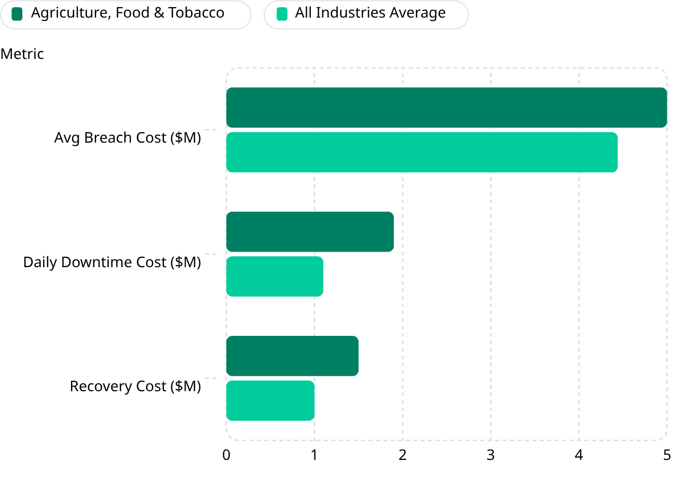
SECTOR VULNERABILITIES · THREAT ACTORS · FINANCIAL IMPACT
Unique Vulnerabilities, Dominant Threat Actors & Financial Exposure
Sector-Specific Vulnerabilities
Financial Impact: Sector vs. All Industries
Just-in-Time Operations: Perishable goods make downtime uniquely costly
ICS/OT Convergence: 20+ year legacy systems on corporate IT networks
SMB Fragmentation: Thousands of under-secured cooperatives
Unsecured IoT: Sensors and cameras create unmonitored entry points
Top Threat Actors
Qilin: 37 sector intrusions in 2025
Akira: 36 intrusions; targets VDI and Active Directory
CLOP: 9.3% of global ops target this sector
Scattered Spider: Help desk impersonation; 2025 retail breaches
RansomHub: Targets SCADA/OT environments
Sector breach cost: $5.00M vs. $4.44M average. Daily downtime: $1.9M vs. $1.1M. Incident growth: 101% YoY vs. 38% cross-industry. Resolution: 11–22 days vs. 7–14. Profit margin buffer: 1.6% vs. 10–15%.

Slide 3
WORST-CASE SCENARIOS · LONG-TERM CONSEQUENCES
Catastrophic Scenarios & Strategic Financial Aftermath
Three Catastrophic Scenarios
Long-Term Financial Consequences
Scenario A — HACCP Bypass: Attacker alters PLC pasteurization temps; undetected pathogen contamination triggers EU-wide recalls and criminal liability
Scenario B — Historian Erasure: Ransomware deletes batch records and cold-chain logs; entire inventory legally classified "suspect" and destroyed
Scenario C — ERP Cascade: SaaS exploit locks distribution platforms; farms dump milk, shelves empty, national shortages and inflation follow
NIS2 Fines: Up to €7M or 1.4% of global turnover
GDPR Fines: Up to €20M or 4% of worldwide revenue
Brand Erosion: Customer recommendation drops >14% post-breach
Market Cap Loss: Share price falls >11% immediately
Uninsurable Losses: Recall and spoilage costs typically excluded from cyber policies

Slide 4
CASE STUDY · JUNE 2025
United Natural Foods Inc. (UNFI) — Cyberattack Profile
North America's largest grocery wholesaler, primary distributor for Amazon's Whole Foods, was compromised via help desk social engineering — likely Scattered Spider.
Day 1 — June 5
1
Unauthorized admin movement detected; core ordering and distribution platforms shut down
2
Days 2–10 — Supply Chain Blockade
30,000+ retail locations hit with fulfillment failure; shelves empty, deliveries cancelled
Day 10+ — Incremental Restoration
3
EDI invoicing restored; manual workarounds with reduced transaction volumes
4
Day 20+ — Full Normalization
Databases rebuilt from clean backups; fleet logistics normalized; loss documentation begins
$350M+
$50M+
$65M+
Sales Reduction
Net Income Hit
Remediation Costs
Estimated FY2025 net sales drop
Direct erosion inclusive of tax impacts
Forensics, rebuild, legal, and premium shipping

Slide 5
MITIGATION STRATEGIES · NIS2 COMPLIANCE
Evidence-Based Security Strategies & Regulatory Obligations
Zero Trust & Hardware MFA
IT/OT Micro-Segmentation
Behavior-Based EDR
FIDO2 authentication; mitigates 99.9% of credential theft
Isolate OT/SCADA; prevents lateral movement to PLCs
Detects LotL activity and zero-days; saves avg. $1.9M
Immutable Offline Backups
Third-Party Risk Audits
Air-gapped copies eliminate ransom leverage; saves avg. $1.5M
Secures supply chain; avoids NIS2 fines up to €7M
NIS2: "Important Entity" Threshold
NIS2 Incident Reporting Deadlines
≥50 FTE employees OR turnover >€10M OR balance sheet >€10M
Early Warning: Within 24 hours of detection
Incident Notification: Within 72 hours
Final Report: Within 1 month

