Slide 1
Self-Driving Cars with CARLA
By Jesus Badillo

Slide 2
The CARLA Simulator
The CARLA Simulator is used in autonomous driving research because of its ability to simulate real vehicles and sensors
It provides access to a suite of sensors such as Lidar and camera sensors. It also provides data on the dynamics of the vehicle such as the throttle and steering angle
Carla uses the unity game engine to create an environment where the vehicle can run and with other running vehicles and real-life conditions.
Using these parameters one can train a vehicle to run semi-autonomously or autonomously

Slide 3
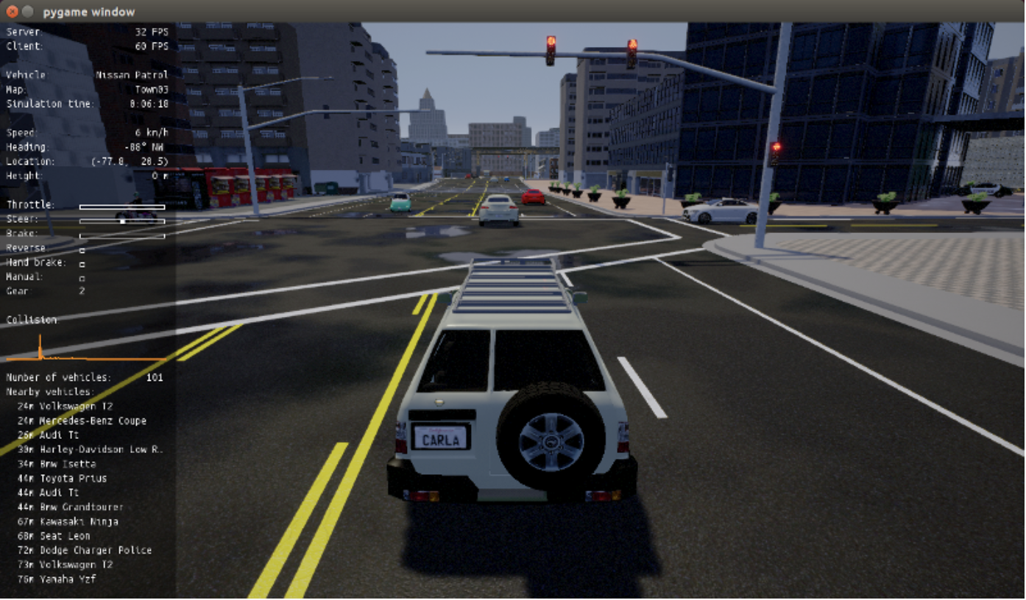

Slide 4


Running CARLA in Colab
To use the CARLA Simulator in google colab we can use an open-souce github which allows one to use a fully functioning version of CARLA, which requires a good GPU. Note that using this requires one to download TurboVNC and Cloudfare to be able to run CARLA remotely.
This is used because CARLA is a heavy and resource intensive program

Slide 5
Creating a Dataset with CARLA
The CARLA simulator gathers information from the running vehicle in an environment and uses the desired sensors with the dynamics and writes it to a csv file
In this project the only sensors that will be used will be the front, left, and right cameras of a Tesla model 3. This simulation will drive in a normal pedestrian scenario

Slide 6
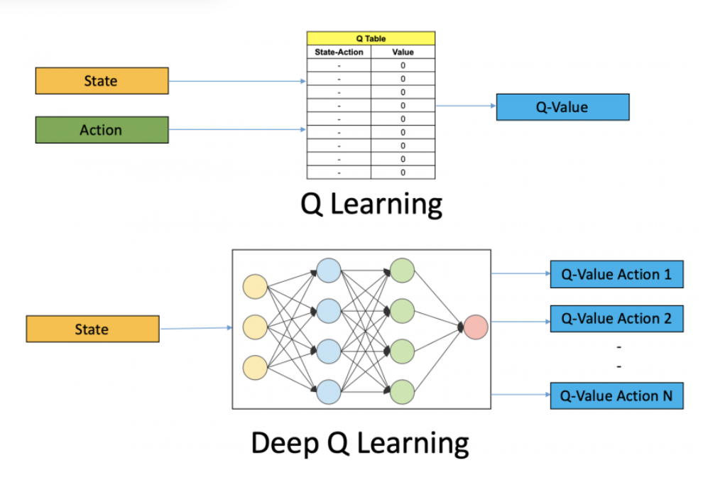
Deep Learning Algorithm
To train the neural network for the self driving car I will be using a neural network that can learn from its previous iterations much like q-learning
This class of neural network is called deep Q-Learning and it uses reinforcement learning to map the actions and Q-values transitions to the input states.
This approach replaces the Q-table from traditional reinforcement learning with neural networks which train the decision-making process of the vehicle.

Slide 7
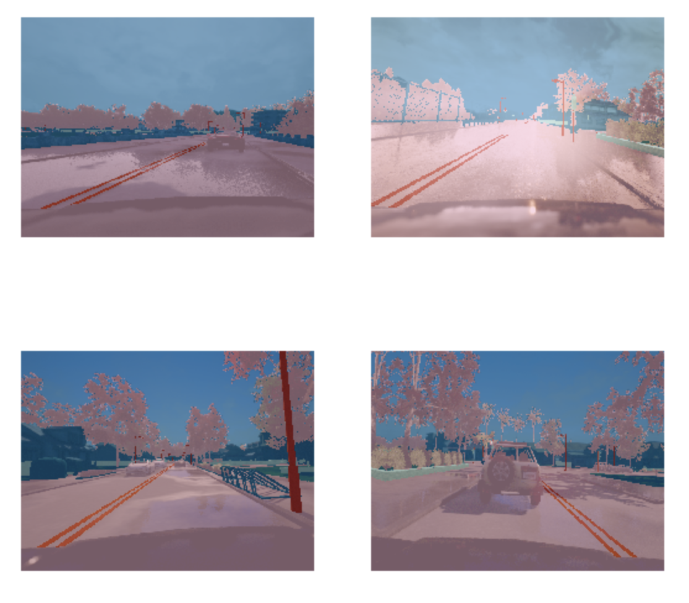
Existing Links
This study uses transfer learning with the ResNet34 neural network on the CARLA simulator to try to run the vehicle autonomously.
https://www.kaggle.com/nbuhagiar/carla-semantic-segmentation

Slide 8
Timeline for Project
Week 1 (April 2 – April 9) | Week 2 (April 10 – April 16) | Week 3 (April 17 – April 23) | Week 4 (April 24 – April 30) | Week 5 (May 1 – May 7)
Setup CARLA in either google Colab or local Computer and make a dataset using cameras of simulated vehicle | Load dataset into notebook and do some analysis of which deep Q-Learning network would work best | Train network, for CARLA simultations the simulations can take up to 5 days | Run model with vehicle and adjust parameters for network to try to achieve higher accuracy | Catch up week and wrap up report

Slide 9
References
https://www.analyticsvidhya.com/blog/2019/04/introduction-deep-q-learning-python/
https://github.com/MichaelBosello/carla-colab.git
http://carla.org/
https://carla.readthedocs.io/en/0.9.7/getting_started/
https://openaccess.thecvf.com/content_cvpr_2018/papers_backup/Mullapudi_HydraNets_Specialized_Dynamic_CVPR_2018_paper.pdf
https://towardsdatascience.com/deep-q-learning-tutorial-mindqn-2a4c855abffc
https://www.youtube.com/watch?v=EaY5QiZwSP4&t=1595s

