Slide 1

REU PROJECT TITLE: Investigating the Classification of Breast Cancer Subtypes Using KMeans
FGLSAMP/FAMU Summer Research in Data Science, Artificial Intelligence (AI), and Machine Learning Experience
Presented by;
Kehinde B. Ezekiel
July 28, 2021

Slide 2
Overview
Motivation behind the Project
Model
Results or what others have found
Conclusion
Takeaways from the REU Experiences

Slide 3
Motivation behind the Project
HEALTHCARE ENTHUSIAST
Interest in healthcare, and passionate about solving problems in the field through innovative approaches (e.g through the implementation of technological solutions).
I focused on breast cancer because it is one of the main cause of mortality due to cancer among women.
AVAILABILITY OF DATA
Also, there has been a lot of research on breast cancer through different perspectives like the treatment and management approach, anatomical approach, genetic approach, artificial intelligence approach and so on.

Slide 4
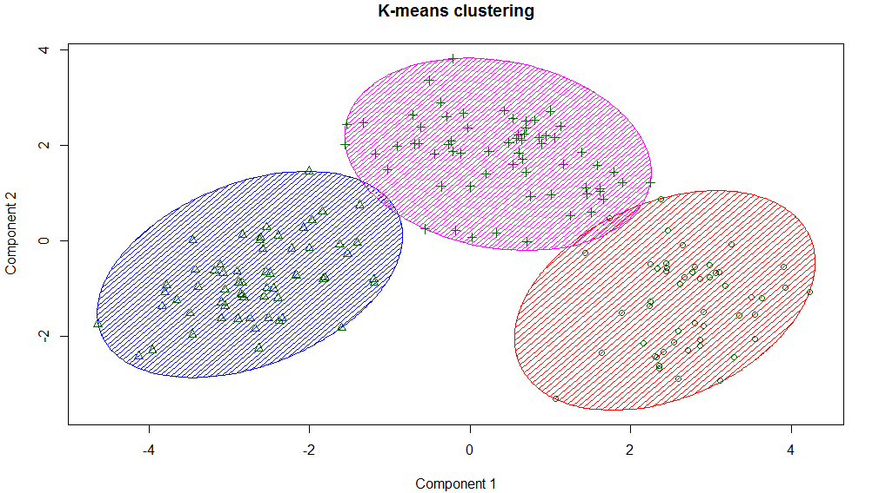
Model
The project was focused on investigating the classification of molecular breast cancer subtypes through the approach of KMEANS using a proteomic dataset.
KMeans is a type of machine learning algorithm. It is a non-supervised learning algorithm.
It aims to identify underlying patterns in a dataset by looking for a fixed number of clusters.
It is usually characterized by having a particular silhouette score.
The original classification is based on gene expression profiling of 50 genes (also known as, PAM50 Genes) and it analyzes the activity of certain genes in early-stage, hormone-receptor-positive breast cancer.
However, a proteomic dataset was used in those model.
https://www.google.com/url?sa=i&url=https%3A%2F%2Ftowardsdatascience.com%2Fkmeans-clustering-for-classification-74b992405d0a&psig=AOvVaw2C6bb7SQH96v2vuOad0Wrh&ust=1627498037705000&source=images&cd=vfe&ved=

Slide 5
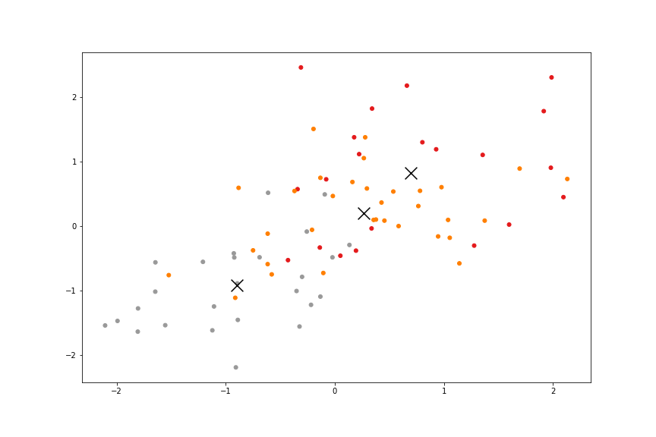
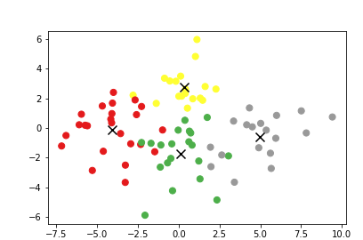
Results
The results of the clusters show that the data are closer together when a cluster of four was used which depicts that a relationship exists between the data.
The silhouette scores for the cluster of 3 and 4 are 0.1426 and 0.1323 respectively
A link to the full report - https://github.com/cybertraining-dsc/su21-reu-362/blob/main/project/index.md
A link to the codes - https://colab.research.google.com/drive/1ETvGu_cMFlATT28LrHdWgRFahBv9gStN#scrollTo=Qu6nLUiudcYa
Each cluster represent the expression levels 43 of the genes that are associated with the classification of breast cancer subtypes.
A KMeans clustering graph showing the classification of a breast cancer proteomic dataset in three clusters.
A KMeans clustering graph showing the classification of a breast cancer proteomic dataset in four clusters.

Slide 6
Conclusion
The results of the KMeans analysis indicated that a cluster of 3 is better than a cluster of 4. Hence, more studies can be done to see the interrelatedness of the four subtypes of breast cancer.
Future research would be to use other machine learning algorithms, possibly a supervised learning algorithm, to identify the correlation between the clusters and the four molecular subtypes.
This model can be improved upon and help radiologists, medical researchers and scientists in their search for better innovative methods and technologies that aid the detection, classification, management and treatment of breast cancer.

Slide 7
Takeaways from REU Experience
NEW KNOWLEDGE:
I have learnt about data science, machine learning and artificial intelligence
TRANSDISCIPLINARY APPROACH:
I have new understanding and approach to combining healthcare and technology.
INTERPERSONAL SKILLS:
I have learnt about flexibility and collaboration.
CAREER-WISE:
I have more understanding to different career-options.

Slide 8
Acknowledgements
This projected was immensely supported by Dr. Gregor von Laszewski
Also, the contribution, support, help and advice I received from the REU Instructors cannot be overemphasized. I truly appreciate Carlos Theran, Yohn Jairo and Victor Adankai for their great assistance and teachings.
I am also grateful to my colleagues who helped me out; Jacques Fleischer, David Umanzor and Sheimy Paz Serpa
Lastly, I’m grateful to Dr. Byron Greene, the Florida A&M University, the Indiana University and Bethune Cookman University for giving me a platform to be able to learn new things and embark on new projects.

