Slide 1
Final project: automated irrigation system
Created by: Ryan Bezerra

Slide 2
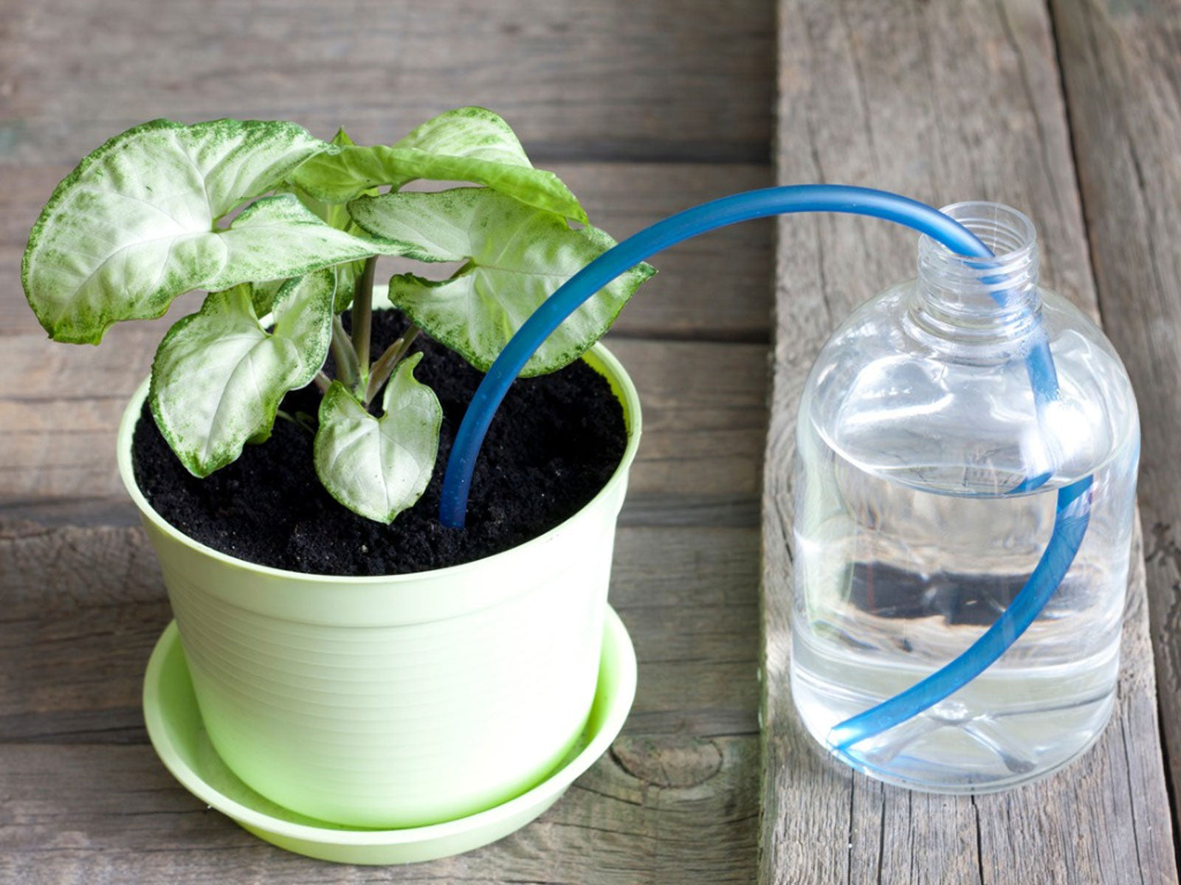
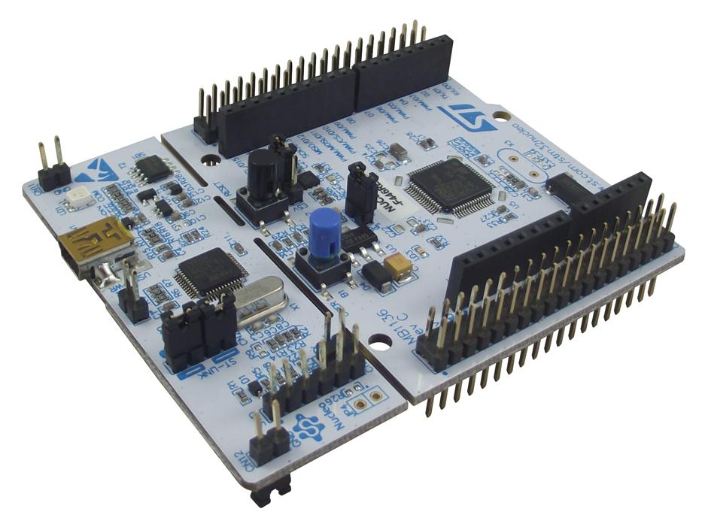
Objective
To create an automated irrigation system for household plants using the Nucleo-FR446RE
Make it easily repeatable and expandable for others to use.

Slide 3
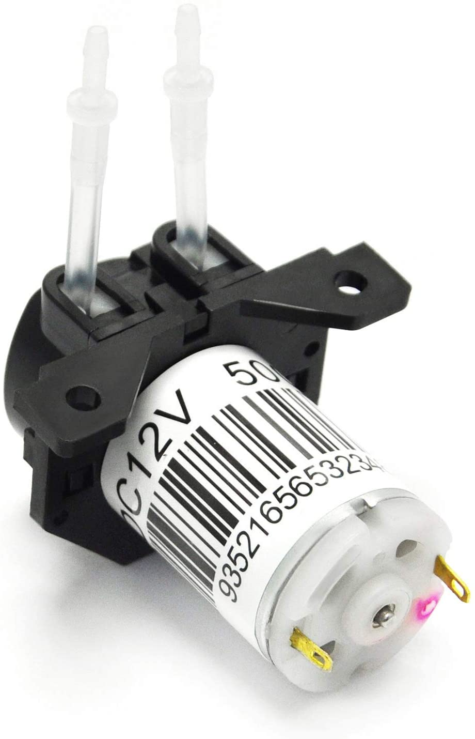
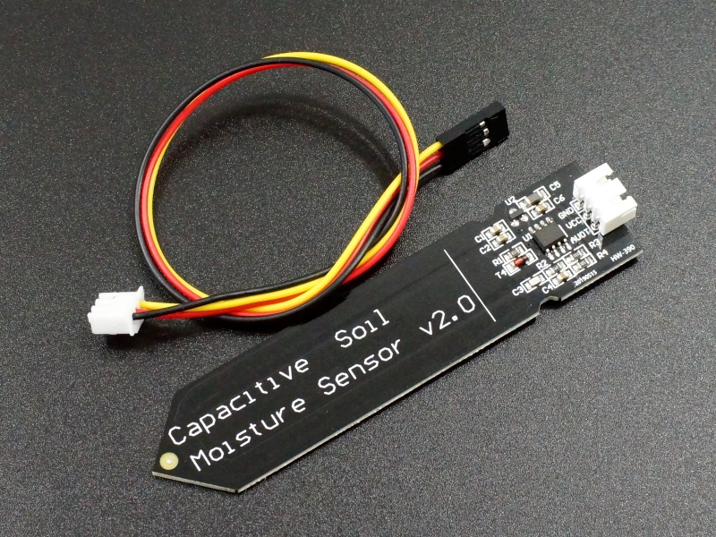
Materials
Nucleo-FR446RE
Capacitive Soil Moisture Sensor
Any simple 12V water pump.
12V Power Adapter
Rubber hosing
LCD Module

Slide 4
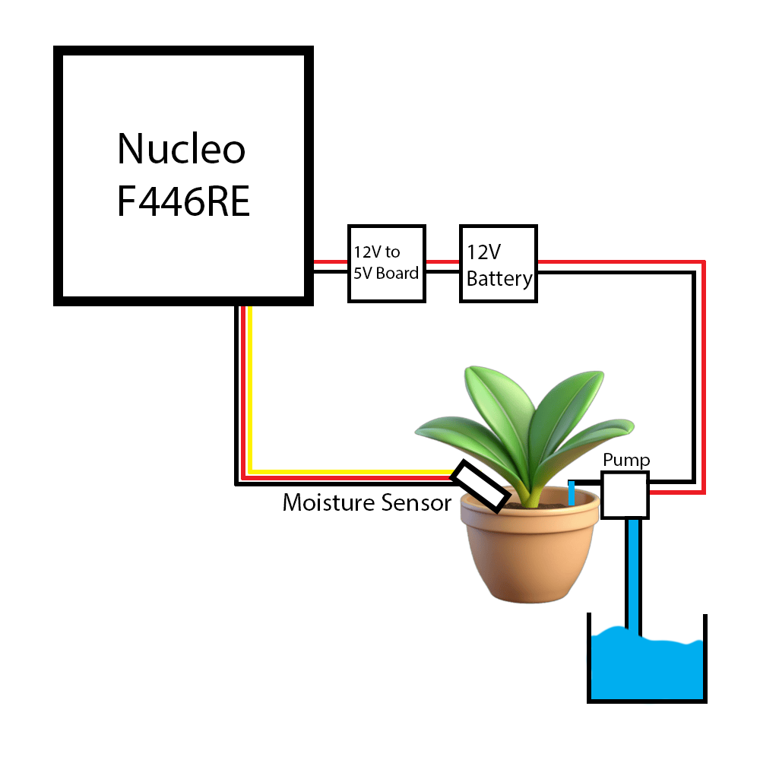
Method
The system will make use of a simple script that engages the water pump based on an interrupt trigger.
A queue will be used to prioritize operations between sending information to an attached LCD display and irrigation operations.

Slide 5
Testing
Testing will be simple and make use of a randomly selected house plant.
01
The system will be run for at least a full day on said plant to ensure functionality.
02
The goal is to have it run for a whole week without any interaction needed from the user for it to be considered “complete”.
03

Slide 6
TimeLIne
Week 1: Have the wiring and necessary hardware connections complete.
Week 2: Write and complete script for the Nucleo board.
Week 3: Testing and troubleshooting.

