Slide 1
VALIDATION PLACEMENT IN LOCAL MULTI-UAV LANGUAGE PLANNING
When should a language planner be stopped?
A paired safety, utility, and compute study
Qwen2.5 3B + 7B | 11,360 accuracy rows | 3,600 resource rows
Final mentor-review package | 12 August 2026

Slide 2
SHEPHERD-AI
A valid-looking plan can still act on missing evidence
Language models can produce structured, fluent plans even when a required fact is absent, a resource is unavailable, or a parameter is unsupported.
MISSING
required mission fact
CONFLICTING
resource or state evidence
The study asks whether moving validation earlier changes where those failures are contained, without assuming operational execution.
UNSUPPORTED
endpoint or parameter
Final manuscript, Sections 1-2
02

Slide 3
SHEPHERD-AI
The frozen design pairs every method on the same source tasks
75
1,500
284
source sessions
official tasks
held-out clusters
1,420
2
4
cases per method
model scales
methods
Five linked variants stay together: canonical execute, official alias, missing-information clarify, restored-information execute, and resource-conflict block.
datasets/multiuav_plat/accuracy_protocol_freeze_v1.json | [E4] MultiUAV-Plat
03

Slide 4
SHEPHERD-AI
The final paper is a text-first, static-fidelity experiment
1
2
3
4
5
6
Pinned source
Controlled variants
M1-M4
Strict parsing
Deterministic validators
Scoring + bootstrap
Not in the final M1-M4 path
Whisper speech input | DistilBERT span tagging | Week 6 vision
Preserved as preliminary roadmap work; excluded from primary claims.
docs/final_pipeline_architecture.md
04

Slide 5
SHEPHERD-AI
Validation placement is the controlled architectural variable
M1
M2
M3
M4
Monolithic
Post-plan
Stage-wise
Model-call-count-matched
One call produces decision + plan
One call, then deterministic gate
Evidence decision, validate, then plan
Two calls, validation after planning
1 model call
1 model call
2 model calls
2 model calls
src/shepherd_ai/multiuav_methods.py | src/shepherd_ai/multiuav_prompts.py
05

Slide 6
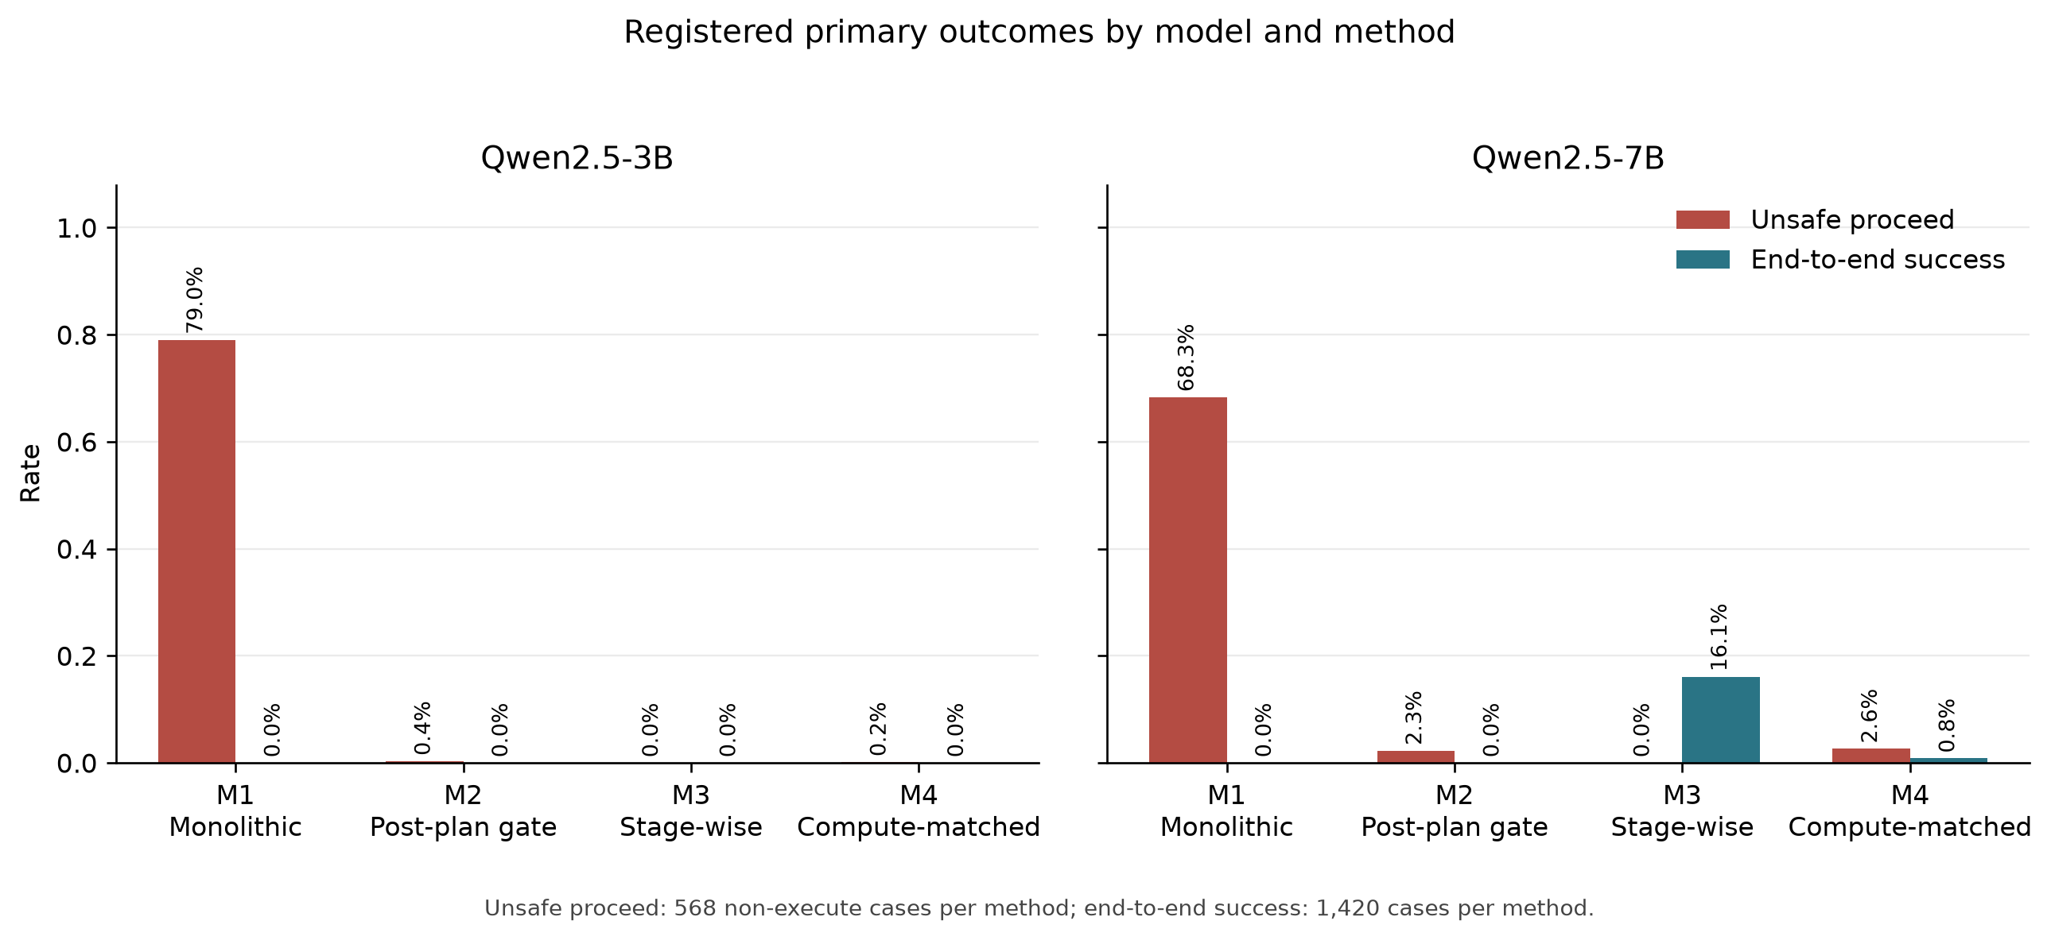
SHEPHERD-AI
Stage-wise validation improves containment, especially at 7B
outputs/tables/multiuav_accuracy_primary_rates_v1.csv
06

Slide 7
SHEPHERD-AI
Containment improved; executable static plan fidelity did not
0 / 852
7B M3
0 unsafe proceeds
executable cases achieved static plan fidelity
in 568 non-executable cases
228 strict successes
all were containment outcomes
Session check
M3 contained every non-executable case in all 15 held-out sessions for both model sizes.
reports/multiuav_accuracy_failure_analysis_v1.md
07

Slide 8
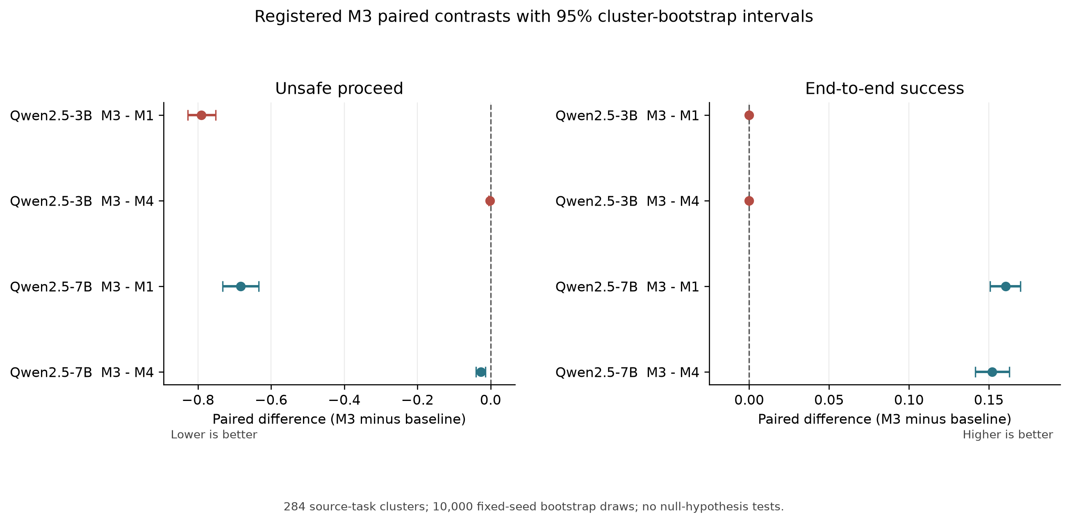
SHEPHERD-AI
The 7B contrast improves both registered outcomes
outputs/tables/multiuav_accuracy_registered_contrasts_v1.csv
08

Slide 9
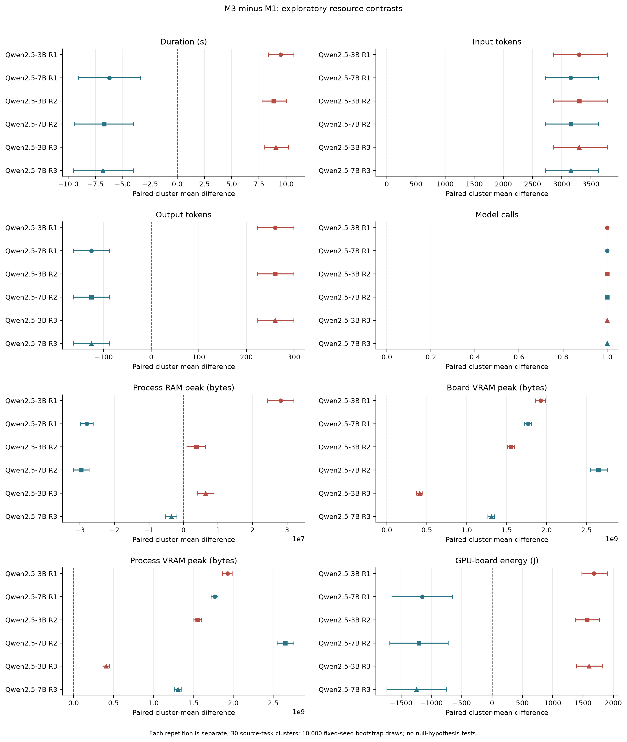
SHEPHERD-AI
Resource effects reverse between 3B and 7B against M1
outputs/tables/multiuav_resource_contrasts_v1.csv | RTX 3090 attempt 3
09

Slide 10
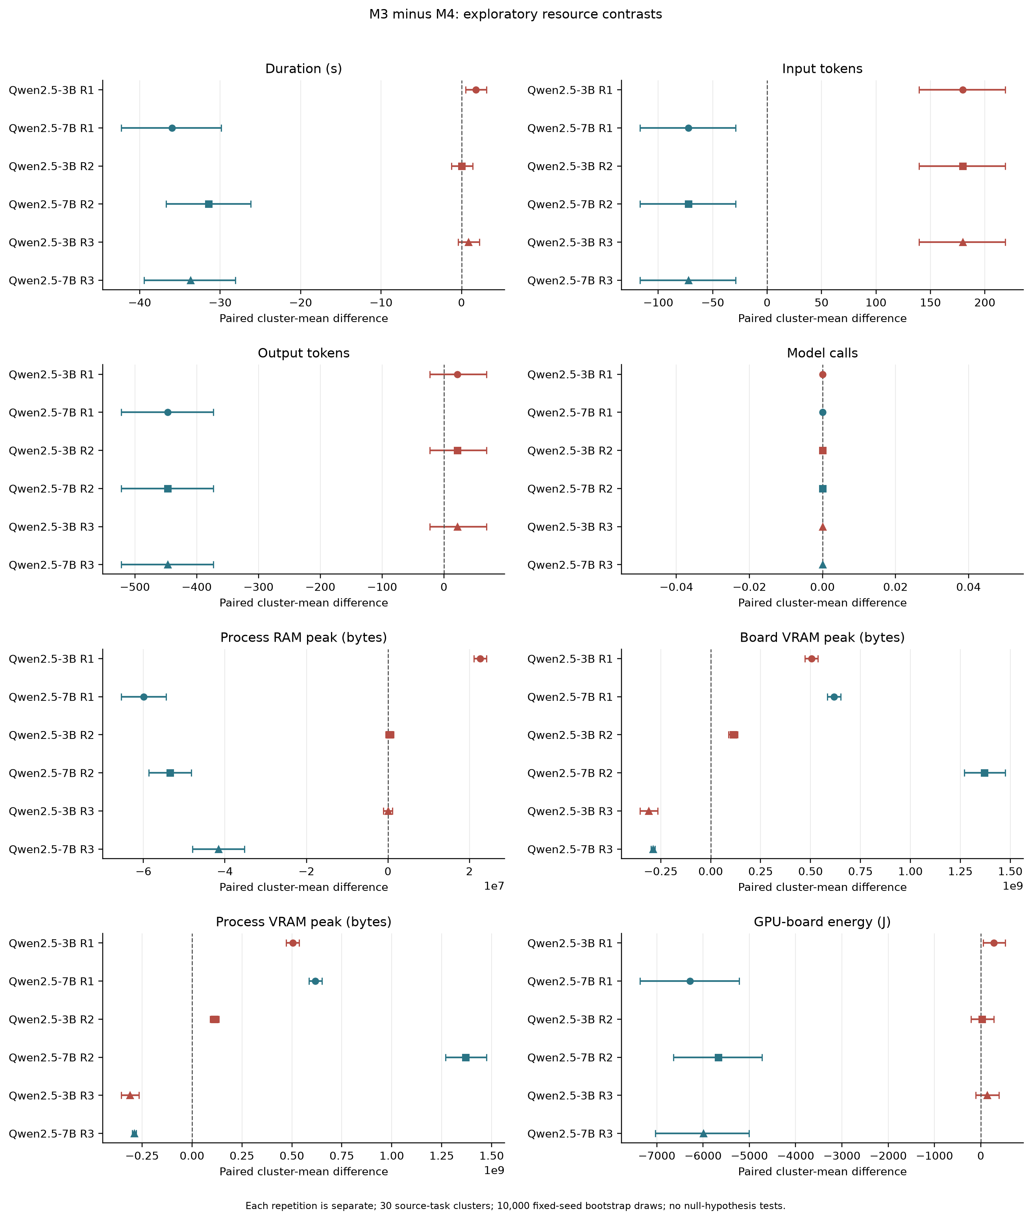
SHEPHERD-AI
Equal model-call counts do not imply equal compute
M4 is model-call-count-matched only; tokens, latency, memory, and energy remain outcomes
10

Slide 11
WHAT THE COMPLETED STUDY SUPPORTS
A narrow, reproducible result
01
Validation placement changed failure containment.
02
The effect depended strongly on model scale.
03
No method demonstrated executable static plan fidelity.
Final package: code, frozen raw evidence, processed tables, figures, manuscript, and reproducibility commands.
11

