Slide 1
Section 1 - Github
GitHub is a Web-based Git repository hosting service. It offers all of the distributed revision control and source code management (SCM) functionality of Git as well as adding its own features. - Wikipedia

Slide 2
Preparing Jobs
1. Create An Github Account
2. Install Git Client on your PC
GitHub Desktop for Mac and Widnows, or
Git for Mac, Windows and Linux from
https://git-scm.com/downloads

Slide 3
Generate SSH Keys
With ssh-keygen for Mac and Linux Users
With Git Bash for Windows Users
Get Individual Guide from
https://help.github.com/articles/generating-ssh-keys/

Slide 4
Setting Up GitHub
Add Public Key to GitHub
Setup Git
Creating A Repository
Forking A Repository

Slide 5
Basic Git Commands
$ git init
$ git clone
$ git add {files}
$ git commit -m “Messages”
$ git push origin master
$ git remote add origin {Server}

Slide 6
More Git Commands - Branch
$ git checkout -b feature_x
$ git checkout master
$ git branch -d feature_x
$ git push origin {branch}

Slide 7
More Again – Update & Merge
$ git pull
$ git merge {branch}
$ git add {filename}
$ git diff {source branch} {target branch}
$ git log
$ git diff {first file} {secend file}
More Guides:
http://rogerdudler.github.io/git-guide/

Slide 8
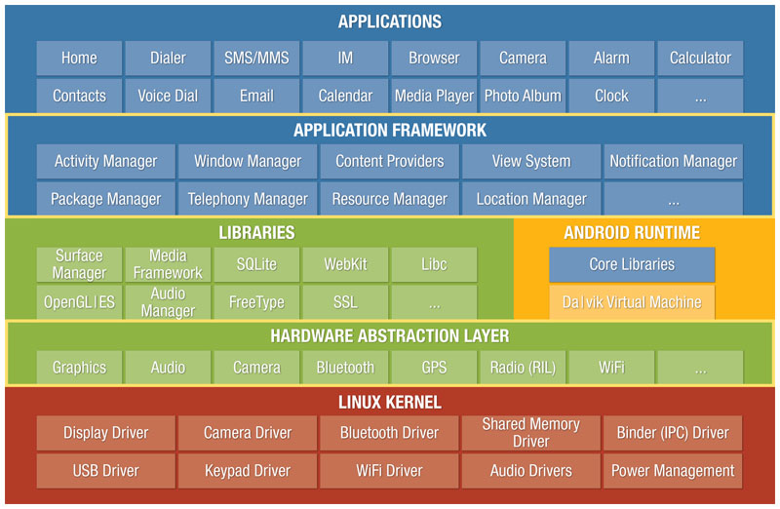
Section 2 – Android Demo

Slide 9
Benefits of Gradle
Create multiple APKs for your app with different features using the same project
Reuse code and resources
Customize, configure, and extend the build process
Customized integration with their own IDE Android Studio
Single build tools to support multiple languages

