Slide 1
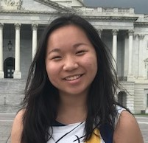
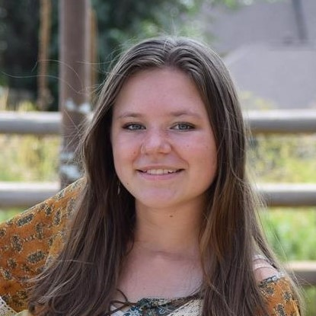
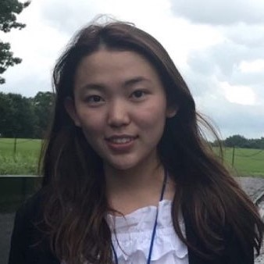
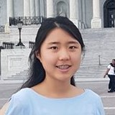
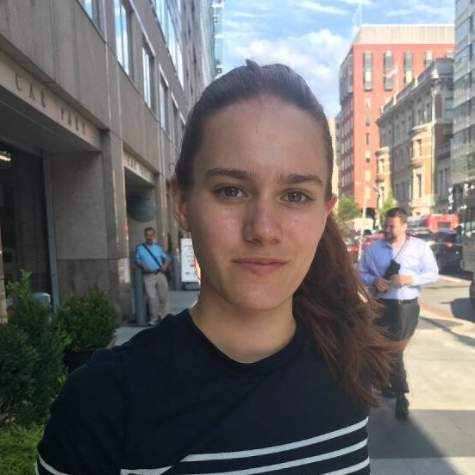
Tiffany Dinh
Beth Chwialkowski
Technical President
Human Resources Director
Tiffany is a high school senior from Alabama, USA. Loving everything in STEM from her participation in FIRST Roboics to CyberPatriot, she is a champion of computer educaiton advocacy and is contiously working for the betterment of access to the field.
Beth is a high school junior from Colorado, USA. Beth is one of our most enthusiastic members with her interest to change the field of technology. She has been with CyTech since its founding and is always looking for the next opportunity to help others.
Charissa Kim
Kanin Liang
Communications Director
Financial Director
Charissa is a high school junior from California, USA. She has a extrodinary set of accomplishments from her winning 1st place in the All Service CyberPatriot National Youth Defense Competition to her STEM education in her community.
Kanin is a high school junior from California, USA. While working tirelessly in multiple organizations for the promotion of computing education, she is another one of our accomplished members in CyberPatriot,
Amberley Odysseas
Public Officer
Amberley Odysseas is from the Kent, UK. She has been crucial to the involvment of youth in her community in STEM and is one of the top students in her country in CyberDiscovery. Taking what she has learned, she is inspiring others to follow her path.

