Slide 1
Document AI: Naive RAG/Agentic RAG/

Slide 2
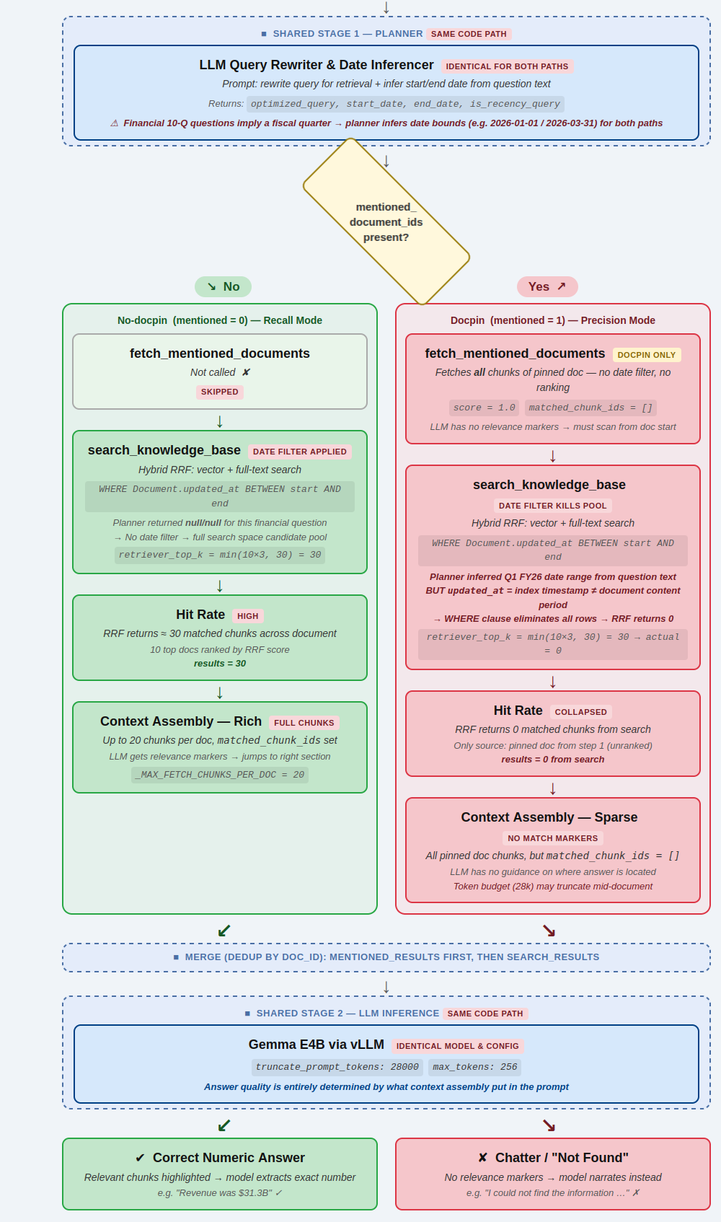
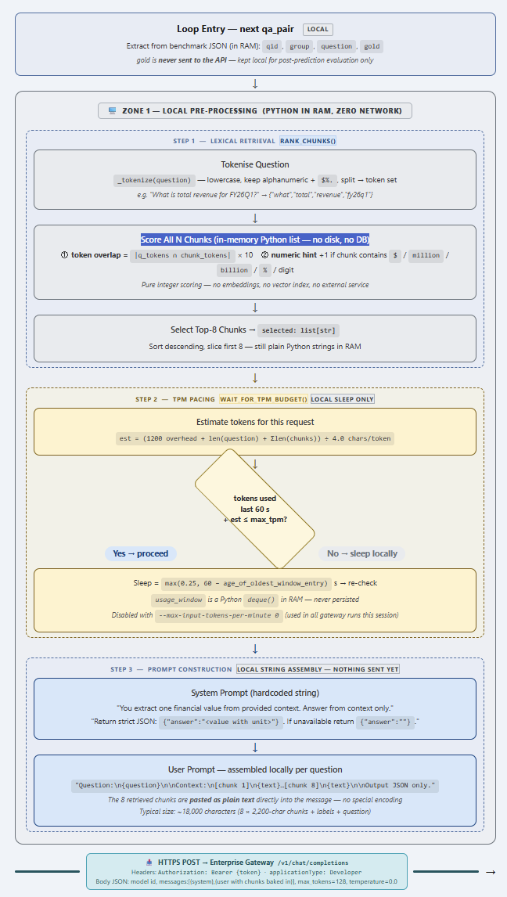
Comparing Two Approaches
Direct Approach
(Naive) RAG Approach

Slide 3
Performance
Direct Approach
RAG Approach
Model | Overall Correct | Number Match
DeepSeek V4 Pro | 62% | 92%
DeepSeek V4 Flash | 58% | 83%
GPT-5 nano | 39% | 89%
GPT-5.1 | 69% | 90%
GPT-4o-mini | 19% | 87%
GPT-4o | 70% | 88%
Claude-opus-4.5 | 74% | 87%
Claude-haiku-4.5 | 67% | 89%
Gemma4-4B Q4 K M | 55% | 83%
Gemma4-31B Q4 K M | 68% | 83%
Model | Config | Overall | Num Match
DeepSeek V4 Flash | think, chunks50, top10 | 48% | 62%
DeepSeek V4 Pro | think, chunks50, top10 | 44% | 63%
Gemma4 31B Q4_K_M | think, top20 | 44% | 57%
Gemma4-E4B | think, top20 | 37% | 54%
Gemma4-E4B | nodatefilter, top20 | 30% | 49%

Slide 4
What causes the Gap?
Factor | Direct | RAG
Context source | Full docx, char-chunked | DB chunks from docling parse
Chunk selection | Lexical (exact field name match). Overlapping windows in a Python list. | Semantic/RRF (concept match)
Coverage | All 102 chunks ranked. Paste the top 8 chunks as text into the user message.106 chunks( 200k chars, 2200-char windows, 300-char overlap). Each query uses the top 8 ranked chunks — covering 7.5% of the document per query. | Top-10 from 60 doc chunks
Table Markdown | _read_docx_text() — opens the .docx as a ZIP, reads word/document.xml raw XML, then: Replaces </w:p> (paragraph end tags) with \n Replaces <w:tab/> with \t Strips all remaining XML tags with re.sub(r"<[^>]+>", " ", ...) HTML-unescapes entities Collapses multiple blank lines The result is plain text — tables come out as space-separated columns (the XML cell boundaries become spaces/newlines from tag stripping). No Markdown pipe tables are produced. This is why it outperforms the pipeline for tables: the char-chunking at 2200 chars naturally keeps a table's header and data rows in the same window (no structural splitting), whereas Docling's Markdown pipe-table + RecursiveChunker splits every row into its own chunk. The tradeoff: Docling's Markdown would be better if chunked correctly (preserving | header | with data rows) — which is what the chunk_text_hybrid fix does. The direct approach just sidesteps the problem by never generating structured Markdown in the first place. | Docling ETL (do_table_structure=True) → detects table boundaries in the DOCX/PDF and exports them as standard Markdown pipe tables: | Item | Q1 FY26 | Q2 FY26 | |---|---|---| | Revenue | 69,632 | 72,431 | Default chunker (RecursiveChunker) then splits that Markdown, breaking the table mid-rows — the header row ends up in one chunk, each data row in separate chunks with no column context. The fix we applied (chunk_text_hybrid) detects contiguous |...| lines in the Markdown and keeps the whole table in a single chunk (or repeats the header row when a large table must be split). So Docling's markdown output is the good part — it preserves table structure. The problem was the chunker then destroyed that structure.

Slide 5
Main Concerns and Goals
Adaption
Generalization
Efficiency
Cost
Persistency
Auditability

Slide 6
