Slide 1

TENSOR BANDIT ALGORITHMS
Shi Yu
09/22/2021
Vanguard Center of ANALTYICS and INSIGHTS

Slide 2
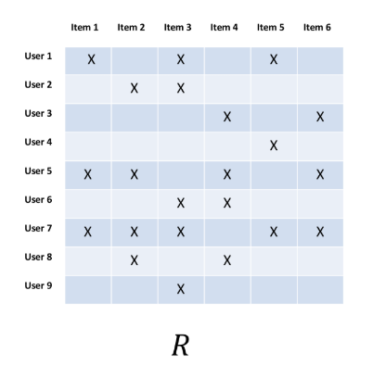
ITERATIVE Learning FROM INCOMPLETE DATA
Continued from Recommendation System …
Recommending news, products, movies, …, based on users’ profiles
Contextual features about users and items are also available
Recommender System:
To learn latent factors that could estimate/predict the ratings/reviews
Ratings/reviews are very sparse observations scatter in a huge list of items
The quality of model is evaluated by the error between predictions and observations
Usually suffers from Cold-start
Bandit algorithm in Recommender System
Items are competing for limited user engagement (click-through, like vote, views, orders)
Items are also competing for limited real estate (mobile phone screen, web page, ads positions)
The engagement results are usually binary (0 or 1), and no explicit feedbacks/ratings
Normally a user only has very few engagement each time, and only the successful engagements can be used as labels (Sparse rewards)
Cold-start is not a vital problem, because the algorithm can iteratively learn and refine the model

Slide 3


From Ads click to RETRIEVAL
User
Items = (Ads, Products, Articles, …)
A
B
C
D
Recommend An Item with
Maximum$u^{T}v$
User Latent Factors u
(Embeddings)
Item Latent Factors v
(Embeddings)
User
Query
Items = (Ads, Products, Articles, …)
Arm Features
Search Results
A
B
C
D
User Latent Factors u
(Embeddings)
Query Latent Factors q
(Embeddings)
Item Latent Factors v
(Embeddings)
Engagement Feedback (Rewards)

Slide 4
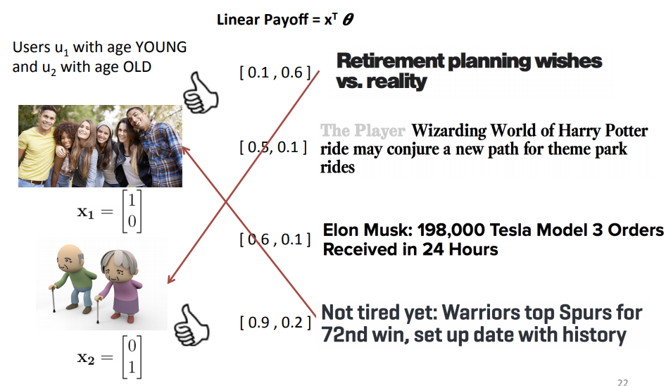
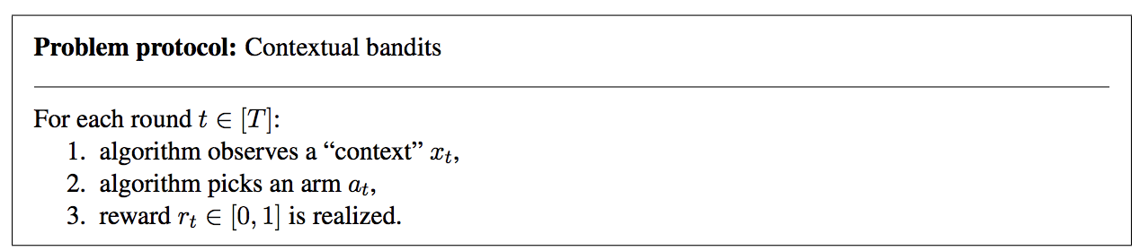

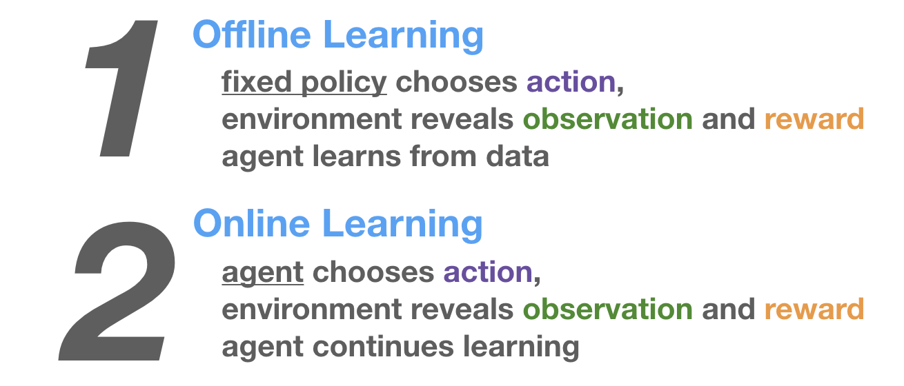
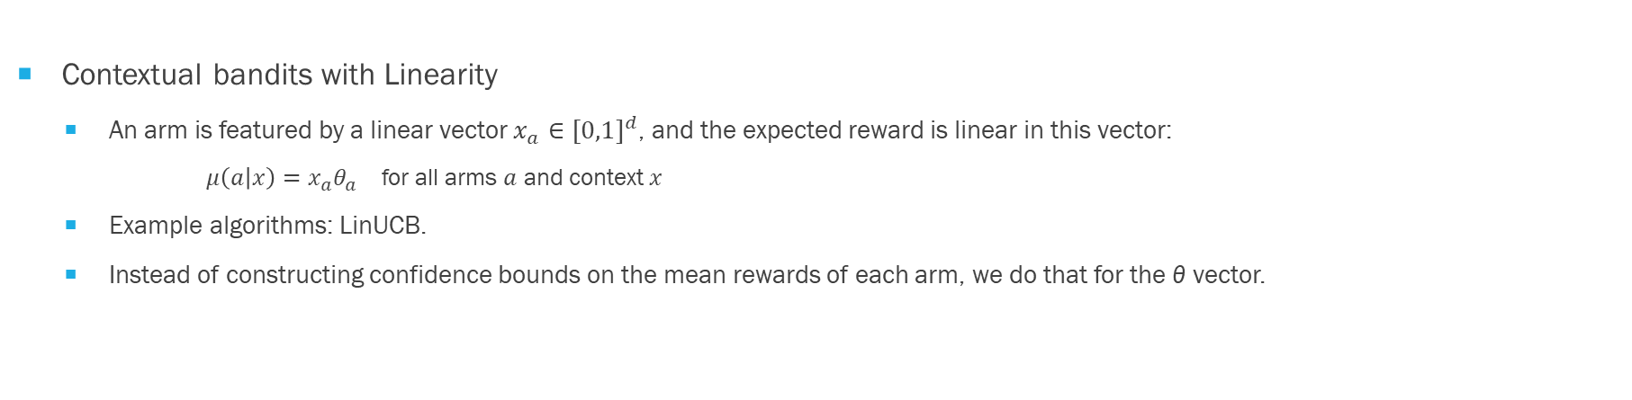
Contextual Bandits in A NUTSHELL
Contextual bandits with Linearity
An arm is featured by a linear vector $x_{a}∈{[0,1]}^{d}$, and the expected reward is linear in this vector:
$μ\left(a | x\right)=x_{a}θ_{a}$ for all arms $a$ and context $x$
Example algorithms: LinUCB.
Instead of constructing confidence bounds on the mean rewards of each arm, we do that for the θ vector.

Slide 5
Problem
Matching Customer Service Query with InfoWave Page
More than 300k customer service queries, most of them should be matched to one or more of 1.6k infowave pages
Questions
3 Rollovers, 1 was Roth but went into a pretax account. How to fix?
Why are three Vanguard funds greyed out for position level dividend update?
Can a client transfer an HSA to an IRA?
Intents
Direct/Indirect Rollover
Dividends/Capital Gains
Incoming Transfer/How-To/Requirements
Infowave Page
http://oedesktop.vanguard.com/us/content/InfoWave/AssocHbk/ProbRes/ProblemResolutionMatrices.js
http://oedesktop.vanguard.com/us/content/InfoWave/OptsManual/SpecOpts/DivCapGainTroubleFAQ.jsp
http://oedesktop.vanguard.com/us/content/InfoWave/IRACompliance/TaxesForms/TaxReliefAct.jsp

Slide 6
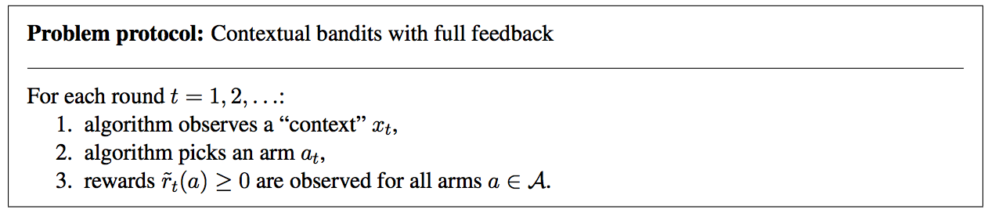
A CLASSIFICATION PROBLEM: FULL-FEEDBACK POLICY
If we have full feedback from OLD data, we can easily learn an optimal policy for OLD data
Classification problem
But in reality, OLD data is very limited, feedback are sparse, NEW data is overwhelming and challenging

Slide 7
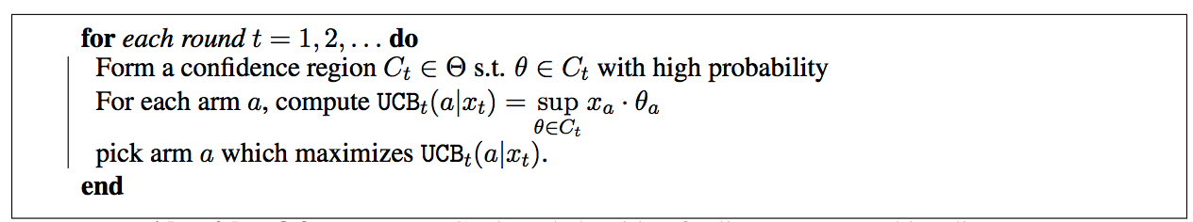

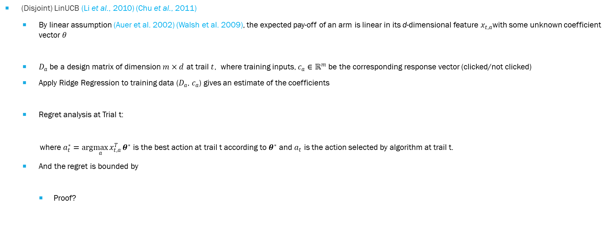

LINEAR UCB CONTEXTUAL BANDIT
The Upper Confidence Bound follows the principle of optimism in the face of uncertainty which implies that if we are uncertain about an action, we should optimistically assume that it is the correct action.
(Disjoint) LinUCB (Li et al., 2010) (Chu et al., 2011)
By linear assumption (Auer et al. 2002) (Walsh et al. 2009), the expected pay-off of an arm is linear in its d-dimensional feature $x_{t,a}$with some unknown coefficient vector $θ$
$D_{a}$ be a design matrix of dimension $m×d$ at trail $t$, where training inputs, $c_{a}∈ℝ^{m}$ be the corresponding response vector (clicked/not clicked)
Apply Ridge Regression to training data ($D_{a}$, $c_{a}$) gives an estimate of the coefficients
Regret analysis at Trial t:
where $a_{t}^{∗}=arg\max_{a}{x_{t,a}^{T}}θ^{∗}$ is the best action at trail t according to $θ^{∗}$ and $a_{t}$ is the action selected by algorithm at trail t.
And the regret is bounded by
Proof?
$$𝔼[r_{t,a}|x_{t,a}]=x_{t,a}^{T}θ^{∗}$$
${\hat{θ}}_{a}={\left[D_{a}^{T}D_{a}+λI_{dd} \right]}^{−1}$ $D_{a}^{T}$ $c_{a}$
$\sum_{t=1}^{T}{r_{t,a_{t}^{∗}}−}$ $\sum_{t=1}^{T}{r_{t,a_{t} }}$

Slide 8
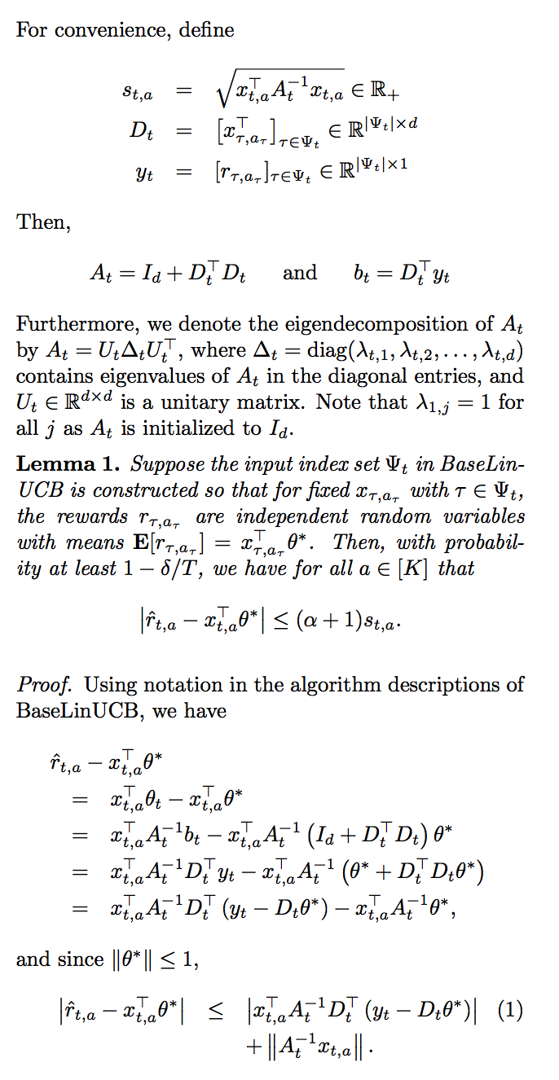
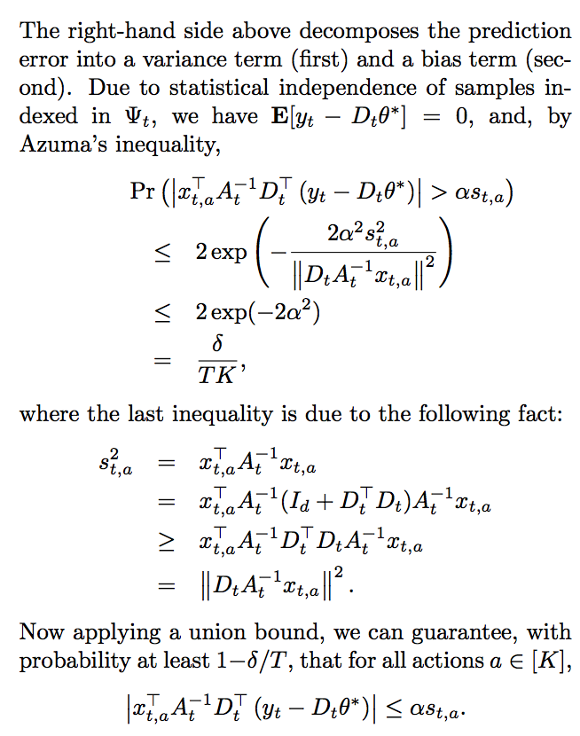
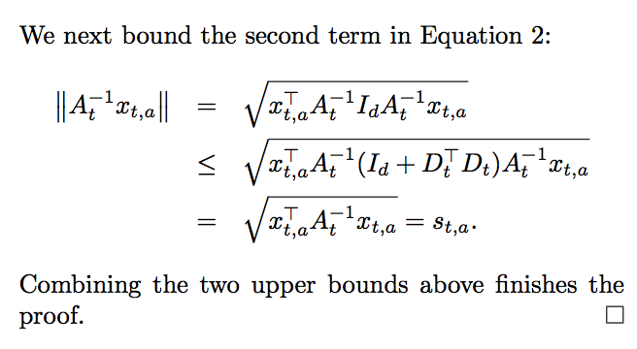
PROOF of LINEAR CONTEXTUAL BANDIT
Chu et al., 2011

Slide 9
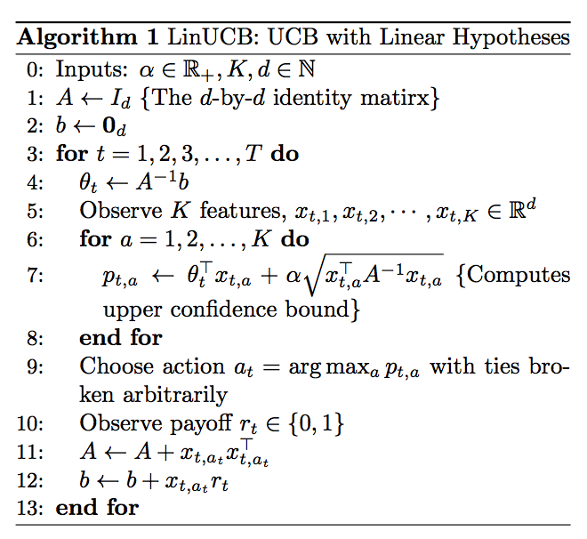
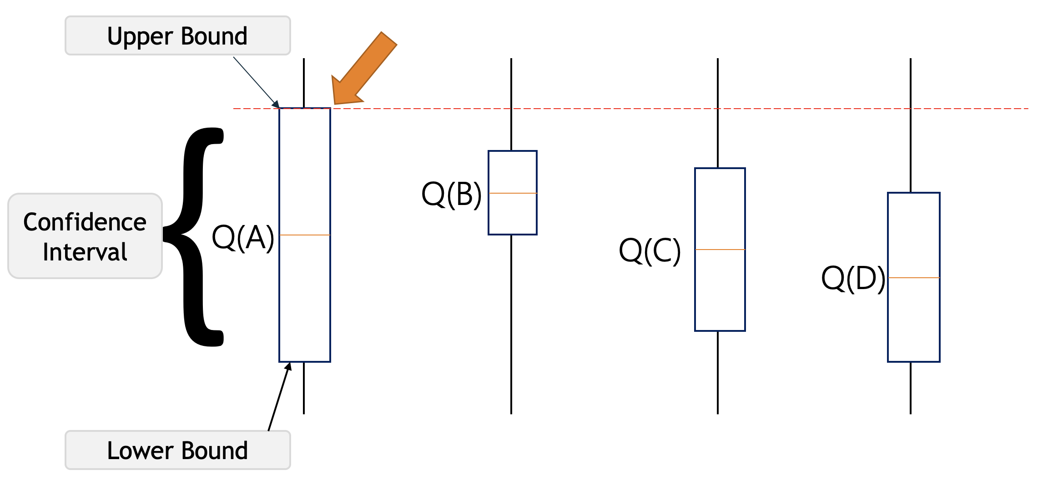
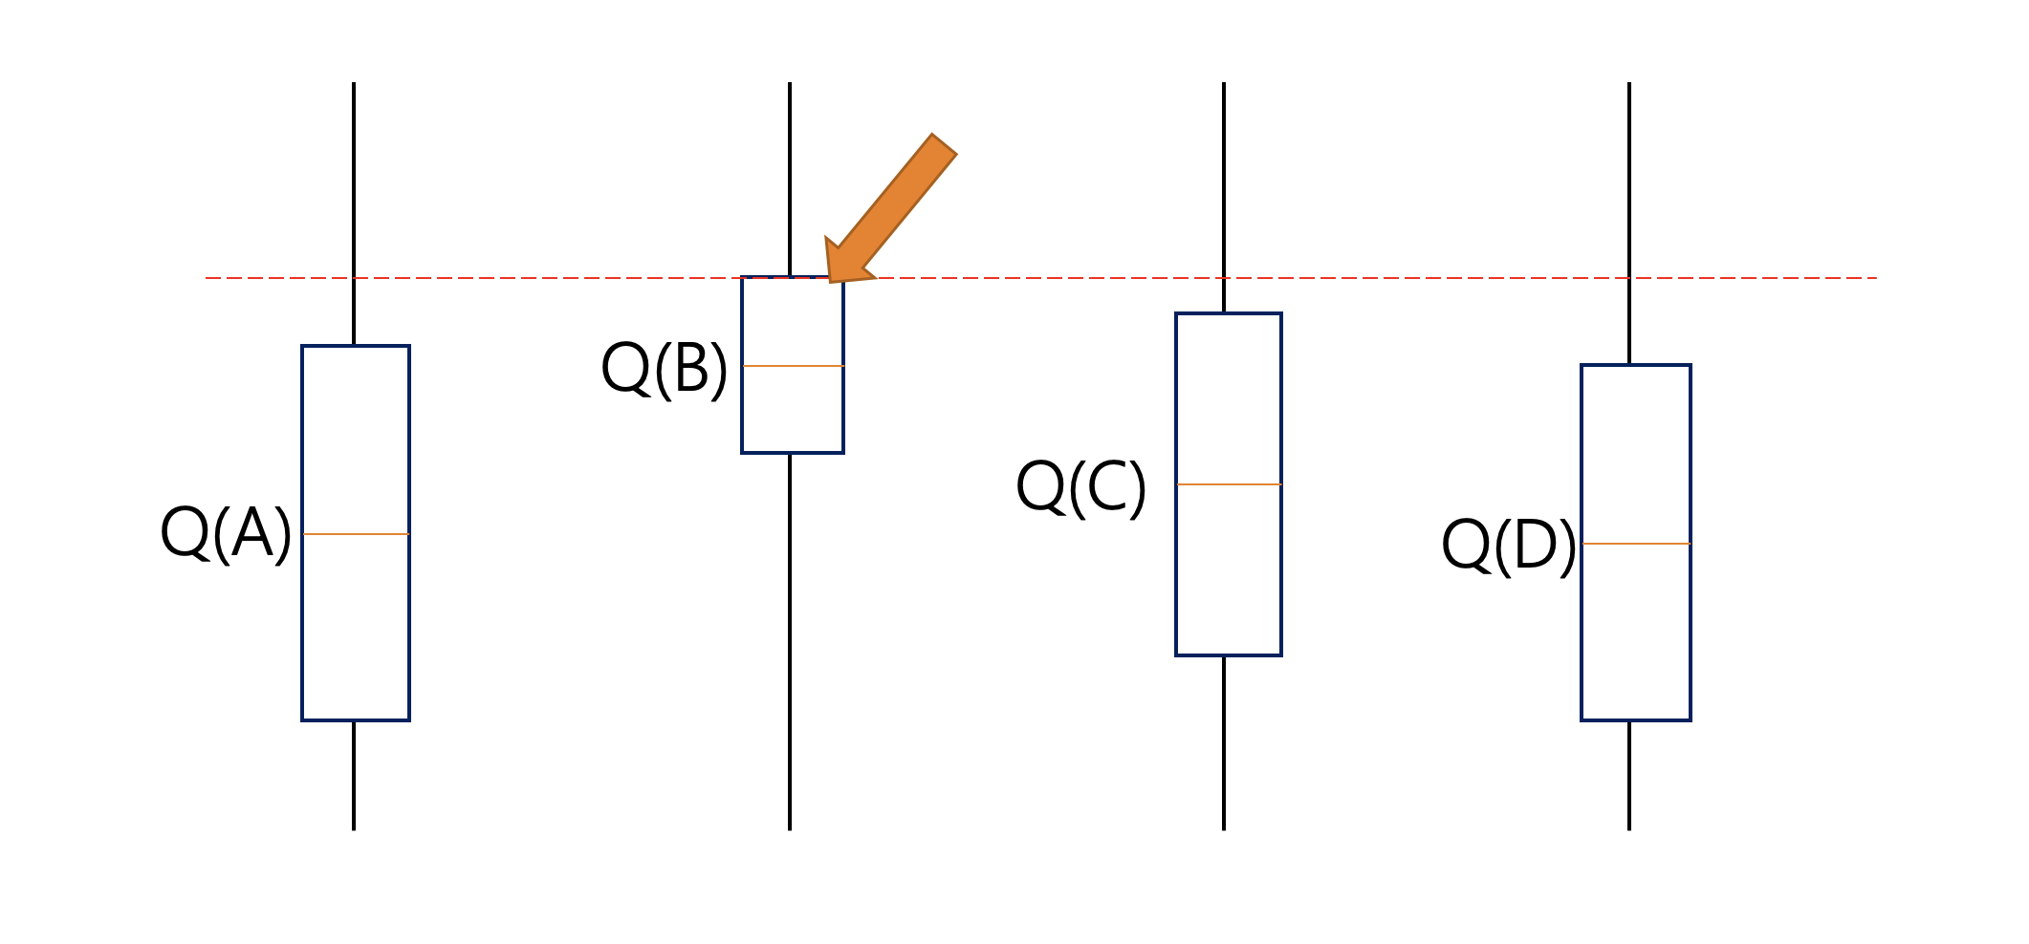
BASE LINUCB Algorithm
Storage of A, b matrices per each arm
Iteration over rounds (usually number of samples)
Iteration over arms (usually number of pages)
Despite its great potentials, LinUCB is notoriously slow on real problems
Need matrix inverse operations T*K times
Storage challenges, though A are generally sparse matrices, A⁻¹ are not sparse

Slide 10
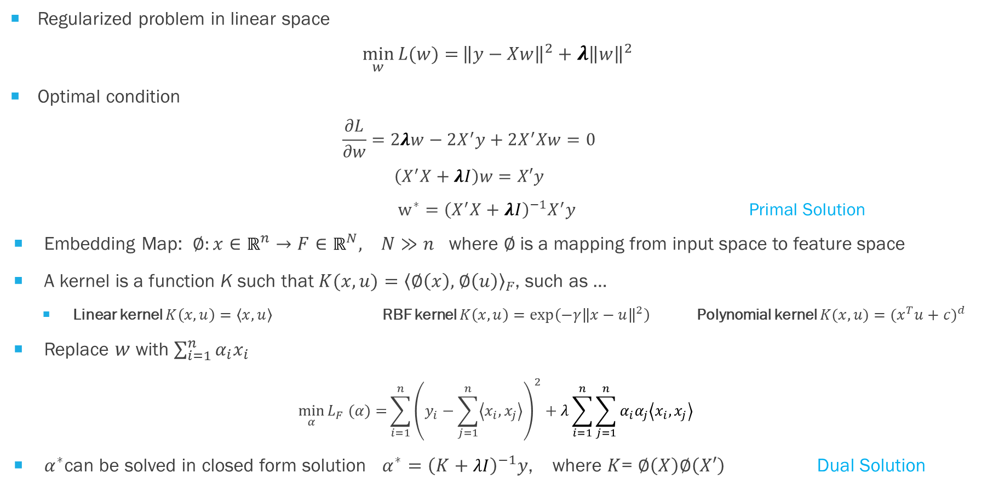
KERNEL RIDGE REGRESSION
Regularized problem in linear space
$$\min_{w}{L(w)=}{\left\|y−Xw\right\|}^{2}+{λ\left\|w\right\|}^{2}$$
Optimal condition
$$\frac{∂L}{∂w}=2λw−2X^{′}y+2X^{′}Xw=0$$
$$\left(X^{′}X+λI\right)w=X′y$$
$w^{∗}=$ ${\left(X^{′}X+λI\right)}^{−1}X^{′}y$ Primal Solution
Embedding Map: $∅:x∈ℝ^{n}→F∈ℝ^{N}, N≫n$ where $∅$is a mapping from input space to feature space
A kernel is a function K such that ${K(x,u)=\left\langle ∅\left(x\right), \right.\left.∅\left(u\right)\right\rangle }_{F}$, such as …
Linear kernel $K\left(x,u\right)=\left\langle x,u\right\rangle$RBF kernel $K\left(x,u\right)=\exp\left(−γ{\left\|x−u\right\|}^{2}\right)$Polynomial kernel $K(x,u)=⁡{(x^{T}u+c)}^{d}$
Replace $w$ with $\sum_{i=1}^{n}{α_{i}x_{i}}$
$$\min_{α}{L_{F} (α)=}\sum_{i=1}^{n}{{\left(y_{i}−\sum_{j=1}^{n}{\left\langle x_{i},x_{j}\right\rangle }\right)}^{2}+λ\sum_{i=1}^{n}{\sum_{j=1}^{n}{α_{i}α_{j}\left\langle x_{i},x_{j}\right\rangle }}}$$
$α^{∗}$can be solved in closed form solution $α^{∗}={\left(K+λI\right)}^{−1}y$, where $K$= $∅\left(X\right)∅\left(X′\right)$ Dual Solution

Slide 11
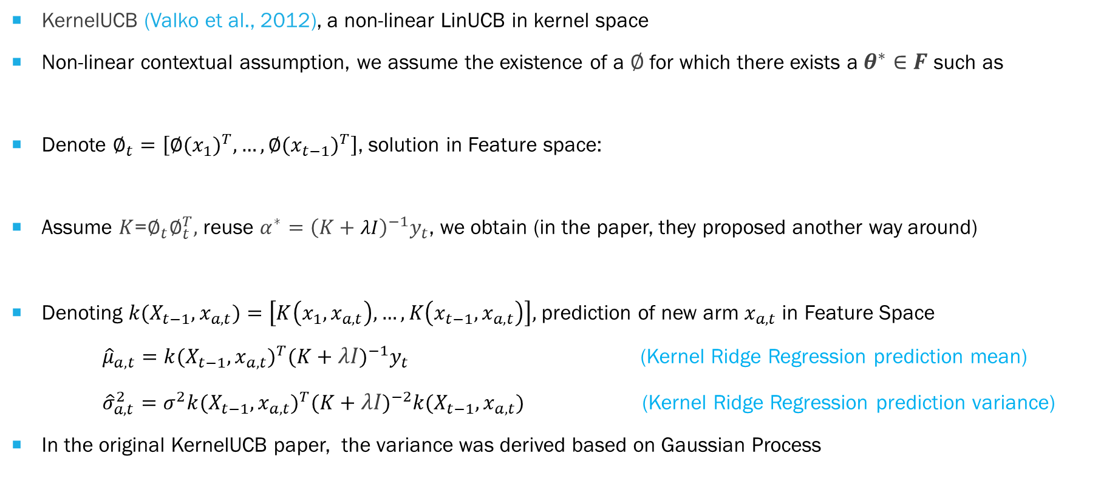
KERNEL UCB
KernelUCB (Valko et al., 2012), a non-linear LinUCB in kernel space
Non-linear contextual assumption, we assume the existence of a $∅$ for which there exists a $θ^{∗}∈F$ such as
Denote $∅_{t}=\left[{∅(x_{1})}^{T},…,{∅(x_{t−1})}^{T}\right]$, solution in Feature space:
Assume $K$=$∅_{t}∅_{t}^{T},$ reuse $α^{∗}={\left(K+λI\right)}^{−1}y_{t}$, we obtain (in the paper, they proposed another way around)
Denoting ${k(X_{t−1}, x}_{a,t})=\left[K\left(x_{1},x_{a,t}\right),…,K\left(x_{t−1},x_{a,t}\right)\right],$prediction of new arm $x_{a,t}$in Feature Space
${\hat{μ}}_{a,t}={{k(X_{t−1}, x}_{a,t})}^{T}{(K+λI)}^{−1}y_{t}$ (Kernel Ridge Regression prediction mean)
${\hat{σ}}_{a,t}^{2}=σ^{2}{{k(X_{t−1}, x}_{a,t})}^{T}{(K+λI)}^{−2}{{k(X_{t−1}, x}_{a,t})}^{}$ (Kernel Ridge Regression prediction variance)
In the original KernelUCB paper, the variance was derived based on Gaussian Process
$$𝔼[r_{t,a}|x_{t,a}]=∅{(x_{t,a})}^{T}θ^{∗}$$
${θ_{t}=(∅_{t}^{T}∅_{t}+λI)}^{−1}$ $∅_{t}^{T}y_{t}$
$$θ_{t}{=∅}_{t}^{T}α_{t}$$
$${\hat{μ}}_{a,t}={{k(X_{t−1}, x}_{a,t})}^{T}{(K+σ^{2}I)}^{−1}y_{t}$$
(Kernel Gaussian Process prediction mean)
${\hat{σ}}_{a,t}=$ ${k(x_{a,t}, x}_{a,t})−{{k(X_{t−1}, x}_{a,t})}^{T}{(K+σ^{2}I)}^{−1}$ ${k(X_{t−1}, x}_{a,t})$
(Kernel Gaussian Process prediction variance)

Slide 12
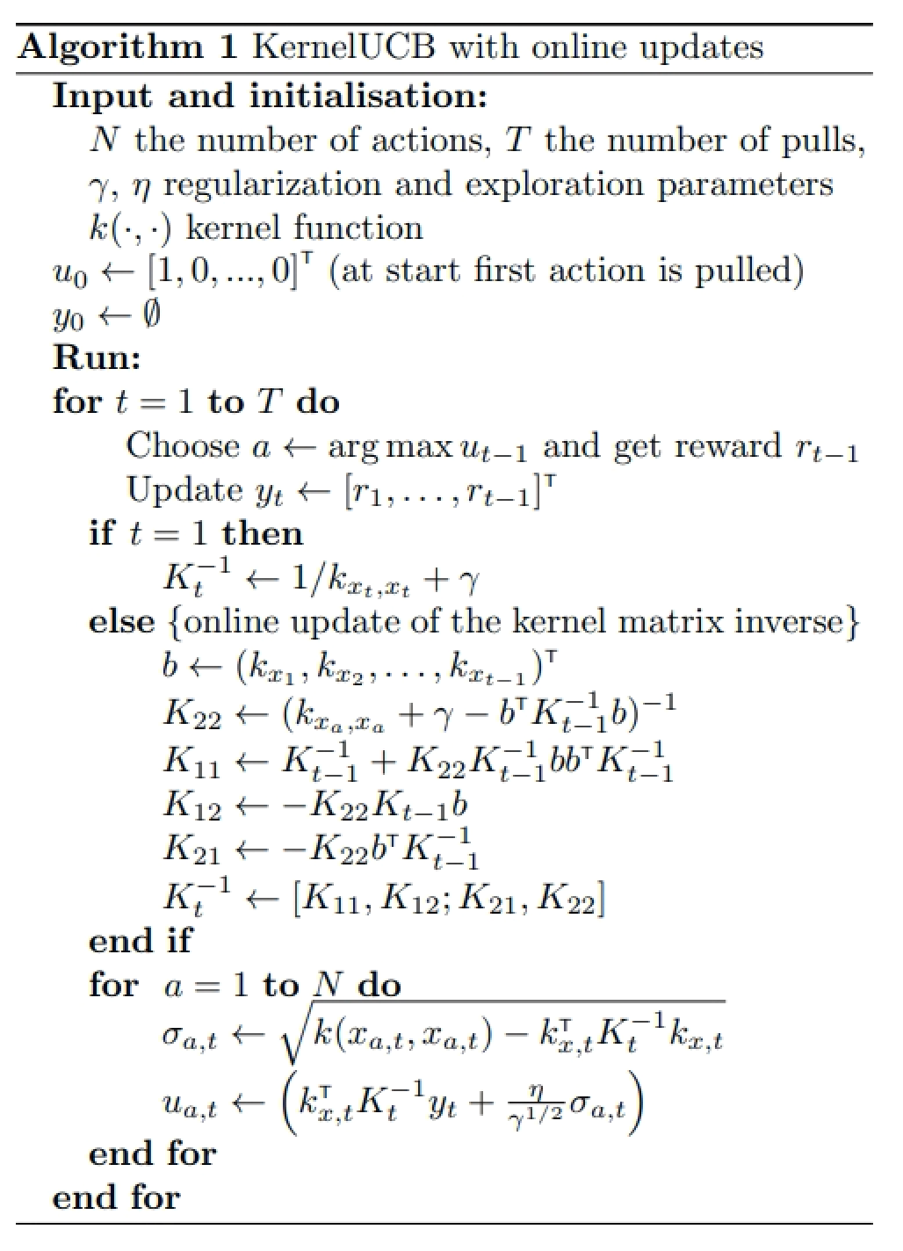
KERNEL UCB Algorithm
Iteration over rounds
Need to store/compute the kernel matrix of
all (unique) arms that have been pulled
For 986x321 problem, it is a matrix of 316K * 316K
Storing that matrix requires about 746G memory
Iteration over arms

Slide 13
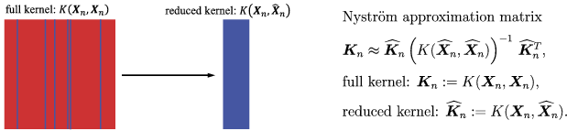




NystrÖM KERNEL RIDGE REGRESSION
Nystrom method (Williams & Seeger, 2001)
Approximated Feature Map (Vedaldi and Zisserman, 2011)
Given a positive-definite kernel $K\left(x,y\right)$ and a data density $p\left(x\right)$, the Nyström approximation of order M is the feature map $φ:ℝ^{N}$→ $ℝ^{M}$
Reconsider Ridge Regression and Kernel Ridge Regression (Primal form)
Kernel trick
Approximation (eigendecomposition)
$$X$$
$$K=∅(X)∅({X)}^{T}$$
$$Z$$
$w={X^{T}\left[X^{T}X+λI\right]}^{−1}$ $y$
$$w={∅(X)}^{T}{\left[∅(X)∅({X)}^{T}+λI\right]}^{−1}y$$
$$w=Z^{T}{\left[Z^{T}Z+λI\right]}^{−1}y$$
$\hat{y}=x^{T}w=x^{T}X^{T}{\left[X^{T}X+λI\right]}^{−1}$ $X^{T}y$
$$\hat{y}={∅(x)}^{T}w={∅(x)}^{T}∅({X)}^{T}{\left[∅(X)∅({X)}^{T}+λI\right]}^{−1}y$$
$$\hat{y}=z^{T}Z^{T}{\left[Z^{T}Z+λI\right]}^{−1}y$$

Slide 14
NystrÖM KERNEL RIDGE REGRESSION
Query-Infowave page problem
Query features 500-dimension TFIDF scores
Page features 500-dimension TFIDF scores from Title, Text, Keywords, Description of the page
Raw Arm features are concatenated features (1000 TFIDF) from 986 queries, 321 pages
Using raw features directly
 | Train AUC | Test AUC
Text | 0.784 | 0.364
Title | 0.779 | 0.379
Keywords | 0.783 | 0.36
Description | 0.784 | 0.364

Slide 15
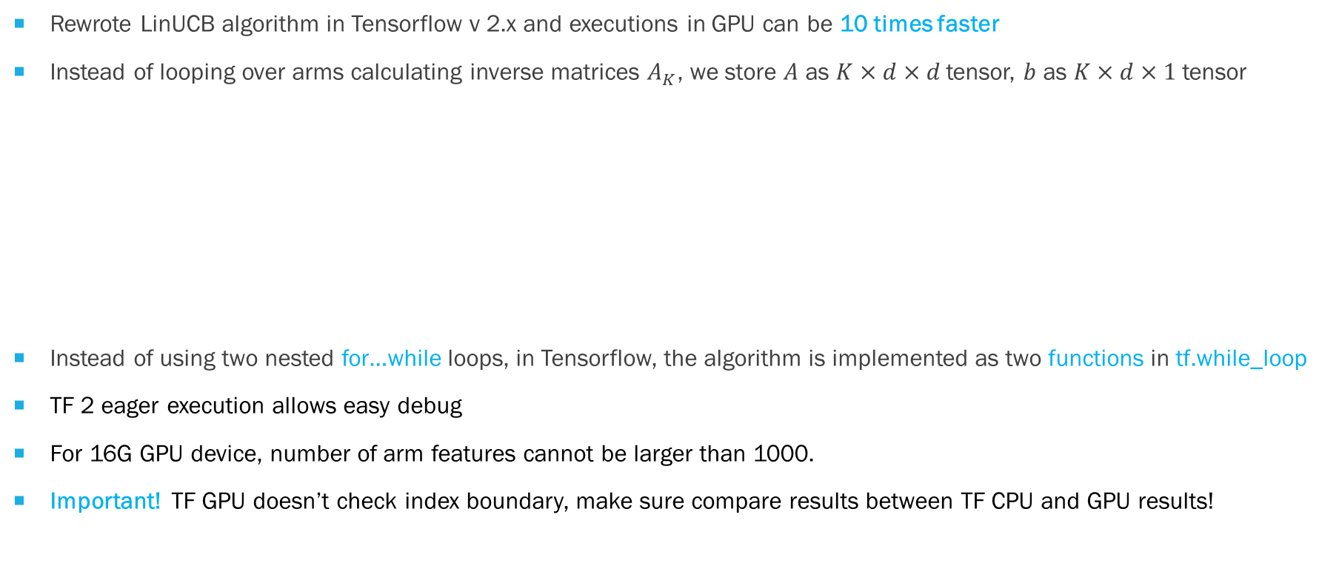
TENSOR UCB v1: LinUCB in TENSORFLOW
Rewrote LinUCB algorithm in Tensorflow v 2.x and executions in GPU can be 10 times faster
Instead of looping over arms calculating inverse matrices $A_{K}$, we store $A$ as $K×d×d$tensor, $b$ as $K×d×1$tensor
Instead of using two nested for…while loops, in Tensorflow, the algorithm is implemented as two functions in tf.while_loop
TF 2 eager execution allows easy debug
For 16G GPU device, number of arm features cannot be larger than 1000.
Important! TF GPU doesn’t check index boundary, make sure compare results between TF CPU and GPU results!
N_arm features
N_arm features
N_arm features
A
1
b
tf.linalg.solve
N_arms

Slide 16

TENSOR UCB v2: NYSTROM features in LinUCB
Enumerate all combinations of queries (400) and pages (161)
Original arm features $X_{a_{ij} }=np.concat({query}_{i},{page}_{j})$ 64,400 x 1,000
Apply Linear/RBF Kernel on $X_{a_{ij} }$ $K=∅(X_{a_{ij}})$ $∅(X_{a_{ij}}^{T})$
Apply Nyström on $K$ and reduce 500 components as new arm features
Arm features created from Page Text perform the best, Raw features perform better than Nyström features

Slide 17
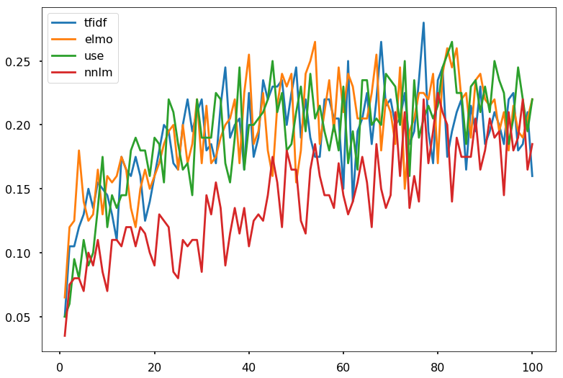
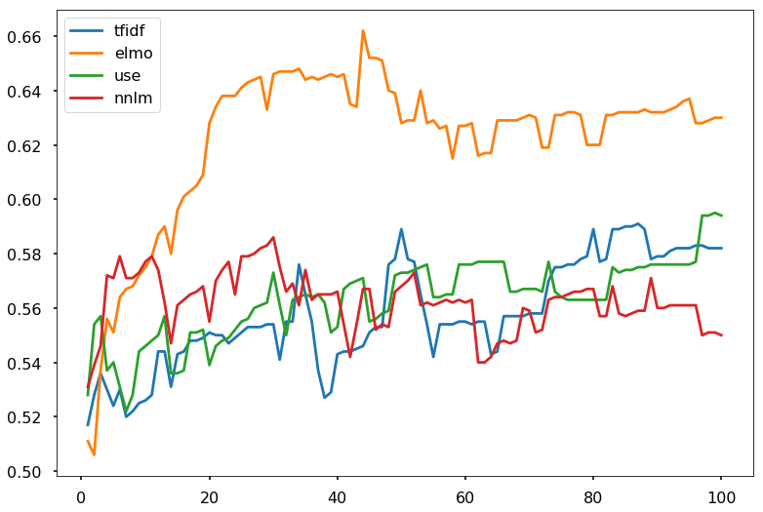
TENSOR UCB v3: MULTI-GPU PARALLELIZATION (Jerry CHEN)
Case 1: Learning the optimal policy from multiple policies
Using CUDA stream and the same feedback data to update models under different policies
No communications among GPUs
N_arm features
N_arm features
A2
A3
A4
A1
N_arms
TFIDF features
ELMO embeddings
Universal Sentence Encodings
NNLM embeddings
Average rewards per epoch
Model AUC on Training data per epoch

Slide 18

TENSOR UCB v3: MULTI-GPU PARALLELIZATION (JERRY CHEN)
Case 2: Multi-modality Search
Parallel training, and update the models using rewards observed on the
arm corresponding to max of maximum UCB across different article groups (GPUs)
Assume that expected pay-off of multiple arms is the maximum among its linear correlations with some unknown coefficient vector $θ_{S}$ in each source
According to prediction means and variances in multiple sources, select the arm with largest UCB
A2
A1
N_arms
Financial Articles
(FiQA-2018)
Biomedical Articles
(NFCorpus)
$$𝔼\left[r_{t,a} | x_{t,a}\right]=\max_{S}{x_{t,a}^{T}θ_{S}^{∗}}$$
$$w_{S}={Z_{S}\left[Z_{S}^{T}Z_{S}+λI\right]}^{−1}y$$
$${\hat{y}}_{S}=z_{S}^{T}{Z_{S}\left[Z_{S}^{T}Z_{S}+λI\right]}^{−1}y$$

Slide 19

Chatbot APPLICATIONS
Items = (Ads, Products, Articles, …)
User
Query
Bot
Item Group 1
(GPU 1)
Item Group 2
(GPU 2)
Online Tensor UCB Learning based on Optimal Policy
User Latent Factors
(Embeddings)
Query Latent Factors
(Embeddings)
…
Item Group N
(GPU N)
Engagement Feedback (Rewards)
Log Data
Optimal Policy
Offline overnight policy learning
Using log data

Slide 20
CONCLUSIONS
Proposed a complete solution using Contextual MAB for Chatbot Applications to learn personalized recommendation/search/retrieval models
Implemented LinUCB algorithm in Tensorflow and now runs 10 – 50 times faster than CPU version
Training 400 epoch on 400x161 matching problem (arm feature 500) takes about 45k seconds
Potential improvement towards sparse solution in Tensorflow, or Multiple GPU versions
Compared KernelUCB with LinUCB, and proposed Nyström feature mapping for KernelUCB
Allows fixed-size kernels to fit the size of GPU memory
Reuse Tensorflow implementation of LinUCB to solve KernelUCB problem
Invent TensorUCB by extending LinUCB, KernelUCB, NyströmUCB to multiple sources/gpus
Pay-off is a nonlinear (maximum) combination of multiple linear contextual bandits, each construct for a specific source (feature set)
Using normalized LinearKernel, or RBFKernel, the uncertainty of Kernel Ridge Regression is bounded, that allows a fair comparison of the upper confidence bound (UCB)

Slide 21
REFERENCES
Magureanu et al., 2004: Lipschitz Bandits: Regret Lower Bounds and Optimal Algorithms, JMLR: Workshop and Conference Proceedings vol 35:1–25, 2014
Li et al., 2010: A Contextual-Bandit Approach to Personalized News Article Recommendation, WWW 2010
Chu et al., 2011: Contextual Bandits with Linear Payoff Functions, Volume 15 of JMLR: W&CP 15, 2011
Williams & Seeger, 2001: Using the Nystroem method to speed up kernel machines, Advances in neural information processing systems 2001
Vedaldi and Zisserman, 2011: Efficient Additive Kernels via Explicit Feature Maps, IEEE Transactions on Software Engineering 34(3):480-92
Slivkins 2019: Introduction to Multi-Armed Bandits, fullbook, https://arxiv.org/abs/1904.07272
Zhou 2016: A Survey on Contextual Multi-armed Bandits, https://arxiv.org/pdf/1508.03326.pdf

