Slide 1

WORLD ARK MISSIONS
WELCOME TO YOUR
MEMBER PORTAL
Your Personal Hub for Church Records, Verified Giving & Pastoral Care
⚡ ACTIVATES IN 60 SECONDS • 🔒 100% CONFIDENTIAL • 📱 WORKS ON ANY PHONE
Notes:
Good morning / evening Church family!
Today, we are thrilled to unveil our official Member Portal at World Ark Missions.
As our church family grows, we want to ensure every single member has direct, transparent access to their records, their contributions, and a private line of communication with our pastoral team. Best of all, you don't have to download anything from an app store — it works right on your phone browser.
Let's dive into how simple it is to activate and use!

Slide 2
WORLD ARK MISSIONS • MEMBER PORTAL
Why You Will Love Your Member Portal
🪪
Digital Identity
Your official Member ID code is always with you — with a one-tap copy button for forms and events.
👤
Personal Profile
Keep your contact info, department, and family milestones (birthdays & anniversaries) accurate.
📊
Giving Transparency
Real-time access to your verified Tithes ledger (by week & month) and Welfare dues records.
💬
Direct Pastoral Care
Submit confidential prayer requests, counseling notes, and inquiries directly to church leadership.
Notes:
Here are the 4 core pillars of your Member Portal:
1. Digital Member Identity: Never lose your church ID number again.
2. Profile Accuracy: Help the church celebrate your milestones and keep in touch.
3. Financial Transparency: Complete visibility into your weekly tithes and welfare records.
4. Pastoral Connection: A direct, secure channel for prayer requests and counseling.

Slide 3
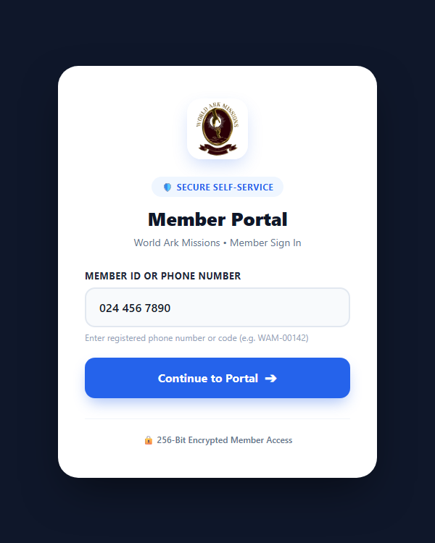
WORLD ARK MISSIONS • MEMBER PORTAL
Step 1: Signing In & Looking Up Your Account
SIMPLE 1-STEP LOOKUP
How to Access Your Portal
📱 No App Installation Needed
Works instantly in Google Chrome, Apple Safari, Microsoft Edge, or any smartphone browser.
📞 Enter Registered Phone Number
Simply type the phone number you registered with the church (e.g. 024 456 7890).
🪪 Or Use Your Member ID Code
If you know your church code (e.g. WAM-00142), you can enter that instead.
➔ Tap Continue
The portal automatically checks your record and proceeds to one-time SMS verification.
Notes:
Here you can see the actual sign-in screen on the left!
1. Open your phone browser and visit our portal link.
2. In the box, type your phone number or your Member ID.
3. Click Continue.
Notice how clean and secure it is — no confusing registration questionnaires!

Slide 4
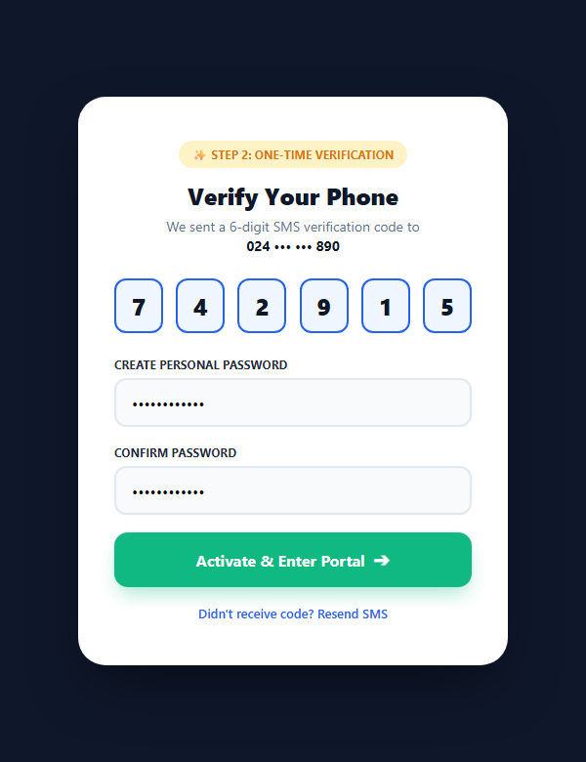
WORLD ARK MISSIONS • MEMBER PORTAL
Step 2: Instant SMS Verification & Password Setup
FAST, SECURE ACTIVATION
One-Time Account Setup
💬 Instant 6-Digit SMS Code
A one-time verification code is texted to your phone within seconds to confirm your identity.
🔑 Set Your Personal Password
Choose a secure password (minimum 6 characters) that only you know.
🛡️ Activated For Life
Once set, your account is activated! On future visits, simply log in directly with your phone/ID and password.
🔄 Easy Reset
If you ever forget your password, you can reset it anytime via SMS in seconds.
Notes:
On screen, you can see Step 2: Verification!
As soon as you enter your number, our system sends a 6-digit text message to your phone.
Type those 6 digits in, create a password you can remember, and hit 'Activate & Enter Portal'.
From then on, you simply log in with your password. The entire process takes under one minute!

Slide 5
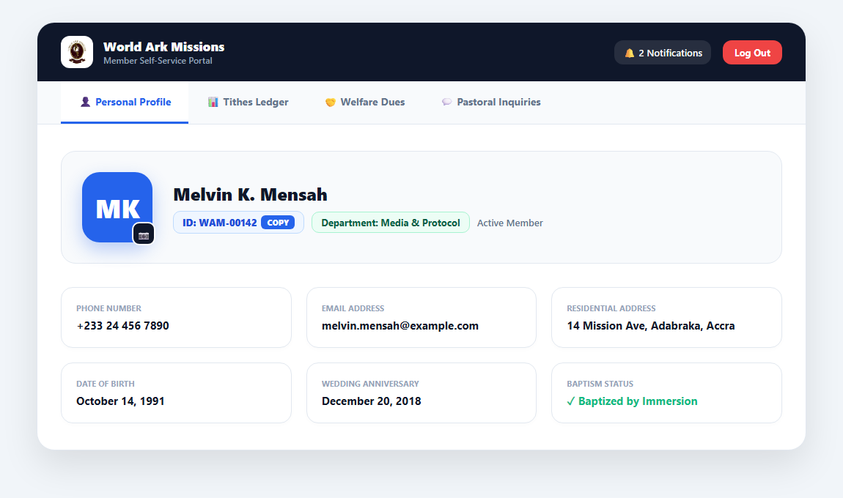
WORLD ARK MISSIONS • MEMBER PORTAL
Dashboard Tour: Your Personal Profile
🪪 Member ID & Copy Button
Your unique ID code (e.g. WAM-00142) is prominently displayed with a 1-tap copy button for easy event sign-ups.
📷 Phone Camera Photo Upload
Tap the camera icon on your avatar to snap a live selfie or upload a portrait from your photo gallery.
🎂 Celebrations & Milestones
Ensure your Birthday and Wedding Anniversary are accurate so the church can celebrate with you.
Notes:
Here is what you see as soon as you log in!
- At the top right of your profile is your Member ID with a copy button.
- You can tap the camera icon to upload a nice photo of yourself so the pastoral team recognizes you.
- You can verify your address, email, department, birthday, and wedding anniversary.

Slide 6
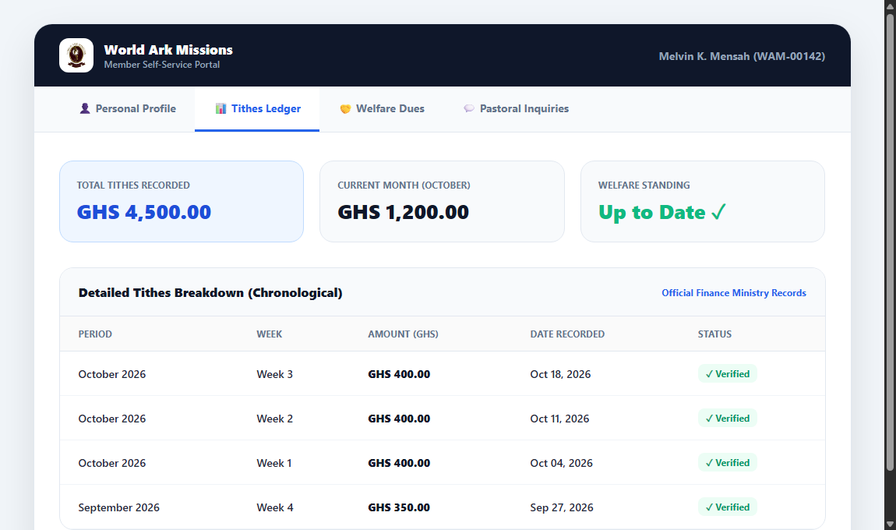
WORLD ARK MISSIONS • MEMBER PORTAL
Giving Transparency: Verified Tithes & Welfare
📊 Verified Weekly Breakdown
Review each tithe recorded by the finance department, broken down by week 1 through 5 of each month.
🤝 Welfare Dues Accountability
Check your recorded welfare contributions and contribution dates to verify you are in good standing.
🛡️ 100% Private Ledger
Nobody else can see your giving records. The data is encrypted and visible only to you and authorized finance officers.
Notes:
Here is the Tithes & Welfare tab on screen!
- You have total transparency over every tithe recorded in your name.
- It shows the month, the week, the exact amount, and a green 'Verified' status badge.
- You also have your Welfare Dues tab right next to it.
- This eliminates any confusion and gives you peace of mind in your stewardship.

Slide 7
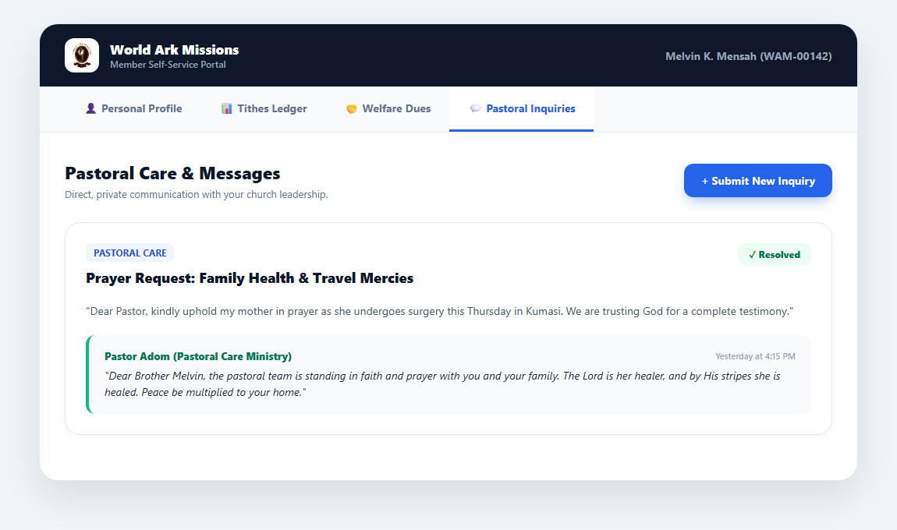
WORLD ARK MISSIONS • MEMBER PORTAL
Pastoral Care: Private Inquiries & Prayer Requests
🙏 Confidential Prayer Requests
Submit private prayer needs, welfare inquiries, or counseling requests directly to church leadership.
🔄 Live Status Tracking
Track the progress of your message: Pending (received) ➔ In Progress (reviewed) ➔ Resolved (replied).
💬 Direct Pastoral Replies
Read personal replies from pastors directly in your portal inbox with exact date and time stamps.
Notes:
Here is the Pastoral Inquiries tab!
- If you have a prayer request or need counseling, you can click '+ Submit New Inquiry'.
- As you see on the screenshot, when Pastor Adom replied to Brother Melvin, the message is marked 'Resolved' and the pastor's personalized encouragement is preserved right in your portal inbox.

Slide 8
WORLD ARK MISSIONS • MEMBER PORTAL
Your Privacy & Data Security Come First
🔒
Strictly Confidential
Your financial contributions, welfare dues, and pastoral inquiries are encrypted and accessible only to you and authorized church leadership.
⏱️
15-Min Auto-Logout
Using a shared computer or tablet? The portal automatically logs you out after 15 minutes of inactivity with a 2-minute countdown warning.
🔑
Instant SMS Password Reset
Forgot your password? Simply click 'Forgot Password' and reset it within seconds via a secure 6-digit SMS code to your phone.
Notes:
We treat your privacy with the utmost importance:
- Your giving records and messages are strictly confidential.
- If you forget to log out on a family computer or public terminal, our 15-minute inactivity auto-logout protects you.
- Password resets are fast and verified by your mobile phone.

Slide 9
WORLD ARK MISSIONS • MEMBER PORTAL
Frequently Asked Questions
Q: What if I didn't get the SMS verification code?
A: Check that you entered the exact phone number you registered with the church. If your number has changed, visit our church IT desk to update your record.
Q: Can spouses or family share a phone number?
A: Yes! If multiple family members share a phone number, the portal displays an account picker so you choose your personal profile.
Q: Can other church members see my giving or messages?
A: Absolutely not. Your portal account is completely private and accessible only with your personal credentials.
Q: Do I need to download an app from Google Play or App Store?
A: No app download is required! It works seamlessly in any web browser. You can tap 'Add to Home Screen' on your smartphone for one-tap access.
Notes:
Here are the top questions members ask:
- If you didn't receive an SMS code, our IT desk can verify your number on file.
- Families sharing a phone number can select their account with ease.
- It takes zero storage space on your smartphone!

Slide 10
ACTIVATE YOUR ACCOUNT TODAY
Get Connected with Your Church Family!
🌐 Direct Access: [ app.worldarkmissions.org/portal ]
💡 Need help? Visit our IT / Media Support Desk in the foyer after service.
Our team will help you activate your account in under 60 seconds!
World Ark Missions • Connected • Informed • Empowered in Faith
Notes:
We encourage everyone to pull out your phone right now or immediately after the service.
Go to the portal link, type your phone number, and experience your new Member Portal.
Our media and IT team is waiting in the foyer to assist anyone who needs help.
Thank you, and God richly bless you!

