Slide 1
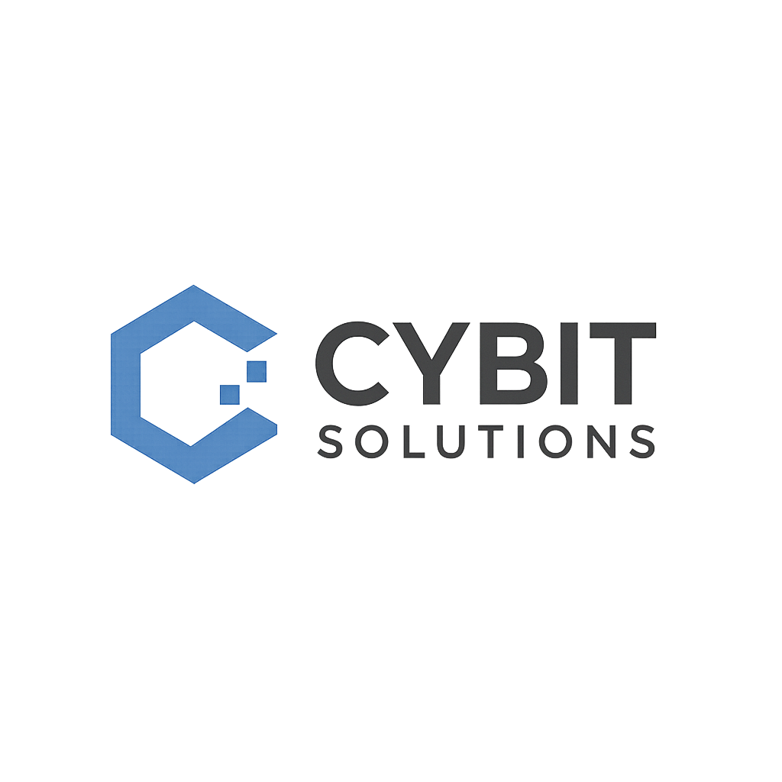
The Technology & Digital Transformation Division of AFANO Group
Company Profile
Mission-Grade Innovation for Cyber, Cloud & AI
20+
500+
100+
$2B+
Years Experience
Cleared Staff
Contracts Delivered
Program Value
SDVOSB
MBE
TS/SCI CLEARED
CMMC L3
www.cybitsolutions.net · info@cybitsolutions.net · (771) 233-1379

Slide 2
Table of Contents
01
Company Overview
02
Our Services — 10 Domains
03
Past Performance Highlights
04
Leadership Team
05
Certifications & Clearances
06
Contract Vehicles & NAICS Codes
07
Technology Partners
08
Why CybitSolutions
09
Contact Information
CybitSolutions — A Division of AFANO Group · SDVOSB · MBE
2 / 12

Slide 3
Company Overview
Established in 2003, CybitSolutions is the Technology and Digital Transformation Division of AFANO Group, delivering mission-critical IT solutions to federal agencies, the Department of Defense, Intelligence Community, and commercial enterprises.
MISSION
Deliver innovative, secure, and reliable IT solutions that empower federal agencies to accomplish their most critical missions.
Our 500+ cleared professionals operate across 10 service domains, supporting programs that protect national security and advance digital transformation with CONUS and OCONUS presence, TS/SCI clearances, and full federal compliance.
VISION
Be the most trusted technology partner for organizations protecting national security and advancing government modernization.
20+
500+
100+
$2B+
10
24/7
Years of
Experience
Cleared
Professionals
Contracts
Delivered
Program Value
Managed
Service
Domains
Global
Operations
CybitSolutions — A Division of AFANO Group · SDVOSB · MBE
3 / 12

Slide 4
Our Services — 10 Domains
01
Cybersecurity & Risk Management
Zero-trust architecture, SOC/MDR, governance risk & compliance, NIST RMF, vulnerability management, penetration testing, and incident response for federal missions.
02
Cloud Computing & Virtualization
AWS GovCloud, Azure Government, FedRAMP High, IL4/IL5/IL6, cloud migration, hybrid/multi-cloud strategy, and FinOps optimization.
03
Core IT Infrastructure & Operations
SD-WAN, data center modernization, network operations center (NOC), Tier 1–3 help desk, monitoring, and disaster recovery.
04
Software Development & DevOps
DevSecOps CI/CD pipelines, agile methodology, application modernization, microservices, API design, and test automation.
05
Data & Analytics
Enterprise data lakes, ETL/ELT pipelines, BI dashboarding, data governance, geospatial analytics, and real-time streaming.
CybitSolutions — A Division of AFANO Group · SDVOSB · MBE
4 / 12

Slide 5
Our Services — 10 Domains (cont.)
06
AI & Automation
Machine learning, NLP, robotic process automation (RPA), computer vision, intelligent document processing, and MLOps for federal AI initiatives.
07
Enterprise IT Platforms
ServiceNow ITSM, Salesforce CRM, Microsoft 365 GCC High, SharePoint Online, SAP, and enterprise architecture consulting.
08
Digital Transformation & Gov IT
IT modernization roadmaps, legacy system migration, citizen experience platforms, change management, and agile governance.
09
Emerging & Next-Gen Technologies
Blockchain for supply chain, post-quantum cryptography, edge computing, IoT/IIoT, 5G integration, and AR/VR for training.
10
Industry-Specific IT
Healthcare IT (HIPAA), financial management systems, law enforcement technology, high-performance computing, and logistics platforms.
CybitSolutions — A Division of AFANO Group · SDVOSB · MBE
5 / 12

Slide 6
Past Performance Highlights
MULTIPLE FEDERAL AGENCIES (DOD, CIVILIAN, IC)
Microsoft Ecosystem — Enterprise Platform Modernization
► M365 GCC High migration for 50,000+ users with 99.99% uptime
► 500+ Power Apps deployed, 200K+ hours automated annually
► 70% faster incident response via Microsoft Sentinel integration
U.S. AIR FORCE & SPACE FORCE
C3BM / ABMS — Joint All-Domain Command & Control (JADC2)
► 60% faster sensor-to-shooter timeline via zero-trust cloud battle network
► 99.99% uptime in contested operational environments
► Full DevSecOps maturity with 2-week sprint cycles
DEPARTMENT OF STATE — CONSULAR AFFAIRS
CAKMI — Consular Affairs Key Management Infrastructure
► Key provisioning reduced from 48 hours to 5 minutes
► 15M+ daily cryptographic operations at 99.999% uptime
► FIPS 140-2 Level 3 certified across global facilities
CybitSolutions — A Division of AFANO Group · SDVOSB · MBE
6 / 12

Slide 7
Past Performance Highlights (cont.)
DEPARTMENT OF STATE — IRM
NGEM — Next-Generation Enterprise Monitoring
► 15+ monitoring tools consolidated into single unified platform
► Mean time to detect (MTTD) reduced from 45 minutes to under 3 minutes
► 98% reduction in false-positive alerts across global diplomatic missions
DEPARTMENT OF STATE — DIPLOMATIC SECURITY
SPARTA PSIM — Physical Security Information Management
► Response time reduced from 12 minutes to 90 seconds
► 10,000+ sensors integrated across 150+ diplomatic facilities worldwide
► 94% AI-powered threat detection accuracy supporting $73M modernization
DMDC, DEPARTMENT OF DEFENSE
RAPIDS/DEERS — Military ID Modernization
► ID issuance time reduced from 30 minutes to 8 minutes
► 95% of legacy COBOL systems migrated to cloud-native architecture
► 18M+ annual identity transactions processed with zero security incidents
CybitSolutions — A Division of AFANO Group · SDVOSB · MBE
7 / 12

Slide 8
Leadership Team
AA
CA
AI
Adupedee "Prof" Ababio
Christian "Chris" Achemdey
Adaobi Ikpeze
Chief Architect / CISO
Division VP of Technology
Division VP of Operations & HR
Enterprise Security Architecture · Zero-Trust & NIST Compliance · 20+ years of federal cybersecurity leadership
Cloud Architecture · DevSecOps · AI/ML for Government · Multi-cloud platform engineering
Program Management · Human Capital Strategy · Federal Compliance · Organizational Excellence
SO
SG
AT
Stanley Opara
Stanley Gorman
Alpha Taylor
Division VP of Cybersecurity
Division VP of Cloud & Infrastructure
Division VP of Government Programs
SOC/MDR Operations · Zero-Trust Implementation · RMF Authorization · Threat Intelligence
Multi-Cloud (AWS, Azure, GCP) · FedRAMP Authorization · IL4/IL5 Environments · Migration
Government Acquisition · Federal Program Management · Contract Strategy · Stakeholder Relations
CybitSolutions — A Division of AFANO Group · SDVOSB · MBE
8 / 12

Slide 9
Certifications & Clearances
✓
SDVOSB Certified
✓
MBE Certified
Service-Disabled Veteran-Owned Small Business via AFANO Group
Minority Business Enterprise via AFANO Group
✓
CMMC Level 3
✓
ISO 27001
Cybersecurity Maturity Model Certification — Good Cyber Hygiene
Information Security Management System certified
✓
ISO 9001
✓
SOC 2 Type II
Quality Management System certified
Service Organization Control for security, availability, confidentiality
✓
FedRAMP Authorized
✓
TS/SCI Facility Clearance
Federal Risk and Authorization Management Program solutions
Top Secret / Sensitive Compartmented Information cleared facility and personnel
CybitSolutions — A Division of AFANO Group · SDVOSB · MBE
9 / 12

Slide 10
Contract Vehicles & NAICS Codes
CONTRACT VEHICLES
► GSA MAS (Multiple Award Schedule)
► CIO-SP3 / CIO-SP4 (NIH NITAAC)
► SEWP V (NASA)
► Alliant 2 Small Business
► STARS III
► OASIS+ Small Business
► DISA SETI
► Army ITES-3S
NAICS CODES
541512
— Computer Systems Design Services
541511
— Custom Computer Programming Services
541513
— Computer Facilities Management Services
541519
— Other Computer Related Services
518210
— Data Processing & Hosting Services
541330
— Engineering Services
561210
— Facilities Support Services
611430
— Professional & Management Development Training
CybitSolutions — A Division of AFANO Group · SDVOSB · MBE
10 / 12

Slide 11
Technology Partners & Differentiators
STRATEGIC TECHNOLOGY PARTNERS
Amazon Web Services (AWS)
Microsoft Azure
Google Cloud Platform
ServiceNow
Splunk
Cisco Systems
CrowdStrike
HashiCorp
Databricks
IBM
Palo Alto Networks
Dell Technologies
VMware (Broadcom)
Fortinet
Red Hat
WHY CYBITSOLUTIONS
Mission-First Approach
Cleared & Compliant
Every solution designed for operational impact, compliance, and mission success — not just technical metrics.
TS/SCI facility clearance, CMMC L3, ISO 27001, FedRAMP — full compliance posture for the most sensitive programs.
Agile at Scale
End-to-End Capability
DevSecOps maturity with 2-week sprints, CI/CD automation, and proven delivery across DoD, DoS, DHS, and IC.
10 integrated service domains covering cyber, cloud, AI, data, and enterprise IT — one partner for the full mission stack.
CybitSolutions — A Division of AFANO Group · SDVOSB · MBE
11 / 12

Slide 12
A Division of AFANO Group
Let's Build the Future of Federal IT — Together.
Ready to modernize your mission? Contact us to discuss how CybitSolutions
can deliver mission-grade solutions for your agency.
PHONE
EMAIL
WEBSITE
+ (771) 233-1379
info@cybitsolutions.net
www.cybitsolutions.net
SDVOSB · MBE · TS/SCI Cleared · CMMC L3 · ISO 27001 · FedRAMP

